Slide 1
What is Service ?
In Kubernetes, a Service is an abstraction which defines a logical set of Pods and a policy by which to access them.
The set of Pods targeted by a Service is usually determined by a selector.
A Service is a REST object, similar to a Pod.
Like all of the REST objects, we can POST a Service definition to the API server to create a new instance
Kubernetes assigns Service an IP address (called the “cluster IP”), which is used by the Service proxies.
The controller for the Service selector continuously scans for Pods that match its selector, and then POSTs any updates to an Endpoint object

Slide 2
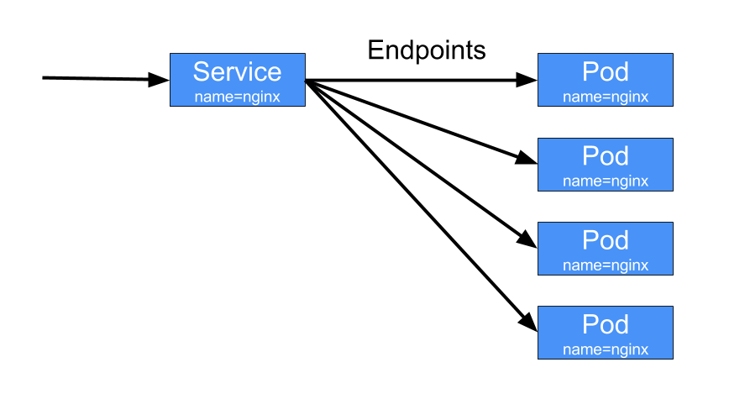
Service cont..
Services provide a stable VIP
VIP automatically routes to backend pods
VIP to backend pod mapping is managed by kube-proxy, implemented using iptables

Slide 3
Service Communication & Types
Service IP is accessible only from within the cluster
Traffic sent to Service IP gets load balanced to pods that belong to service IP
Source NAT is used for pods to communicate to external world
IPtables are used extensively for load balancing and NAT
There are four types of Service
ClusterIP
NodePort
LoadBalancer
ExternalName
Type “ClusterIP” is used for internal communication within the cluster
Nodeport, load balancer and Ingress controller are service types for external world to reach services inside the cluster.

Slide 4
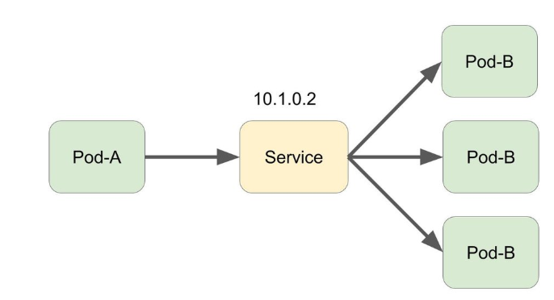
Cluster IP
Exposes the Service on a cluster-internal IP.
This IP makes the Service only reachable from within the cluster.
communication between pods happens always using the IP address.
This is the default Service Type.

Slide 5
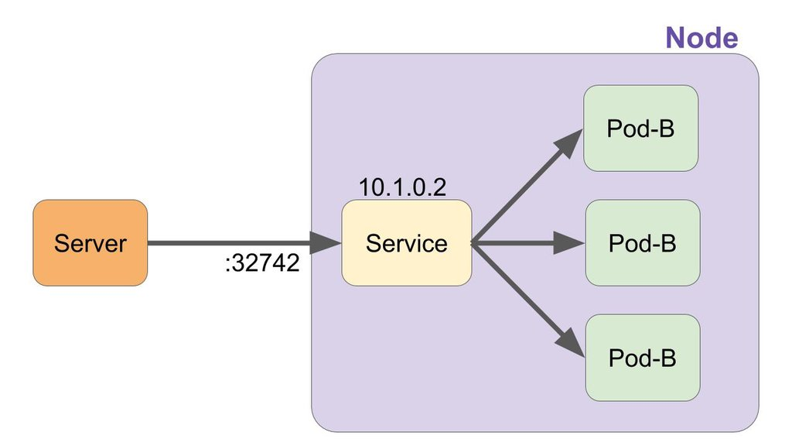
NodePort
NodePort uses Kubernetes Node's random port to communicate with external servers. After that, it is the same as ClusterIP Service.
If we set the type field to NodePort, the Kubernetes control plane allocates a port from a range specified by --service-node-port-range flag (default: 30000-32767).
Each node proxies that port (the same port number on every Node) into your Service.

Slide 6
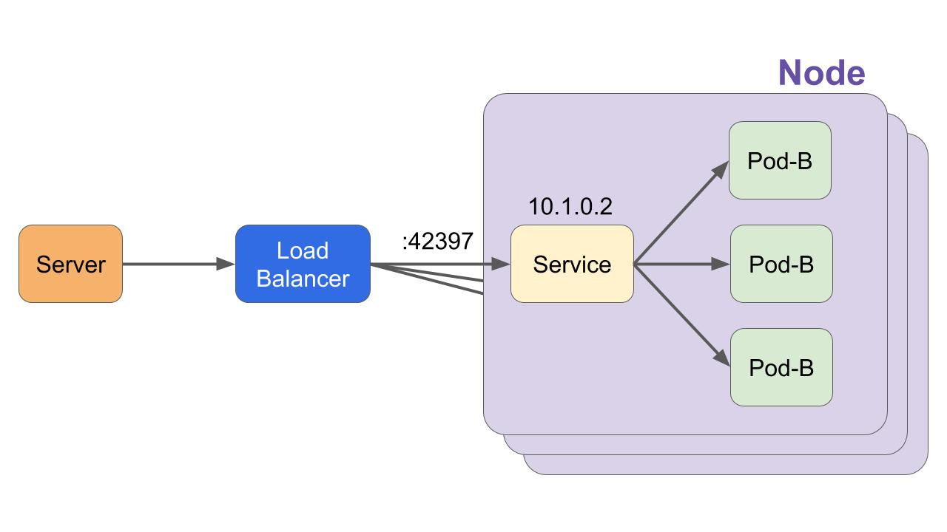
LoadBalancer
On cloud providers which support external load balancers, setting the type field to LoadBalancer provisions a load balancer for your Service.
The actual creation of the load balancer happens asynchronously, and information about the provisioned balancer is published in the Service’s .status.loadBalancer field
LoadBalancer creates a NodePort Service, then creates an external LoadBalaner, and configures it to forward to the port that is communicating with NodePort as LoadBalancer Upstream.

Slide 7
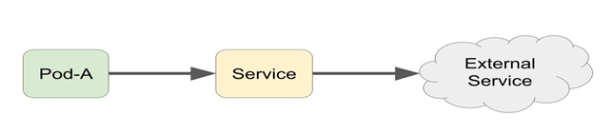
ExternalName
Services of type ExternalName map a Service to a DNS name
This ExternalName function requires a DNS component to be installed in Kubernetes

Slide 8
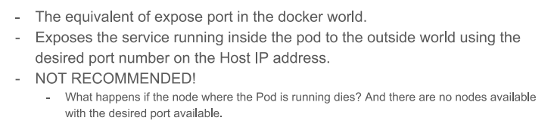
HostPort

Slide 9
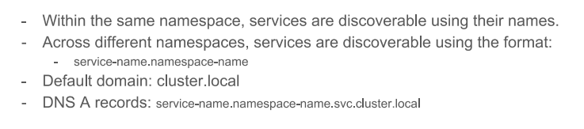
Service Discovery

Slide 10
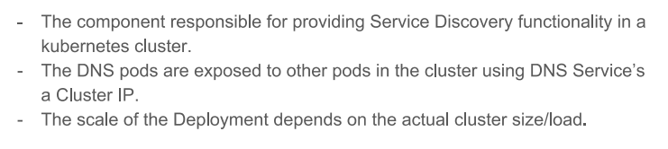
kube-dns

