Slide 1
Kubernetes Volumes

Slide 2
Agenda
Volume
PersistentVolume and PersistentVolumeClaim

Slide 3
Volume

Slide 4
Volume is
Disk resource which is described as a part of Pod
It can be shared across containers in Pod
It must be mounted to container which wants to access the volume
Life cycle is managed by Pod
Volume is created when Pod is started and deleted when Pod is deleted. (Not along with container)

Slide 5
Volume type
Temp | Local | Network
emptyDir | hostPath | GlusterFS gitRepo NFS iSCSI gcePersistentDisk AWS EBS azureDisk Fiber Channel Secret VshereVolume

Slide 6
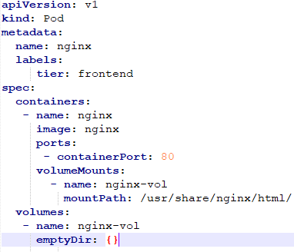
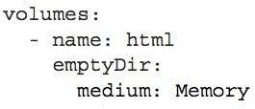
Volume type - empyDir
A simple empty directory used for storing transient data
It is good for ephemeral storage and good for file sharing across container
emptyDir can use Memory as a disk

Slide 7

Volume type - gitRepo
A gitRepo volume is basically an emptyDir volume
It gets populated by cloning a Git repository and checking out a specific revision
when the pod is starting up (but before its containers are created)
Useful to provisioning static (HTML) data or script source from git
apiVersion: v1 kind: Pod metadata:
name: gitrepo-volume-pod spec:
containers:
image: nginx:alpine name: web-server volumeMounts:
name: html
mountPath: /usr/share/nginx/html
readOnly: true
ports:
containerPort: 80 protocol: TCP
volumes:
name: html gitRepo:
repository: https://github.com/luksa/kubia-website-example.git revision: master
directory: .
Pod
Container
gitRepo
<<emptyDir>>
Clone

Slide 8
PersistentVolume
& PersitentVolumeClaim

Slide 9
Why Persistent Volume ?
Because emptyDir volumes get deleted when a Pod gets deleted
If we need persistent volumes we need to use
PersistentVolume and PersistentVolumeClaim
This is a 3 step process:
we or the Kubernetes administrator defines a PersistentVolume ( Disk space available for use )
we define a PersistentVolumeClaim - you claim usage of a part of that PersistentVolume disk space.
You create a Pod that refers to your PersistentVolumeClaim

Slide 10
Volume type - hostPath
It posts to a specific file or directory on the node’s file system
Pods running on same node and using the same path in their volume
hostPath volume is not deleted when Pod is torn down
(If new Pod is started, the files in the hostPath volume will be remained)
Node
Pod
/mydirectory/
Node
/mydirectory/
Pod
Pod
If you’re thinking of using a hostPath volume as the place to store a database’s data directory, think again. Because the volume’s contents are stored on a specific node’s filesystem, when the database pod gets rescheduled to another node, it will no longer see the data.

Slide 11

PersistentVolume
PersistentVolume
Life cycle is managed by k8s cluster (not pod)
Admin can create PersistentVolume (Static provisioning) and developer just use the volume thru PersistentVolumeClaim without understanding of infrastructure
(It is more common to use dynamic volume provisioning instead of volume provisioning by admin)
Pod
create
Physical disk
Container
PersistentVolu meClaim
PersistentVolume
<<Created by admin>>
create
Volume
Bind
Select
admin

Slide 12
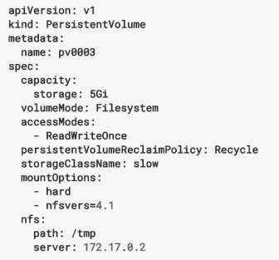
PersistentVolume
PersistentVolume
Capacity : Storage size
In future it will include IOPS,throughput etc
VolumeMode (from 1.9) : Filesystem(default) or rawblock device
Reclaim Policy
Retain – manual reclamation
Recycle – basic scrub (rm -rf /thevolume/*)
Delete – associated storage asset such as AWS EBS, GCE PD, Azure Disk, or OpenStack
Cinder volume is deleted
Currently, only NFS and HostPath support recycling. AWS EBS, GCE PD, Azure Disk, and Cinder volumes support deletion.
Mount Option
Additional mount options for when a Persistent
Volume is mounted on a node

Slide 13
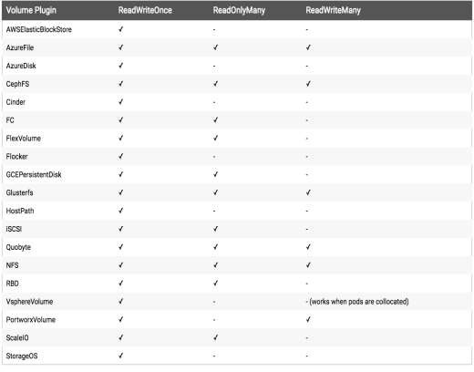
PersistentVolume
AccessModes
ReadWriteOnce (RWO)– the volume can be mounted as read-write by a single node
ReadOnlyMany (ROX) – the volume can be mounted read-only by many nodes
ReadWriteMany (RWX) – the volume can be mounted as read-write by many nodes
A volume can only be mounted using one access mode at a time, even if it supports many. For example, a GCEPersistentDisk can be mounted as ReadWriteOnce by a single node or ReadOnlyMany by many nodes, but not at the same time.
RWO를 여러 Pod에 붙일려고 하면 에러가 남

Slide 14
PersistentVolume Phase
Available - a free resource that yet is not bound to a claim
Bound - the volume is bound to a claim
Released - the claim has been deleted but the resource is not yet reclaimed by the cluster
Failed - the volume has failed its automatic reclamation

Slide 15
Lifecycle of volume and claim
Provisioning
Static
Dynamic : Dynamically create volume with storage class.
Binding
Bind PV to PVC
Using
Bind PVC to Pod and starts to use Reclaiming

Slide 16

PersistentVolumeClaim (PVC)
Claiming a PersistentVolume is a completely separate process from creating a pod, because you want the same PersistentVolumeClaim to stay available even if the pod is rescheduled (remember, rescheduling means the previous pod is deleted and a new one is created
List PersistentVolumeClaim
apiVersion: v1 kind: PersistentVolumeClaim metadata:
name: mongodb-pvc spec:
resources: requests:
storage: 1Gi accessModes:
- ReadWriteOnce storageClassName: ""
쿠버네티스 인액션 예제
List PersistentVolume
Nobody else can claim the same volume until you release it.

Slide 17
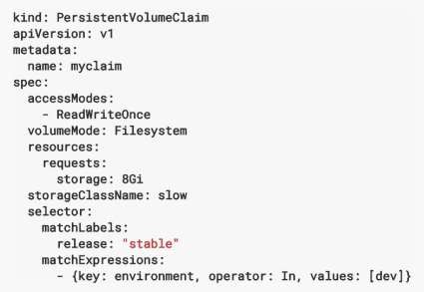
PersistentVolumeClaim (PVC)
accessMode : same as volume
VolumeMode : same as volume
Resource : Claims, like pods, can request specific quantities of a resource. In this case, the request is for storage. The same resource model applies to both volumes and claims.
Selector : Claims can specify a label selector to further filter the set of volumes. Only the volumes whose labels
match the selector can be bound to the claim
https://kubernetes.io/docs/concepts/s
torage/persistent- volumes/#persistentvolumeclaims
All of the requirements, from both matchLabels and
matchExpressions
are ANDed together – they must all be
satisfied in order to match

Slide 18
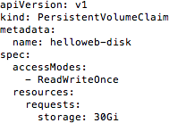
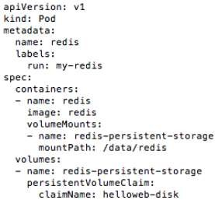
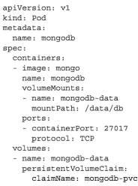
Using PVC in Pod
쿠버네티스 인액션 예제
Google Cloud Kubernetes example

Slide 19
Recycling
When a user is done with their volume, they can delete PVC object which allows
reclamation of the resource
Reclaim policy for PersistentVolume tell the cluster what to do with the volume after it has been released of its claim
Reclaim policy
Retain (remain / cannot reuse)
After PVC is deleted, PV still exists and volume is marked as “released”. It cannot be reused by other PVC. (it needs to delete manually)
Delete
Delete volume as well as associated storage asset in external infrastructure
Recycle (remain / can reuse)
Perform basic scrub (rm -f /thevolume/*) on volume and makes it available again for a new claim
The Recycle reclaim policy is deprecated. Instead, the recommended approach
is to use dynamic provisioning.

Slide 20
Volume retaining test
Change Reclaim policy from DELETE to Retain
Delete Pod and PVC
Recreat PVC & POD

Slide 21

Dynamic Provisioning
From k8s 1.6. Without manual provisioning of PersistentVolume. Kubernetes can dynamically create volume based on PersistentVolumeClaim (and storage class)
Pod
PersistentVolume
<<DynamicVoume>>
Container
Dynamically created
Bind
PersistentVolu meClaim
PersistentVolume
<<DynamicVoume>>
Volume
Dynamically created
k8s
Request Volume with storage class
Instead of admin to create PV manually, admin can deploy Persistent volume provisioner and define one or more storage class object to let users choose type of PV.

Slide 22
Dynamic Provisioning
apiVersion: v1
kind: PersistentVolumeClaim metadata:
name: mongodb-pvc spec:
apiVersion: storage.k8s.io/v1 kind: StorageClass metadata:
name: fast
provisioner: kubernetes.io/gce- pd
parameters: type: pd-ssd
zone: europe-west1-b
storageClassName: fast resources:
requests: storage: 100Mi
accessModes:
- ReadWriteOnce

Slide 23
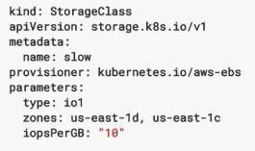
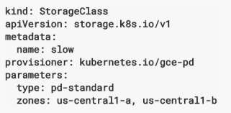
Storage Class
Example

Slide 24

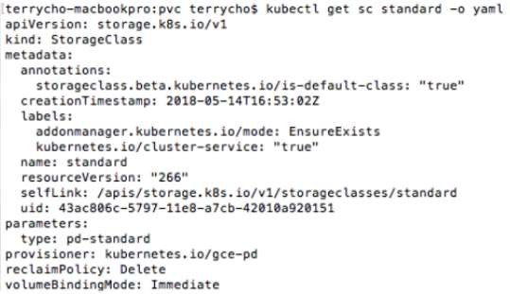
Storage Class
Get default storage class

