Slide 1
Global superstore dataset
Analyzing consumer behavior and trends from the 2024 dataset
Notes:
Photo by Johanne Kristensen on Unsplash
Photo by Laura Chouette on Unsplash

Slide 2
Introduction to the Global Superstore Dataset
The dataset offers a comprehensive view of retail performance across various regions and product categories.
By analyzing this dataset, businesses can uncover consumer behavior patterns, identify trends, and make data-driven decisions
It enhances sales and customer satisfaction from various geographic regions enabling a detailed analysis of regional performance across the Global Superstore network.

Slide 3
KPI's
Key performance indicators for the Global Superstore dataset of 2024 show significant growth and customer satisfaction improvements.
Total sales
Average order value
Customer satisfaction rate
Total profit

Slide 4
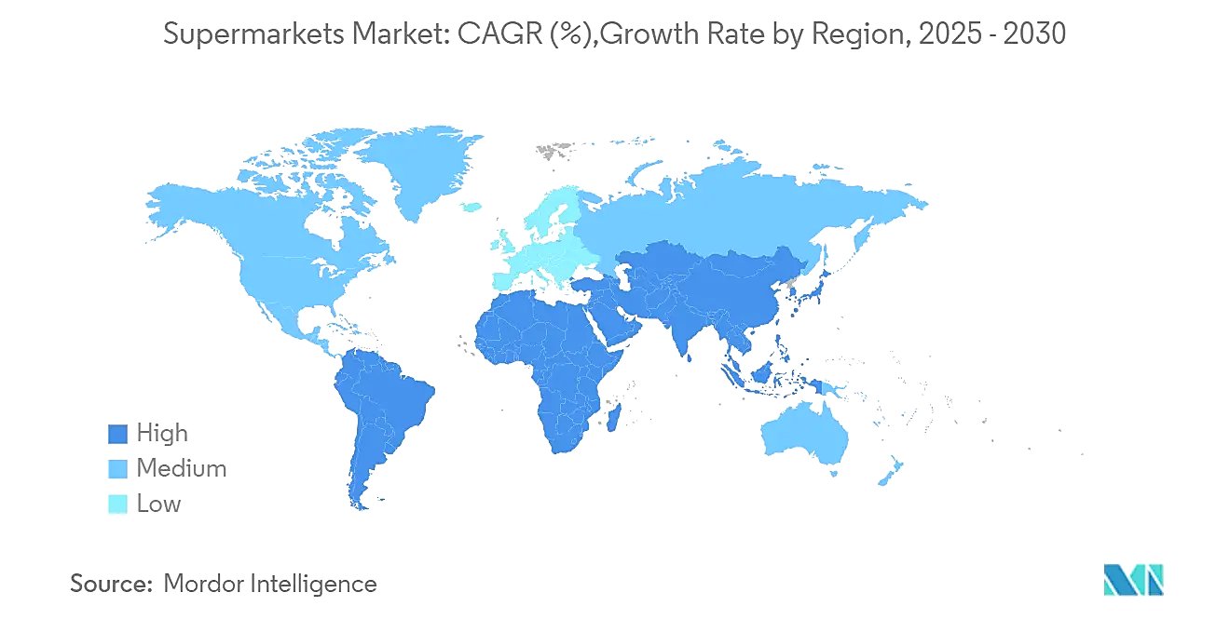
The dataset comprises comprehensive sales records from various geographic regions, enabling a detailed analysis of regional performance across the Global Superstore network.
Sales Data from Multiple Regions
Diverse Product Categories
Performance Metrics
Product categories span a diverse range, including electronics, furniture, office supplies, and more, allowing for insights into consumer preferences and purchasing patterns.
Key performance metrics such as total sales, profit margins, and quantities sold are included, providing a robust framework for evaluating business performance and strategic planning.
Overview of Dataset

Slide 5
Data Dictionary
Column Name | Data Type | Description
Order ID | Text | Unique identifier assigned to each customer order.
Order Date | Date | The date when the order was placed.
Customer Name | Text | Full name of the customer who placed the order.
Region | Text | Geographical region where the order was delivered.
Category | Text | Main category of the product (e.g., Furniture, Office Supplies).
Sales | Decimal | Total sales amount generated from the product (in USD).
Profit | Decimal | Profit earned from the sale after deducting costs and discounts.

Slide 6

Conclusions and recommendations
The analysis of the Global Superstore dataset of 2024 reveals significant opportunities for enhancing sales and boosting customer satisfaction. Key findings emphasize the need for targeted marketing strategies, improved inventory management, and enhanced customer engagement practices.

