Slide 1

Efficient tools and techniques for modern software development
Visual Studio Code
Vineel Kovvuri

Slide 2
Agenda
VS Code Installation
Open VS Code via Command line
IDE vs Text Editor
Interface overview
Basic Editing/Navigation Tricks
The Editor
Multiple Cursors
Extensions
Settings and Customization
References

Slide 3
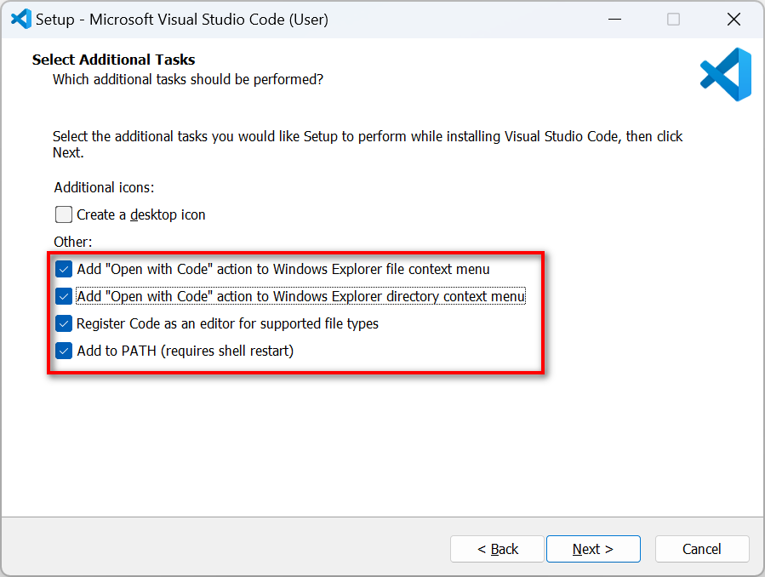
VS Code Installation
https://code.visualstudio.com/download

Slide 4
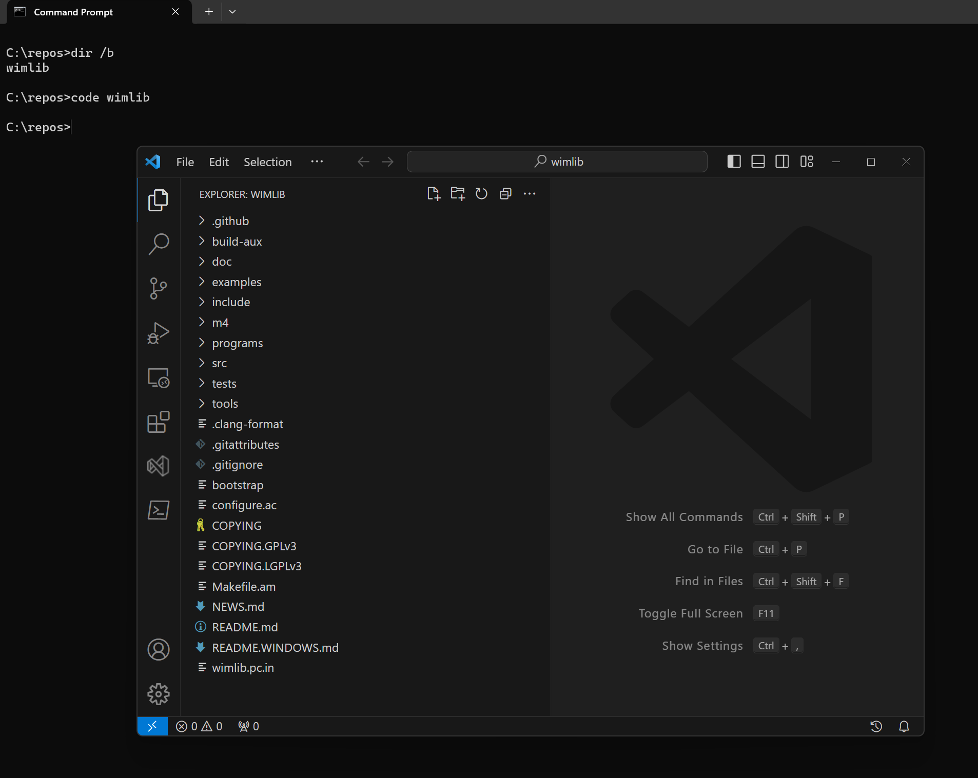
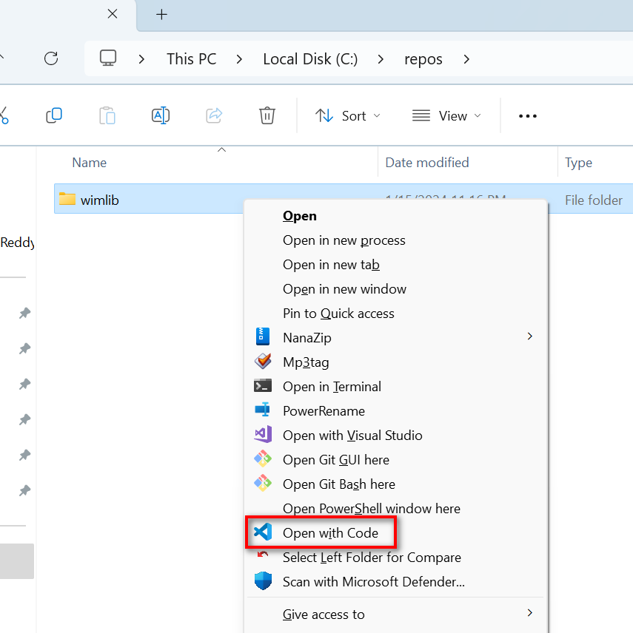
Opening VS Code
Via Explorer Context Menu
Via Command Line – Code.exe
Open single file vs folder

Slide 5
IDE vs Text Editor
IDE(Integrated Development Environment)
Eclipse
IntelIiJ
Visual Studio
Text Editors
VS Code
Sublime Text
Vim
Emacs
Don’t have to switch editor – Stick to the editor which makes you productive
But please do not use Notepad/Notepad++ ☺

Slide 6
Interface Overview
Traditional Clunky Toolbars vs Command Palette
Ctrl + Shift + P – Open Command Palette
Ctrl + P –Open File from workspace(?)
Fuzzy find file name
File with line number
Ctrl + Tab – List/switch b/w open files
MiniMap
Explorer
Create files with multiple sub directories deep
Reveal in File Explorer
Search inside explorer
Compare Files
Extensions
Git
Sync Settings
Terminal
Status Bar
Ctrl+B – To minimize the side bar

Slide 7
Basic Editing/Navigation Tricks
Character Operations
Delete – deletes the next character
Backspace – deletes a previous character
Word Operations
Ctrl + Left/Right - Navigating b/w words
Ctrl + Delete – Delete next word
Ctrl + Backspace – Delete previous word
Home/End – Move to beginning and end of the line
Shift – Selection
Usage of keyboard/mouse 95%:5%

Slide 8
The Editor
Editor tabs
BreadCrumbs
80/100 Column Guides
Indent Guides
Ctrl + F/H – Find/Replace in current file
Scroll bar search highlights
Ctrl + Shift + F/H – Find/Replace in workspace
Ctrl + Shift + O – Switch b/w functions
Ctrl + \ - Splits
Sticky Scroll
Ctrl + Shift + \ - Find the matching brace
Alt + Left/Right – Navigation history
Remove blank lines
Line Operations(no selection)
Ctrl + C – Copy entire line
Ctrl + X – Cut Line
Shift + Alt + Left/Right – Expand or Shrink Selection

Slide 9
Multiple Cursor
Ctrl + D – Create Multiple cursor at next occurrence
Ctrl + Alt + Down/Up – Create Multiple cursors on each line
Each Cursors copies its own select word
Alt + Down/Up – Move lines
Ctrl + Shift + I – Multiple Cursors on all selected lines
Ctrl+F > Search > Alt+Enter – Create multiple cursor on all occurrences in the current file

Slide 10
Multiple Cursors Walkthrough

Slide 11
Extensions
Align
Case conversion(Transform)
Text Pastry - 1 to X
Delete trailing spaces
Commenting flow
Prettier – Code formatter – Shift + Alt + F
VSCode-PDF extension
Rainbow CSV extension

Slide 12
My Extensions List
13xforever.language-x86-64-assembly
adpyke.codesnap
bierner.markdown-emoji
christian-kohler.path-intellisense
chunsen.bracket-select
csholmq.excel-to-markdown-table
cxfksword.goto-documentation
dakara.transformer
DavidWang.ini-for-vscode
dbankier.vscode-quick-select
DotJoshJohnson.xml
earshinov.simple-alignment
earshinov.sort-lines-by-selection
esbenp.prettier-vscode
fernandoescolar.vscode-solution-explorer
formulahendry.auto-rename-tag
formulahendry.code-runner
heaths.vscode-guid
humao.rest-client
ionutvmi.reg
jbockle.jbockle-format-files
jkjustjoshing.vscode-text-pastry
josa.markdown-table-formatter
jsynowiec.vscode-insertdatestring
kevinkyang.auto-comment-blocks
konstantin.wrapSelection
lixquid.calculator
maelvalais.autoconf
mechatroner.rainbow-csv
ms-dotnettools.csharp
ms-dotnettools.vscode-dotnet-runtime
ms-vscode-remote.remote-containers
ms-vscode-remote.remote-ssh
ms-vscode-remote.remote-ssh-edit
ms-vscode-remote.remote-wsl
ms-vscode-remote.vscode-remote-extensionpack
ms-vscode.cmake-tools
ms-vscode.cpptools
ms-vscode.hexeditor
ms-vscode.powershell
ms-vscode.remote-explorer
ms-vscode.remote-server
msazurermtools.azurerm-vscode-tools
shardulm94.trailing-spaces
stkb.rewrap
streetsidesoftware.code-spell-checker
tamasfe.even-better-toml
thamaraiselvam.remove-blank-lines
tomoki1207.pdf
twxs.cmake
wmaurer.change-case
xaver.clang-format
yzhang.markdown-all-in-one

Slide 13
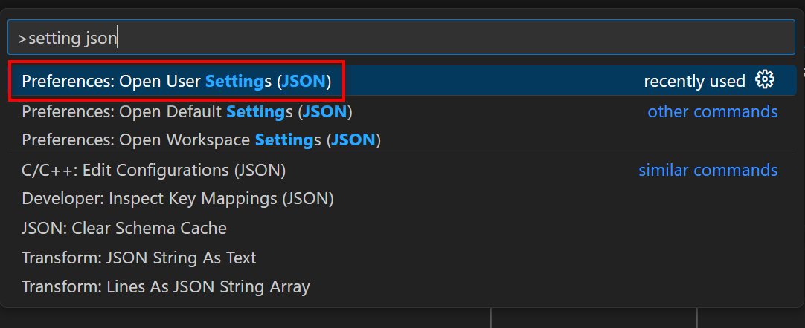
Settings and Customization
My Settings
https://github.com/vineelkovvuri/dotconfig

Slide 14
Advanced features
Build/Debug configurations
Git features
VS Code Profiles
Ssh into a remote machine
Github Copilot
Jupyter Notebooks in VS Code

Slide 15
References
https://stackoverflow.com/
https://www.youtube.com/@code/shorts
https://code.visualstudio.com/docs

Slide 16



Thank You
Vineel.Kovvuri@gmail.com
https://github.com/vineelkovvuri
https://www.linkedin.com/in/vineelkovvuri

