Slide 1

FinRisk Analytics
Strategic Loan Risk & Opportunity Assessment

Slide 2

The Challenge
1.2%
500
2%
Quarterly Default Increase
Customers Analyzed
Current Conversion
Rising loan default rates requiring immediate action
Comprehensive dataset with 20,000+ transactions
Personal loan campaign performance needs improvement

Slide 3
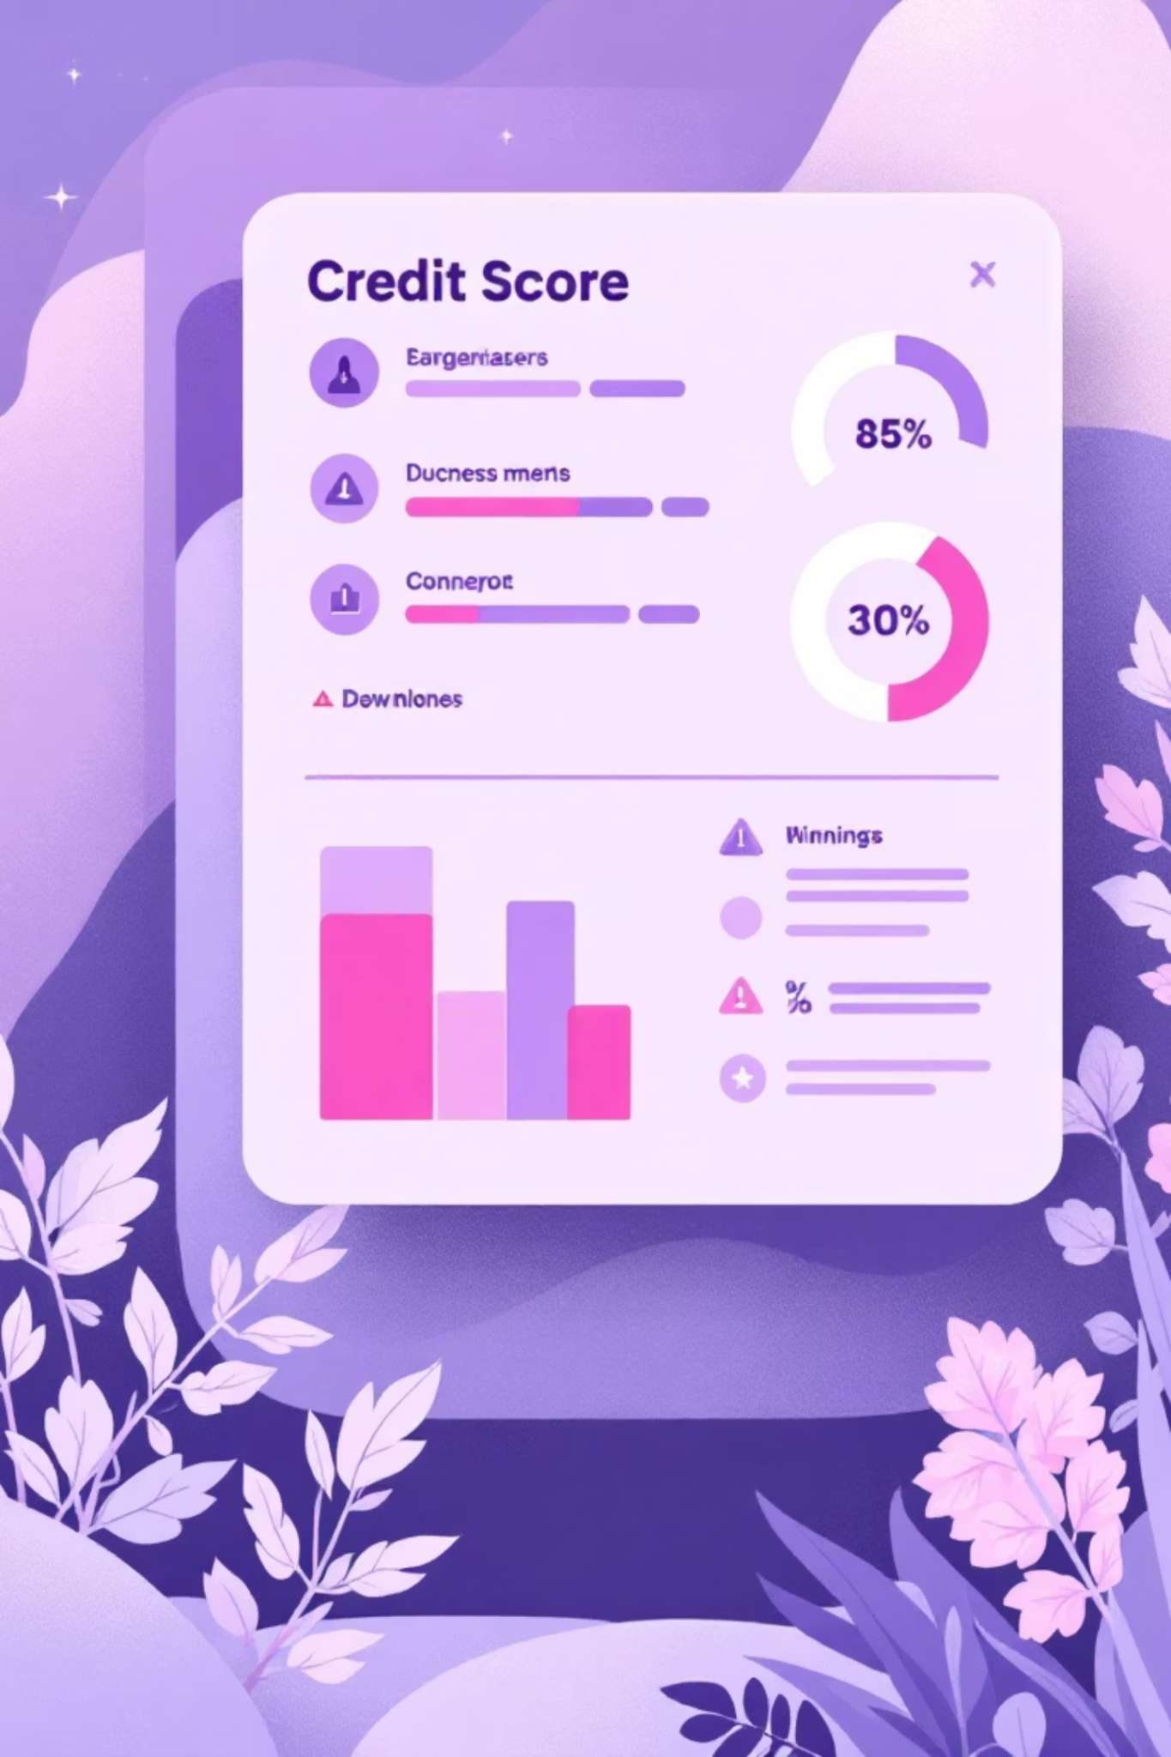
Critical Discovery
Traditional Credit Scores Miss the Full Picture
The Problem
The Solution
Customers with CIBIL scores >650 still defaulting
Behavioral risk markers from transactional data
Static demographic data lacks real-time visibility
Cash flow analysis reveals true financial health
False positives in loan approvals
Real-time financial distress indicators

Slide 4


Introducing: The Burn Rate
Formula
Critical Threshold
Total Outflow ÷ Total Inflow
Burn Rate >0.90 = High Risk
Impact
65% of defaults identified
A powerful new metric that captures "living within means" better than traditional scores

Slide 5

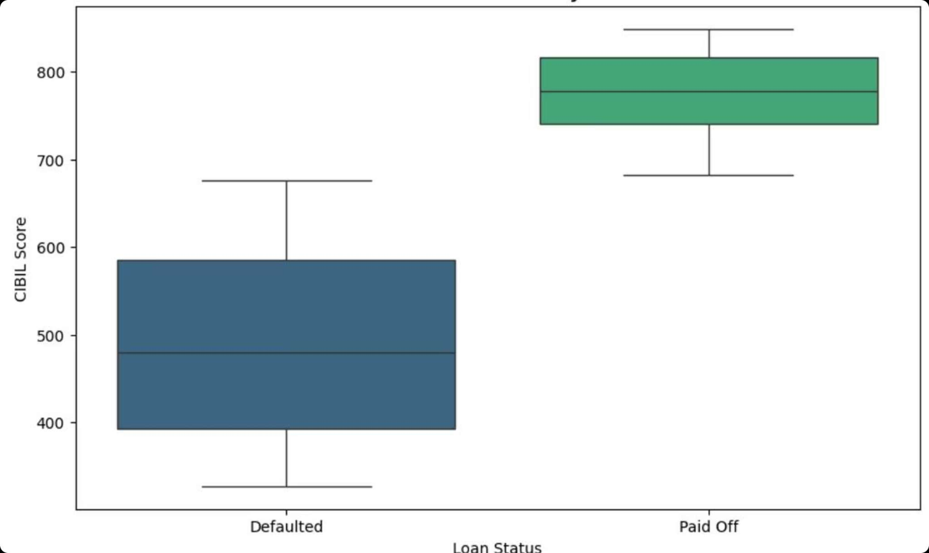
CIBIL Score Limitations Revealed
The Overlap Zone
Significant overlap in 650-700 range between defaulted and paid-off customers
The Blind Spot
Mid-range scores cannot distinguish temporary dips from chronic default risk

Slide 6

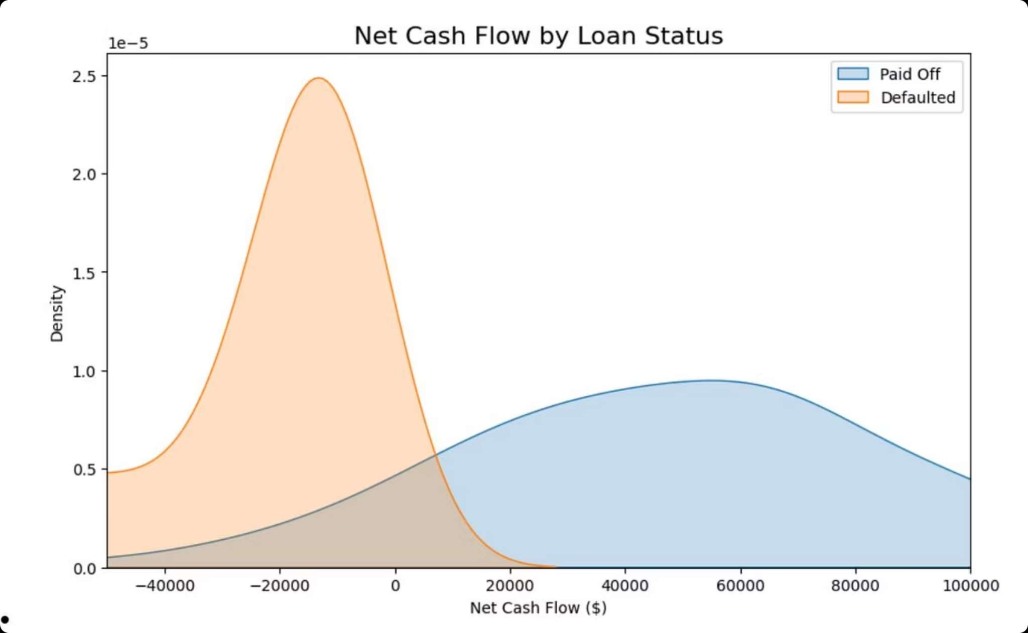
Cash Flow: The Leading Indicator
Defaulted Group
Paid Off Group
Peak at or below zero Net Cash Flow
Maintains positive monthly surplus
Consistent financial cushion
Visible months before missed payments

Slide 7

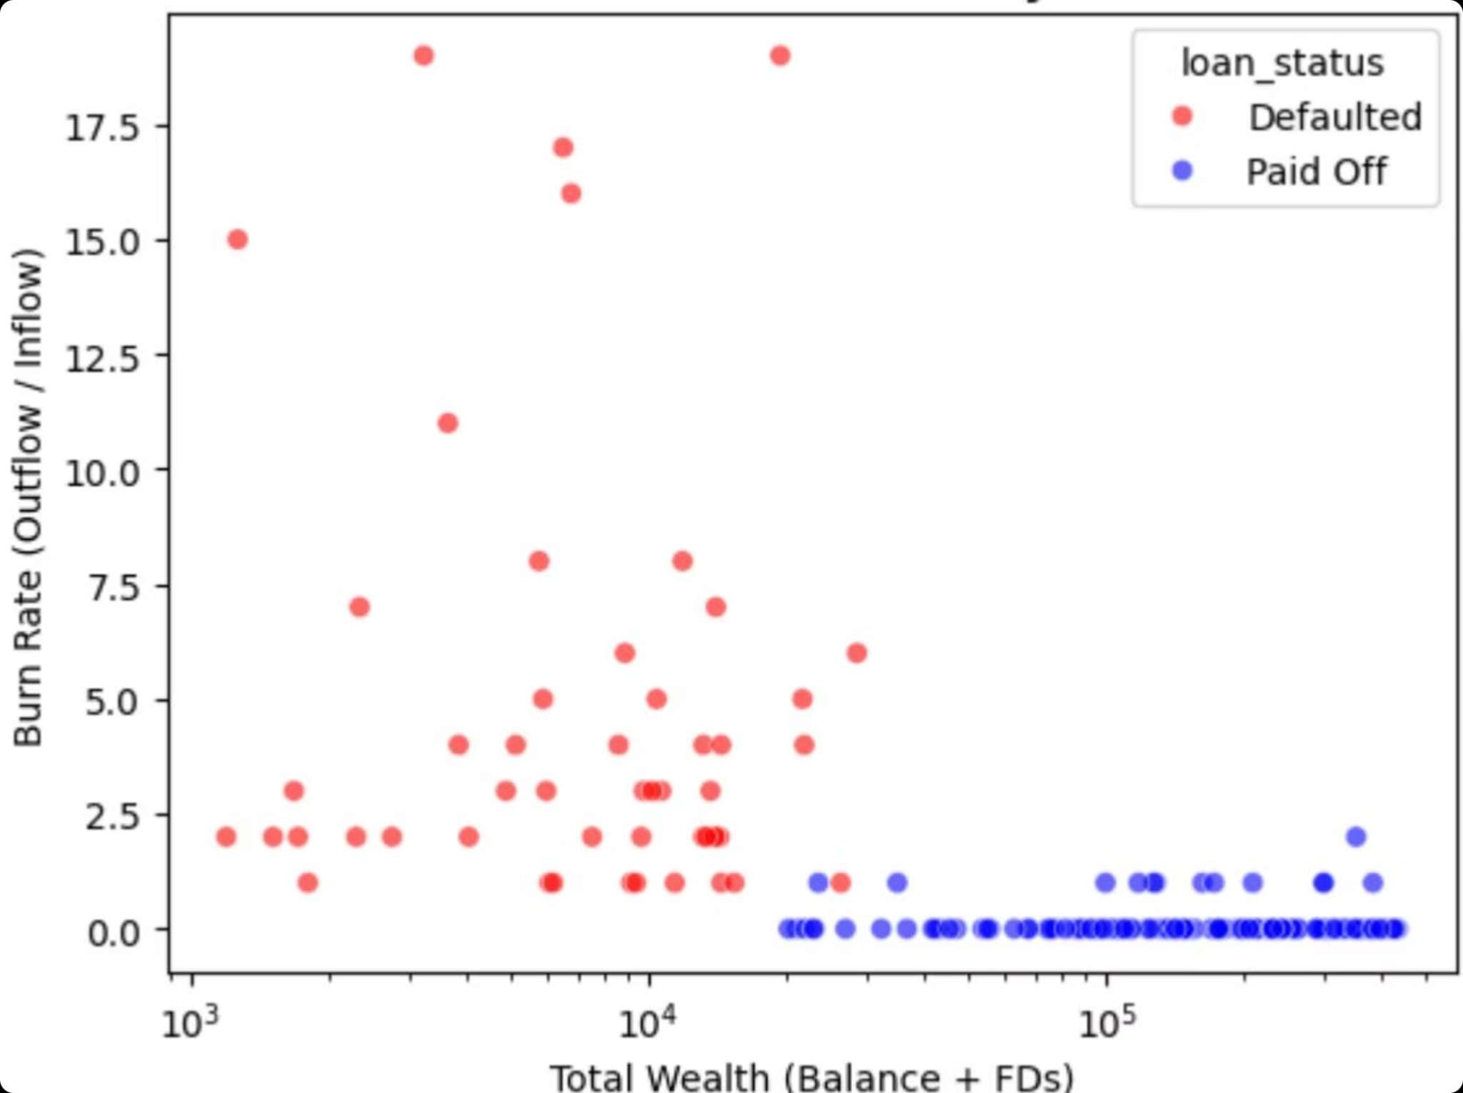
The Risk Quadrant
Wealth vs. Burn Rate Analysis
Danger Zone
Low Wealth (<₹5,000) + High Burn Rate (>90%)
Highest concentration of defaults

Slide 8
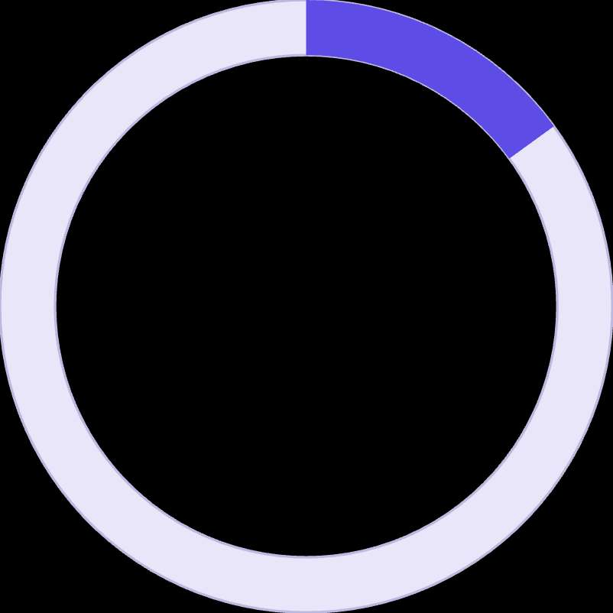
Recommendation 1: Red Flag System
01
02
03
Integrate Cash Flow Stress Test
Trigger High Risk Alert
Filter Over-Leveraged Applicants
Add to loan application API
Burn Rate >0.95 AND Net Cash Flow <₹0 over 3 months
Prevent bad loans that look good on paper
15%
Target Reduction
Expected decrease in default rate

Slide 9



Recommendation 2: Prime Prospects
Untapped Opportunity Identified
The Prime Segment
Targeted Campaign
Cross-Sell Strategy
18% of customer base
Wealth Management & Personal Credit offers
Premium credit cards to build engagement
No Active Loan + CIBIL >750 + Wealth >₹50,000
Lower interest rates for near-zero risk profile
Convert non-loan customers to active borrowers
5%
Target Conversion
Up from current 2% campaign performance

Slide 10
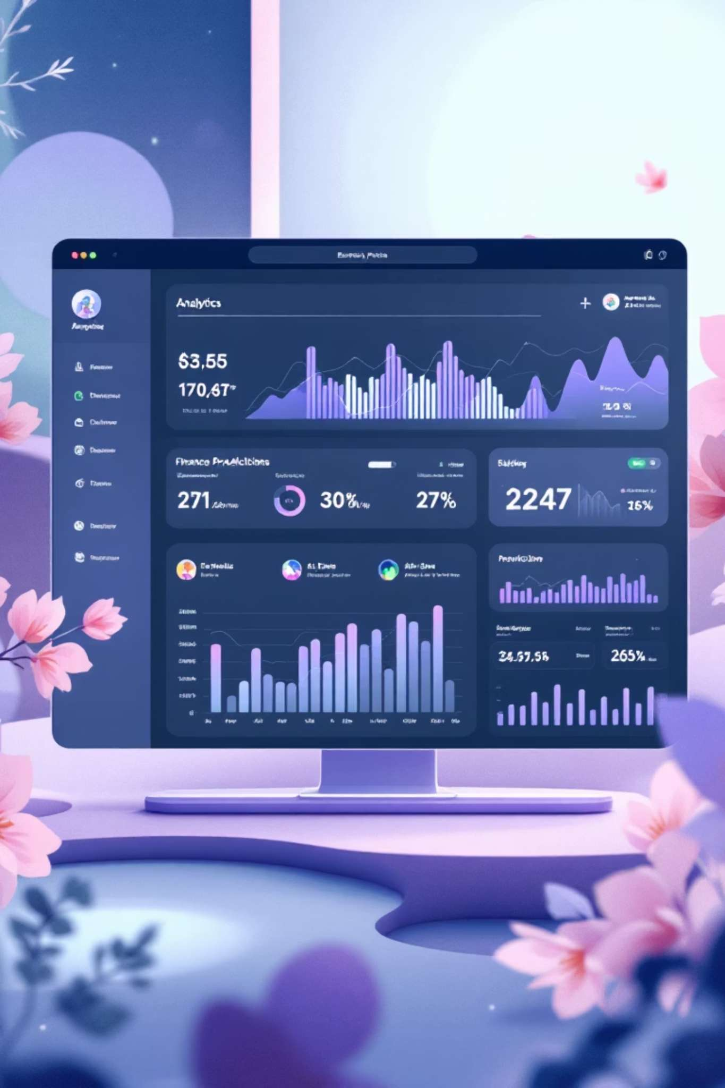


Next Steps & Future Vision
Predictive Modeling
Random Forest Classifier for 0-100% default probability scores
Real-Time Dashboard
Power BI deployment for underwriting team assessment
Transform risk management from reactive to predictive

