Slide 1

Plant Seedling Classification Using Xception and Logistic Regression
A project to classify different plant seedlings
Presented By Vineet Ingale
Institution : Imarticus Learning
Date : 03/10/2024

Slide 2
Introduction
What is the problem?
Farmers need to identify different types of seedlings to ensure proper care.
Manual classification is time-consuming and prone to error.
Goal of the Project:
The goal of this project is to classify plant seedlings into 12 distinct categories using a deep learning approach.

Slide 3
Dataset Overview
Categories:
12 plant species such as Black-grass, Charlock, Cleavers, Sugar beet, and others.
Dataset Structure:
Training Set: 4750 images
Testing Set: 794 images
Data Size :
The dataset includes a balanced sample of 221 images per category.

Slide 4
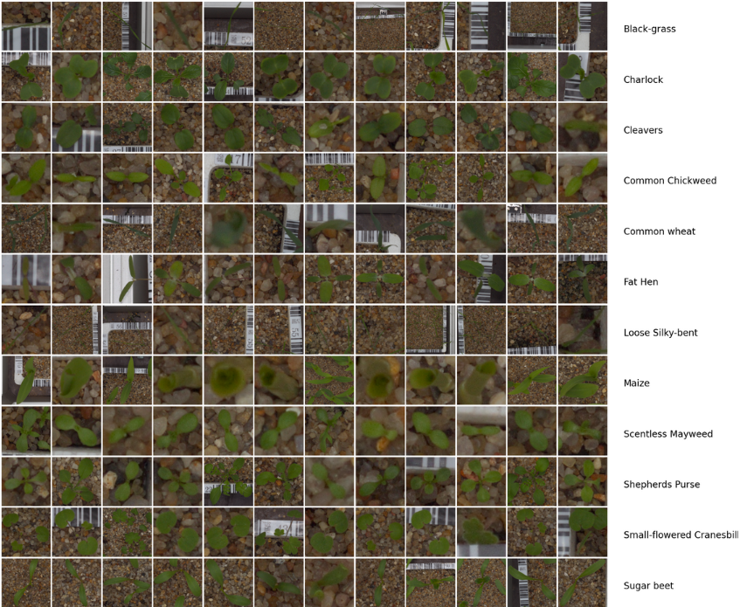

Slide 5
Preprocessing Steps
Loading the Data: Images were loaded from folders, and associated labels were extracted.
Image Resizing: Resized all images to 299 x 299 to match the input size of the Xception model.
Data Splitting: Train set (80%) and validation set (20%).
Normalization: Images were normalized using the preprocessing method specific to the Xception model.

Slide 6
Xception Model Overview
Architecture:
The Xception model, a deep convolutional neural network, was employed for feature extraction.
Transfer Learning
Pre-trained weights from ImageNet were utilized to enhance model performance.
Purpose:
Designed for superior performance in image classification tasks

Slide 7
Why Xception Model?
Xception is a powerful convolutional neural network architecture designed for image classification tasks.
It is pre-trained on ImageNet and can extract robust features from images
Outperforms traditional CNNs like VGG16 and Inception in image classification
Reduces computational cost while maintaining high accuracy
Highly efficient for small datasets like the Plant Seedlings Dataset

Slide 8
Training Process
Model Selection:
Used Logistic Regression for classification due to its simplicity and effectiveness with high-dimensional data.
Feature Extraction:
Utilized Xception model to extract bottleneck features from images, reducing the dimensionality of the data while retaining important information.
Training Dataset:
Trained on a subset of the dataset (2132 samples) with 80% allocated for training and 20% for validation.

Slide 9
Model Fitting:
Fitted the logistic regression model using logreg.fit(train_x_bf, y_train):
train_x_bf : Extracted features from the training set
y_train : Corresponding labels for the training set.
Predicting Validation Set:
Made predictions on the validation set to evaluate model performance using Logreg.predict(valid_x_bf)

Slide 10
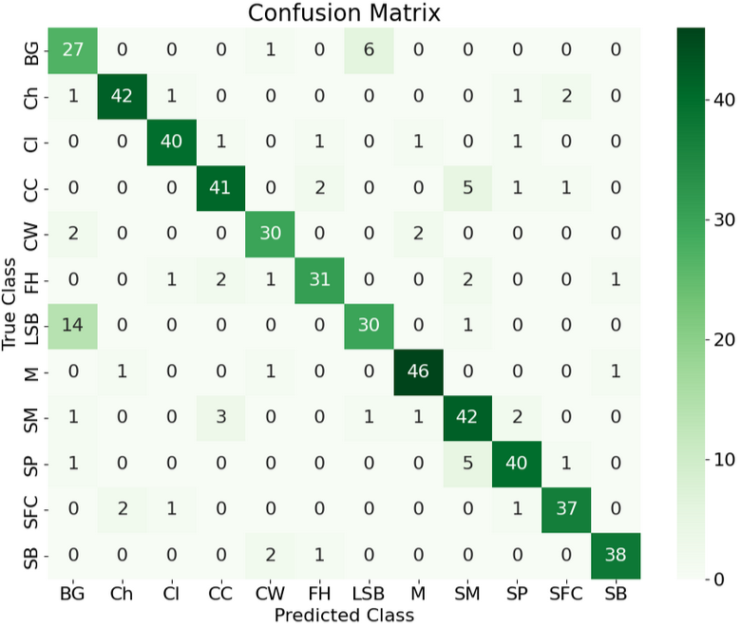
Confusion Matrix

Slide 11
Model Performance Overview:
High accuracy species :
"Ch" (Charlock): 42 correct predictions.
"M" (Maize): 46 correct predictions.
"SFC" (Small-flowered Cranesbill): 40 correct predictions.
Misclassifications:
Black-grass (BG) often misclassified as Loose Silky-bent (LSB) (6 times).
Loose Silky-bent (LSB) misclassified as Black-grass (BG) (14 times).
Fat Hen (FH) and Common Chickweed (CC) show minor confusion.

Slide 12
Key Insights From Confusion Matrix:
Misclassifications are more common between visually similar species.
The model performs well overall but struggles with certain species distinctions.

Slide 13
Results
Performance Metrics
Validation Accuracy : 0.8538
ROC AUC Score: 0.9900
Cross-Validation Scores: [0.84543326 0.85948478 0.83568075 0.85680751 0.83098592]
Mean CV Accuracy: 0.8457

Slide 14
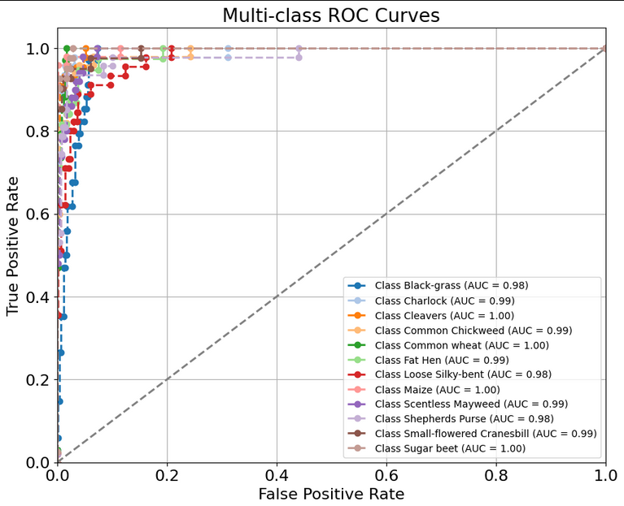

Slide 15
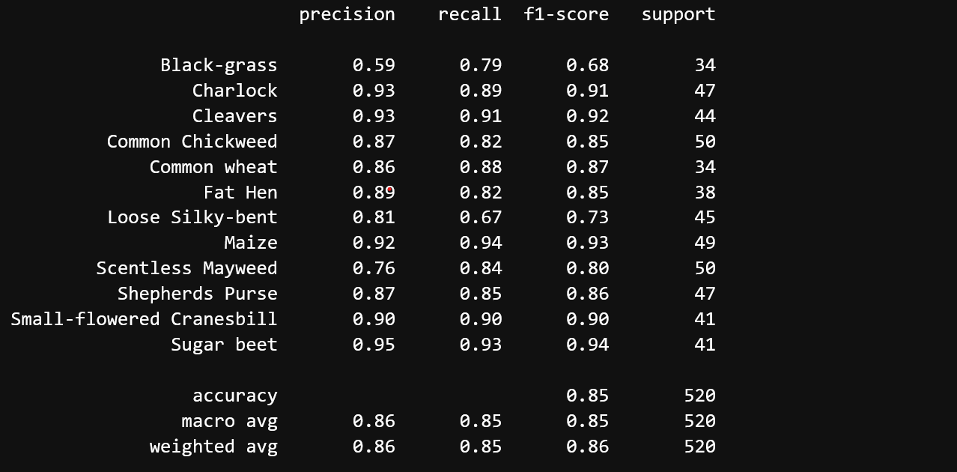

Slide 16
Conclusion
Summary of Findings:
Developed a plant seed classification model to categorize various seed types using image data.
Extracted bottleneck features from images using the Xception model.
Implemented logistic regression classifier for effective classification.
Achieved validation accuracy of 85.38%.
Generated a confusion matrix to visualize model performance.
Obtained impressive ROC AUC scores (0.9900), indicating strong class distinction.
Averaged 84.57% across multiple folds, confirming model reliability.

Slide 17
Conclusion
Future Work:
Exploring Convolutional Neural Networks (CNNs) or Ensemble Learning for improved accuracy.
Implementing techniques to increase dataset diversity and enhance generalization.
Fine-tune Xception or other pre-trained models for better adaptation.

