Slide 1

myNEU
A complete information system for its students and faculty.
A project overview presented by:
Vineet Dandekar
Rugved Jahagirdar

Slide 2
Topics of Discussion
Product Objectives
User Needs
Product Specifications
Requirements (Functional + Content)
Wireframes
Information Architecture
Prototype

Slide 3


Work distribution and schedule
Equal contribution in all stages of project lifecycle, No separate roles
Scheduled kick off date – 06/01/15
Project duration ~ 10 days
Product Owners | Blackboard | myNEU
 |  | Student Finance | Student Employment | library management | NU Mail Services | Adhoc
Vineet
Rugved

Slide 4
Product Objectives
To create a single platform for managing all business processes related to Northeastern
To reduce maintenance cost of website
To provide access via multiple devices.
To promote the “Northeastern” brand.
To optimize site performance.

Slide 5
User Needs – Process Overview
Identifying and defining different users of the system.
Categorization of Users / Personas.
Gathering user requirements through surveys.
Validating and prioritizing requirements.

Slide 6
User Needs – Detailed Analysis
User Segmentation
Full-time Student
Usability and User Research
Link to survey
Personas
Link to moqup personas
Part-time/Online Student
Faculty

Slide 7
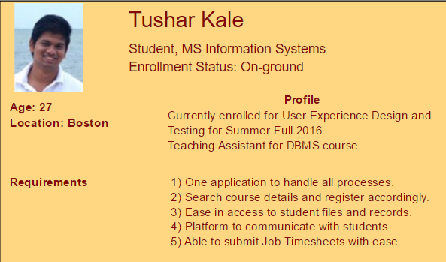
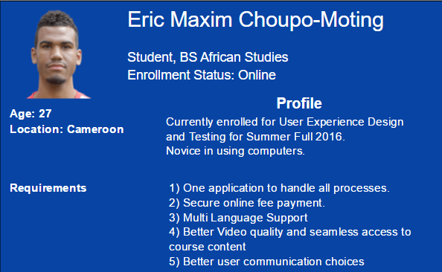
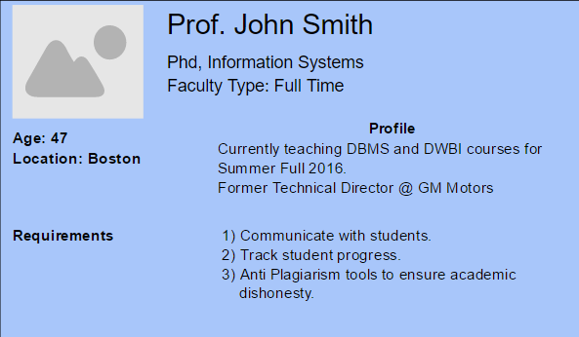
Sample Personas

Slide 8
Functional Requirements
To allow students to download / upload content.
To allow student to play/stop/fast-forward audio and video.
To allow faculty to add, post and modify student grades.
To allow users to view/book tickets to NU events.
To allow users to pay/view bills.
To allow users to access library / online learning materials
To allow users to customize their dashboards, profile info etc.

Slide 9
Content requirements
Broad categorization based on functional areas of website
Text: Font should adhere to True-type format
For Tegrity: Audio – MP4 and Video – MP3
For Library: Copyrighted content cannot be downloaded but only viewed.
For Assignments: Supports all formats. Content should be displayed to user.
For News: Aspect ration of 16:9 to be maintained throughout.

Slide 10
Prioritized Requirements

Slide 11
Information Architecture
Bottom-up approach.
Link to Image File

Slide 12
Wireframes

Slide 13

THANK YOU !

