Slide 1

myNEU
A complete information system for its students and faculty.
A project overview presented by:
Vineet Dandekar
Rugved Jahagirdar

Slide 2
Topics of Discussion
Project Recap
Improvements in Existing System
Prototype
Testing – Functional
User Acceptance Testing
User Feedback and Conclusion
Future Improvements / Q & A

Slide 3
Project Overview - Recap
WHAT ? Redesign the user experience of myNEU portal and many of its features viz. Fess Payment, Student Employment, Blackboard, etc.
WHY ? To create a better UX for us ! Reduce Maintenance Costs and improve performance
HOW ? By following the best UX practices defined in the book
WHO ? Team effort and collaboration
A better product with enhanced user experience

Slide 4
So far what have we done ?
Strategy Plane
Scope Plane
Structure Plane
Skeleton Plane
Product Goals
User Segmentation
Personas
Requirement gathering
Prioritization
Conceptual models
Information Architecture
Wireframes

Slide 5
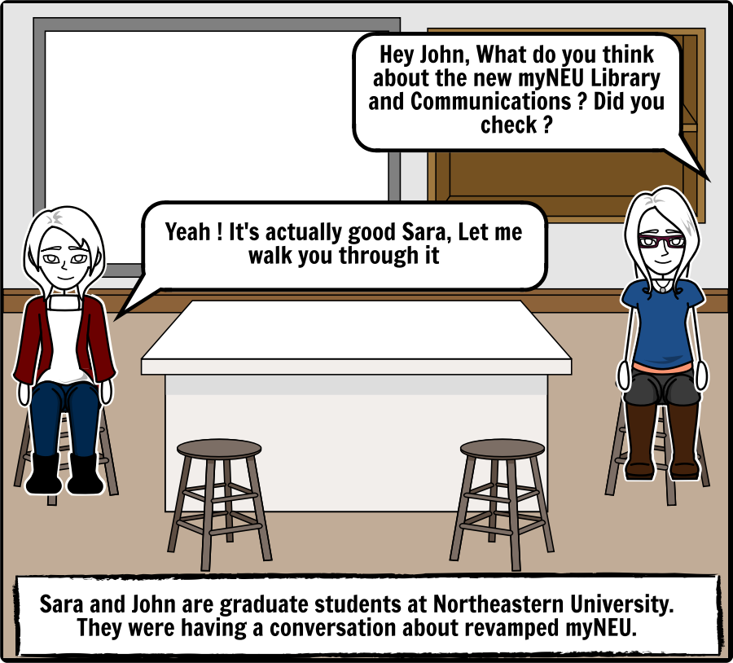
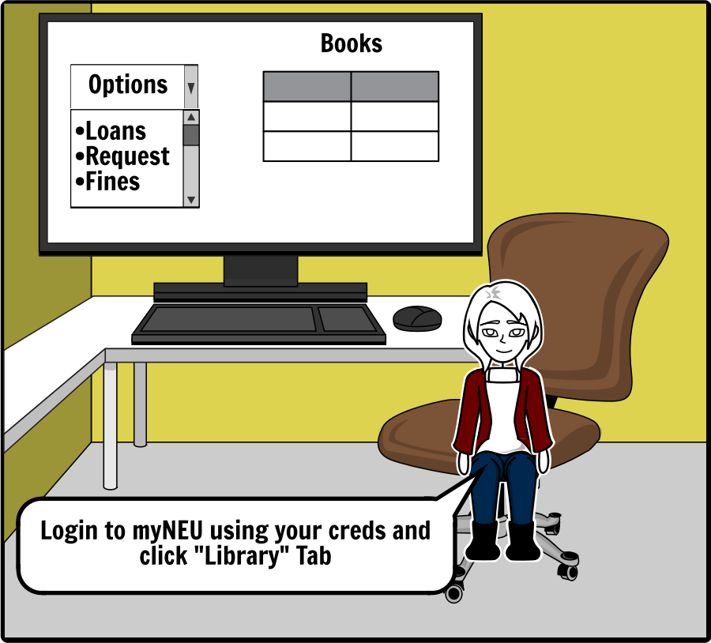
Storyboards
A short scene where John helps out Sara by walking her through courses page, registration process and grades on the new myNEU prototype
https://www.storyboardthat.com/portal/storyboards/rugvedj/class-storyboard/finalproject---academics---course-list-reg
Covers critical features of the site viz. Library Management, Emails, Market Place etc

Slide 6
Prototype
http://127.0.0.1:32767/01.48.21/login.html

Slide 7
Style Guide
Serial # | Parameters | Specification
1 | Branding | A unique, self identifying logo
2 | Colors | A combination of cool and warm color scheme
3 | Typography | Arial, Sans-Serif Font in 3 sizes (16/26/32)
4 | Buttons | Bootstrap style color coded
5 | Icons | 35 x 35 px OR 24 X 24 px
6 | Form Fields | Dropdown, Textfield, Radio button, Checkboxes

Slide 8
User Research Methods
Interviews
Conducted on Users
Understand features directly from users
Surveys
Link to survey
Card Sorting
Link to OptimalSort
A/B Testing
Usability Lab Studies

Slide 9
Usability Testing
Activities:
Login to myNEU and Navigate to Medical Services. Try to schedule an appointment.
Login to myNEU and Navigate to Courses, access Course materials and grade for UI/UX Course.
Login to myNEU and Navigate to Library and schedule a room
Login to myNEU and Navigate to Library and renew Book
Login to myNEU and Navigate to Parking Services and try to book a parking slot.

Slide 10
Usability Testing - Response
Tasks Users | Completion Status |  |  |  |  | Time Taken in sec
 | 1 | 2 | 3 | 4 | 5 | 1 | 2 | 3 | 4 | 5
User1 | Complete | Complete | Complete | Complete | Complete | 30 | 20 | 41 | 67 | 3
User2 | Complete | Complete | Complete | Complete | Complete | 10 | 16 | 37 | 22 | 10
User3 | Complete | Complete | Incomplete | Complete | Complete | 28 | 15 | 120 | 20 | 20
User4 | Complete | Complete | Complete | Complete | Complete | 31 | 24 | 39 | 33 | 20
User5 | Complete | Complete | Complete | Complete | Complete | 26 | 33 | 43 | 12 | 12

Slide 11
Functional Testing
Drafted a Test Strategy and created a Test Plan
Created Automated Test Suites for performing Functional white box testing
Performed tests on all implemented functionality
Recorded results in Test Results

Slide 12
Future Scope & Improvements
Potential to go live !
Based on feedback, incorporate upgrades
Creating a mobile application

Slide 13
Technologies Used
Moqup
Axure RP 8.0
Trello
Storyboardthat.com
OptimalWorkshop.com for Card Sorting
Selenium
GIT

Slide 14

THANK YOU !

