Slide 1
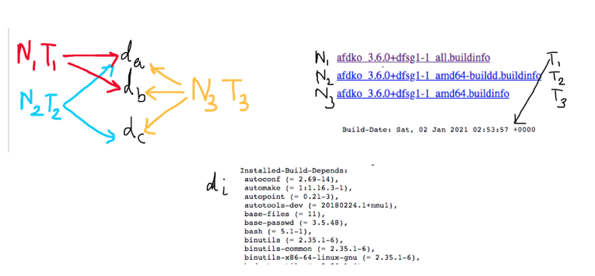
Directed Graph construction for temporal analysis

Slide 2
Selection of Time scale
Daily basis (1st Jan, 2nd Jan, 3rd Jan, …….)
Hour's basis (1st Jan 3:45 PM, 1st Jan 4:00 PM, 1st Jan 4:30 PM,…….)

Slide 3


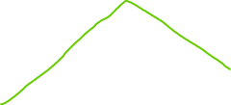

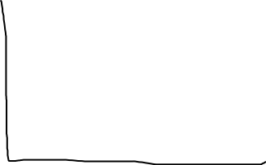

Top 5 packages of each day by degree
Package Present on all 3 days
Package Present on any 2 days

Slide 4

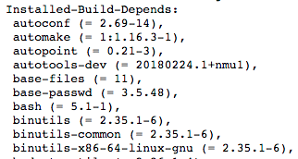









Slide 5
Observation
Dependent packages repeat on almost all days. Therefore time variation of these packages possible.
Source do not repeat on all days. Temporal plots of Source difficult.

