Slide 1
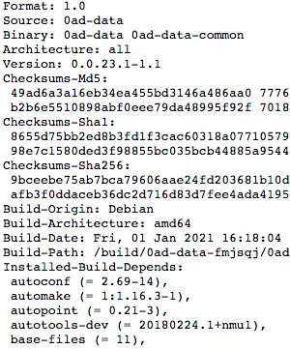
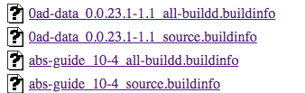
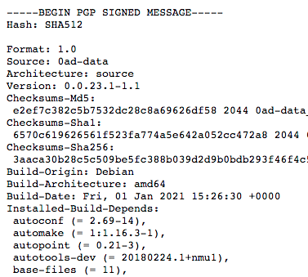
Directed Graph
base-files (= 11)
base-passwd (= 3.5.48)
0ad-data_0.0.23.1-1.1_source
autoconf (= 2.69-14)
automake (= 1:1.16.3-1)
autopoint (= 0.21-3)
autotools-dev (= 20180224.1+nmu1)
0ad-data_0.0.23.1-1.1_all-buildd

Slide 2
Analysis
Analysis 1: 1st Day of months from Jan’21 to Sept’21
Analysis 2: First 4 days of Jan’21

Slide 3
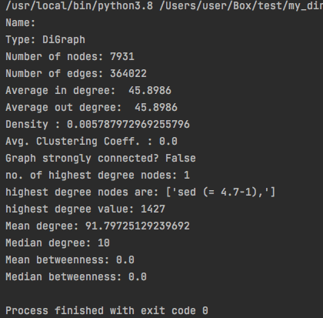
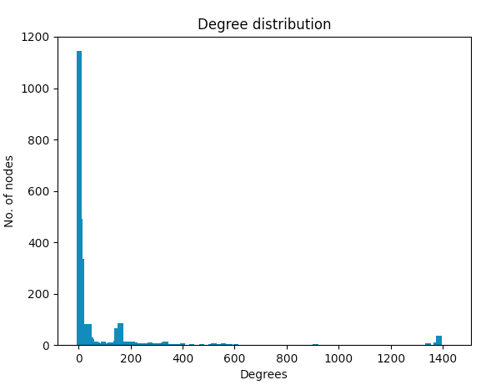
1st Jan 2021

Slide 4
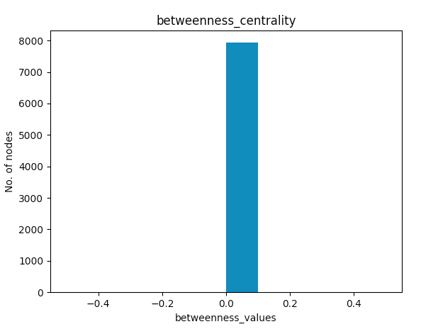
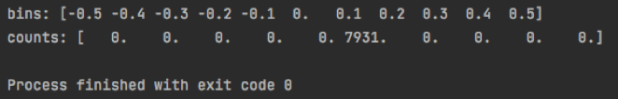

Slide 5
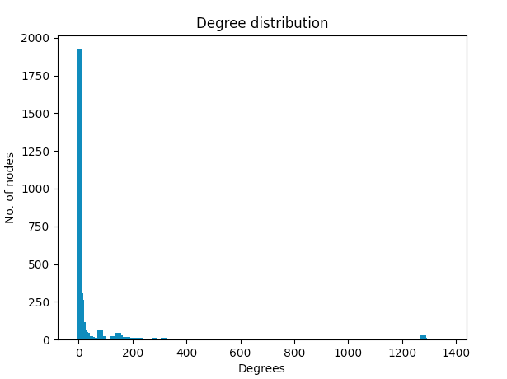
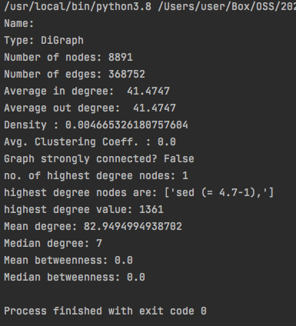
1st Feb 2021

Slide 6
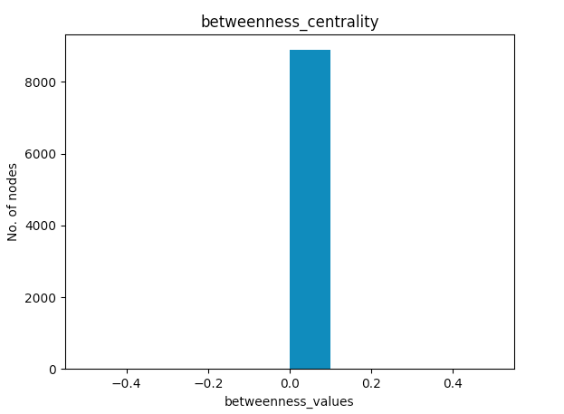

Slide 7
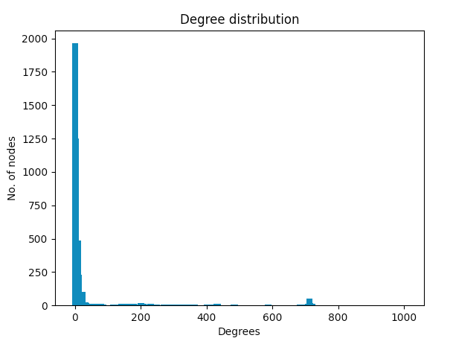
1st Jan
1st Feb
1st Mar

Slide 8
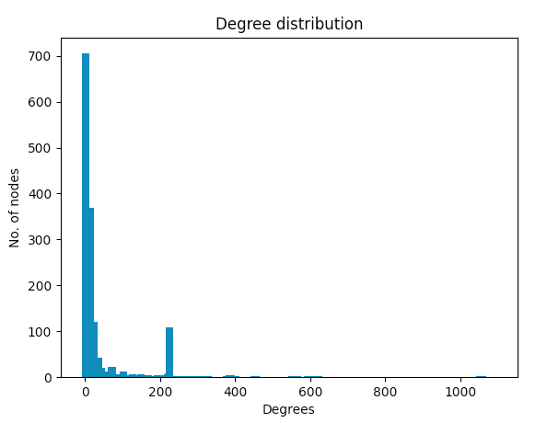
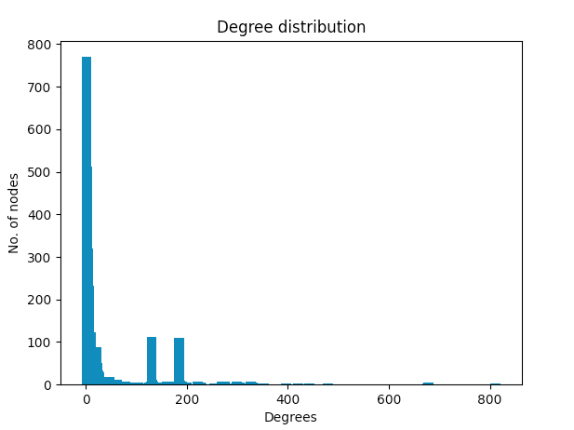
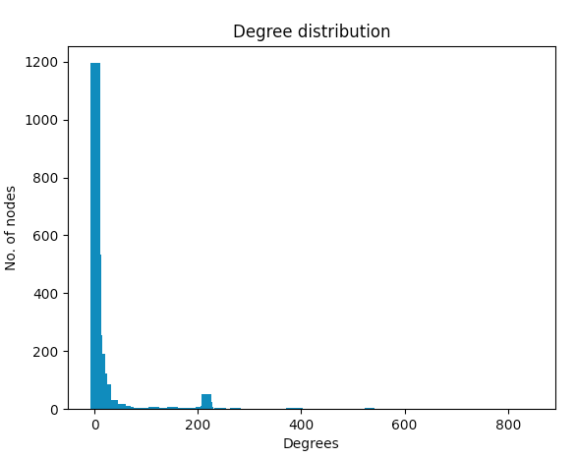
1st Apr
1st May
1st June

Slide 9
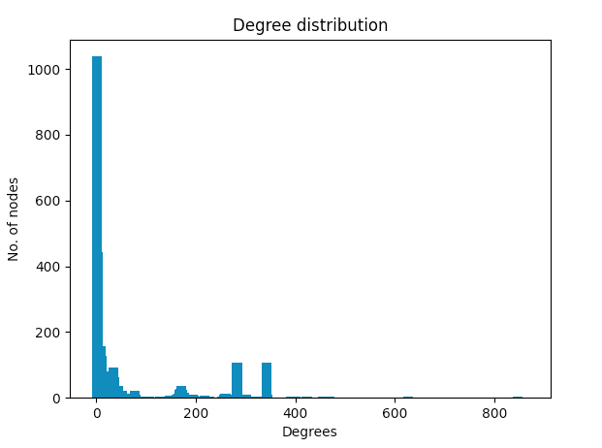
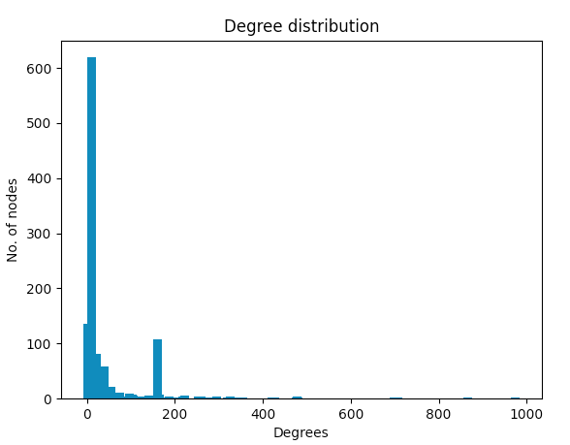
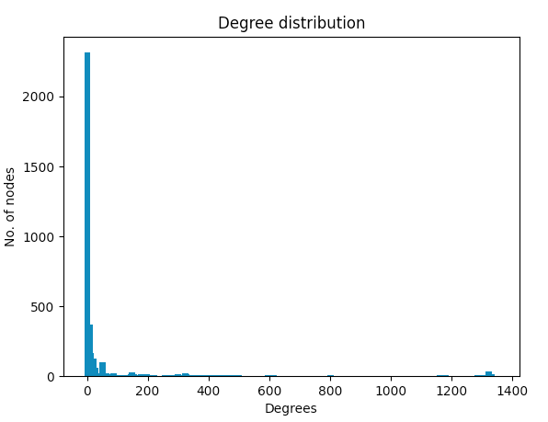
1st July
1st Aug
1st Sept

Slide 10
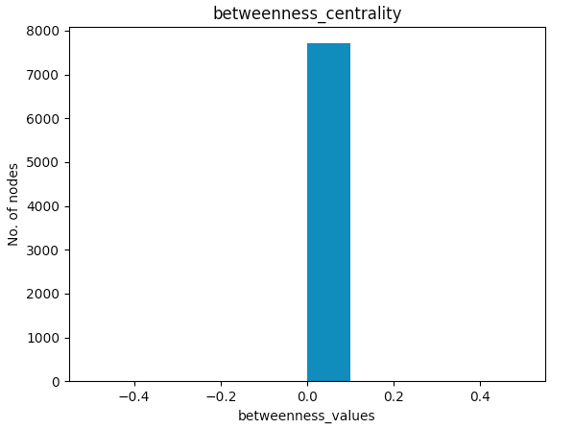
1st Jan
1st Feb
1st Mar

Slide 11
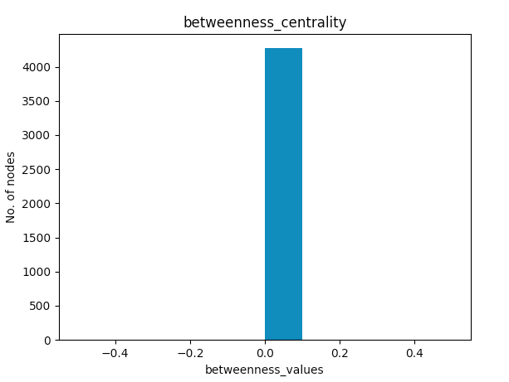
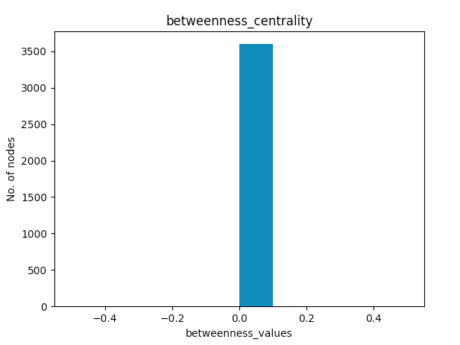
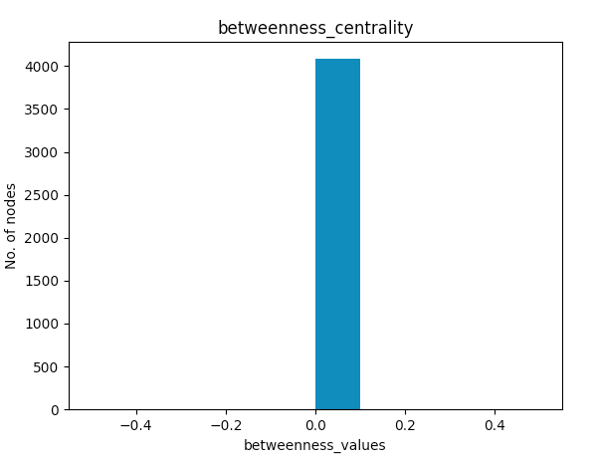
1st Apr
1st May
1st June

Slide 12
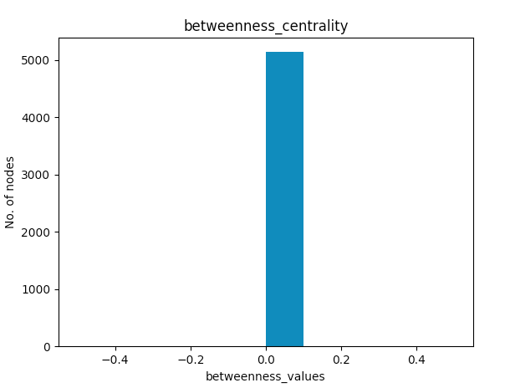
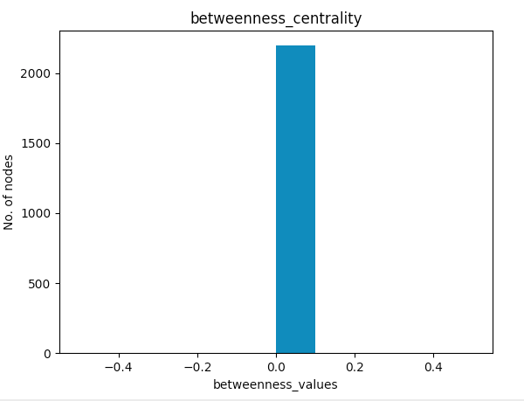
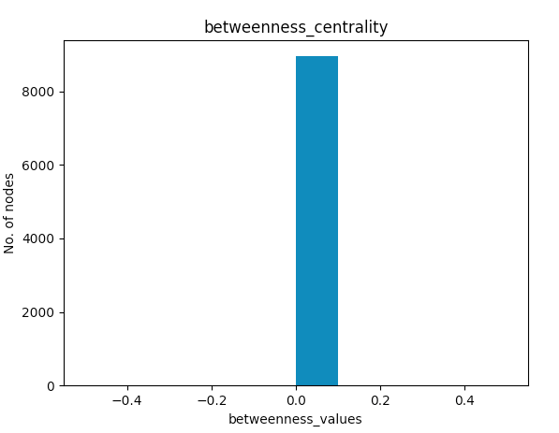
1st July
1st Aug
1st Sept

Slide 16
Analysis 2 : First 4 days of Jan’21

Slide 17
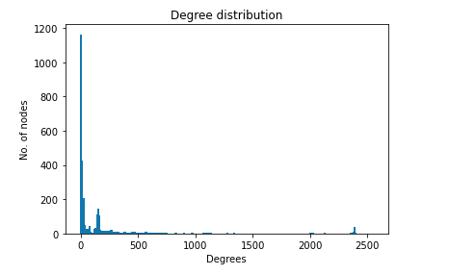
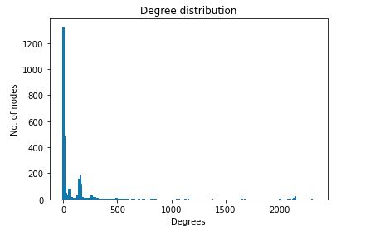
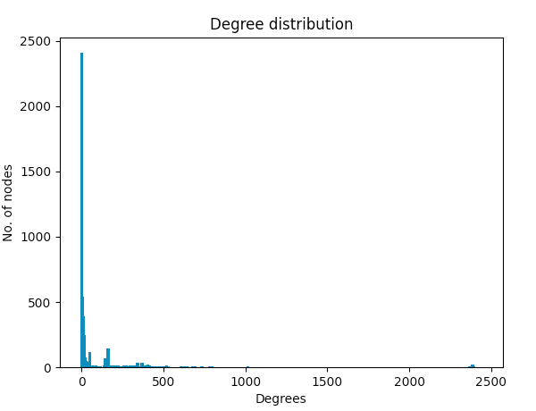
1st Jan
2nd Jan
Degree Distributions
3rd Jan
4th Jan

Slide 18
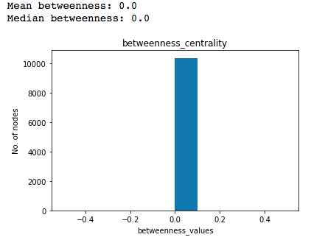
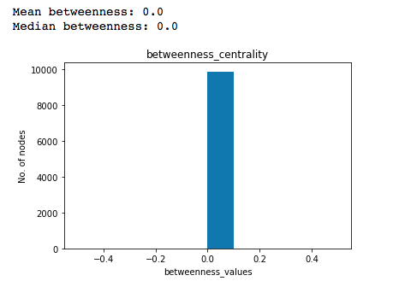
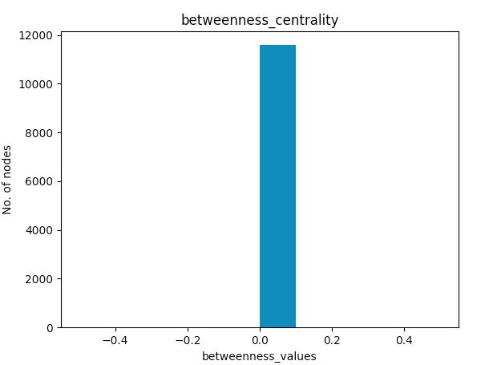
1st Jan
2nd Jan
Betweenness Centrality
4th Jan
3rd Jan

