Slide 1
Network Science for OSS – Supply Chain
Vineet Mohanty
PhD student
RCODI

Slide 2
Network science is a field of study to understand complex networks such as :
telecommunication networks
computer networks
biological networks
social networks
by constructing graphs of distinct elements (nodes) and the connections between the elements as links (edges).
Source: www.BarabasiLab.com

Slide 3
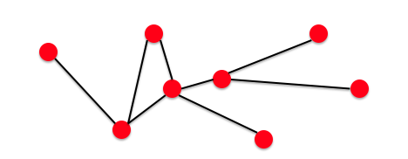
Components of a network
Nodes (N)
Edges (E)
Graph (N, E)

Slide 4
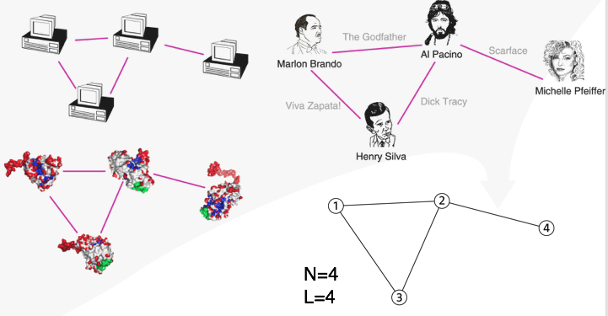
Communication networks
Movie actor collaboration
Cellular networks
Phone call networks

Slide 5
Network properties
Source: www.BarabasiLab.com

Slide 6
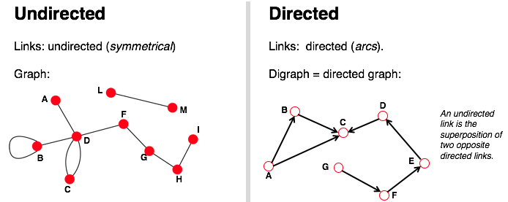
Co-authors of a research paper
Facebook mutual friends
Phone calls
Twitter Followers

Slide 7
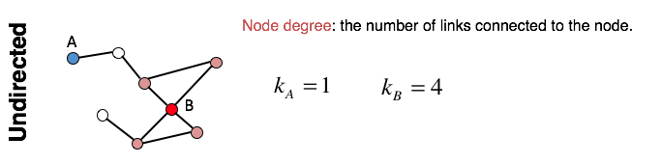
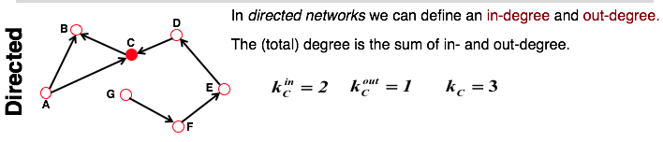

Slide 8
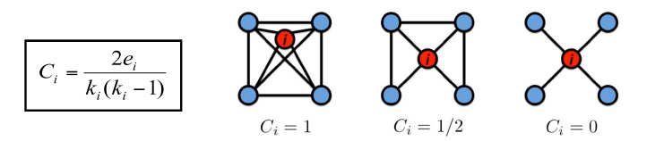
Clustering Coefficient
Clustering coefficient is a measure of the degree to which nodes in a graph tend to cluster together
Or
what fraction of your neighbors are connected?
k: the degree of node i
e: is the number of edges between the ki neighbors of node i
C in [0,1]

Slide 9
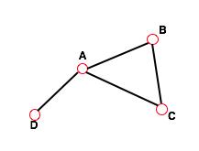
The distance (shortest path) between two nodes is defined as the number of edges along the shortest path connecting them.
Diameter: d_{max} the maximum distance between any pair of nodes in the graph

Slide 10
OSS – Supply Chain
Supply chain: System/network of stakeholders present in an ecosystem to achieve a certain goal.
OSS supply chain involves:
source code development
building & packaging
re-configuration & re-packaging
deployment

Slide 11
OSS-Supply Chain
pre-process the raw data from OSS communities that design and maintain large commercial OSS products, namely: Debian Buster, Fedora (Red Hat).
develop a graph-theoretical model that allows us to explain the risk of OSS supply chain ecosystems by evaluating the vulnerabilities in the design and identifying critical packages in the structure.
Big Data analysis and Machine Learning to classify the OSS risk profile and predict the expected bugs in the repository/OSS ecosystem

Slide 12
Motivation to solve the problem: Risks inherent to OSS supply chain?
Symantec Internet Security Threat Reports : 534% cumulative increase in compromised software products due to the increased complexity of the software supply chains relying on OSS.
Eg: hack of SolarWinds, a software vendor of multiple US agencies
Increase in reuse : Actors reuse each others’ freely available work and OSS products
More OSS packages are re-used, re-packaged across multiple products and software supply-chains.
Increase in interdependence : Technical and organizational interdependence among multiple products and actors increase.

Slide 13
Motivation to solve the problem: What are the sources of threat and cause for 'critical' packages?
Vulnerable package due to:
lack of security updates
lack in release frequency
defects in environmental configuration
malicious code alteration in the repository
failed packaging process
As dependence on OSS products increase, more stakeholders get involved and hence more chances of threat.

Slide 14
Debian(An open-source software)
Debian is one of the oldest operating systems based on the Linux kernel/distribution.
Use raw data from Debian .buildinfo file

Slide 15
The .buildinfo file
A buildinfo file is a record of what a particular builder did to build some binary output/packages.
Records information about the system environment used during a particular build -- packages installed, system architecture, version, source, etc.

Slide 16
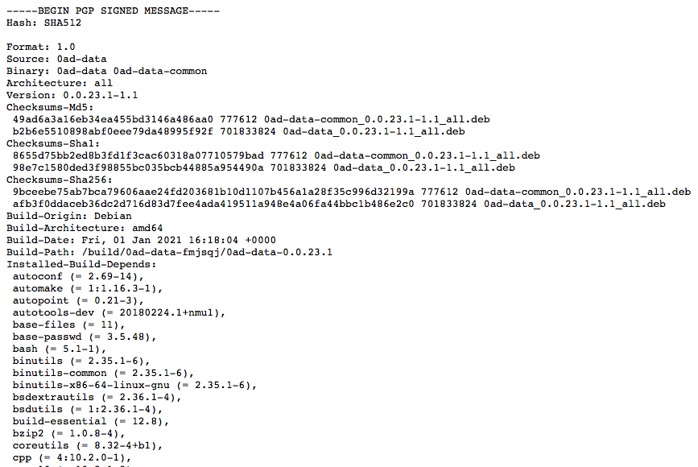

Slide 17
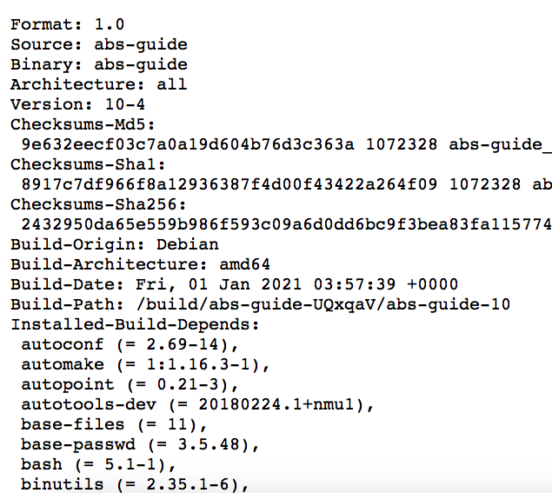
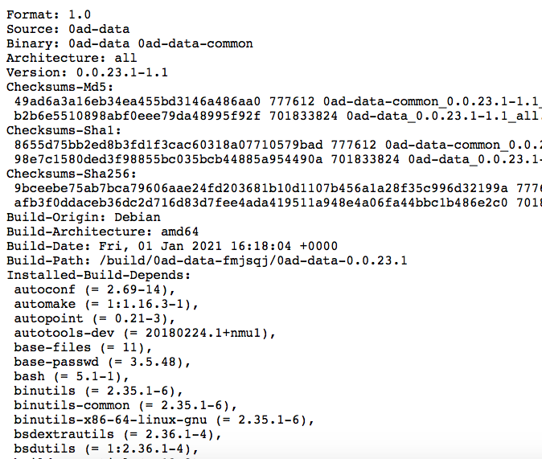
autoconf (= 2.69-14)
abs-guide
0ad-data

Slide 18
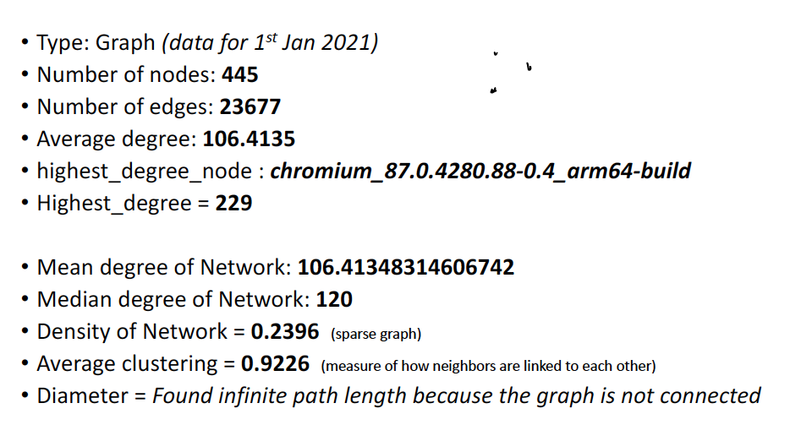
(1st Jan 2020)

Slide 19
