Slide 1



SeizureScoreAI: Multi-Agent Clinical Reasoning System
Vineet Reddy

Slide 2
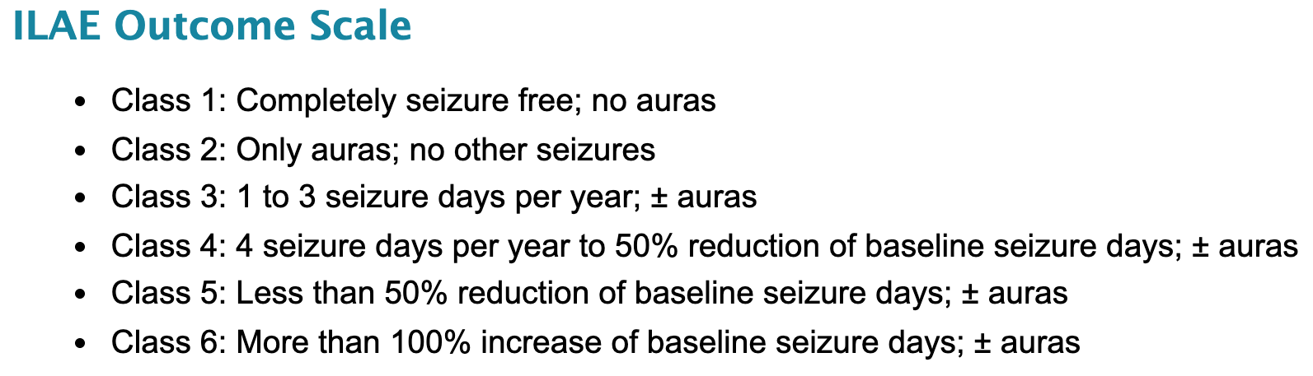
SeizureScoreAI - Enhancing Post-Surgical Outcome Evaluation
Objective: Simulate epileptologists' clinical reasoning to assign ILAE (International League Against Epilepsy) outcome scores after epilepsy surgery.
Core Function: Automates interpretation of clinical notes using a multi-agent system driven by Large Language Models (LLMs).
Relevance: Streamlines decision-making, ensuring reproducibility and transparency in outcome reporting.
Adaptability: While the system is tuned to generate ILAE scores, it can be fully adapted to generate Engel scores instead.

Slide 3
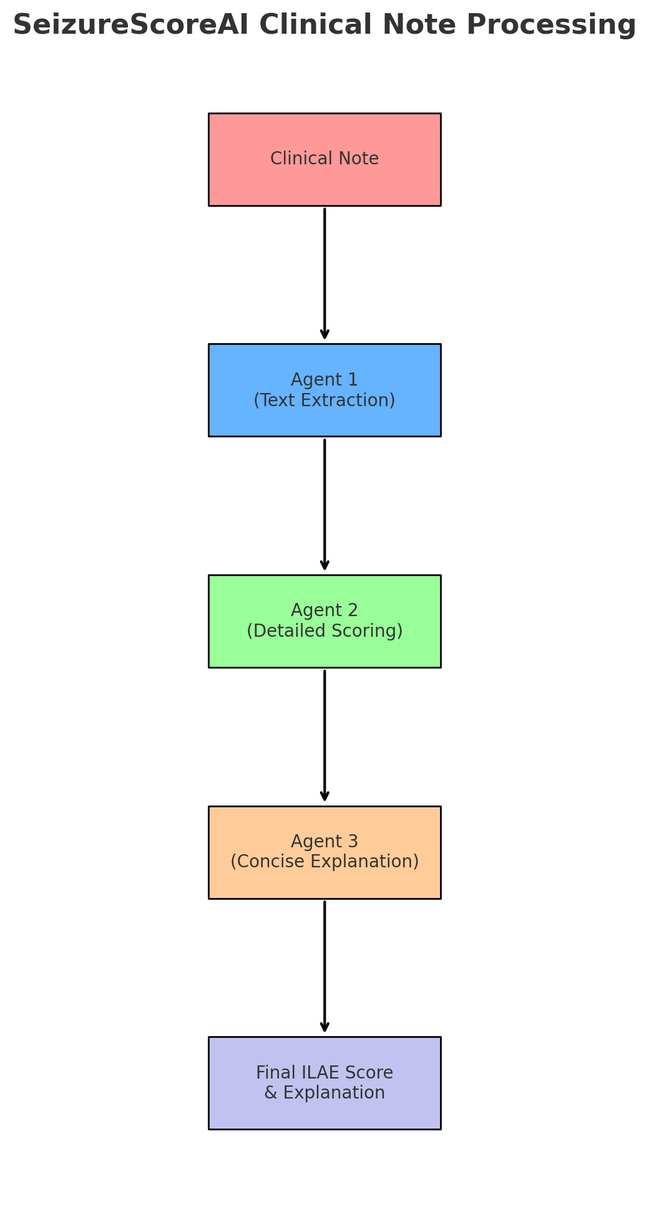
Epilepsy-Focused Pipeline
3-Agent System:
Clinical Information Extractor:
Identifies key data from clinical notes:
Seizure recurrence
Aura presence
Baseline vs. post-operative seizure frequency
ILAE Score Calculator:
Implements ILAE-defined scoring criteria:
Incorporates nuanced clinical reasoning for score determination.
Concise Reporter:
Generates user-friendly summaries:
Final ILAE score.
Key influencing factors from clinical note text.
Clinical logic supporting the result.
Workflow:
Input: Operative clinical notes.
Processing: Extraction → Classification → Scoring.
Output: Transparent, structured score reports and explanations.

Slide 4
Enhancing Post-Surgical Outcome Evaluation
Features
Epileptology-Specific: Tailored for seizure outcomes and ILAE scoring.
Streamlit Frontend: Easy-to-use portal for efficient clinical note processing.
Backend: Advanced multi-agent LLM pipeline for structured data analysis. Can be used to loop through thousands of clinical notes with inexpensive API costs.
Outputs: Provides JSON-formatted reasoning consistent with ILAE guidelines.
Limitations
Not HIPAA-Compliant: Avoid using protected health information (PHI) until future updates.
Assists, Not Replaces: Complements expert judgment but does not substitute it.
Get Involved
Explore: Visit the GitHub Repository for more details.
Collaborate: Help refine this epilepsy-focused AI system!

Slide 5
Contributors
This project builds upon an original AI ATL Hackathon project developed by Vineet Reddy, Viresh Pati, MukProgram, and Sachi Goel. After the hackathon, I revamped the project to create the advanced multi-agent RAG system and updated interface presented today.
Viresh Pati: Contributed to the design of the initial named entity recognition (NER) and knowledge graph retrieval-augmented generation (KG RAG) system, which has since been replaced with the multi-agent RAG system currently in use.
Mukesh: Helped develop the backend for the original NLP-styled NER and KG RAG system.
Sachi Goel: Designed the initial Streamlit frontend, which has been revamped into the current version.
Their contributions laid the foundation for the advanced multi-agent RAG system and user interface enhancements that define the project today.

