Slide 1
Syren Overview / Capabilities
2026

Slide 2






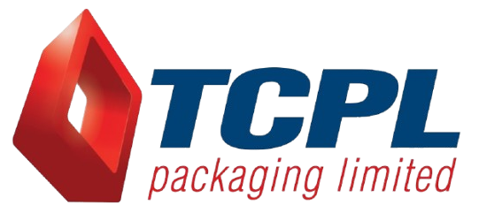










Company Snapshot
Syren is a Data and AI transformation partner that helps enterprises modernize data platforms, operationalize AI, and drive smarter decisions across supply chain, analytics, and business operations. We turn fragmented data into scalable, AI-ready solutions that improve visibility, accelerate decisions, and enhance business performance.
Our Clientele
400+
Employees
150+
Databricks Technical Certifications
50+
Data science & ML
Experts
Key Partnerships
Awards & Compliance
Syren Offerings
Supply Chain Accelerators & Solutions
Retail & Commercial Solutions
AI/ML & Generative AI Services
Data Science Services
Databricks Native Accelerators
2

Slide 3
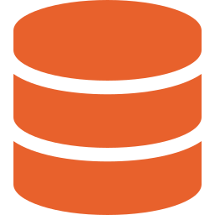




Syren Capabilities
Supply Chain
Quality & Regulatory
Domain CoE & GenAI
Commercial
On Time in Full
Available to Promise
MEIO / SEIO
Demand & Planning
SC Resiliency
Control Tower
DC Archetype
SC Planning
Zone Model
Intelligent Audit AI
NC Escalation AI
Comm/Prod/ External Quality
TRIA Framework
RBQM Design
Agentic AI (SC)
Clinical Risk Monitor
Gen AI QRM
CDL / Databricks
AI Risk Library
Central Recommendation Engine
Demand Planning
Trade Promo Analytics
VMI Programs
S&OE
Channel Management
Engineering Excellence
Data Engineering
& Ingestion
AI & Agentic AI
Data Science & Machine Learning
Migration &
Modernization
Analytics &
Warehousing
Real Time ingestion
Change Data Capture
ETL/ELT
Streaming
Data Quality
Lakehouse
Observability
RAG
LLM-powered copilots
Agentic AI
Autonomous workflows
Guardrails
LLMOps
Responsible AI.
Forecasting
Optimization
Segmentation
Anomaly detection
Propensity models
Price/promo models, MLOps
Data warehouse migration
Platform modernization
SQL refactoring
Data catalog
Lineage
DevSecOps.
BI Platforms
Semantic layer
Self-service analytics
Forecasting models
Decision intelligence
Governed metrics.

Slide 4
30+ Supply chain Use Cases. Your Data Driving Operational Excellence.
Other Supply Chain Use Cases
Order Prioritization Classification​​
Supplier Risk Assessment/Clustering​​
Order Allocation​​
Warehouse Performance Analytics​​
Contingency Planning (Modeling & Simulations)
Logistic And Transportation Use Cases
Transportation Optimization
Distribution Network Optimization
Logistics Planning and Optimization
Order Planning, Deployment Compliance & TAT
Sustainability & Environmental Analytics
Carbon Footprint Optimization
Carbon Footprint Assessment
Business Waste Reduction
Yield and Energy Optimization
Demand Planning And Forecasting
Demand Forecasting​
Lead Time Prediction​
Cost Prediction​
Inventory Management And Optimization
Inventory Classification
Inventory Optimization
MEIO (Multi-Echelon Inventory Optimization)
Service Level Driven Stock Replenishment
Raw Material Storage Space Optimization
Manufacturing & Operations
Predictive Maintenance of Assets​
Root Cause Analysis​
Condition Monitoring and Predictive Maintenance​
Quality and Safety Analytics​
Digital Twin
Supplier Risk Intelligence
Network And Production Optimization
Network Optimization
Production Scheduling Optimization
Capacity Planning Optimization
Container Utilization Optimization
© SYREN CLOUD INC – 2026 – ALL RIGHTS RESERVED
4

Slide 5

30+ Proven Supply Chain Use Cases. In Production
Data Science — Delivered Use Cases
Demand Forecasting
Causal models: seasonality, promotions, signals
Reduces forecast error · leaner inventory
Proven library from real enterprise deployments
Baseline ready — not a blank page
Inventory Optimisation
Eliminates stockouts & excess carrying costs
Dynamic safety stock per SKU-location
What this means:
Improve Service Levels & Product Availability
Optimize Cost, Inventory & Network Efficiency
Enable AI-Driven Decision Intelligence
Network Optimisation
Max service level at minimum landed cost
Scenario modelling for facility & transport
Logistics Optimisation
Transport, warehousing & distribution efficiency
Route & carrier performance models
Lead Time Prediction & Compression
Forecast & reduce lead times across fulfilment
Delay hotspots surfaced before SLA impact

Slide 6
20+ Commercial Use Cases. Your Data Working for Growth.
Cost to Serve Optimization
RFM-R segmentation model
Customer profitability analysis
Trade spend effectiveness
Customer churn prevention
Shopper insights (POS, incidence)
Loyalty optimization
Opportunity Mapping & Portfolio
Growth & Resource Optimization
Category landscaping & market share levers
Micro market segmentation
OBPPC architecture
NPD lifecycle analytics
SKU rationalization
Distribution opportunity mapping
W@POS analytics
Trade promotion optimization
Cost to serve optimization
Pricing & Promotion
Price optimization
Promo optimization
Price elasticity modelling

Slide 7
Syren Center of Excellence
© SYREN CLOUD INC – 2026 – ALL RIGHTS RESERVED

Slide 8







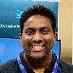









Syren Center of Excellence
Centre of Excellence
Domain + Business SMEs
Data Architects
Data Scientists
AI Engineers
Heena
(SCM + HLS US)
Anmol
(RSA - GCP and Migration expert)
Devanand Chintoju
(Program & SCL)
Bharat Meda
(AI-Engineering expert)
Nagesh
(RCPG + MANU APJ)
Shivam
(RSA - AWS and UC expert)
Mandeep Singh
(Optimization & OR)
Avinash
(AI Engineering Head)
Rohit
(SCM + MANU APJ)
Balaji
(RSA - Azure+ ETL expert)
Uday Pratap Rao
(DF & CPG AI)
Deepak Garg
(AI Engineering & Platform)
Harsha
(SCM + R-CPG APJ)
Vinay Chavan
(Lakehouse expert)
Haripriya Joshi
(Agentic AI & Recommendations)
Kedar
(BQ (GCP) AMER)
Mohamad Yaseen
(ML & Data Science)

Slide 9
Journey & Use cases in J&J​
© SYREN CLOUD INC – 2026 – ALL RIGHTS RESERVED

Slide 10
Our Journey within J&J – Enterprise & IM
Partnership Highlights
~125
Associates
15
Projects
5+
Years of partnership
300+ Supply Chain & Data engineering experts
Databricks, Microsoft – C& SI partnerships
Azure & AWS – Cloud partnerships
Delivered substantial savings by Optimization Techniques
Footprint Across Segments
Sustained near-perfect CSAT scores throughout
Network Decision Support Tool
Supplier Reliability Sandbox
Global Dist. Capacity Mgmt.
Data modernization
Exceptionally low attrition, retained talent & Org’s knowledge
CART Recommendation
CO2 Emissions
Workforce &
Real Estate Ops
One Performance Management
Built Natively on Databricks (Our solutions & platforms)
Global SC Services
Supply Chain Visibility Maps
Agent Alpha
Data Studio
DAP visualization
Risk sensing
Co-innovation on Data Fabric, Agent Alpha & Decision Intelligence
GTM
Supply Chain Resilience
Cost-to-Deliver (CTD)
Nerve Center
OTIF
Site-Level Operational Excellence
EQ Digital Products
Supply Chain Conversational Analytics
Control Tower
Data Quality Services
Dolphin
QuickBase Development
Project Futures
Architected a GenAI-powered risk intelligence platform consolidating fragmented risk data across 13 workstreams into one governed, real-time view — replacing spreadsheet-based, siloed tracking.
Designed a unified CEI structure and S×L scoring model, standardizing risk language across functions that previously had no shared taxonomy or RACI clarity.
Built automated signal ingestion and governance routing, cutting the reported 30–60 day lag from risk detection to leadership action down to real-time.
Delivered persona-based GenAI summarization and mitigation recommendations, while maintaining full ICH Q9 alignment and GxP compliance — currently in POC (Horizon 2) stage.
Analytics & Data Science
Supply Chain & Innovation SME
Business Intelligence
Footprint Across Segments
Enterprise
Innovative Medicine

Slide 11
Our Journey with J&J - Medtech
Footprint Across Segments
~50
Associates
Analytics & Data Science
Supply Chain & Innovation SME
Business Intelligence
10
Projects
Inventory Studio
CDL MD Curation
Track & Trace
Transcend- CDL MD Curation
Available-to-Promise (ATP)
MD DC Archetypes
MT MAPS
CDL MD Curation
Transcend- CDL MD Curation
Lab Capacity
5+
Years of partnership
Partnership Highlights
CDM L2- Common Data Management Layer
Designed and developed the L2 layer to support multiple initiatives across the organization, building on the L1 foundation.
Standardized KPI definitions (Inventory, Consensus Demand, Collaborative Demand, DOS, Shipments, and more) with relationships mapped across different L1 entities.
Implemented logging and monitoring capability to generate deep, actionable insights into L2 utilization backed by optimized ETL/ELT pipelines (Databricks Asset Bundles), Unity Catalog-based lineage/audit tracking, and self-healing pipelines with automated rollback.
CDL Medtech Curation – L1+
Established a shared enterprise data language via standardized, extensible schemas (entities, attributes, semantic metadata, relationships) published across the organization.
Unified data from all ERP sources so teams focus on business logic instead of repeating common transformation work.Modeled commonly used business concepts (Sales Orders, Delivery, Material Master) to simplify creation, aggregation, and analysis of data enterprise-wide.
Enabled a marketplace for static Excel/flat files and external systems, bringing ungoverned data sources into a managed structure.

Slide 12
With other Clients

Slide 13
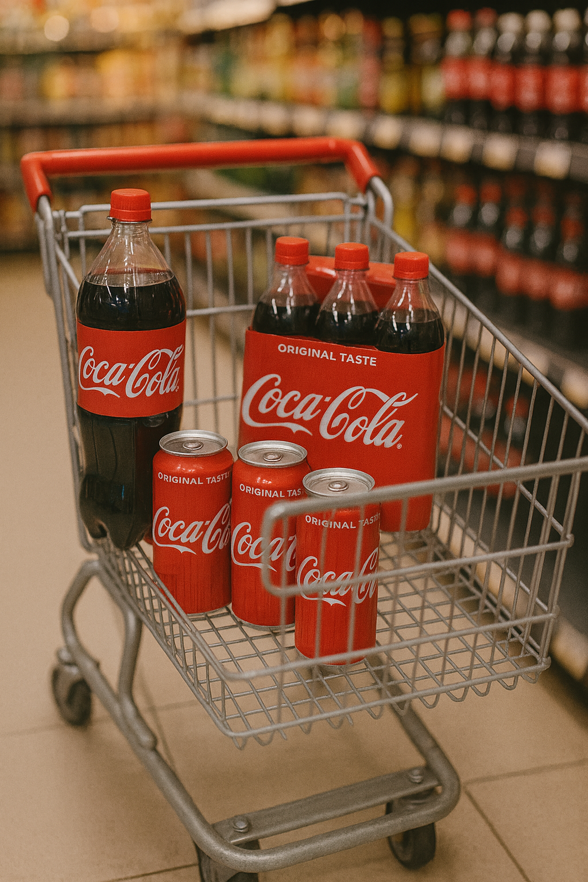

Perfect Basket Selection
Replenishment
Ensures core SKUs are always in stock based on demand and inventory data.
Business Impact
UC Volume - + 9.6%
SKUs / Order - +4 (12-16)
Strategic Cross-Sell / Up Sell
Identifies and introduces new SKUs to expand portfolio depth.
Daily / Monthly Basket
Must-Have SKUs
Mandates essential SKUs to maintain brand consistency and presence.
Model Performance
Adherence - 72%
SKU Recall - 74%
Adoption - 85%
NPD
Focuses on visibility and trial of new product launches.
Additional Feature Configuration
market-specific policies—pack restrictions, minimum order norms, delivery rules, and assortment guidelines
13

Slide 14







Sales Captain.AI
We envision an AI Field Sales Co-Worker that helps sales reps plan better visits, execute outlet actions and improve sales productivity with explainable guidance.
Spot high-potential outlets and risks early
Know which outlets need attention today
The best action for every outlet, explained
Sales Opportunity Signals
Daily Beat Prioritization
Next-Best Field Action
Governed data reps can act on
A view tailored to every field role
Trusted Sales Data
Sales Captain.AI
Role-Based App Experience
One view of every outlet, visit, target and sales opportunity
Execute in the app and continuously improve
Unified Outlet View
Act, Learn & Improve
14
Notes:
Plan today’s route with confidence Prioritise the right outlets first Understand each outlet before the visit Convert store-level insights into action Improve visit productivity and target achievement Give managers visibility into field execution

Slide 15
"Behind the Scenes: The Data Science Powering the Supply Chain"

Slide 16
AI-Powered Supply Chain Decision Intelligence
Sense
Predict
Optimize
Recommend
Agentic AI
What is happening?
"What will happen?"
What is the most effective ?
What should I do?
Can I automate?
Decision Intelligence Platform
Enterprise AI Accelerators
Demand Forecaster
Inventory
optimizer
Production
scheduler
Strategic Planning
Tactical Planning
Operational Execution
Autonomous Operations
Capacity
Optimizer
Transportation
Optimizer
Traceability
intelligence
Demand Planning
Inventory Planning
Network Planning
Capacity Planning
Production Scheduling
Transportation Planning
Warehouse Optimization
Replenishment Planning
Exception Management
Root Cause Analysis
Decision Recommendations
Scenario Analysis
Planning Agents
Inventory Agents
Manufacturing Agents
Executive Copilot
Supplier risk
intelligence
Digital twin
IoT Intelligence
Where Syren can help
Possible Challenge | Syren Capability
Device demand volatility | Demand intelligence
Sterilization capacity | Production & capacity optimization
Cold-chain and IoT monitoring | IoT intelligence
Possible Challenge | Syren Capability
Global inventory balancing | Multi-echelon inventory optimization
Product recalls | Traceability & root cause analysis
Supplier disruption | Supply risk intelligence
Executive trade-off decisions | Scenario planning & decision copilot
© SYREN CLOUD INC – 2026 – ALL RIGHTS RESERVED
16

Slide 17
Use case 1: Store Remodels Supply Chain for retail giant
The Right Store. The Right Time. The Right Plan. The Right Cost
Al-powered planning and execution intelligence to optimize the end-to-end store remodel lifecycle from portfolio strategy to project close-out.
STORE REMODEL LIFECYCLE
Portfolio Strategy
Design & Scope
Material Planning
Supplier & Procurement
Construction Execution
Close-out & Performance
Prioritize stores.
Assess ROI & impact
Scope definition
Design standards
Demand planning
Material take off
Supplier selection
Contracting
Ordering
Scheduling
Quality assurance
Post-remodel impact
700 stores annually
20,000 SKU's
$1B inventory flow
32 DC's
Hundreds of suppliers
2 consolidators

Slide 18
Store remodels Decision Intelligence Platform
DATA SOURCES
STORE REMODEL DECISION INTELLIGENCE PLATFORM
INTERNAL SYSTEMS
Store Master Data
Sales & Traffic Data
Financial Data (P&L)
Project History
Inventory & DC Data
Contractor Performance
Portfolio Prioritization
Demand & Material Planning
Supplier & Procurement Intelligence
Logistics & Distribution Planning
Project Execution& scheduling
Performance & Post-remodel Analytics
Store scoring
Financial modeling
Strategic fit
Scenario analysis
SKU & material forecast
Demand sensing
Substitution logic
Supplier segmentation
Capacity planning
Risk & reliability
Inbound material flow
DC allocation
Route optimization
Resource leveling
Critical path mgmt.
Crew & trade planning
Sales lift measurement
Traffic & conversion
ROI tracking
Lessons learned
EXTERNAL DATA
Market & Demographics
Competitor Activity
Economic Indicators
Weather & Seasonality
TECHNOLOGY & IoT
Store Sensors
Energy & Equipment Data
Building Condition
Powered By ML
Powered By ML Forecasting
Powered By
ML & Risk Models
Powered By
Network Optimization
Powered By
ML Models
Powered By Cause & Effect Analytics
Explainable Ai & Recommendations
SUPPLIER DATA
Supplier Capacity
Lead Times
Performance Scores
Cost Index
Why this recommendation?
What is the expected impact
Confidence level
Trade – off
Analysis
Scenario comparison
What should I do next?
Decision API Layer
Secure, Governed Scalable APIs for all Decision Services
OPTIMIZATION & AI METHODS
DIGITAL TWIN FOR REMODELS
Machine Learning
Optimization
Constraint Programming
Simulation & Scenario Analysis
Natural Language Processing
Real-time Project Data
Demand Forecasting
Store Scoring
Cost Forecasting
Risk Prediction
Sales Uplift Modeling
Portfolio Optimization
Material Allocation
Supplier Selection
Logistics Optimization
Budget Optimization
Project Scheduling
Resource Levelling
Trade Sequencing
Dependency Mgmt.
Crew Planning
What-if Scenarios
Disruption Modeling
Capacity Simulation
Financial Scenarios
Document Extraction
Contract Analysis
Vendor Feedback
Risk Monitoring
What –if Scenarios
Simulation Engine
Decision Engine
Optimization Engine

Slide 19

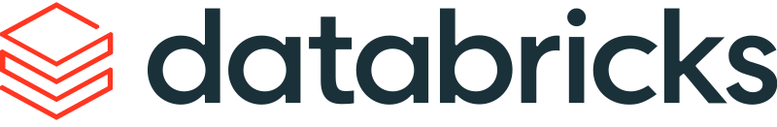
Business Impact
Business Impact
ON-TIME COMPLETION
↑20-25%
COST SAVINGS
↑8-11%
MATERIAL WASTE
↓10-20%
SUPPLIER PERFORMANCE
↑5-10%
SALES UPLIFT (POST REMODEL)
↑5-12%
KEY CAPABILITIES
TECHNOLOGY STACK
END-TO-END VISIBILITY Unified view across portfolio, projects, suppliers, materials, and performance.
AI-POWERED OPTIMIZATION Right stores, right plan, right resources, right time.
PROACTIVE RISK MANAGEMENT Identify and mitigate risks in cost, schedule, and supply.
FRESHER STORES, BETTER EXPERIENCE Drive sales, improve customer satisfaction, and brand perception.
DATA-DRIVEN GOVERNANCE Measure ROI, learn continuously, and improve future remodels.
CLOUD & DATA PLATFORM
INTEGRATION LAYER
Cloud Data Lake
Data Warehouse
Feature Store
Streaming Ingestion
Data Governance
Analytics Workbench
ERP Integration
Project Mgmt. Tools
BIM & Design Tools
TMS/Logistics Tools
Finance Systems
KEY PERFORMANCE INDICATORS
Forecast Accuracy (MAPE)
One Time
Completion (%)
Cost variance(%)
Material Waste (%)
Supplier OTIF (%)
Sales Uplift(%)
ROI (%)
Budget Adherence(%)

Slide 20
Use case 2: AI - Driven Decision Intelligence For Dairy Manufacturing plant
Optimizing Freshness, Production, and Supply Chain Performance End-to-End
From milk to customer: Al, Optimization and Digital Twins powering every decision across the dairy value chain
Dairy Supply Chain Overview
Milk procurement
Raw milk storage
Pasteurization
Packaging & filling
Cold storage
Distribution centres
Retail Stores
Farm Network
Quality & Testing
Milk Collection
Quality Analysis
Temperature Control
Milk Reception
Heat Treatment
Safety Assurance
Standardization
Bottles, Cartons, Pouches
Packaging Lines
Quality Check
Finished Goods Storage
Temperature Control
Shelf-life Management
Cross Docking
Route Planning
Load Optimization
Fresh Availability
In-Store Execution
Customer Satisfaction

Slide 21
Dairy Decision Intelligence Platform
DATA SOURCES
DAIRY DECISION INTELLIGENCE PLATFORM
Enterprise Systems
ERP (Finance, MM, PP, SD)
MES/MOM
WMS/Inventory
LMS/Quality Systems
Demand Forecasting
Inventory Optimization
Production Planning
Production Scheduling
Labor Scheduling
Distribution Planning
Freshness & Shelf-life
IOT & SENSORS
Temperature/Humidity
Flow Meters
Equipment Health
Cold Chain Monitoring
Stone/DC/SKU Level
Hierarchical Forecasts
Probabilistic Forecasts
Promo & Event impact
Multi-echelon Inventory
Safety Stock Optimization
Shelf-life Aware Policies
FOFO/FIFO Strategies
What to Produce
How much
Which Day
Capacity & Ingredient Alignment
Which Line
Which Sequence
Start Times
Changeovers
CIP Windows
Shift Planning
Skill Matching
Labor Standards
Overtime Control
Load Buliding
Route Optimization
Temperature Compliance
On-time Delivery
Shelf-life Tracking
Age-based Allocation
Spoilage Prediction
Freshness Index
Operational Data
Production Runs
Downtime & CEE
Labor & Shift Data
Cleaning (CIP) Cycles
Powered By ML Forecasting
Powered By ML + Optimization
Powered By Optimization (MILP)
Powered By CP/MILP/GA
Powered By Optimization (MILP)
Powered By Network Optimization
Powered By ML + Optimization
Explainable AI & Intelligent Recommendations
EXTERNAL DATA
Weather Forecast
Holidays & Events
Promotions
Market & Demographics
Why this recommendation?
What is the expected impact
Confidence level
Trade – off
Analysis
What should I do next?
Decision API Layer
Secure, Governed, Scalable APIs for Seamless Integration with SAP & Executive Systems
OPTIMIZATION & AI METHODS
DIGITAL TWIN ARCHITECTURE
Mixed Integer Linear Programming (MILP)
Constraint Programming (CP)
Genetic Algorithms (GA)
Machine Learning
Statistical Models
Real – time Data
Production Planning
Inventory Optimization
Labor Planning
Transportation Planning
Production Scheduling
Sequence Optimization
Changeover Constraints
CIP Scheduling
Sequence Optimization
Setup Minimization
Batching Prediction
Large Search Spaces
Demand Forecasting
Yield Prediction
Spoilage Prediction
Anomaly Detection
Time Series Models
Survival Analysis (Shelf-life)
Regression &
Classification
What –if Scenarios
Simulation Engine
Decision Engine
Optimization Engine

Slide 22
Business Impact
Business Impact
SERVICE LEVEL (OTIF
↑10-15%
PRODUCTION EFFICIENCY
↑8-12
SPOILAGE / WASTE
↓ 15-30%
INVENTORY DAYS
↓10-20%
LABOR PRODUCTIVITY
↑15-25%
COST TO SERVE
↓8-12%
FRESHNESS INDEX
↑10-20%
KEY CAPABILITIES
TECHNOLOGY STACK
END-TO-END OPTIMIZATION Coordinated planning from milk intake to store delivery with freshness constraints
FRESHNESS-FIRST APPROACH Shelf-life aware optimization to maximize freshness and minimize waste
CONSTRAINT-AWARE SCHEDULING Finite capacity, sequence dependent setup, CIP cleaning, packaging constraints
DIGITAL TWIN & SCENARIO PLANNING Simulate demand spikes, equipment failures, supply disruptions, and what if scenarios
EXPLAINABLE & TRUSTED AI Transparent recommendations with business logic, drivers and confidence
REAL-TIME & ADAPTIVE Continuously learn and adapt to changing conditions and sensor and sensor data
CLOUD & DATA PLATFORM
ERP INTEGRATION
Azure Data Factory
Azure Data Lake
Azure Databricks
Azure Machine Learning
Azure Kubernetes Service
Power Bl
SAP S/4HANA
SAP ISP (Optional)
SAP EWM / TM
SAP Analytics Cloud
IoT Hub / Event Hub
KEY PERFORMANCE INDICATORS
Forecast Accuracy (MAPE)
OTIF (%)
Spoilage & of Sales
Inventory Turns
(Turns/Year)
Capacity Utilization (%)
Schedule Adherence (%)
Cost per Liter ($)
Freshness Index(0-100)

Slide 23
Use case 3: AI - Driven Decision Intelligence For Beef Manufacturing plant
Optimizing Yield, Production, and Supply Chain Operations End-to-End
Transforming complex meat supply chains into a coordinated, optimized, and intelligent decision ecosystem
Beef Supply Chain Overview
Livestock Procurement
Harvesting
Fabrication
Sub-primal Processing
Packaging
Cold Storage
Distribution Centers
Retail Stores
Supplier Network
Quality & Grade
Planning
Slaughter Planning
Carcass Data
Grading
Primal Cutting
Yield Capture
Traceability
Bone-in/Boneless
Trimming
Value Addition
Portioning
Packaging
Labeling
Inventory Aging
Temperature Control
Shelf Life
Replenishment
Cross Docking
Routing
Fresh Availability
In-Store Execution
Customer Satisfaction

Slide 24
Decision Intelligence Platform
DATA SOURCES
DECISION INTELLIGENCE PLATFORM
Enterprise Systems
ERP (SAP, Oracle, etc.)
MES/Production Data
WMS/Inventory Data
QMS/Quality Data
Demand Forecasting
Yield
Prediction
Raw Material Optimization
Production Planning
Production Scheduling
Inventory Optimization
Logistics Optimization
OPERATIONAL DATA
Line Performance
Downtime & OEE
Yield & Trim Data
Labor & Shift Data
Store-Level Forecasts
Hierarchical Models
Probabilistic Forecasts
Promo & Event impact
Carcass to Cut Yield
Primal/Sub-Primal
Quality Grade Impact
ML Yield Models
Which Cattle to Run
Maximize Expected Yield
Cost & Availability
Supplier Selection
What to Produce
How Much
Which Day
Demand & Capacity
Alignment
Which Line
Which Sequence
Start Times
Changeovers
Cleaning
Plant, DC & Store
Inventory
Freshness-Aware
Multi-Echelon
Service vs Cost
Load Building
Routing
Temperature
Compliance
On-Time Delivery
IOT & SENSORS
Temperature/Humidity
Equipment Health
Cold Chain Tracking
ML MODELS
XGBoost, TFT, LSTM Prophet, Croston
ML MODELS
GBM, Random Forest Neural Networks
OPTIMIZATION
MILP
OPTIMIZATION
MILP
OPTIMIZATION
CP/MILP/Genetic Algorithms
OPTIMIZATION
MILP
OPTIMIZATION
Network Flow
EXPLAINABLE AI & RECOMMENDATIONS
EXTERNAL DATA
Weather
Holidays & Events
Promotions
Market & Price Signals
Why this recommendation?
What is the expected impact
Confidence level
Trade – off
Analysis
Scenario
Comparison
Decision Api Layer
Seamless Integration with ERP & Execution Systems=
OPTIMIZATION METHODS
DIGITAL TWIN ARCHITECTURE
Mixed Integer Linear Programming (MILP)
Constraint Programming
Genetic Algorithms & Metaheuristics
Network Flow Optimization
Monte Carlo Simulation
Real – time Data
Production Planning
Raw Material Optimization
Inventory Optimization
Labor Planning
Finite-Capacity Scheduling
Sequence Optimization
Changeover Constraints
Cleaning Windows
Complex Sequence
Optimization
Large Search Spaces
Near Optimal Solutions
Transportation
Multi-Echelon Inventory
Distribution Planning
Capacity Balancing
Uncertainty Quantification
Risk Analysis
Service Level
Evaluation
What –if Scenarios
Digital Twin
Simulation Engine
Decision Engine
Optimization Engine

Slide 25
Business Impact
Business Impact
SERVICE LEVEL (OTIF)
↑12-18%
YIELD UTILIZATION
↑3-6%
SPOILAGE / WASTE
↓15-25%
INVENTORY DAYS
↓10-20%
LINE UTILIZATION
↑10-15%
PLANNER PRODUCTIVITY
↑50%+
TOTAL COST TO SERVE
↓8-12%
KEY CAPABILITIES
TECHNOLOGY STACK
END-TO-END OPTIMIZATION
Coordinated planning from procurement to store replenishment
YIELD & QUALITY INTELLIGENCE
ML models predict yields at multiple levels product mix
CONSTRAINT-AWARE SCHEDULING
Finite capacity, changeovers, labor and cleaning constraints
FRESHNESS-FIRST APPROACH
Optimize for shelf life, minimize waste maximize freshness
SCENARIO PLANNING
Simulate demand spikes, supply disruptions, equipment failures
DIGITAL TWIN
Virtual plant simulation for what-if analysis and continuous improvement
CLOUD & DATA PLATFORM
ERP INTEGRATION
Azure Data Factory
Azure Data Lake
Azure Databricks
Azure Machine Learning
Azure Kubernetes Service
Power Bl
SAP S/4HANA
SAP ISP (Optional)
SAP EWM
SAP TM
SAP Analytics Cloud
KEY PERFORMANCE INDICATORS
Forecast Accuracy (MAPE)
Yield Accuracy (%)
OTIF (%)
Spoilage & of Sales
Inventory Turns
(Turns/Year)
Capacity Utilization (%)
Schedule Adherence (%)
Cost per Pound ($)
Gross Margin (%)

Slide 26

Use case 4: Journey from Reactive to Prescriptive Asset Maintenance
Asset Health
Get a 360-degree view to asset lifecycle history and health ​
Capability | Focus Area | Business Impact | Primary KPI
Asset Health | Continuous asset condition monitoring | Improve equipment reliability and availability | Asset Health Score, Uptime %, MTBF
Reactive Alerts | Real-time anomaly detection | Reduce response time and minimize production disruptions | Alert Response Time, MTTR
Predictive Alerts | Failure prediction & early warning | Prevent unplanned downtime and maintenance costs | Failure Prediction Accuracy, Downtime Avoided
Prescriptive & Root Cause Analysis | AI-driven diagnosis & action recommendations | Faster root cause identification and optimized maintenance | RCA Time, First-Time Fix Rate
Agentic Alerts | Autonomous monitoring, prioritization & execution | Eliminate manual intervention and accelerate resolution | Autonomous Resolution %, Time Saved
Reactive Alerts
Detect issues in real time and notify teams for immediate action.
Predictive Alerts
Forecast potential failures before they occur using AI-driven insights..
Prescriptive Alerts & Root cause Analysis
Identify root causes and recommend the best corrective actions to minimize downtime.
Agentic alerts and Task management
Autonomous AI agents prioritize, investigate, and initiate actions without manual intervention.
Monitor → Detect → Predict → Recommend → Act → Execute

Slide 27



Thank you
www.syrencloud.com
Follow Us:

Slide 28
Case Study 3: Journey from Reactive to Prescriptive Supply Chain Decisions – Goal to Optimal Supply Chain
Advanced Analytics – Control Tower
Ensures core SKUs are always in stock based on demand and inventory data.
Stage | Focus Area | Core Business Impact | Primary KPI
Control Tower | Core SKU Availability | Eliminates stockouts and slashes premium freight costs. | 99% SKU Availability
Demand & Forecast | Portfolio Expansion | Captures missed revenue by accurately scaling new SKUs. | Forecast Accuracy
Inventory & Process Optimization | Brand Consistency | Lowers holding costs while securing mandatory shelf presence. | Inventory Turnover
Promo & Pricing | Margin Gains | Stops profit leakage via data-driven, dynamic pricing. | Gross Margin %
Agentic Orchestration | Self-Healing Decisions | Minimizes cost-to-serve through automated execution loops. | Cycle Time & Labor
Demand planning and forecast
Understands demand and Identifies and introduces new SKUs to expand portfolio depth.
End to End Supply Chain Management
Inventory & Process optimization
Mandates essential SKUs to maintain brand consistency and presence.
Recommendation
Recommend Actions
Agentic orchestration
Automate intelligent actions

Slide 29
Appendix

Slide 30
Our Journey with J&J
Partnership Highlights
~230
Associates
150+
Programs
5+
Years of partnership
300+ Supply Chain & Data engineering experts
Databricks, Microsoft – C& SI partnerships
Azure & AWS – Cloud partnerships
Delivered over $75M in value — and counting
Sustained near-perfect CSAT scores throughout
Network Decision Support Tool
Supplier Reliability Sandbox
CDL MD
Curation
Transcend- CDL MD Curation
Workforce &
Real Estate Ops
Global Distt. Capacity Mgmt.
CART Recommendation
CO2 Emissions
Agent Alpha
Data Studio
DAP visualization
Data modernization
Exceptionally low attrition, retained talent & Org’s knowledge
Inventory Studio
Supply Chain Visibility Maps
Cost-to-Deliver (CTD)
Moris
Transcend
One Performance Management
Built Natively on Databricks (Our solutions & platforms)
Global SC Services
Available-to-Promise (ATP_
Control Tower
Data Quality Services
OTIF
Risk sensing
Co-innovation on Data Fabric , Agent Alpha & Decision Intelligence
GTM
Supply Chain Resilience
Track & Trace
MD DC Archetypes
Dolphin
Site-Level Operational Excellence
EQ Digital Products
Supply Chain Conversational Analytics
MT MAPS
Nerve Center
Lab Capacity
QuickBase Development
Analytics & Data Science
Supply chain & Innovation SME
Business Intelligence
Footprint Across Segments
Enterprise
Med Tech
Innovative Medicine

Slide 31
With other Clients
2026

Slide 32
Journey to Maximize Gross Margins using Pricing 360
(Pricing, Promo and Mark down)
We reduce promotional waste by identifying which promotions drive incremental sales
Optimization Goal: Maximize Gross Margin Dollars
Optimization algorithm
Mixed Integer Programming
Reinforcement Learning
Constraint Optimization
Subject to: Revenue targets ,Inventory targets ,Brand constraints
Current retailers’ decision making
Promotion Team → Runs Promotion → Merchants → Observe Results → Inventory Team→ Panics → Markdown Team → Clears Excess Inventory
5
layered product
architecture
Layer 1: Data Foundation
Layer 2: Demand Intelligence
Future decision making
Layer 3: Pricing Intelligence
Forecast Demand → Predict Inventory Risk → Optimize Promotions → Monitor Response → Optimize Markdowns → Maximize Margin
Layer 4: Optimization Engine
Layer 5: Decision Applications

Slide 33
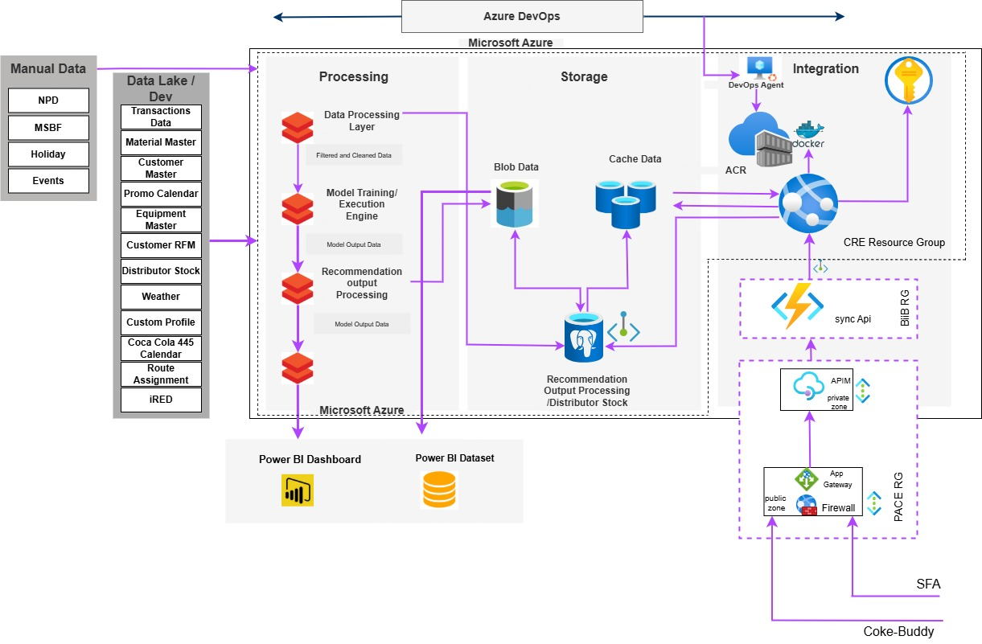
Suggested Order Architecture
The SO platform combines enterprise data, advanced analytics, machine learning, and business rules to generate scalable and actionable recommendations that can be consumed through existing business applications.
PACE
Aling Cora

Slide 34
DE & UI/UX Capabilities​
2026

Slide 35
Expertise in Data Engineering
Eight competencies from architecture to insight delivery — all managed
Your team focuses on decisions, not infrastructure
Planning, Architecture & Design
Architecture blueprints & stack selection
Cloud migration strategy & scalability planning
Data Ingestion & Integration
200+ connectors: ERP, CRM, IoT, syndicated
Batch, real-time & CDC · full-fidelity replay
Lakehouse Implementation
Delta / Iceberg / Hudi · cloud-agnostic
Time-travel · open formats · full history
Data Modelling & Semantic Layer
Medallion in dbt · semantic layer · feature store
Gold tier certified · self-serve APIs
Data Quality & Contracts
ML + rule-based checks via Optima DQ
Contract-first SLAs · enforced accountability
Observability & Field Lineage
100% field-level lineage · freshness & drift
Per-pipeline cost tracking · alerts before impact
Custom Dashboard & BI Development
Executive dashboards & data storytelling
Self-serve analytics from your Gold layer
Strategic Insights by Senior BAs
KPI definition & decision frameworks
Data capabilities → business roadmaps
Overcome key challenges to unlock the full potential of data-driven transformation and achieve impactful business outcomes.

Slide 36
Expertise in Software Engineering
Scalable, compliant & user-centric platforms
Built for the next use case — not rebuilt in three years
Application Development
Custom supply chain & data-driven applications
Serverless, micro-frontend · enterprise scale
Mobile Development
iOS & Android for field, logistics & supply chain
On-the-go visibility & control
DevOps & Site Reliability
CI/CD · IaC · 99.9% reliability SLA
We own uptime — not just deployment
IoT Integration
Devices & sensors wired into your data platform
Real-time edge signals governed & routed
Testing Excellence
Jest, Robot & JMeter automated testing
90%+ coverage — the standard, not the aspiration
Human-Centric Design
WCAG-compliant · Figma & Material UI
Designed around actual user workflows
Cloud-Native Solutions
Azure, AWS & GCP · cloud-native patterns
Genuine scalability & proactive monitoring
Compliance-Driven Development
GxP & SOX-compliant · validated workflows
Audit-ready code from day one
Proprietary Accelerators
Monitoring, telemetry & auth frameworks
Reused across engagements — no reinvention
Complexity to Clarity — Platforms built to last, not projects delivered once. Multi-cloud, 99.9% reliability, NPS 80.

Slide 37
DS & Agentic AI Expertise
2026

Slide 38
Transforming Supply Chains: From Prediction to Autonomous Action
Optimize
Simulate
Recommend
Automate
Predict
Operations Research
Digital Twins
GenAI + Analytics
Agentic AI
Maximize service level, minimize operational cost
Model what-if scenarios before committing
Grounded, cited recommendations at speed
Sense signals, plan & execute autonomously
Machine Learning
Forecast demand from historical & real-time data
Demand Forecasting
Inventory Optimization
Route/Schedule Optimization
Customer Segmentation (RFM-R)
S&OP Orchestration
Inventory Risk Forecasting
Network Optimization
AI control tower
Portfolio & Market Strategy
Demand Planning Agent
Site Selection engine
Cost to Serve Optimization
Trade Promo Simulation
Next Best Action
Predictive Maintenance
Improved Forecasting Accuracy
Reduced Inventory & Working capital
Lower logistic cost
Improved Resilience & OTIF
Increase productivity
Notes:
We help global manufacturers transform supply chain decisions using AI, Optimization and Agentic Intelligence.

Slide 39
Intelligence that acts — Governed at every step
Governed sense → reason → plan → execute loop
Ingest
IoT, CRM, ERP & market signals in real-time
Ground
Graph RAG 2.0 fuses SOPs, policies & structured data
Rank
Cited scenario actions — every recommendation traceable
Execute
AI-as-Judge gated write-back. Human-in-the-loop for high stakes.
Sense
Reason
Plan
Act
Data Agent
Queries governed lakehouse · structured outputs
Native ERP, IoT & CRM calls — no hand-off
Knowledge Agent
RAG over SOPs, policies & regulatory docs
Every output cited · zero hallucinations
Action Agent
Writes back to ERP, CRM & operational systems
AI-as-Judge gated · human-in-the-loop

Slide 40
Technical competencies that separate Governed AI from Experiments
Multi-Agent Architecture
Data, Knowledge & Action agents by role
Planner → Reasoner → Governance · MCP & A2A
Graph RAG 2.0
SOPs, policies & structured data fused
Grounded, cited · zero hallucinations
Tool Use & API Integration
Native calls to ERP, CRM, IoT & DBs
Tool-use verification · audit logged
AI-as-Judge Governance
Quality gate before every write-back
Configurable risk thresholds per domain
Memory Management
Short-term context per session
Long-term recall · role-bounded
Prompt Engineering & Versioning
Versioned prompts · A/B testing · token budgets
Semantic caching — 40–60% cost reduction
Continuous Evaluation (RAGAS)
RAGAS scoring on every deployment
No agent goes live without passing evaluation
Drift Detection & Auto-Retrain
Feature, data & concept drift in <4 hours
Shadow/canary before full production swap
Regulatory AI Compliance
FDA AI · EU AI Act · 21 CFR Pt 11 aligned
Audit trails · bias reports · runtime guardrails
Domain AI Agents In Production
S&OP Orchestrator
Consensus in <48 hrs
GxP Quality & CAPA
21 CFR Pt 11 aligned
PV Signal & Safety
24/7 adverse-event triage
Demand
Planning
Causal sensing + promo
Predictive Maintenance
Failure 7–10 days ahead
HCP / KOL NBA
Compliant omnichannel
© SYREN CLOUD INC – 2026 – ALL RIGHTS RESERVED
40

Slide 41
Journey to Maximize Gross Margins
Optimization Goal: Maximize Gross Margin Dollars
(Pricing, Promo and Mark down)
We reduce promotional waste by identifying which promotions drive incremental sales
Optimization algorithm
Mixed Integer Programming
Reinforcement Learning
Constraint Optimization
Subject to: Revenue targets ,Inventory targets ,Brand constraints
Current retailers’ decision making
Promotion Team → Runs Promotion → Merchants → Observe Results → Inventory Team→ Panics → Markdown Team → Clears Excess Inventory
5
layered product
architecture
Layer 1: Data Foundation
Layer 2: Demand Intelligence
Future decision making
Layer 3: Pricing Intelligence
Forecast Demand → Predict Inventory Risk → Optimize Promotions → Monitor Response → Optimize Markdowns → Maximize Margin
Layer 4: Optimization Engine
Layer 5: Decision Applications

Slide 42
Supply & Commercial DS &Agentic Usecases
2026

Slide 43
AI-Powered Supply Chain Decision Intelligence
Supply Chain decision Framework
Sense
What is happening?
Predict
"What will happen?"
Optimize
What is the most effective ?
Recommend
What should I do?
Agentic AI
Can I automate?
Decision Intelligence Platform
Enterprise AI Accelerators
Demand sensing
& Forecasting
Inventory
Optimization
Network
Optimization
Strategic Planning
Tactical Planning
Operational Execution
Autonomous Operations
Capacity
Optimization
Transportation
Optimization
Traceability
intelligence
Demand Planning
Inventory Planning
Network Planning
Capacity Planning
Production Scheduling
Transportation Planning
Warehouse Optimization
Replenishment Planning
Exception Management
Root Cause Analysis
Decision ]
Recommendations
Scenario Analysis
Planning Agents
Inventory Agents
Manufacturing Agents
Executive Copilot
Supplier risk
intelligence
Digital twin
IoT Intelligence
Where Syren can help
Possible Challenge | Syren Capability
Device demand volatility | Demand Intelligence
Sterilization capacity | Production & Capacity Optimization
Cold-chain and IoT monitoring | IoT Intelligence
Possible Challenge | Syren Capability
Global inventory balancing | Multi-Echelon Inventory Optimization
Product recalls | Traceability & Root Cause Analysis
Supplier disruption | Supply Risk Intelligence
Executive trade-off decisions | Scenario Planning & Decision Copilot
© SYREN CLOUD INC – 2026 – ALL RIGHTS RESERVED
43
Notes:
We build Decision Intelligence platforms that help supply chain leaders make better decisions—from sensing and prediction through optimization, recommendation, execution, and continuous learning. Our reusable accelerators shorten time to value, and our approach is readily adapted to MedTech, where service, compliance, and resilience are mission-critical

Slide 44
Supply Chain Decision Intelligence Platform
Architecture Layers
Layer 5
Business Outcomes
Measurable improvements in inventory, OTIF, service, & savings
AI Agents
Automated agents:
Demand Agent
Inventory Agent
Logistics Agent
Supplier Agent
Risk Analytics
Layer 4
Decision Intelligence Engine
Layer 3
Al and simulation tools:
Forecasting Al
Optimization Engine
Digital Twin
Scenario Simulation
Risk Analytics
Data Foundation
Layer 2
Centralized data repository for orders, inventory, and shipments
Layer 1
Enterprise Systems
Connect to Core business applications like SAP & Oracle

Slide 45
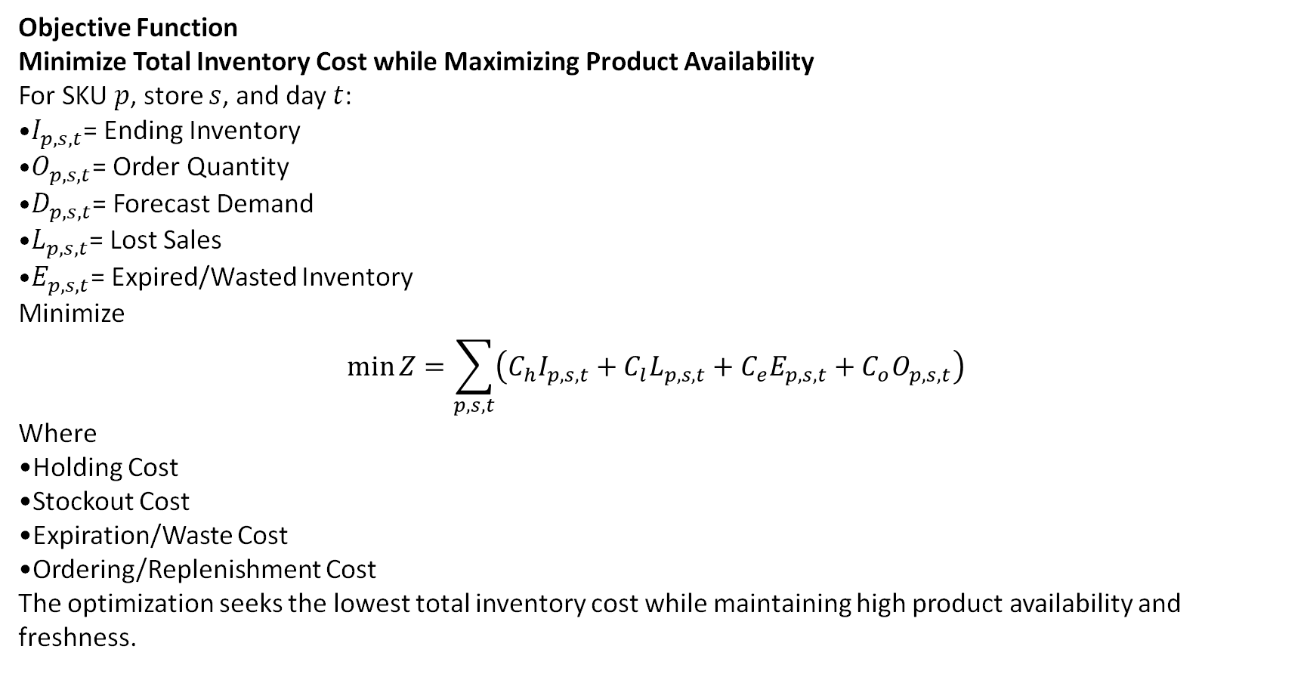
Inventory Optimization formulation for grocery store
Objective Function
Minimize Total Inventory Cost while Maximizing Product Availability
For SKU $p$, store $s$, and day $t$:
$I_{p,s,t}$= Ending Inventory
$O_{p,s,t}$= Order Quantity
$D_{p,s,t}$= Forecast Demand
$L_{p,s,t}$= Lost Sales
$E_{p,s,t}$= Expired/Wasted Inventory
Minimize
$$\min{Z}=\sum_{p,s,t}{\left(C_{h}I_{p,s,t}+C_{l}L_{p,s,t}+C_{e}E_{p,s,t}+C_{o}O_{p,s,t}\right)}$$
Where
Holding Cost
Stockout Cost
Expiration/Waste Cost
Ordering/Replenishment Cost
The optimization seeks the lowest total inventory cost while maintaining high product availability and freshness.

Slide 46
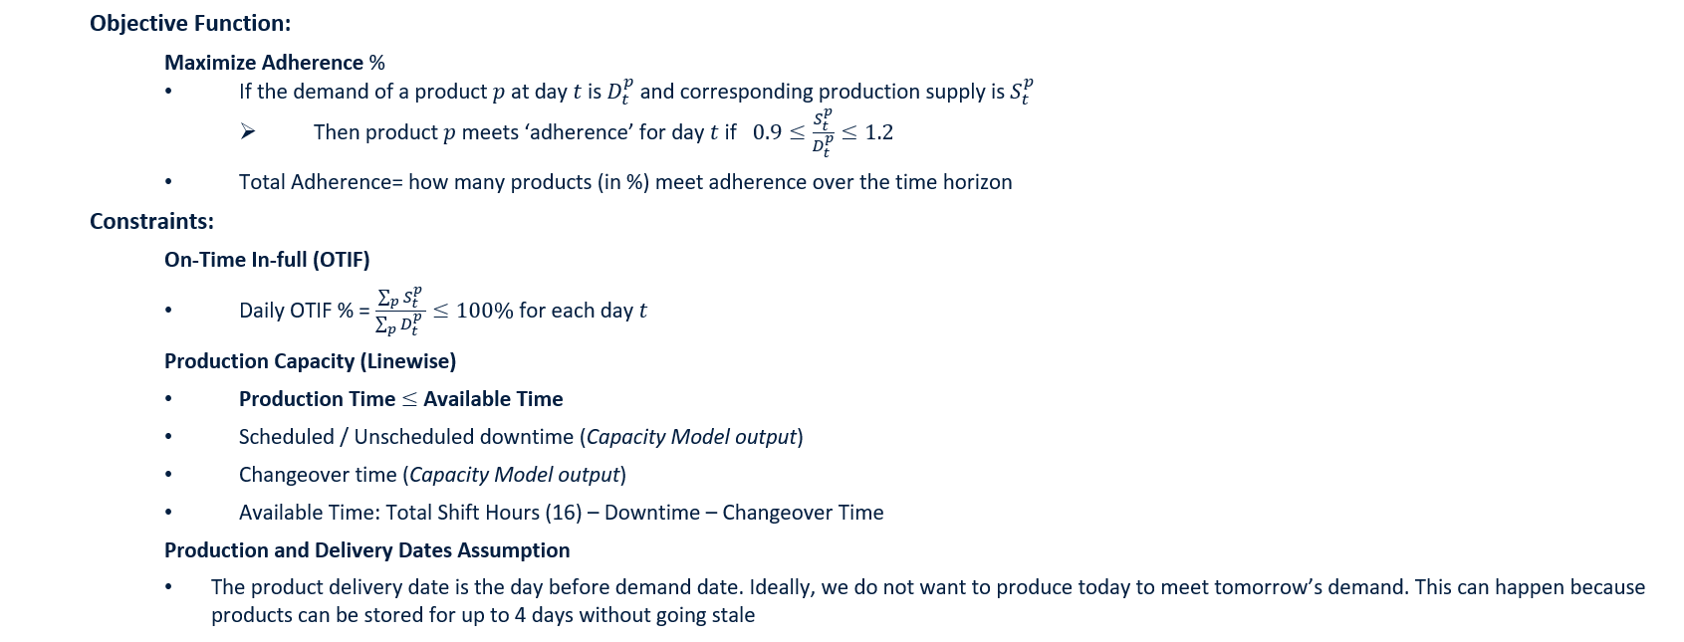
Manufacturing plant: Scheduling problem formulation

Slide 47
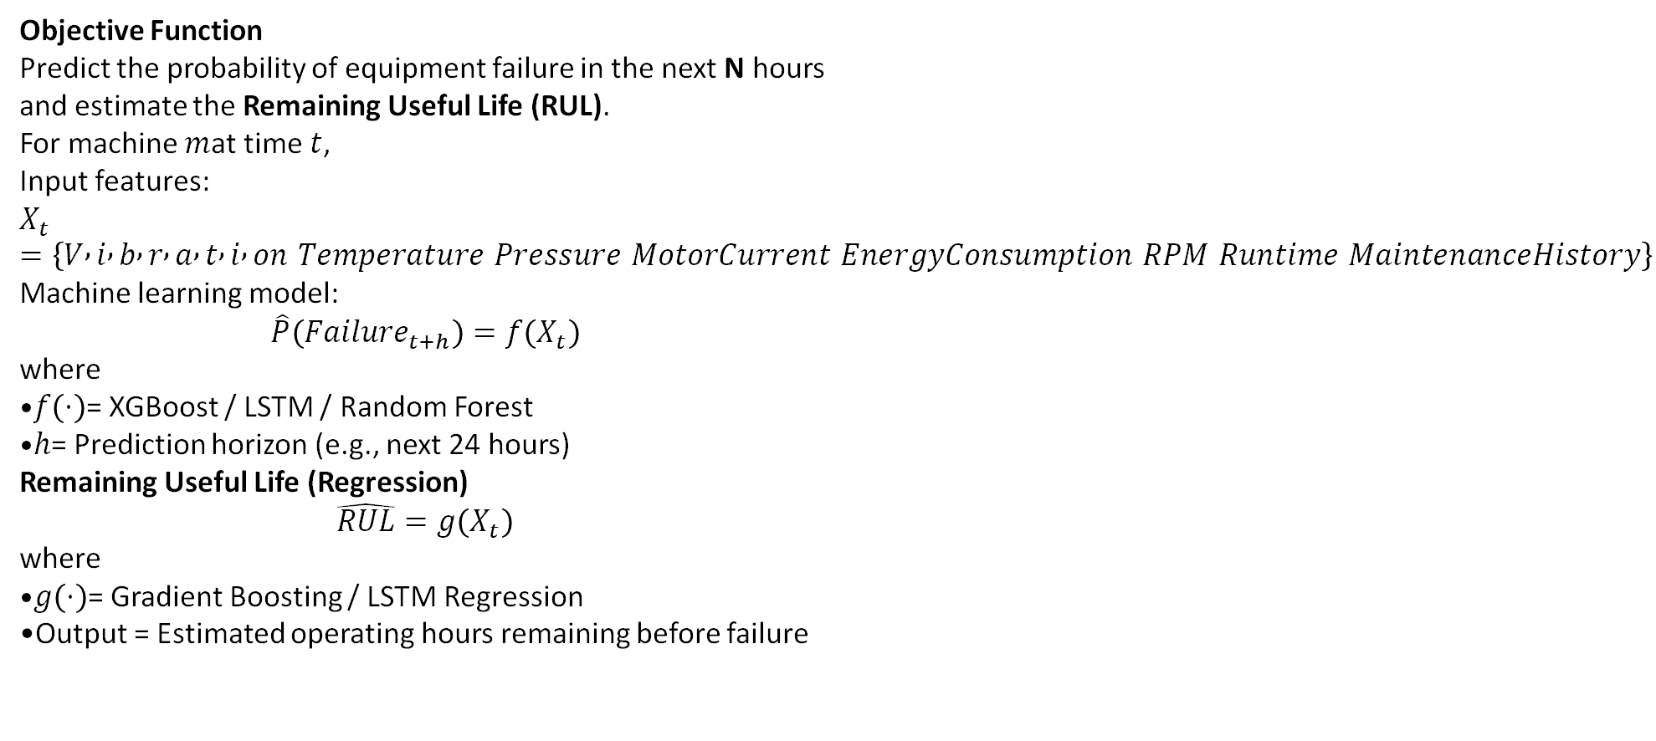
Predictive Maintenance (Machine Learning Formulation)
Objective Function
Predict the probability of equipment failure in the next N hours and estimate the Remaining Useful Life (RUL).
For machine $m$at time $t$,
Input features:
$$X_{t}=\left\{V , i , b , r , a , t , i , on Temperature Pressure MotorCurrent EnergyConsumption RPM Runtime MaintenanceHistory\right\}$$
Machine learning model:
$$\hat{P}\left(Failure_{t+h}\right)=f\left(X_{t}\right)$$
where
$f\left(⋅\right)$= XGBoost / LSTM / Random Forest
$h$= Prediction horizon (e.g., next 24 hours)
Remaining Useful Life (Regression)
$$\hat{RUL}=g\left(X_{t}\right)$$
where
$g\left(⋅\right)$= Gradient Boosting / LSTM Regression
Output = Estimated operating hours remaining before failure

Slide 48
Case Study 1: Inventory Optimization
Eliminating Distribution Center Stock-outs through AI-Driven Multi-Echelon Inventory Optimization
Challenge
Solution
Outcome
High SKU-level stock-outs across DC network
Excess inventory with poor allocation
Static replenishment rules ignored demand variability
Manual planning unable to optimize network inventory
Key Challenge
Balance service level, inventory cost and replenishment decisions across multiple echelons simultaneously.
AI + Operations Research Decision Engine
Unified demand, inventory & supply data
ML models predicted demand and stock-out risk
XG-Boost demand forecasting
Probabilistic demand forecasting
Inventory Optimization using Operations Research
Multi-Echelon Inventory Optimization
Mixed Integer Linear Programming
Optimized safety stock, replenishment & inventory allocation
Safety Stock Optimization
Explainable recommendations delivered through planner dashboard
Business Impact
Significant reduction in DC stock-outs
Higher product availability & customer service
Lower network inventory and working capital
Faster, data-driven replenishment decisions
Stock-outs
Service Level
Working Capital
Planner Productivity

Slide 49
Case Study 2: Scheduling Optimization
AI-Driven Production Scheduling Optimization for a Manufacturer
Challenge
Solution
Outcome
Frequent production schedule changes and firefighting
High changeover losses reducing line utilization
Capacity constraints during peak demand periods
Manual scheduling unable to balance competing priorities
Key Challenge
Complex setup/changeover constraints
Labor, maintenance and raw material availability limitations
AI + Operations Research Decision Engine
ML models predicted
Demand forecasting (XGBoost & Time Series Models)
Production bottleneck prediction
Capacity utilization forecasting
Inventory Optimization using Operations Research
Finite Capacity Scheduling
Sequence & Changeover Optimization
Multi-objective Production Optimization
Decision Intelligence
AI-generated production schedules
Dynamic schedule optimization
What-if scenario simulation
Business Impact
Optimized production schedules across manufacturing plants
Improved manufacturing throughput and resource utilization
Reduced production changeovers and scheduling conflicts
Enhanced schedule stability and planning agility
Optimized Production Scheduling
Capacity Utilization
AI-Powered Intelligence
Manufacturing Efficiency

Slide 50
Thank You​
2026

Slide 51
Managed Intelligence Services
Your Data, AI, and Software partner - end to end.
We build, operate, and evolve your data foundation, intelligence models, AI agents, and enterprise software
One partner accountable for the full stack — from raw ingest to autonomous decisions
60% Cost-to-serve reduction | 50+ DS use cases in production | 99.2% Trusted data | 99.9% Software reliability | 80 NPS score | 30% Faster time-to-market
Raw Signals
Autonomous AI Decisions
June 2026

Slide 52
Five Challenges Enterprises haven't solved well. Until now.
Regulated AI with no accountability
Data you can't trust
Five vendors, zero accountability
Decisions still run at human speed
ML that never reaches production
21 CFR Pt 11, GAMP 5, EU AI Act expertise missing
Standard architectures fail regulatory scrutiny
Audit findings surface after go-live
80% of DS time spent cleaning, not modelling
Bad data produces bad decisions at scale
Costs surface long after the model ships
85% of ML models never reach production
Those that do decay silently — no drift detection
You paid for a pilot, not a platform
Data, ML, software, monitoring — four contracts
When it breaks, they all point at each other
You own the gap between them
S&OP cycles weekly; signals move in hours
Demand planning still lives in spreadsheets
Speed of the slowest meeting, not the market
Compliance-first from day one.
We govern before the first model runs.
We operate models, not just deliver them.
One contract. One accountable partner.
Planning cycles from days to hours.

Slide 53
Four capabilities. One Accountable Partner.
Most providers specialise in one layer — we connect all four
Data estate and software products evolve on a single roadmap
Data Engineering & DataOps
Managed pipelines, lakehouse & quality contracts
Governed data for every downstream system
Data Science
50+ production use cases delivered
Proven baseline — not a blank slate
Agentic AI & MLOps
Multi-agent systems that sense, reason & execute
Human-in-the-loop · full audit trail
Software Engineering
Platforms consuming your Gold data layer
Agent decisions surfaced to operational teams
70%
fewer incidents
50+
use cases live
40–60%
token cost cut
99.9%
uptime

Slide 54
From Tribal knowledge to Self-healing pipelines
Go from Reactive to Predictive with Syren
CI/CD gates · 90%+ coverage · MTTR in minutes
Raw
Batch, streaming & CDC
Schema-on-read
Point-in-time replay
Reactive
Manual · tribal
Incidents found by end users
MTTR in hours or days
No automated tests or gates
Schema changes break production
Proactive
CI/CD · automated tests
Git DAGs, 90%+ coverage
Blue/green & canary rollouts
Freshness & schema monitoring
Auto-triage — hrs → mins MTTR
Predictive
ML · self-healing
ML anomaly detection first
Self-healing with root-cause
Distribution drift caught early
Cost regression alerts at 15%
Bronze
Typical today
Target state
Gold standard
Conformed
dbt modelling + contracts
ML + rule-based DQ
Entity resolution
Silver
Curated
Semantic layer & glossary
Feature store for ML/AI
Versioned self-serve APIs
Gold
dbt
Great Expectations
OpenLineage
Airflow
Prefect
Monte Carlo
Optima DQ

Slide 55
What we enforce in every engagement. Non-negotiable.
BEST PRACTICES — OUR OPERATING STANDARDS
DATA
Contract-First Data Design
Schema + SLAs defined before any pipeline is built
Bronze → Silver → Gold non-negotiable
Full-fidelity replayable Bronze layer always
Producer/consumer accountability enforced
DATA
Data as a Product
Domain ownership with certified data products
Self-serve semantic layer with versioned APIs
Business glossary tied to physical schemas
Data product NPS measured alongside SLAs
DATAOPS
DevOps Discipline for Pipelines
DAGs versioned in Git — CI/CD is mandatory
90%+ test coverage: Great Expectations + dbt
Blue/green & canary for zero-downtime releases
Auto-triage runbooks — MTTR hours → minutes
DATAOPS
Proactive Observability
Freshness, volume, schema, distribution monitored
Per-pipeline cost tracked alongside quality SLAs
100% field-level lineage for impact analysis
Automated tiered alerting on every breach
AI
Grounded & Governed AI
Graph RAG 2.0 grounds all LLM responses
Humans in the loop for high-stakes actions
AI-as-Judge gates every write-back
Every output cited to source document or SOP
AI
Multi-Agent Hygiene
Data, Knowledge, Action agents separated
Planner → Reasoner → Governance pattern
MCP & A2A for interoperable agent comms
Short-term context + long-term recall per agent
AIOPS
Continuous Eval & Drift Mgmt
RAGAS + hallucination regression on every deploy
Feature, data & concept drift within 4 hours
Shadow/canary rollouts before production swap
Prompts versioned in MLflow alongside artefacts
AIOPS
Regulatory & Audit Readiness
Full audit trails: 21 CFR Pt 11, HIPAA, GDPR
Model cards + bias reports on every deployment
Guardrails enforce content safety + compliance
LLM governance aligned to FDA AI & EU AI Act
Performance & Cost Optimization — Data · DataOps · AIops
DATA
Lakehouse Cost Efficiency
Partition & cluster by query access patterns
Incremental/CDC ingestion — never full-reload
Cache semantic layer; auto-expire stale
DATAOPS
Pipeline Cost Governance
Per-pipeline cost · alert on regression >15%
Right-size autoscaling; use spot nodes
Eliminate zombie pipelines quarterly
AIOPS
AI Inference Cost Optimization
Cascade routing — 40–60% token savings
Semantic caching reduces LLM calls by 70%
PEFT/LoRA cuts inference cost vs retraining
© SYREN CLOUD INC – 2026 – ALL RIGHTS RESERVED
55

Slide 56
J&J Journey So Far
Q2 FY21
Q3 FY21
Q4 FY21
Q1 FY22
Q2 FY22
Started with DQS
Expanded into Control Tower projects
Introduced to Data & BI projects
Recognized for Data Engineering projects across J&J
Launched JSC Maps
Team of 200+ Engineers working in J&J
GTOM
Q1 FY25
Q1 FY24
Q4 FY23
Q3 FY23
Q3 FY22
Managing 60+ engagements in Data, Software and supply chain domain with 200+ engineers working from India, Brazil and USA
Managing 50+ engagement, single largest partner with 200+ Engineers
Initiated Nerve center and DS work support in GDCM, Pharm CT
Helpr & T&T
Expanded into flagship products like CT, ATP, OTIF-D, CTD, etc.
GDCM Launch
Q1 FY26
Q1 FY25
Q2 FY25
Q3 FY25
Q4 FY25
Strategic Data & Software Engineering Partner
Expanded into Intelligent Audit , Maps -Lab capacity , Agent Alpha
Started working on DC Archtypes MVP0

Slide 57
Our Journey with J&J- Medtech
~230
Associates
150+
Programs
5+
Years of partnership
300+ Supply Chain & Data engineering experts
Databricks, Microsoft – C& SI partnerships
Azure & AWS – Cloud partnerships
Partnership Highlights
Network Decision Support Tool
Supplier Reliability Sandbox
CDL MD
Curation
Transcend- CDL MD Curation
Workforce &
Real Estate Ops
Global Distt. Capacity Mgmt.
Delivered over $75M in value — and counting
CART Recommendation
CO2 Emissions
Agent Alpha
Data Studio
DAP visualization
Data modernization
Sustained near-perfect CSAT scores throughout
Inventory Studio
Supply Chain Visibility Maps
Cost-to-Deliver (CTD)
Moris
Transcend
One Performance Management
Exceptionally low attrition, retained talent & Org’s knowledge
Global SC Services
Available-to-Promise (ATP_
Control Tower
Data Quality Services
OTIF
Risk sensing
Built Natively on Databricks (Our solutions & platforms)
GTM
Supply Chain Resilience
Track & Trace
MD DC Archetypes
Dolphin
Site-Level Operational Excellence
EQ Digital Products
Supply Chain Conversational Analytics
MT MAPS
Nerve Center
Lab Capacity
QuickBase Development
Co-innovation on Data Fabric , Agent Alpha & Decision Intelligence
Analytics & Data Science
Supply chain & Innovation SME
Business Intelligence
Footprint Across Segments
Enterprise
Med Tech
Innovative Medicine

Slide 58
What we built for J&J - why it mattered . Supply Chain
J&J's supply chain spans 6 sectors, 4 regions, 200+ sites. The problems weren't one-off — they were structural: no visibility, no committed dates, no network simulation. We built the operating backbone, piece by piece.
7 platforms in production
Order Management
ATP — Available to Promise
WHY
OTIF collapsed from 74% → 28% post-pandemic. Customers had no reliable delivery date.
HOW
4-model ML pipeline refreshing ship & delivery dates every 30–60 min, with stability logic to prevent date-flip noise.
Delivery Tracking
OTIF-D — On-Time In-Full
WHY
Poor OTIF costs >$11M/yr in chargebacks. No unified view across Pharma, MD & Vision Care.
HOW
Global CDL tracking for 6 sectors & all regions; Looker dashboards with failure-mode root cause.
Network Visibility
SC Maps
WHY
Only 6% of businesses have full SC visibility. Flow data siloed across OMP, Jonova & SAP.
HOW
Neo4J graph DB unifying all sources. 3 zoom levels: material, process stage, product group.
→ >98% OTIF target · live on J&J Customer Connect
→ 1% OTIF gain materially cuts chargebacks · NA/EMEA/APAC/LATAM
→ Single design & planning platform for all VCTs
DC Capacity
GDCM — Distribution Capacity
WHY
No 15-year visibility into DC capacity. Demand spikes and NPIs create over/under-capacity blind spots.
HOW
SIMIO simulation + Neo4J + Looker across inbound, outbound & inventory utilisation.
Network Simulation
Options Modelling
WHY
One long-term disruption without a model can cost 30–50% of EBITDA. Late corrections are expensive.
HOW
Modular SIMIO E2E library for Type 1 & 2 products. Scenario assumptions + Tableau output.
→ 15-yr DC outlook · prevents $15–20B/yr stockout risk
→ Trade-off decisions in hours, not weeks

Slide 59
What we built for J&J - why it mattered
Risk & Quality
68% of pharma leaders hit a critical supplier disruption in 2024 — costing an avg $16M/year. Risk was being managed on spreadsheets with 30-day lag. We made it predictive, real-time, and quantified.
$2.3M cost avoidance in yr 1
Supplier Intelligence
SRS — Supplier Risk Sensing
WHY
4–5 disconnected data sources, 30+ day assessment cycle, no early warning signal.
HOW
5 risk dimensions (Financial, Geopolitical, Reliability, Quality, Sourcing) + ML Risk Exposure Values. Integrated with SPRA.
Network Resilience
SCR — Supply Chain Resilience
WHY
Disruptions cost 6–10% revenue/year; over a decade that's ~45% of a year's profit. No node-level risk framework existed.
HOW
E2E model: TTR, TTS, VAR/AVAR, RI per node. SMT disruption simulation. Linkurious graph explorer.
Quality Risk
Project Dolphin
WHY
74% of SC experts assess supplier quality manually. No predictive signal for EM quality failure.
HOW
Predictive analytics across Enterprise, MedTech & Pharma. NLP mapping + auto failure notification.
→ 30 days → days · ≥20% reduction in 3rd-party exposure
→ Financial risk quantified per supplier node · deployed for MedTech
→ $2.3M cost avoidance · compliance penalty infractions avoided
Life Sciences
In life sciences, delays are measured in patient lives, not dollars. 18% of CAR-T batches fail, vein-to-vein takes 28 days, and vaccine supply chains break at data entry. We brought real-time visibility where it was most needed.
3,000+ patients tracked/yr
Cell Therapy
CAR-T Batch Tracker
WHY
28-day vein-to-vein, 18% batch failure rate, 5+ stakeholders with no shared visibility. Every delay is a patient without treatment.
HOW
Azure pipeline: CDL + SharePoint + Outlook → near-real-time batch tracking from Apheresis to Infusion, clinical & commercial.
Vaccine Supply
Lenti Virus Batch Tracker
WHY
18,000 supply disruption events/yr globally. Manual tracking causes temperature excursions & missed QP release windows.
HOW
Integrated Azure pipeline across shipment, manufacturing, quality & distribution — all in one platform.
Quality Risk
Project Dolphin
WHY
Lab capacity tools stopped at 18 months. No strategic view of 5–10 yr FTE, space & equipment across the Large Molecule network.
HOW
Digital capacity modelling for scenario analysis. Integrated with SC Maps for lab needs, governance & action tracking.
→ $2.97B market · 3,000+ patients/yr · no more blind spots
→ Manual errors eliminated · global vaccine distribution resilience
→ Proactive gap identification · cost reduction + revenue via optimal lab selection

Slide 60
What we built for J&J - why it mattered
Manufacturing
200+ sites. Manual Excel for volume allocation. No shared KPI system from daily ops to quarterly review. Manufacturing was running on tribal knowledge and spreadsheets. We replaced that with a digital performance backbone.
200+ sites enabled globally
KPI Platform
OPM — One Performance Mgmt
WHY
43% of manufacturers cite disruptions impacting operations. No integrated daily-to-quarterly KPI tool across all SC functions.
HOW
Unified scorecard: 100 KPIs across Planning, Deliver, Quality & Safety. Replaces DPM. PCMD + SCLT + Brand scorecards.
Daily Operations
DPM — Digital Performance Mgmt
WHY
200+ manufacturing sites. Scattered data, no unified issue tracking or meeting management.
HOW
Angular/Node app: A3 root-cause tools (Fishbone, 5-Why, Pareto), action log, meeting charter, self-service KPIs.
Volume Planning
NDST — Network Decision Support
WHY
Volume allocation across manufacturing sites still ran on Excel/ VBA. Replanning took weeks. Errors scaled across DS, DP, DAP.
HOW
Digital DST: demand, capacity, cost & CapEx in one place. Three variants: Large Molecules, Small Molecules, Advanced Therapies.
→ 100+ KPIs · >200 sites · continuous improvement backbone
→ 200+ MedTech & Janssen sites · Safety, Quality, Cost & Reliability KPIs
→ Excel/VBA gone · real-time replanning · 30% faster cycle time
AI Agent
Inventory decisions were taking 4–5 hours per query with 20–30% error rates. Analysts were building spreadsheets, not decisions. Agent Alpha replaced that loop with a conversational AI that thinks across the entire data estate.
22.6% avg productivity gain
Gen AI · Supply Chain
Agent Alpha
WHY
4–5 hrs/query on manual spreadsheets. 20–30% forecast errors. No repeatability — every follow-up question started from scratch.
HOW
Conversational agent: NLP + ML + RAG + simulation over a governed Canonical Data Layer. Confidence scores & lineage on every answer.
WIN
Hours → Minutes. Inventory costs down 20–50%. Forecast errors cut 30–50%. 22.6% productivity lift.
What makes it different
The Agent Alpha Difference
Not a dashboard. Analysts ask questions in natural language and get answers with sourcing, confidence, and drill-down — in seconds.
Built on J&J's own Canonical Data Layer — no hallucinations, no black box. Every output is traceable.
Simulation mode: "What if we reorder 3 weeks earlier?" — answered in real-time, not next week's report.
→ 100+ KPIs · >200 sites · continuous improvement backbone
→ The intelligence layer J&J's supply chain was missing

Slide 61
Project Phase Futures -Quality Risk was running on spreadsheets
Today's reality across IM quality
13 workstreams, zero shared risk view — every function manages risk in isolation
Risks are discovered after they become issues — the system is reactive, not predictive
No single language for risk — RACI unclear, local procedures vary, governance inconsistent
No central repository, no real-time dashboards, no cross-functional early-warning signal
Leadership can't align — because the data that would unite them doesn't exist
Before Phase Future
Risks live in siloed portals, emails, and Excel
No shared risk language or scoring standard
30–60 day lag from risk signal to governance action
Manual aggregation for every leadership review
Cross-functional risks are invisible until they escalate
After Phase Future
One governed risk register, fed by automated signal ingestion
Unified CEI structure + S×L scoring across all functions
Real-time risk posture — signals routed to the right governance tier
GenAI summarizes, prioritizes, and recommends mitigations by persona
Leadership sees a single heatmap across all 13 workstreams
What Phase Future Is
A GenAI-powered risk intelligence programme that consolidates signals from all 13 workstreams into a single, governed, real-time view — replacing manual effort with automated detection, prioritization, and mitigation.
13 Workstreams
ICH Q9 Aligned
GxP Regulated
GenAI · Horizon 2
POC Underway

Slide 62
Quality risk was running on spreadsheets (Contd..)
How we're building it — 3 phases
Phase 1 · Now — POC
Capture & Ingest
Users log risks in a structured format (CEI). Existing portal signals and human observations flow into a single governed record system. Scalable foundation for org-specific customisation.
Phase 2 · Next
Aggregate & Prioritise
GenAI aggregates risks across workstreams, summarises by persona, and visualises posture via radar charts and heatmaps. Leadership sees what matters most — without manual prep.
Phase 3+ · Future
Mitigate & Learn
GenAI recommends mitigation actions, tracks effectiveness, and produces risk-reduction reports. A continuous feedback loop that focuses resources on the highest-impact risks.
In POC with Patrick / EQ
Roadmap · Horizon 1
Horizon 2 · GenAI MCP
Who this serves
Risk Owner
Manages, mitigates & escalates risks with clear accountability and due dates
Quality Leadership
Single heatmap view across all functions — no more pre-meeting aggregation
QRM / EE
Sets standards & surfaces systemic patterns — not buried in individual risk reviews
External Partners
Participates in evidence workflows with scoped, controlled access — no email chains

Slide 63
The Engine underneath the programme
The Quality Workbench is a regulated, auditable case & workflow platform — purpose-built so that every risk signal is traceable, every governance action is enforced, and every GenAI output is grounded in governed data.
Foundation
Unified Risk Record System
Risks, mitigations, controls, and supplier signals all live as first-class objects with traceable links — not flat rows in a spreadsheet. Every record carries full lineage back to the workstream signal that created it.
Workflow Engine
Governed Process Orchestration
Users log risks in a structured format (CEI). Existing portal signals and human observations flow into a single governed record system. Scalable foundation for org-specific customization.
Access Control
Role & State-scoped Permissions
Internal teams, external suppliers, and cross-functional reviewers each see exactly what they need at exactly the right workflow step. Internal-only content never leaks to partner-facing views. Server-enforced, not UI-enforced.
Evidence Handling
Structured Evidence Requests
The platform requests specific documents from internal or external actors as part of workflow execution. Submissions are reviewed, accepted, rejected, or returned. All versions preserved — superseded files remain traceable for audit and inspection.
Notifications
Action-driven Alerts & Escalation
Every participant — internal approver, external partner, risk owner — is notified when action is required. SLA timers trigger escalation automatically. Work queues show each actor exactly what's waiting for them, with no chasing required.
Audit & GxP
Full Immutable Audit Trail
Every data change, workflow transition, submission, and approval is logged — who, what, when, and in which state. Auditors can reconstruct the exact state of any risk record at any point in time. Inspection-ready by design.
Visibility
Risk Heatmaps & Governance Views
Leadership sees a live, unified risk heatmap across all workstreams — no manual aggregation. Bottlenecks, overdue reviews, and stalled workflows surface automatically. Risk posture by function, product, or region in one view.
GenAI Layer
Summarize, Prioritize & Recommend
GenAI aggregates risk signals across all workstreams, summarizes by persona, generates mitigation recommendations, and routes signals via MCP protocol. Every output grounded in governed data — no hallucinations, full traceability.

Slide 64
Data Engineering – Data Foundation
CDL L1 Entity Modeling
CDL L2 Entity Modeling
Improved stability and maintainability by simplifying architecture and implementing reusable libraries for integrations, notifications
Generating, deep actionable insights on L2 utilization through implementation of logging and monitoring capability
Reduced infrastructure cost by >60% through architectural and workflow optimizations
Designed and developed CDL L2 Layer to support multiple initiatives across Organization
Simplified the process by providing a shared data language for business and analytical applications​
Simplified the process by providing and implementing standard definition for a KPI that can be leveraged for business and analytical applications
Provided a set of standardized, extensible data schemas that is published across organization.​
Published predefined KPI's that includes entities and relationships across different L1's used to build the KPI.
Published predefined schemas includes entities, attributes, semantic metadata, and relationships. ​
The schemas represent commonly used KPI's which includes Inventory, Consensus Demand, Collaborative Demand, DOS, Shipments and many more.
The schemas represent commonly used concepts and activities, such as Sales orders or Delivery or Material master to simplify the creation, aggregation, and analysis of data​
Marketplace for the static excel/flat files/ external systems for data management ​
Delivered optimized ETL/ELT pipelines with Databricks Asset Bundles for efficient data ingestion and transformation.​
Enhanced data lineage tracking & audit compliance using Unity Catalog & metadata-driven frameworks.​
Built self-healing pipelines leveraging failure and automated rollback mechanisms.​
Included data from all ERP so development efforts can concentrate on business logic rather than common sticky transformations.​

Slide 65

CDL MedTech Curation L1
J&J
|
Syren
Project proposal
New project proposal | governed Silver/Gold supply-chain data products for MedTech reporting, planning and digital consumers
What J&J gains
1
2
3
Curation Scope
Modern Lakehouse Delivery
DAB-Based Deployments
Curated MedTech L1 data products that simplify complex ERP structures
Common vocabulary for strategic enterprise metrics and downstream consumers
High-quality Silver and Gold datasets for analytics, planning and data science
Release-ready governance for source conversions, mappings and ongoing enhancements
Core domains: Material, Inventory, Delivery, BOM, Order Management and related supply-chain objects. Multi-source: standardized patterns for SAP/JDE source-system variants and sector-specific logic. Consumption: analytics-ready tables/views for Power BI, SQL analytics, data science and downstream apps.
Delta + Databricks: curated Silver/Gold data products with scalable batch processing. Unity Catalog: schema/table/view lifecycle, permissions and governance aligned with enterprise standards. Databricks Workflows: orchestrated jobs with reusable configurations and environment consistency.
Asset Bundles: jobs, schemas, volumes and permissions managed as code across feature/dev/pqa/qa/prod. Environment parity: target-specific variables reduce manual deployment drift. Wheel + source sync: packaged Python and reusable source modules deployed through automation.
4
5
6
Quality & Regression
Observability & FinOps
Proposal Value
Regression automation: in-scope and out-of-scope validation to protect converted and non-converted sources. DOMD driven: schema, location and business-rule checks tied to Jira/mapping inputs. Evidence ready: text/CSV/ZIP outputs to support QA review and release sign-off.
Operations Hub: job timelines, table lineage, cloud costs and node utilization captured for support teams. Monitoring jobs: failure alerting, history tracking, task timing and operational dashboards. Cost levers: SQL standardization, incremental patterns, workload batching and compute review.
Faster delivery: established patterns speed onboarding for new objects and enhancements. Lower risk: automated regression and deployment controls reduce release uncertainty. Sustainable ops: supportability, governance and cost controls are included from the start.
Proposal differentiator: Syren can reuse proven CDL MedTech patterns: DAB, Jenkins CI/CD, regression automation, Operations Hub, FinOps and SQL modernization.
Syren
© SYREN CLOUD INC – 2026 – ALL RIGHTS RESERVED
1

Slide 66
CDL MedTech L1 – Coding standards
Project proposal
Existing engineering accelerators that strengthen the proposal beyond standard development delivery
1
2
3
4
1
DAB & Environment Automation
2
CI/CD & Code Quality
3
Regression & Release Assurance
4
Ops, Cost & Reuse
Bundle as code: Databricks jobs, schemas, volumes and permissions defined in YAML with target variables. Multi-env setup: feature, dev, pqa, qa and prod targets promote consistent deployment and rollback discipline. Large job estate: 40+ Silver source-system job definitions plus Gold, Operations and Operations Hub workloads. Schema lifecycle: Unity Catalog schemas for Silver, Gold, config, operations and operations hub managed centrally.
Jenkins automation: deploy, lint and unit-test pipelines support controlled promotion and repeatable releases. Wheel packaging: Python modules built and synced to Databricks as release artifacts. Quality gates: Black, SQLFluff, YAML formatting, pytest config, pre-commit and Sonar-style static analysis. Branch governance: PR/branch triggers and environment mapping align delivery with release governance.
Jira-driven validation: framework extracts target table, environment, fix version and source scope from story context. DOMD alignment: expected schema and business rules are compared against actual tables and registry tests. Dual-scope testing: validates sources being converted and protects sources that should remain unchanged. Evidence automation: standardized TXT/CSV/ZIP evidence reduces manual QA effort and improves audit readiness.
Operations Hub: lineage, run timelines, cloud costs, node utilization and deployed objects captured as reusable data. FinOps discipline: cloud-cost ingestion, compute utilization review and workload optimization built into operations. Performance levers: SQL migration, batching, incremental loads and table maintenance reduce runtime and instability. Reusable platform: connectors for Jira, SharePoint, FinOps, logging and DDL operations reduce future delivery effort.
Proposal differentiator: This is the strongest selling point: Syren is proposing a production-grade engineering platform with governance, automation and cost control—not just pipelines.

Slide 67
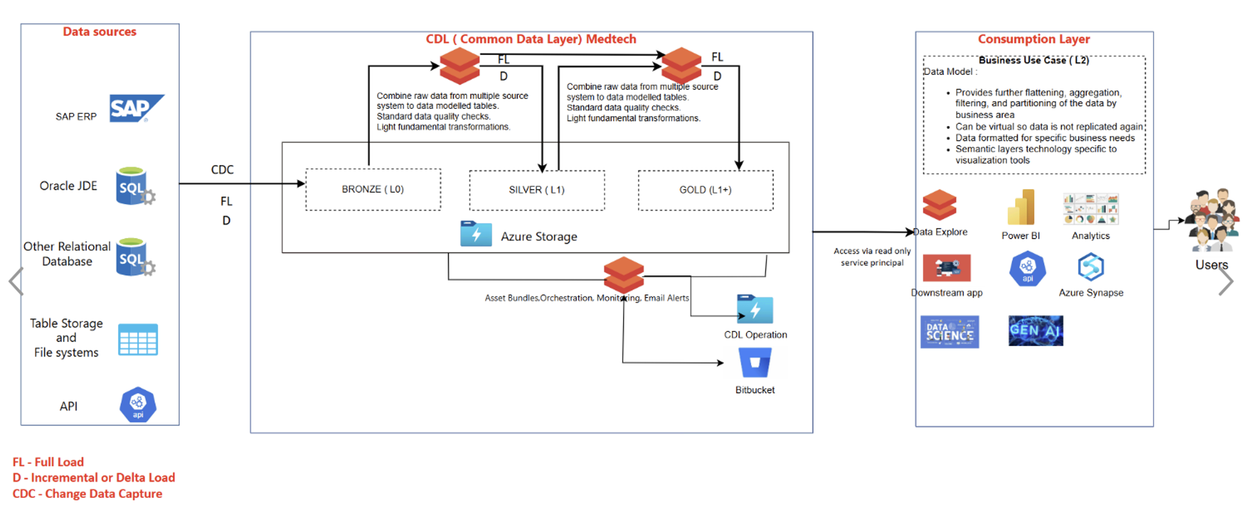
Typical Platform Building Strategy- CDL L1

Slide 68
CDM L2 – Common Data Management Layer
J&J
|
Syren
Project proposal
New project proposal | business-friendly, reusable L2 data products across Pharma, MedTech, Vision Care and Enterprise
What J&J gains
1
2
3
Reusable Object Factory
Data Contract & Naming
Quality & Validation
Reusable L2 objects instead of repeated CDL L0 joins in every project
Business-readable data models over complex SAP/JDE/OMP source structures
Standardized object granularity for faster L3/L4 analytics and applications
Governed foundation for Sales Order, Delivery, Material, UOM, Schedule Line, Plant, Receipts and Billing
Object catalog: prioritized backlog of high-value L2 objects mapped to business use cases. Granularity standard: clear object-level contract, keys, relationships and reusable joins. Sector fit: common model with extension points for Pharma, MedTech and Vision Care.
Business names: replace German/SAP technical naming with intuitive English definitions. Mapping traceability: source-to-target rules, lineage and field-level meaning documented from day one. Consumer readiness: stable tables/views designed for BI, data science and downstream product teams.
Built-in controls: row counts, schema checks, uniqueness, null handling and reconciliation gates. Release validation: repeatable evidence pack for data readiness and promotion decisions. Defect governance: structured triage across source data, mapping logic and consumption issues.
4
5
6
Engineering Standards
Cost & Performance
Proposal Value
Lakehouse design: Databricks/Delta patterns optimized for maintainability and scalable consumption. CI/CD ready: promotion gates, branch discipline, code review and controlled release workflows. Documentation: object-level design, runbooks and handover artifacts for long-term ownership.
Less duplication: reduce redundant pipelines, repeated transformations and manual data preparation. Optimized jobs: partitioning, workload design and compute sizing reviewed as part of delivery. FinOps lens: cost-conscious design from ingestion through consumption.
Speed: new downstream projects can start from trusted objects rather than raw source joins. Consistency: common definitions reduce KPI and analysis mismatch across teams. Scale: repeatable framework to add more L2 objects without restarting design each time.
Proposal differentiator: Syren brings proven J&J supply-chain data modeling patterns, reusable L1/L2 object delivery, CI/CD rigor and data-quality governance.
Syren
© SYREN CLOUD INC – 2026 – ALL RIGHTS RESERVED
1

Slide 69
CDM L2 – Delivery Standards
Project proposal
How Syren will make the L2 layer reusable, governed and extensible instead of a one-off data build
1
2
3
4
1
Discover & Prioritize
2
Design for Reuse
3
Engineer with Controls
4
Operate & Optimize
Use-case led scope: select objects based on immediate downstream demand and reuse potential. Source assessment: confirm SAP/JDE/OMP availability, keys, cadence, quality and business ownership. Backlog model: group objects into delivery waves with clear readiness criteria. Stakeholder alignment: bring business, data engineering, governance and platform teams into design decisions.
Canonical L2 patterns: documented structures for facts, dimensions, bridge objects and lookup/reference data. Business semantics: data dictionary, owner, SLA, primary keys and traceability per object. View strategy: core tables plus virtual views for consumer-specific lenses without duplication. Change control: managed mapping versioning when source fields or business rules change.
Automated gates: linting, unit checks, validation notebooks and release evidence. Peer review: code, mapping and data quality review before environment promotion. Reusable templates: accelerators for ingestion, transformation, reconciliation and publishing. Deployment discipline: bundle-aware release packaging to keep environments aligned.
Operational monitoring: run status, failure alerts, freshness checks and consumer-impact visibility. Cost optimization: workload sizing, SQL migration opportunities, incremental processing where applicable. Lineage & audit: documented source-to-consumer flow for trust and supportability. Continuous improvement: standardized retrospectives to capture reusable fixes and new accelerators.
Proposal differentiator: The proposed L2 program is positioned as a reusable data product factory, not another isolated data pipeline.
Syren
© SYREN CLOUD INC – 2026 – ALL RIGHTS RESERVED
2
Proposal differentiator: The proposed L2 program is positioned as a reusable data product factory, not another isolated data pipeline.

Slide 70



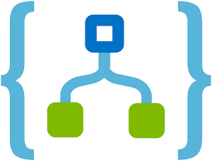

Typical Platform Building Strategy
Analytics
Data Sources
User Persona
Scenario Planning
Databricks Unity Catalog
Interactive Visualizations
MedTech Datasets in CDL
Transformation
L2+Data Sets
Data Warehouse
CSR / Field Team
ERP Translations
Power BI
ERP Systems
(Product, Vendors, Customers, Orders, Inventory)
ERP Systems
(Product, Vendors, Customers, Orders, Inventory)
SQL Data Warehouse
Supply Chain Plans
Business Data Model
Planners
Structured, Sem-structured and Unstructured
SCP Systems
(Demand, Supply, Productions, Transport, Inventory)
SCP Systems
(Demand, Supply, Productions, Transport, Inventory)
CRM/SRM/PLM Data
Data Lakehouse
Business Applications
OMS/WMS/TMS/QMS Data
PLM, SRM, CRM, QMS, Finance Systems
PLM, SRM, CRM, QMS, Systems
(Engg, Contracts, Promos, Defectives)
Operators
Backend Services
Master Data / External Data
Data Transformation Pipelines
Azure Databricks
Managers
Workflows
Web Application
Executive Leadership
Custom Workflows
ERP Writeback
Notifications
Teams
Outlook

Slide 71
Not another vendor. Your intelligence partner.
WHY SYREN
50+
Use cases in production
4
Pillars. One partner.
NPS 80
Client satisfaction
99.9%
Platform reliability
5+
Regulated verticals
End-to-end ownership
Outcome owned, not just the deliverable
All four pillars under one agreement
Platforms, not projects
Reusable architecture · multi-cloud
Designed for the next use case, not just this one
Proved at enterprise scale
50+ in production, not pilots or POCs
Regulated enterprise deployments with metrics
Compliance is not an add-on
21 CFR, HIPAA, GDPR, SOX, EU AI Act built in
Compliance work already done across all verticals
One team, no translation layer
Data, DS, ML & software engineers — one practice
No finger-pointing · no deployment gaps
Operated, not just delivered
Models drift — we monitor, retrain & govern
Intelligence that stays intelligent

Slide 72
Trusted by regulated enterprise leaders
OUR CLIENTELE
Partners in compliance-intensive, high-stakes industries
Where bad data means audit findings, recalls & market failures
Global Pharma & Life Sciences
Compliant, AI-ready platforms: clinical to commercial
GxP-governed pipelines from R&D to market
Healthcare Systems & Payers
FHIR-native care coordination at scale
Pharmacovigilance signal detection
Manufacturing & Industrial Leaders
Predictive maintenance, QC & supply chain AI
OPC-UA, MES & SCADA connected & governed
CPG & Retail Market Leaders
Shelf performance, demand sensing & trade ROI
Syndicated data → agentic commercial planning
Financial Services Enterprises
Governed data & AI for risk & commercial intel
SR 11-7 & SOX from architecture to audit trail
Global Supply Chain & Logistics
Planning, track & trace, carrier optimization
EDI-integrated · TMS-connected · real-time visible

Slide 73
Certified for regulated enterprises. Audit-ready on day one.
INDUSTRIES & COMPLIANCE
Pre-built signals for the most regulated verticals
21 CFR Pt 11, HIPAA & GDPR compliant from go-live
Pharma
21 CFR Part 11
CDISC / SDTM
GAMP 5
ALCOA+
Healthcare
FHIR R4 / HL7
OMOP CDM
HIPAA
HITRUST
Manufacturing
OPC-UA
MES / SCADA
ISO 9001
IEC 62443
CPG & Retail
Syndicated data
Distributor feeds
Trade promo
Supply Chain
EDI 850/856/810
Track & trace
TMS
SOC 2
Cross-industry
SOC 2
ISO 27001
GDPR
CCPA
EU AI Act
FDA AI Guidance
SR 11-7
SOX

