Slide 1

Text-To-Speech System for Marathi
Miss. Deepa V. Kadam
Indian Institute of Technology, Bombay

Slide 2
Text-to-Speech Synthesis
Text-to-Speech (TTS) synthesizer :
It is a computer based system that should be able to read any text aloud whether it was directly introduced in the computer by an operator or scanned and submitted to an Optical Character Recognition (OCR) system
Voice response system are application of speech synthesis technology and broadly classified in two types
1. Limited vocabulary system
2. Unlimited vocabulary system

Slide 3
General functional diagram of
Text-to-Speech system
TEXT-TO-SPEECH SYNTHESIZER
NATURAL LANGUAGE PROCESSING
Linguistic Formalism
Inference Engines
Logical Inferences
DIGITAL SIGNAL PROCESSING
Mathematical Models
Algorithms
Computations
Text
Phonemes
Speech
Prosody

Slide 4
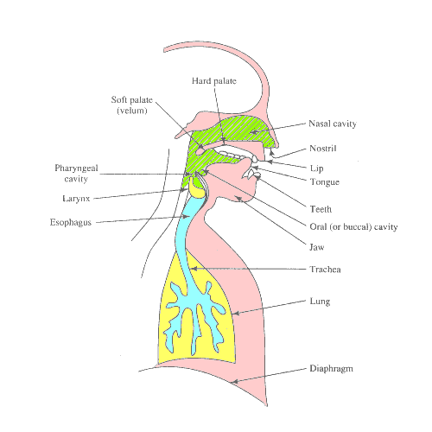
Human Speech Production System

Slide 5
Architecture of TTS system
Text Analysis
Document Structure Detection
Text Normalization
Linguistic Analysis
Raw text or tagged text
Tagged text
Phonetic Analysis
Grapheme-to-Phoneme Conversion
Tagged phone
Prosodic Analysis
Pitch & Duration attachment
Controls
Speech Synthesis
Voice Rendering

Slide 6
Concatenative Synthesis
It requires neither rules nor manual tuning.
Stores segments
Choice of segments
eg. Words, Syllables, Demi-syllables, Diaphones, Phones.
Segment concatenation

Slide 7
Text-to-Speech Synthesis System for Marathi Language
1. Marathi Script
2. Design of Synthesizer
a. Speech Synthesis Model
b. Structure of Database
c. Linguistic Rules
3. Implementation of Synthesizer
a. Database Creation
b. Algorithm
c. Applying Rules

Slide 8
Algorithm
Initialize the program
- Initialize GUI.
- Load all sound files in Buffer array.
- Load default values of rules.
On key type event (Marathi keyboard help)
- If typed key does not form a text which is displayed in loaded help, then remove the old help table and load a new help which displays a possible combinations of typed consonant followed by all vowels.

Slide 9
Display Marathi text
- Read Marathi readable text (English format).
- Convert it to text which is equivalent to script use by Marathi font (KIRAN) to display it in Marathi.
- Output this converted text to the other text box whose font is set to Marathi script.

Slide 10
Synthesize speech
- Read Marathi readable text (English format)
- Normalize input text.
- Parse this text into words.
- Parse these words into phonemes (Speech Units).
- For each word, process all units as follows
* Get index of Unit
* Get index of previous and next unit
* Calculate the values of Length, decay and silence by applying rules.
* Apply these values to the indexed speech segment.

Slide 11
On amplify event the synthesize speech
On waveform Event draw waveform of synthesize

Slide 12
Speech Synthesis Features
This interface has two text areas. One for inputting Marathi text in English and other for displaying equivalent text in Marathi.
This interface also provides help for typing Marathi with the help of normal keyboard. It displays how to type all related Marathi phonemes which begin with last character typed.
The waveform button shows the waveforms for output speech signal.

Slide 13
Applications
1. Talking Calculator
2. Computer generated wiring instruction
3. Aids for the blind
4. Telephone inquiry service
5. Teaching machines

