Slide 1

DELTA LIVE TABLES
VINEET SRIVASTAVA
AI INTERN
23rd June 2023

Slide 2
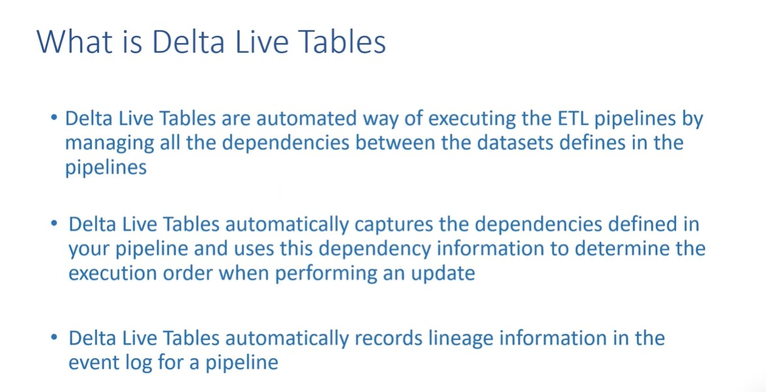

Slide 3
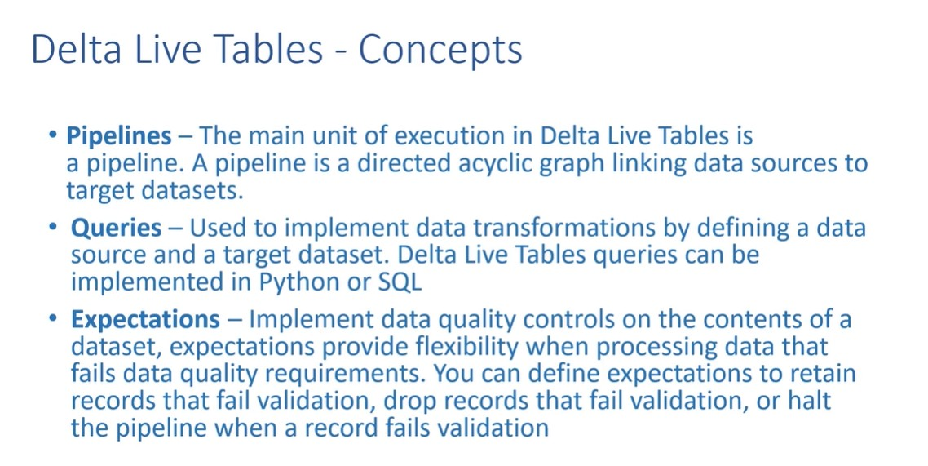

Slide 4
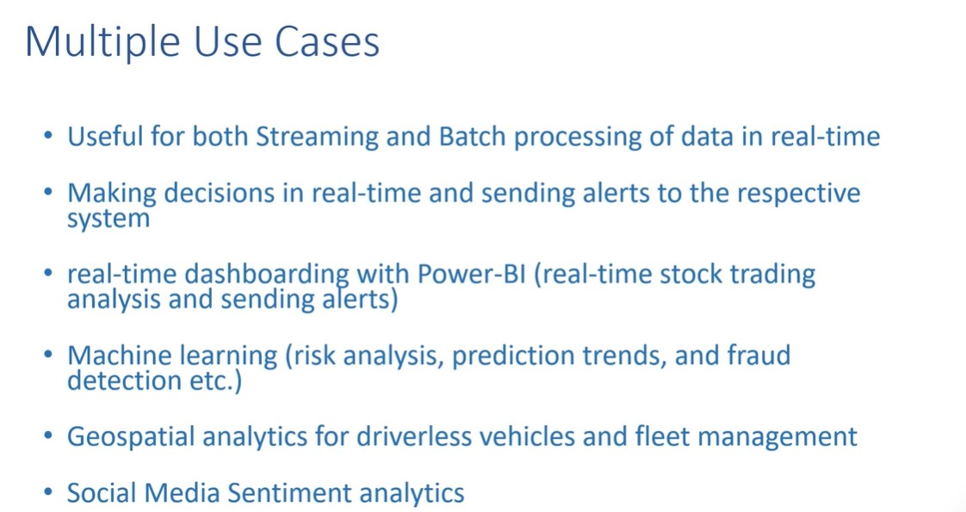

Slide 5
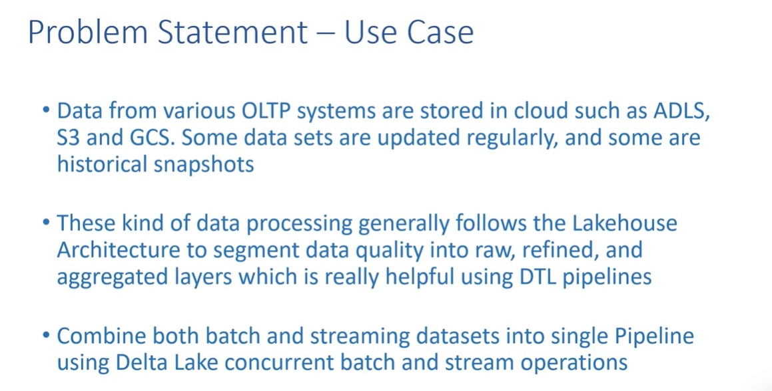

Slide 6
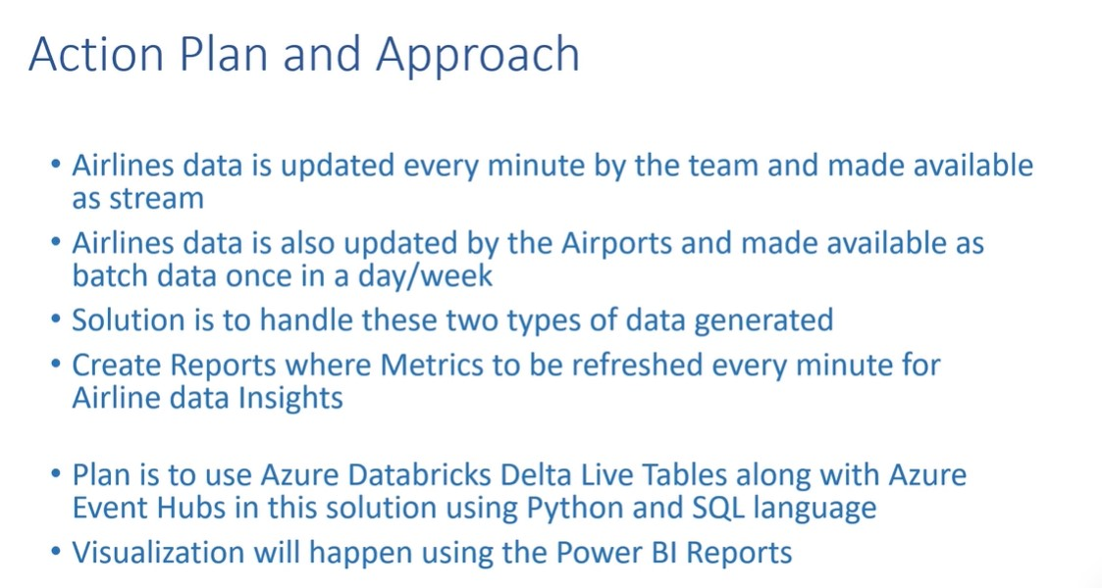

Slide 7
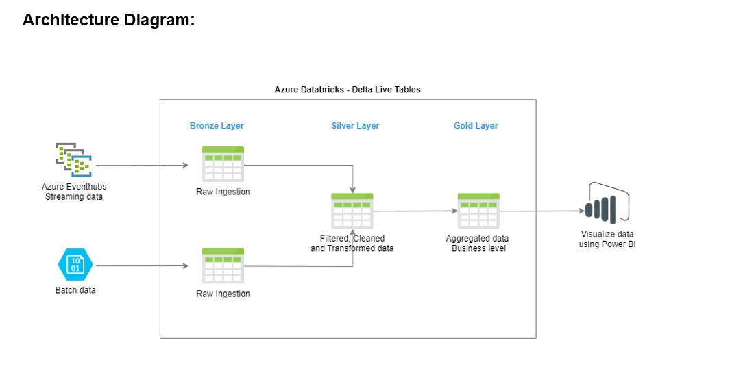

Slide 8
Action Items
Create Event-hub resource and note the primary access keys to be used by client code (python, SQL, etc.) for pushing data to event-hub
Data is pushed to event-hub via a python code, this is real-time stream data
Batch data is ingested to azure blob container-raw layer and then is stored in databricks in a table (DBFS partition)
Stream data is then extracted from event-hub and is also stored as a separate databricks table
Create Delta-live Table:
a) Create a DLT cluster since DLT internally uses its own cluster and not general-purpose cluster of databricks
b) Assign the notebook(s) to run as pipeline- multiple notebooks can be assigned to run in a sequential manner
c) The notebook written (either in SQL or Python) uses databricks table earlier for streaming and batch data to create bronze, silver and gold layers.
d) The pipelines and the DLT tables are stored in the path specified while creating DLT pipelines (by default it will be stored at DBFS partition
The cleansed-gold layer is queried using SQL query notebook
Visualizations using Power-BI is done using the "partner connect" menu section of databricks.

Slide 9
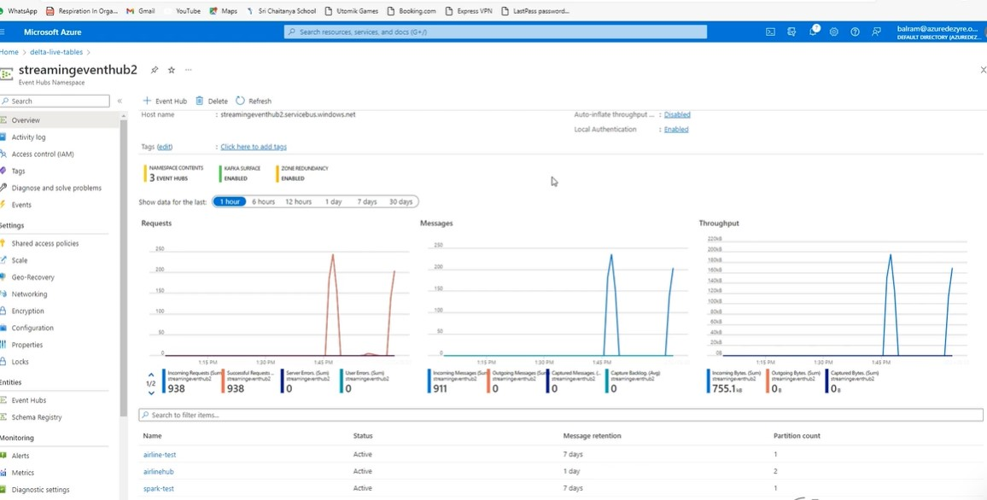
Event-Hub Data Ingestion

Slide 10
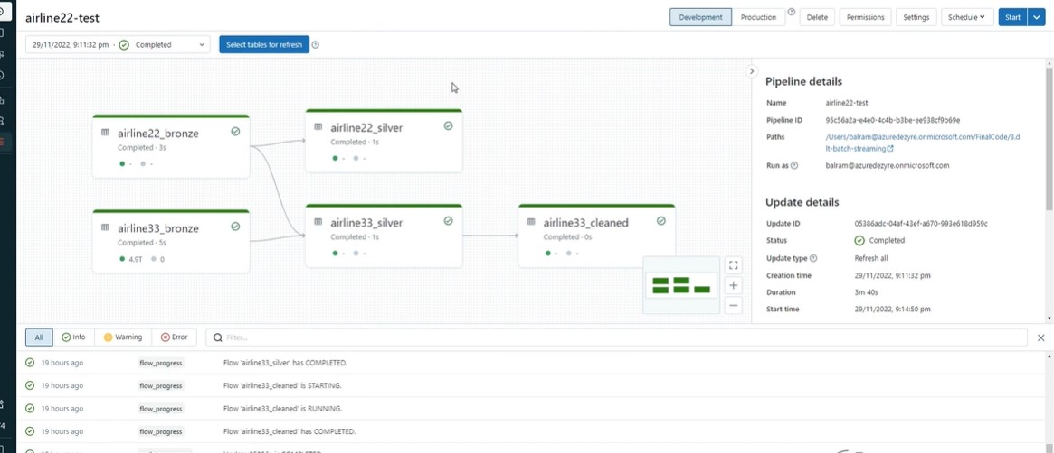
Delta Live Table Pipeline

Slide 11
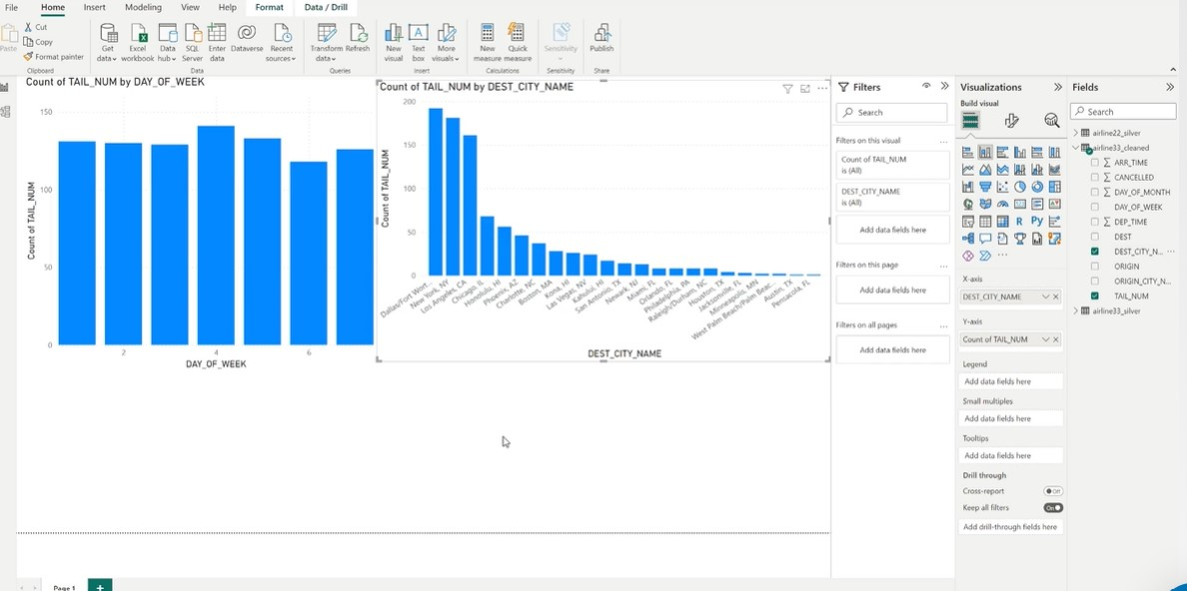
Power-BI Visualization of the DLT Gold Layer

