Slide 1
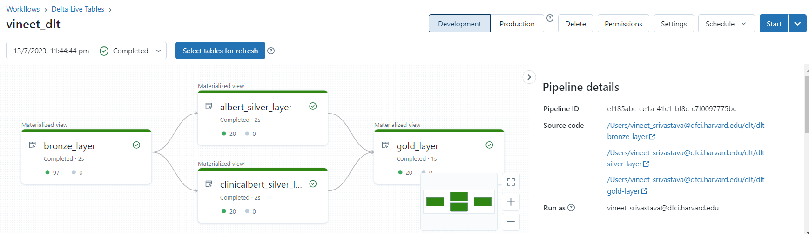
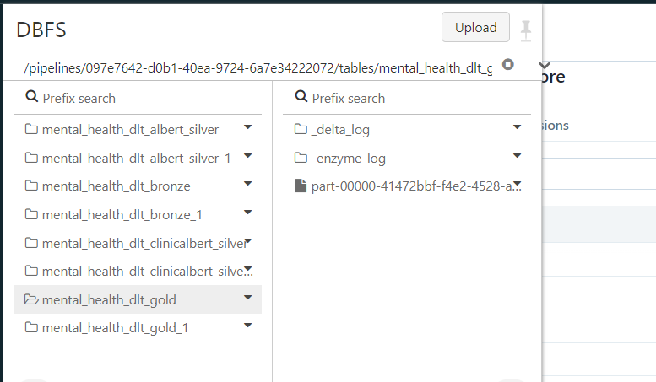
Pipeline-id: ef185abc-ce1a-41c1-bf8c-c7f0097775bc

Slide 2
