Slide 1
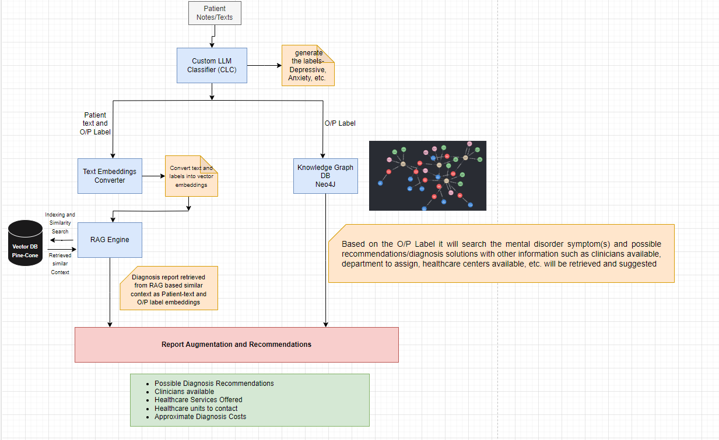
Graph RAG (Intelligent Document Search and Retrieval for Mental Disorder Recommendations)

