Slide 1
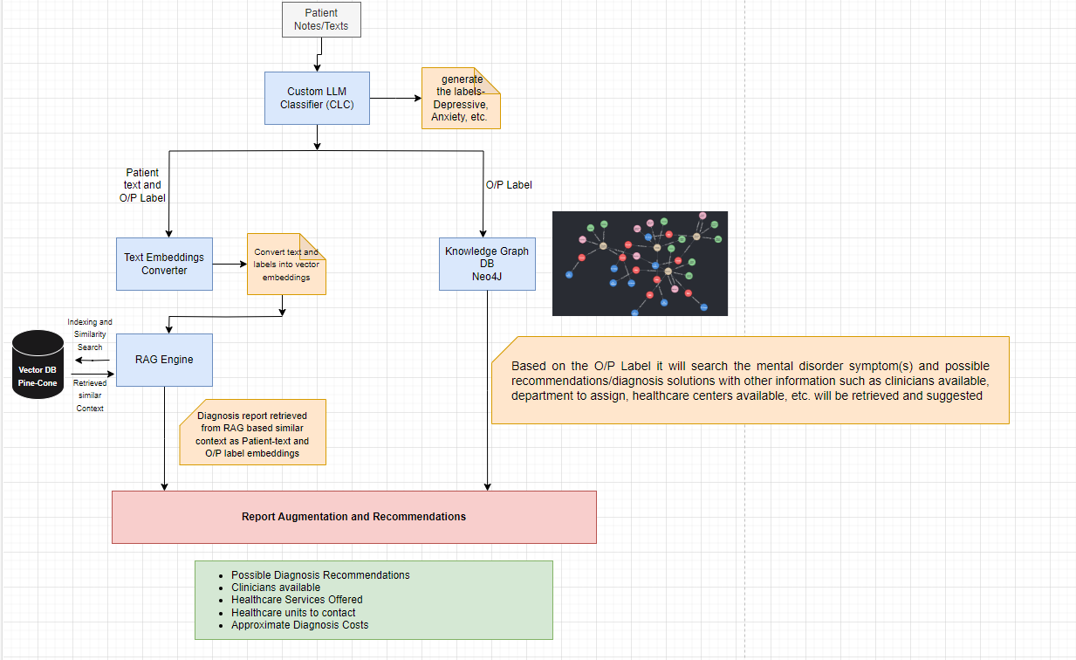
Graph RAG (Intelligent Document Search and Retrieval for Mental Disorder Recommendations)

Slide 2
Graph RAG Highlights
Leverages state-of-the-art NLP with BERT for text classification. Fine-tuning on medical data allows highly accurate disorder identification.
Modular RAG framework allows flexible retrieval from multiple sources:
Vector DB provides relevant patient contexts based on unstructured text
Knowledge graphs provide structured medical data and relationships
Redundancy between the vector DB and knowledge graphs makes the system robust. If one source is lacking or low quality, the other can compensate.
Knowledge graphs provide logical relationships between medical entities like symptoms, disorders, treatments. This enables structured reasoning.
Retrieved contexts are combined by an ensemble recommendation engine that aggregates signals from across components.
The recommendations are personalized for each patient based on their specific profile and reported symptoms.
Modular components allow updating individual pieces like the BERT model or knowledge graphs over time. System can evolve as new techniques/data emerge.
Evaluation on real-world clinician data provides quantitative rigor and validation of performance.
Can reduce issues such as hallucinations of LLMs.

Slide 3
Graph RAG – Countering Hallucinations (Grounding the LLMs)
One key challenge with large language models is that they can sometimes "hallucinate" content that seems coherent but is factually incorrect or unsupported by evidence. Integrating knowledge graphs into the RAG framework is a great way to address this:
Knowledge graphs provide structured, logical constraints on the relationships between entities. This logical scaffolding helps reduce hallucinated output.
Retrieving relevant knowledge graph nodes and relationships grounds the system in factual medical knowledge.
The knowledge graph relationships act as a "sanity check" on generated text - ensuring it fits established medical knowledge.
Knowledge graph traversal can prompt the model to expand on supported relationships rather than fabricate unsupported links.

