Slide 1


Project Demonstration
End-to-End ETL Big Data Engineering
and
ML Pipeline
Speaker & Author:
VINEET SRIVASTAVA (he/him)
Pursuing MS at University of Illinois at Chicago (UIC)
Research Assistant at UIC School of Public Heath
02/07/2023

Slide 2
Agenda
My work portfolio – (3 to 4 mins)
Project’s Overview and Problem Statement – ( 2 to 3 mins)
System Design and Architecture
Big Data Engineering and Analytics – ( 5 to 6 mins)
Machine Learning (ML) Pipeline – ( 4 to 5 mins)
CI/CD Pipeline- Deployment on Cloud – ( 2 to 3 mins)
Quick Demo – (4 to 5 mins)
Questions and Answers (Q&A)

Slide 3

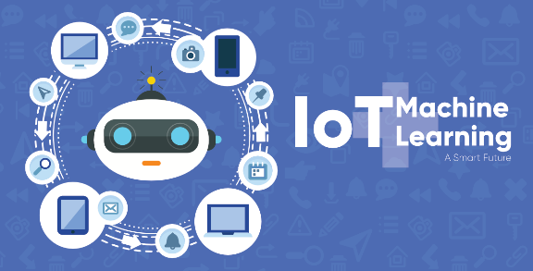
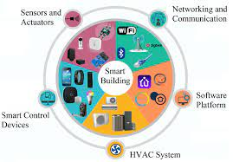
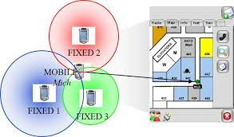








My Work Portfolio
Currently working as Graduate Research Assistant at UIC School of Public Health (UI Health)
5 years of Industrial experience in India, working for both Product and Service based companies like Qualcomm and Capgemini, in the field of IOT, Big Data Analytics and Machine Learning.
Industrial expertise and experience of working in different domains such as Healthcare, Smart Building Automation, Indoor Localization & IOT, for creating ML models, designing pipelines, developing automation frameworks and make data-driven decisions.
Designed ETL Pipelines for both Batch and Real time data Streaming on Cloud involving AWS & Azure analytics
Interest: To create end-to-end predictive models, involving big data and cloud analytics, amalgamating IOT and Machine learning, to create products especially in the healthcare sector, to promote remote patient monitoring and enhanced women healthcare, all at reduced costs
Patent & Research:
US-Patent on RSSI Data Analytics for designing fine-tuned trilateration algorithm (2018) while working for OTIS Elevators (Client) in India.
Currently working on a healthcare research paper for designing synthetic syndromic surveillance architecture on Azure & AWS
LinkedIn: https://www.linkedin.com/in/vineet-srivastava-452730165/

Slide 4
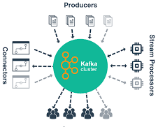

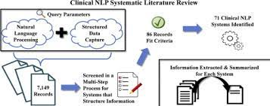
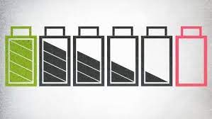
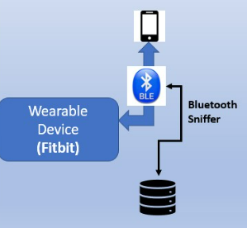
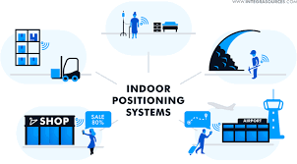
Industrial Projects (Big Data Analytics/ML)
Synthetic Syndromic Surveillance on Azure & AWS
Develop Search Engine using NLP on Clinical
Trial Datasets for Lung Cancer
IOT Sensor Fault Prediction(Smart Building Automation)- Real Time Streaming
Frequent
Connection
failures
Identify Bluetooth Connection Failures and design predictive model
People Tracking & Indoor Localization

Slide 5
Project’s Overview & Problem Statement
Project:
Deriving Critical Metrics and Create Predictive ML Models to identify Bluetooth Connection Failures
between Wearable Devices (Fitbit) as Transmitter and Phone (Healthcare App) as Receiver.
Domain: IOT HealthCare
Problem Statement:
The production line team was facing regular BLE (Bluetooth Low Energy) connection failures between wearable devices like Fitbit and BLE receiver(Phone) thereby leading to loss of real time sensor data (BLE packets).
The team wanted to identify the critical metrics and understand the pattern behind connection loss.
The task was to create a pipeline to analyze the metrics from sniffed BLE packets and perform quick analytics.
Frequent connection
failures

Slide 6
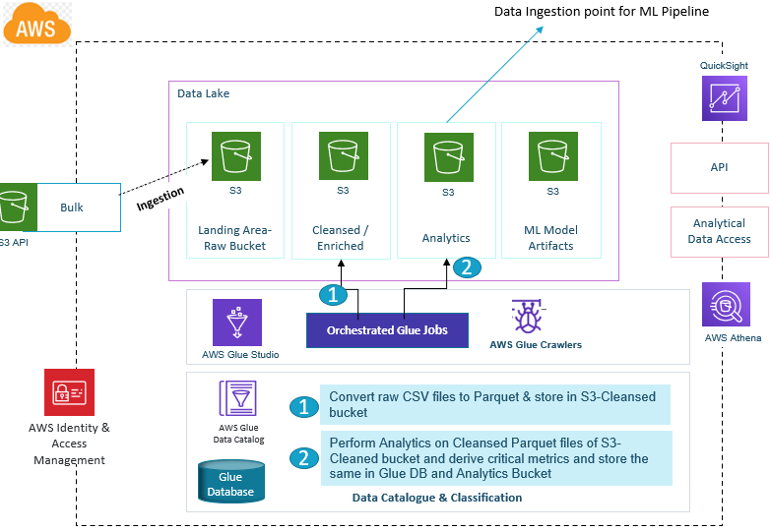
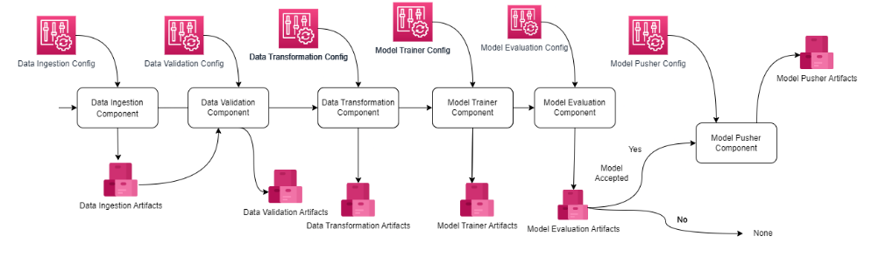

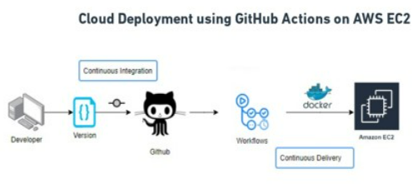
System Design & Architecture
1. Big Data Engineering & Analytics
2. Machine Learning Pipeline
S3 Analytics
3. CI/CD Pipeline- Deployment using GitHub Actions

Slide 7








Big Data Engineering & Analytics
Data Ingestion point for ML Pipeline
Monitoring / Alert
QuickSight
Data Lake
AWS Cloudwatch
Landing Area- Raw Bucket
Cleansed / Enriched
Analytics
ML Model Artifacts
CI/CD Deployment
API
Database
Bulk
Ingestion
S3
S3
S3
S3
Analytical Data Access
S3 API
AWS EC2
2
1
Orchestrated Glue Jobs
AWS Glue Crawlers
AWS Athena
AWS Glue Studio
Data Catalogue & Classification
1
Convert raw CSV files to Parquet & store in S3-Cleansed bucket
AWS Identity & Access Management
AWS Glue Data Catalog
Perform Analytics on Cleansed Parquet files of S3-Cleaned bucket and derive critical metrics and store the same in Glue DB and Analytics Bucket
Glue Database
2
Data Flow

Slide 8
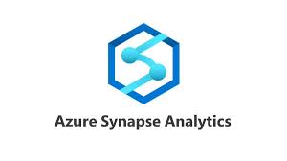
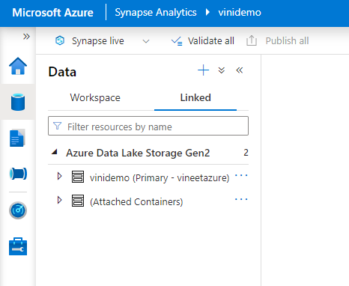


System Design & Architecture(Proposed) on Azure
Azure Synapse Studio
Azure Data Factory
Data
Development
Integrate- Synapse Pipelines
Dashboards
Analytics Runtime
Apache Spark Pool
Data Lake
Data Lake Storage Gen 2
Raw
Cleansed-Parquet files
Analytics
ML Model

Slide 9
Machine Learning Pipeline
S3 Analytics

Slide 10
CI/CD Pipeline using GitHub Actions
Steps:
Created the Docker Image for the Codebase in Git-Repo
Pushed the Docker Image to AWS ECR (Elastic Container Registry)
Launched the EC2 instance- make sure to configure it as self-hosted runner from GitHub actions
Pulled the docker image for ECR in EC2
Created the docker setup in EC2 and launched the pulled docker image

Slide 11
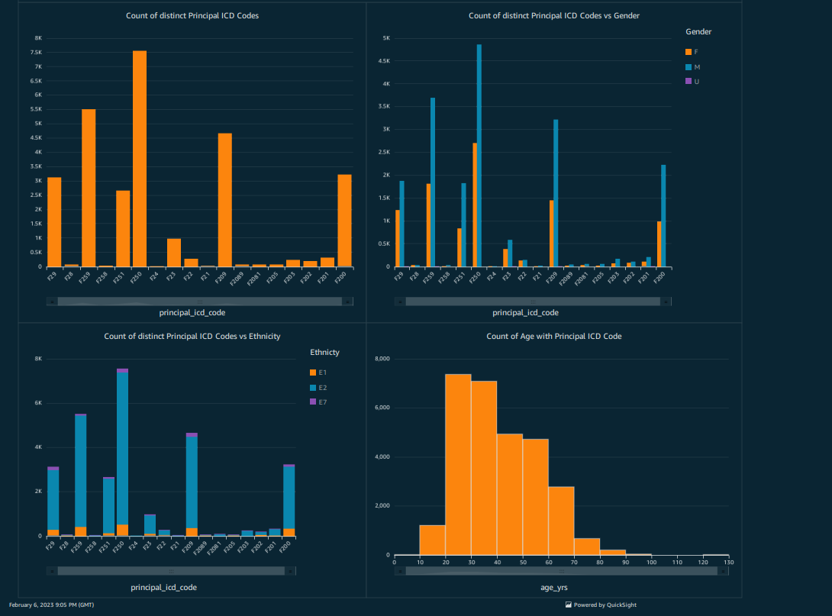
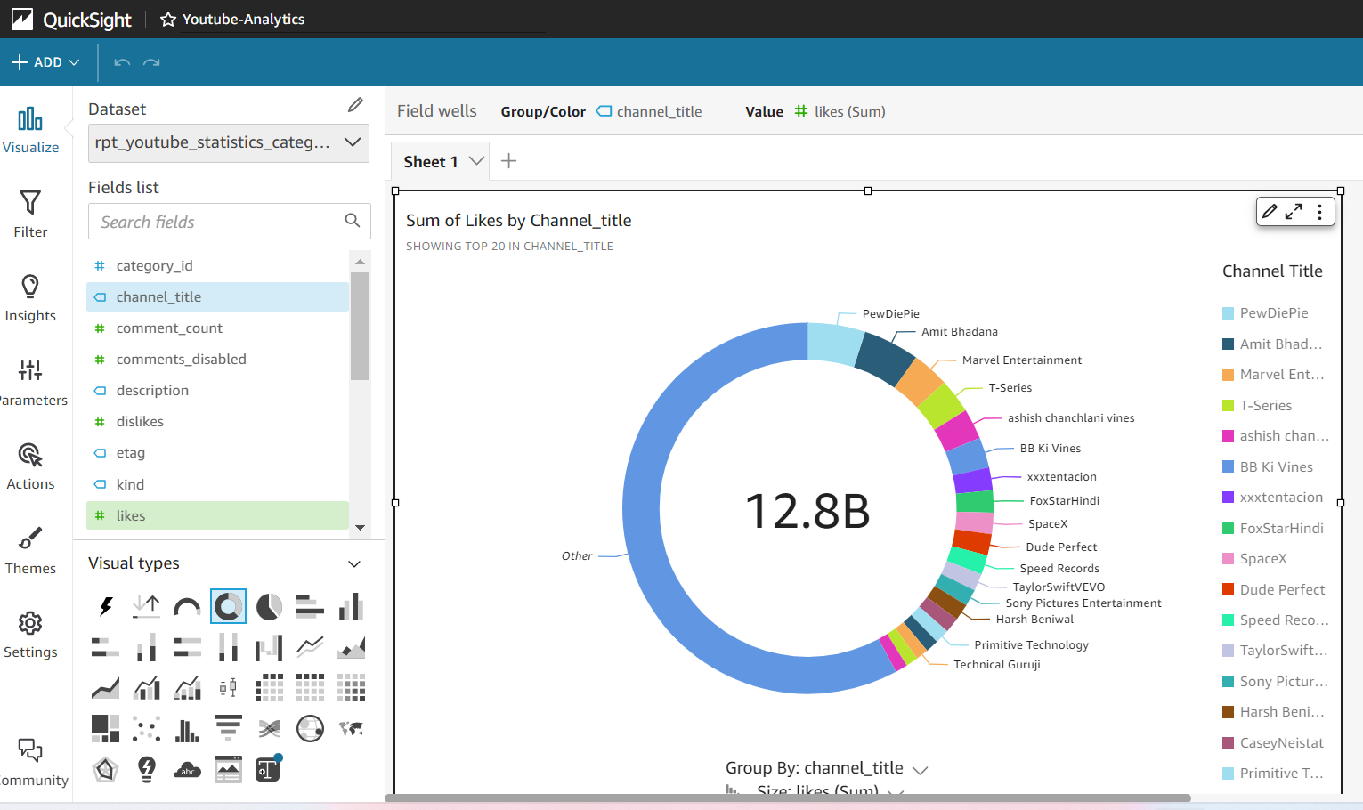
Quick Live Demo- AWS
Business Intelligence and Analytics

Slide 12
Questions?

