Slide 1

Smart Waste Management System
"Imagine this: Every time you throw away leftover food, you're not just wasting a meal—you're throwing away water, energy, and money that went into producing it. In fact, if global food waste were a country, it would be the third-largest emitter of greenhouse gases after the US and China. This project streamlines waste tracking using AI and interactive dashboards.

Slide 2

Introduction: Problem and Objective
Problem Statement
Objective
Inefficient waste tracking leads to poor environmental decisions.
Develop a system that enables real-time waste monitoring and analysis.

Slide 3
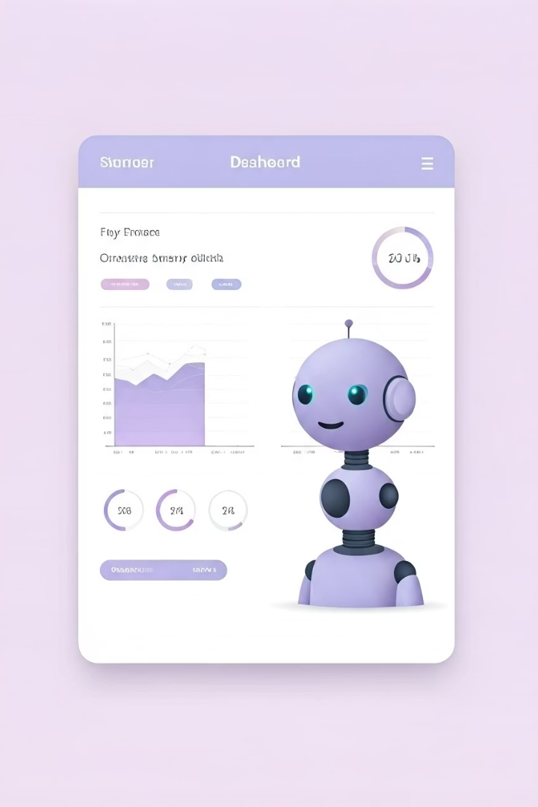
Key Features Overview
Dashboard
Chatbot
Displays waste data trends and actionable insights visually.
Offers conversational interaction for waste queries and assistance.
Visuals
Charts and graphs dynamically represent waste metrics and stats.

Slide 4
System Architecture
MongoDB
Streamlit
AI Modules
Stores waste entries and user data securely and flexibly.
Serves web interface for data entry, visualization, and chatbot.
Processes conversational input and generates intelligent responses.

Slide 5
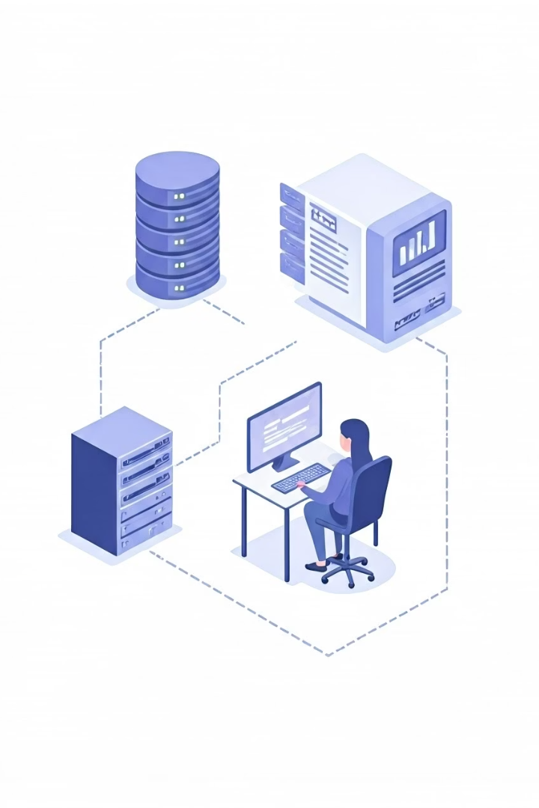




Workflow Process
Waste Entry
User inputs waste data through form interface.
Database
Data is securely stored in MongoDB.
Response
Chatbot interprets queries and provides replies.
Visualization
Dashboard updates with real-time insights and charts.

Slide 6

Chatbot Modes
Online Mode via Claude
Offline Mode via Transformers
Connects to Claude AI for real-time cloud-powered responses.
Utilizes local transformer models for privacy-focused interactions.

Slide 7





Technologies Used
MongoDB
Python
Streamlit
Flexible and scalable NoSQL database
Backend logic and AI model integration
Rapid prototyping of interactive web UI
AI & Transformers
Natural language processing and intelligent chatbot

Slide 8
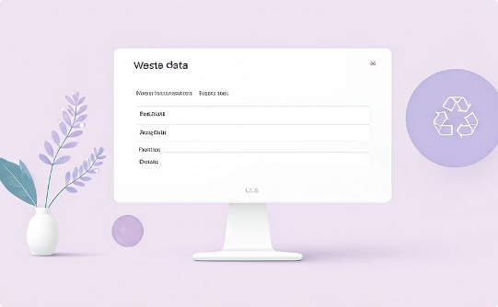
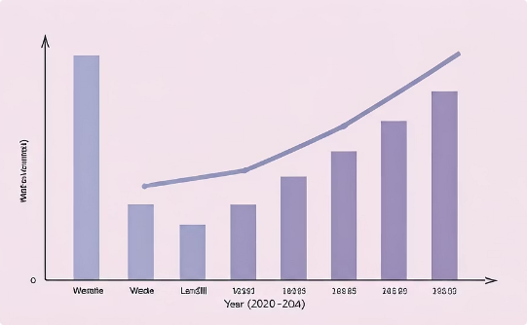
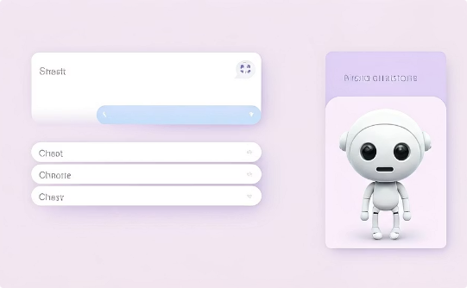
UI Screenshots
Entry Form
Chart Visualization
Chat Interface
Simplified data input for waste tracking.
Real-time graphical data representation.
Interactive user support and query handling.

Slide 9
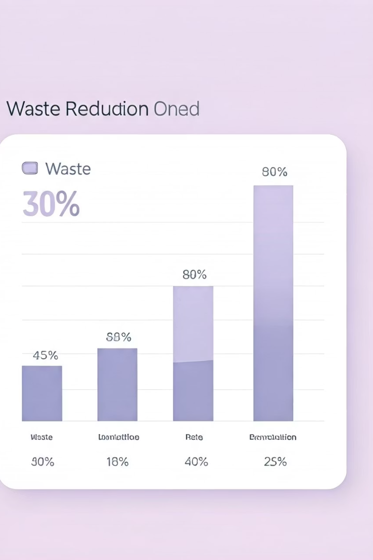
Results & Insights
Waste Reduction
15% decrease in reported waste volume over 6 months.
.
Insights Generated
Identified peak waste times and hotspots for better planning.

