Slide 1
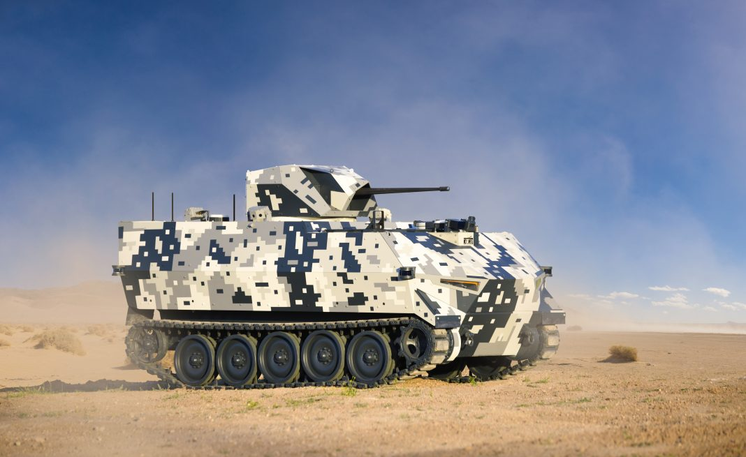

Presentation on Navigation and Control of Ground Vehicle
CO-SUPERVISOR
Dr. Shubhashisa Sahoo
Scientist-F, ISRD Division, CAIR DRDO
PRESENTED BY
VINEET KUMAR YADAV
Research scholar ICE Department 410120005 NIT TRICHY

Slide 2
Literature Review

