Slide 1
Digital Marketing Glossary with Real-World Examples
BBA Digital MarKETing Internship Project
VINEET KUMAR PANDEY
IIT PATNA
DOMAIN:-DIGITAL MARKETING
ROLL NO:-2311RES79
MAIL ID :- VINEET_2311RES79@iitp.ac.in

Slide 2
SEO (Search Engine Optimization)
Definition: The process of improving a website’s visibility on search engines like Google, so it ranks higher when people search for relevant keywords..
Example: A bakery in Patna optimizes its site for 'Best Cake Shop in Patna' and gets good backlinks, when someone searches that phrase on Google.
Tool: Google Search Console, SEMrush

Slide 3
CPC (Cost Per Click)
Definition: It is the amount an advertiser pays each time a user clicks on their ad. It’s a common pricing model in online advertising.
Example: Flipkart pays ₹5 per click on Google Ads for 'Best Smartphones'. then every time someone clicks the ad, the company pays ₹5 — whether the person buys the shoes or not.
Tool: Google Ads

Slide 4
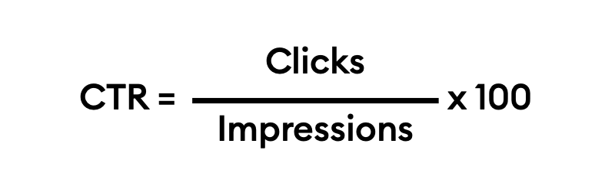
CTR (Click Through Rate)
Definition: The percentage of people who click after seeing an ad. It shows how effective the content is at driving engagement.
Example: An Instagram ad gets 1,000 views and 50 clicks = 5% CTR.
Tool: Facebook Ads Manager

Slide 5
LTV (Customer Lifetime Value)
Definition: The total revenue expected from a customer over time.
Example: Netflix subscriber paying ₹499 monthly for 2 years. the LTV = ₹499 × 24 = ₹11,976.
Tool: HubSpot, Salesforce

Slide 6
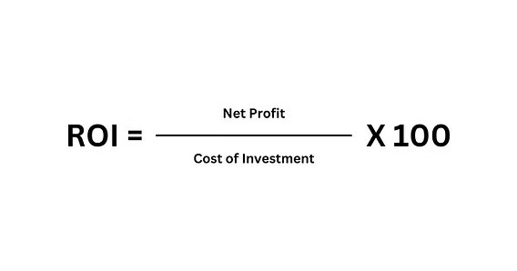
ROI (Return on Investment)
Definition: A financial metric that measures the profit or benefit gained from an investment compared to its cost. It is usually expressed as a percentage.
Example: Spend ₹10,000 on ads, earn ₹50,000 in sales = 400% ROI.
Tool: Google Analytics

Slide 7
Engagement Rate
Definition: It is the percentage of people who interact with your content (likes, comments, shares, saves, clicks) compared to the total number of followers or viewers.
Example: Post gets 200 likes, 50 comments, 20 shares from 1,000 followers.
Tool: Instagram Insights

Slide 8
Organic Reach
Definition: Number of unique users who saw content without paid promotion.
Example: Facebook post reaches 5,000 users without ads.
Tool :Facebook Insights

Slide 9
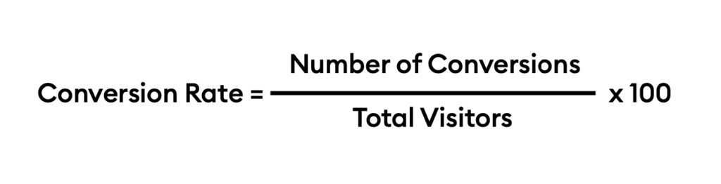
Conversion Rate
Definition: Percentage of users completing a desired action.
Example: Out of 1,000 visitors, 50 buy a product = 5% conversion.
Tool: Google Analytics

Slide 10
Bounce Rate
Definition: Percentage of visitors leaving without interaction.
Example: Blog with 70% bounce rate shows poor engagement.
Tool: Google Analytics

Slide 11
Keyword Density
Definition: Frequency of a keyword in content.
Example: Blog with 2% keyword density for 'best smartphones'.
Tool: Yoast SEO

Slide 12
Impressions
Definition: How often content is displayed.
Example: Twitter ad shown 10,000 times = 10,000 impressions.
Tool: Twitter Analytics

Slide 13
Retargeting
Definition: Targeting ads to users who visited but didn’t convert.
Example: Myntra shows shoes ads to users who visited product page.
Tool: Google Display Network

Slide 14
Influencer Marketing
Definition: Using influencers to promote products.
Example: Tech influencer promotes OnePlus phone on Instagram.
Tool: Instagram, Upfluence

Slide 15
Hashtag Strategy
Definition: Using hashtags to increase content reach.
Example: #TravelTuesday increases post visibility.
Tool: Instagram Analytics

Slide 16
Content Marketing
Definition: Creating valuable content to attract users.
Example: HubSpot blogs generate leads via free guides.
Tool: WordPress, HubSpot

Slide 17
Marketing Funnel
Definition: Stages: Awareness → Consideration → Conversion → Loyalty.
Example: E-commerce ad brings awareness, retargeting leads to purchase.
Tool: Google Analytics, HubSpot

Slide 18
Automation
Definition: Using software to streamline marketing tasks.
Example: Automated email welcome series after signup.
Tool: Mailchimp

Slide 19
Landing Page
Definition: Dedicated page for a campaign.
Example: Flipkart Diwali Sale landing page.
Tool: Unbounce

Slide 20
A/B Testing
Definition: Comparing two versions to find best performer.
Example: Email subject A gets 10% open rate, B gets 15%.
Tool: Optimizely

Slide 21
Backlinks
Definition: Links from other websites to yours.
Example: Suppose Times of India writes an article about “Top Colleges in India” and adds a link to IIT Patna’s official website. That link is a backlink for IIT Patna.
Tool: Ahrefs, SEMrush

Slide 22
Viral Marketing
Definition: Content that spreads rapidly online.
Example: Zomato witty memes going viral on Twitter.
Tool: Twitter, Instagram

Slide 23
UGC (User Generated Content)
Definition: Content created by customers.
Example: Starbucks reposts customer coffee photos.
Tool: Instagram

Slide 24
Lead Generation
Definition: Capturing potential customer interest.
Example: Free eBook download after filling contact form.
Tool: HubSpot, Google Ads

Slide 25
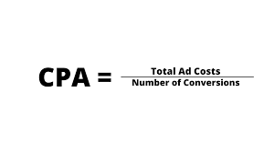
CPA (Cost Per Acquisition)
Definition: Cost of acquiring a customer.
Example: Spend ₹20,000 on ads, gain 100 customers = ₹200 CPA.
Tool: Google Ads

Slide 26
Open Rate
Definition: Percentage of opened emails.
Example: 2,000 sent emails, 500 opened = 25% open rate.
Tool: Mailchimp

Slide 27
Conclusion
✔ Digital marketing success depends on understanding these terms.
✔ Businesses use these metrics daily to improve strategies.
✔ A strong glossary helps beginners and professionals alike.

