Slide 1

RELIABLE RAIN-DETECTING WEATHER PREDICTION USING MLR ALGORITHM
PRESENTED BY
1. VINEET BHARANGER
2. G.BHARGAV
3. P.SUMANTH

Slide 2
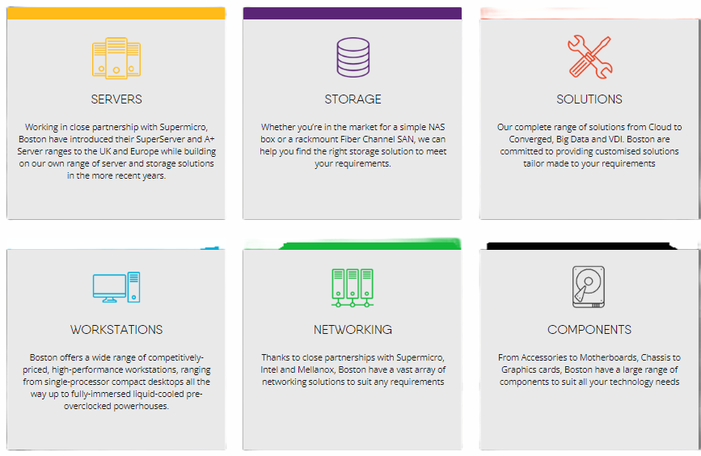
ABOUT :
Boston IT Solutions focused on delivering IT services to clients in India and potentially other regions. As an offshore development center, it may work on projects from international clients, leveraging the skilled workforce and cost advantages of the Indian IT industry. It provides various IT services and solutions to businesses, including software development, IT consulting, cloud services, cybersecurity, infrastructure management.

Slide 3
ABSTRACT :
The project aims develop rain prediction using the Multiple Linear Regression (MLR) Algorithm. This also highlight the potential applications of the MLR algorithm in various fields, like transportation as most of the goods are transported through ships from one place to another they carry many precious thing. So, rain prediction will help to detect the weather condition so that the goods can reach on time and with any damage. This project result can be used by policymakers, farmers, and disaster management organizations to make decisions based on accurate weather predictions.

Slide 4
TECHNOLOGY USED :
MLR stands for Multiple Linear Regression. It is a statistical modeling technique used to analyze the relationship between multiple independent variables and a dependent variable. MLR extends simple linear regression, which examines the relationship between two variables, to account for multiple predictors.
In MLR, the goal is to find the best-fitting linear equation that relates the independent variables (features) to the dependent variable (target). The equation takes the form:
Y = β0 + β1X1 + β2X2 + …
Y represents the dependent variable or target variable that we want to predict.
X1, X2, ..., Xn represent the independent variables or features.
β0, β1, β2, ..., βn are the regression coefficients that determine the impact of each feature on the target variable.

Slide 5
SETPS :
Download the weather data from website.
Open google colab.
Import necessary libraries such as pandas , sklearn.
Load the weather data from a CSV file.
Select relevant columns for modelling.
Drop rows with missing values.
Split the data into independent variables (X) and the dependent variable (y).
Perform feature scaling.
Split the scaled data into training and testing sets.
Create a linear regression model.
Train the model using the training data.
Make predictions on the testing data.
Make predictions on the testing data.
Prediction.

Slide 6
THANK YOU

