Slide 1
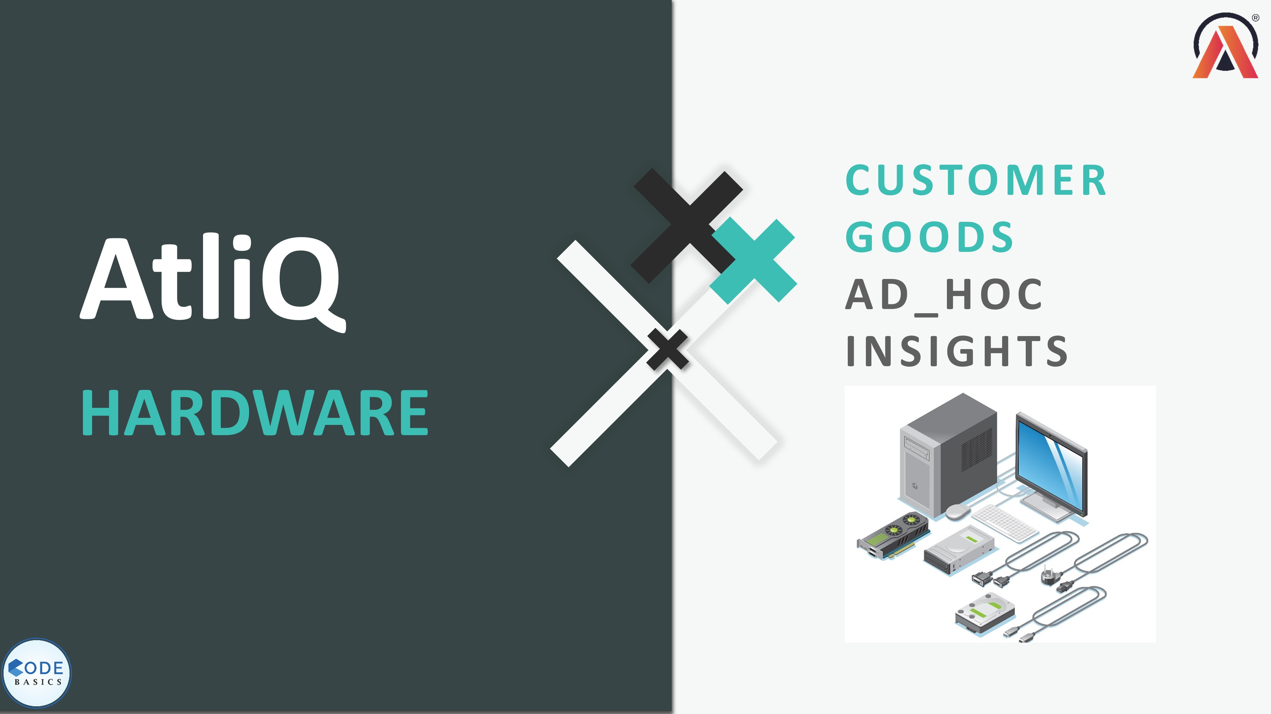

Slide 2

REQUEST 1
Provide the list of markets in which customer Atliq Exclusive operates its business in the APAC region
Output:

Slide 3
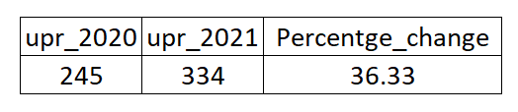
REQUEST 2
What is the percentage of unique product increase in 2021 vs 2020?
Output:
Insights:
Here it can be seen percentage change in unique products is 36.33% which is resulting increase gross sales

Slide 4
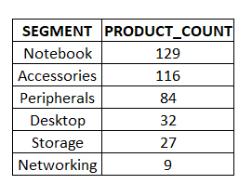
REQUEST 3
Provide a report with all the unique product counts for each segment and sort them in descending order of product counts
Output:

Slide 5
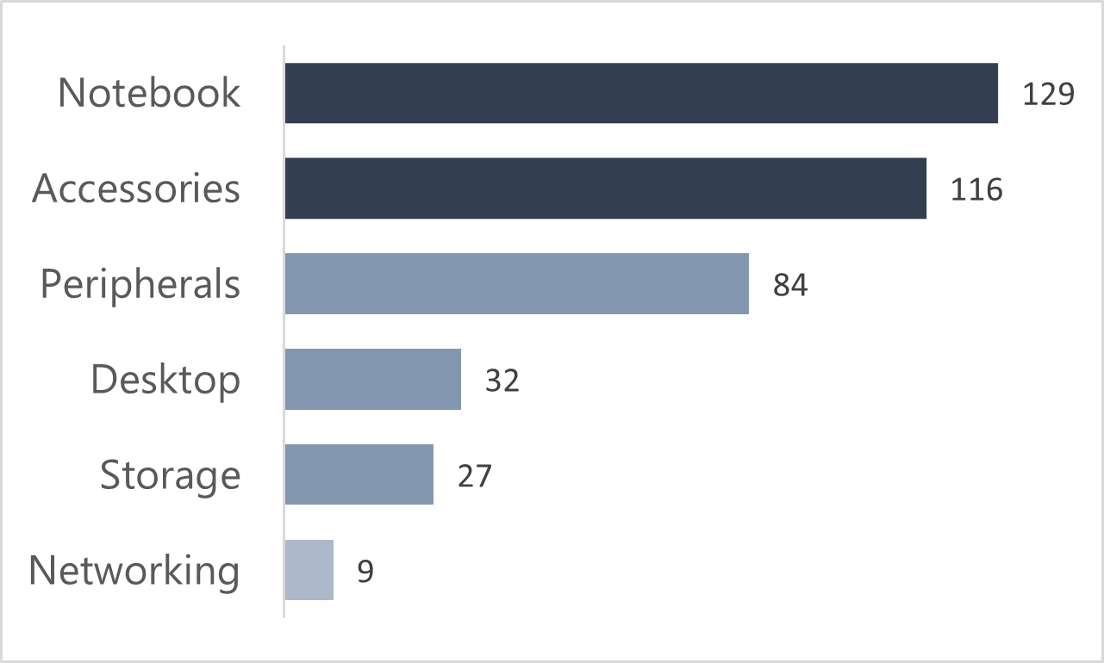
REQUEST 3
Provide a report with all the unique product counts for each segment and sort them in descending order of product counts
Insights:
There are total 397 unique products and, in that Notebook and Accessories are with highest counts products, which is 61% of total.

Slide 6
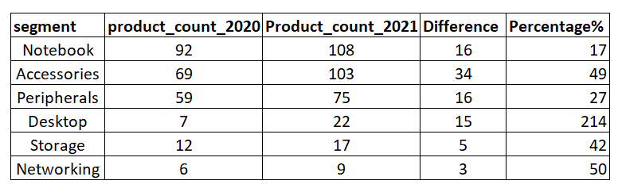
REQUEST 4
Which segment had the most increase in unique products in 2021 vs 2020?
Output:

Slide 7
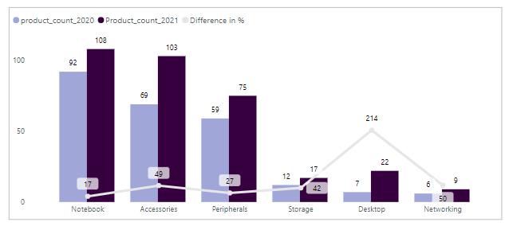
REQUEST 4
Which segment had the most increase in unique products in 2021 vs 2020?
Insights:
The chart shows Product count in 2020 and 2021 with percentage increase in each segment
Desktop has highest increased product count which is 22 count which was before 7 counts, resulting 214% increase.
Notebook is least increased by 17% which is 108, which in 2020 was 92 counts.

Slide 8

REQUEST 5
Get the products that have the highest and lowest manufacturing costs
Output:

Slide 9
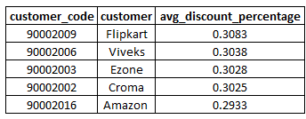
REQUEST 6
Generate a report which contains the top 5 customers who received an average high pre_invoice_discount_pct for the fiscal year 2021 and in the Indian market
Output:

Slide 10
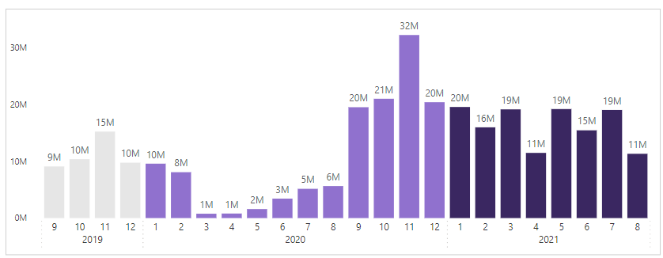
REQUEST 7
Get the complete report of the Gross sales amount for the customer Atliq Exclusive for each month
Insights:
FY2020:
80 Million
FY2021:
224 Million
It can be clearly seen that after increasing product counts in fiscal year 2021,
The gross sales is increased with a jump.
Highest sales month was November 2020 which is fiscal year 2021

Slide 11
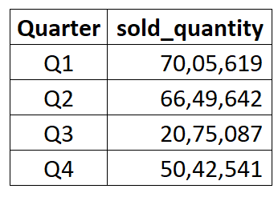
REQUEST 8
In which quarter of 2020, got the maximum total sold quantity?
Output:

Slide 12
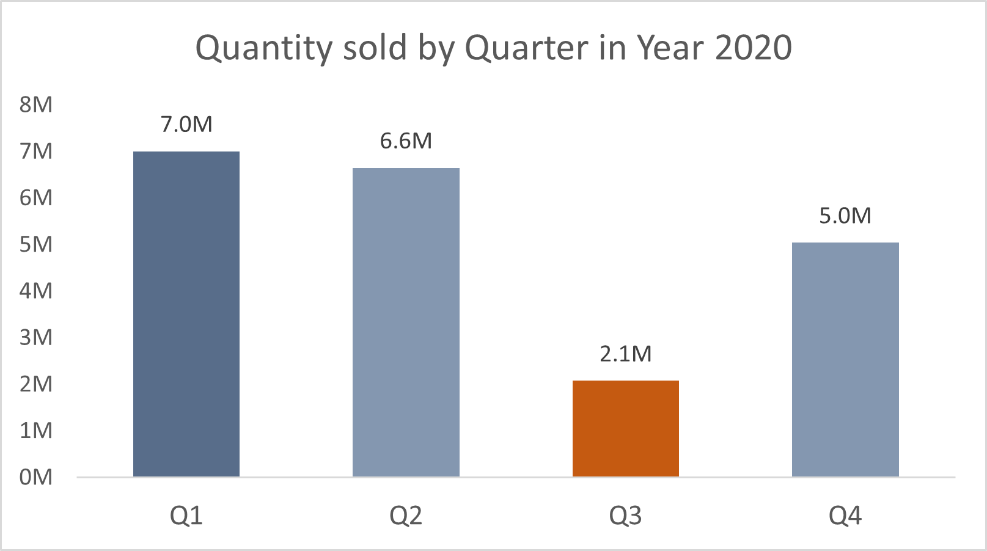
REQUEST 8
In which quarter of 2020, got the maximum total sold quantity?
Output:
In Quarter 1, total quantity sold was highest of 7M, which generated sales of 34M.
Quarter 3 was lowest in term of quantity sold with 2.1M, which generated sales of 5M.

Slide 13
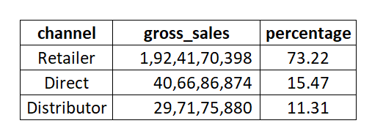
REQUEST 9
Which channel helped to bring more gross sales in the fiscal year 2021 and the percentage of contribution?
Output:

Slide 14
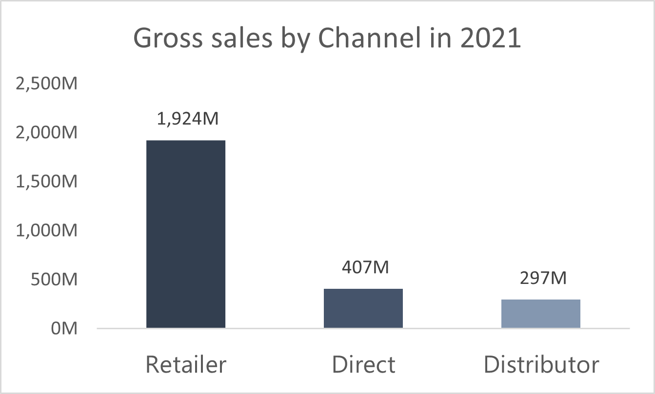
REQUEST 9
Which channel helped to bring more gross sales in the fiscal year 2021 and the percentage of contribution?
Insights:
Atliq Hardware generates most of its sales revenue from retail sales, which accounts for 82.6% of its total sales revenue, Direct sales is the second-largest source with 17.4% of its total sales revenue and Distributor sales is a smaller source of sales revenue, accounting for 8.7% of its total sales revenue.
Suggestions:
Consider expanding the direct sales channel to increase sales revenue.
Expand the product line to attract more customers and increase sales revenue.
Optimize the distribution strategy to improve efficiency and reduce costs.

Slide 15
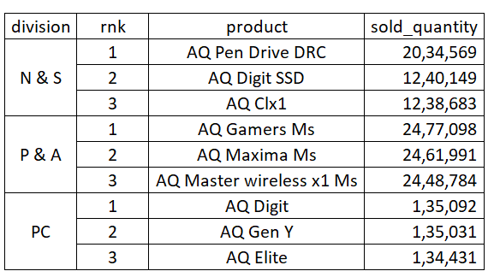
REQUEST 10
Get the Top 3 products in each division that have a high total sold quantity in the fiscal year 2021?
Output:

