Slide 1

Hinglish (Hindi-English Code switched) Speech Recognition
Vineet Kumar Srivastava
21/02/2026
AI/ML for Industry
Continuing Education Programme
Indian Institute of Technology Delhi

Slide 2
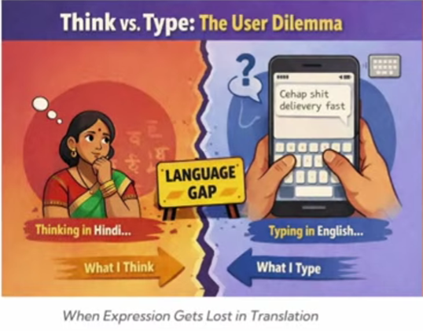
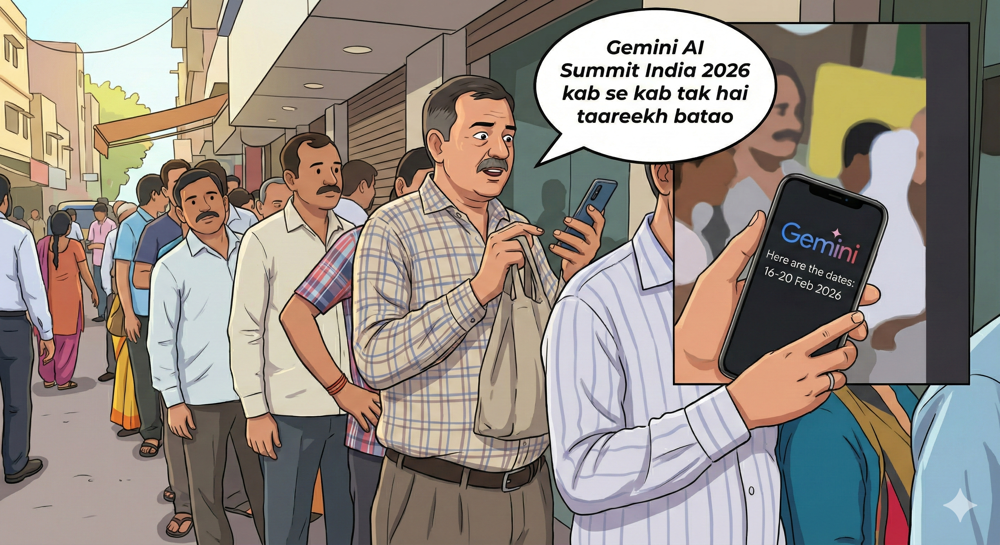
Background
Indian AI is going to run on Voice – solves typing problem/ screen coverage

Slide 3
Background
ASR has evolved from probabilistic models (Hidden Markov Model, Gaussian Mixture Model) to deep-learning architectures including RNN-T and transformer sequence-to-sequence model like whisper.
Field underwent a paradigm shift with Whisper ( a transformer sequence-to-sequence model)
Its features:
Multilingual support
Adaptability to suit specific use-cases
High accuracy and robustness to noise
Existing ASR systems are trained on monolingual corpora i.e. language specific.

Slide 4
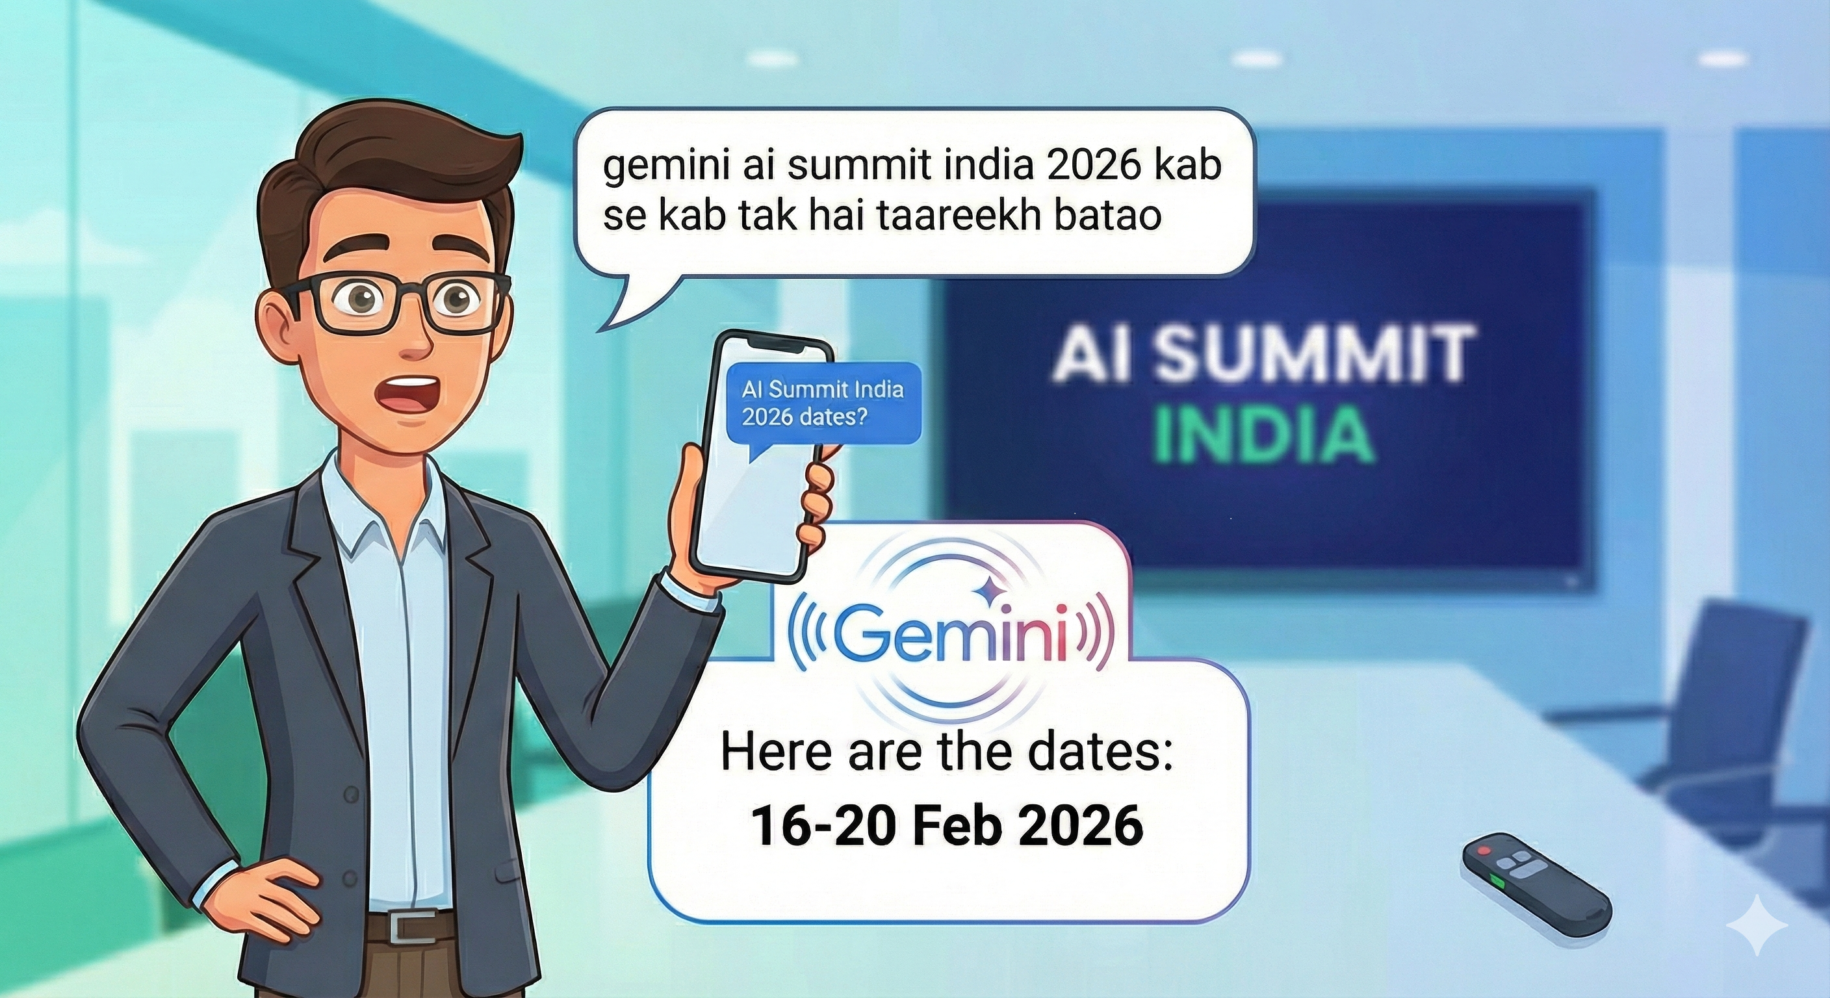
Background
Code-Switching
Practice of alternating between two or more languages or language varieties in a single discourse
Example: “kal meeting schedule kar dena”
kal – Hindi
meeting – English
schedule – English
kar – Hindi
dena – Hindi
switching within a sentence
Why code switching is hard for ASR
Traditional ASR assumes one language, one language model and one phoneme inventory.
But Hinglish as Hindi grammar as well as English words, Indian accented English, Mixed phonetics and variable pronunciation.
Causes confusion in language modelling.

Slide 5
Problem Statement
To design and empirically evaluate a parameter-efficient fine-tuning ASR framework that
Reduces Word Error Rate (WER) on Hinglish speech
Enhances robustness across multiple SNR conditions
Preserves multilingual generalization
Operates within limited computational constraints
Measurable Research Goals
Achieve significant WER reduction over baseline Whisper-base.
Quantify performance across SNR levels (5-20dB)

Slide 6
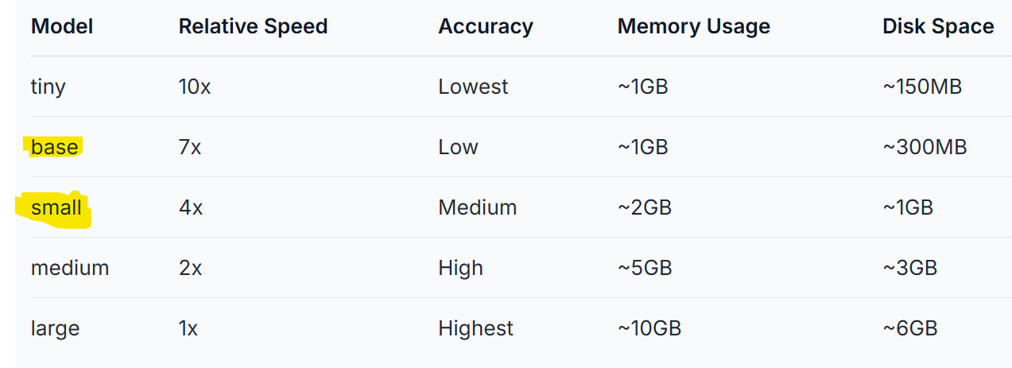
Methodology, Datasets, and Tools used
Model
Dataset
https://huggingface.co/datasets/ujs/hinglish - Hugging face wrapper for OpenSLR 104
dataset by IIT Madras.

Slide 7
Methodology, Datasets, and Tools used
Methodology
Dataset preparation → Fine-tuning → Metrics Comparison
Metrics: WER (Word Error Rate), CER (Character Error Rate)
Deep Learning Framework
Pytorch
Development Environment
Google colab

Slide 8
Results 1

Slide 9
Results 2

Slide 10
Conclusions

