Slide 1
Fact_Checker Group name : SmartBV2
Vineet Vasishta Eranki 6818911
Sandeep Varma Ganaraju 6787429
GitHub repo: https://github.com/SmartBV2/Fact_Checker
Branch: Hits_Algo

Slide 2
Overview
Earlier approaches
Implemented approach
Algorithm design
Evaluation results
Task Division

Slide 3
Earlier approaches
Naïve:
Corpus creation: New York Times 2013
Corpus analysis: Stanford NER, FOX
Graph DB
Inspiration from "Computational fact checking from knowledge networks" paper.
Corpus analysis: Neo4J

Slide 4
Implemented Approach
Corpus creation: On the Fly using FOX and DBpedia
Corpus analysis: Hits_Algo
Confidence value between 0 [False] and 1 [True]

Slide 5
Algorithm : Hits_Algo
Reading of data from file
FactID and Fact_Statement
Pass the Fact_Statement as input to FOX.
FOX uses NLP algorithms to extract RDF triples.
Store the JSON format and identify the entities.(e.g.Person)
Search in DBpedia by entity by considering the Infobox data of Wikipedia.
Store the results.

Slide 6
Parse the sentence and clean the text for stop words.
Tokenization of words.
Removal of searched entity from the tokens.
Searching of tokens in the DBpedia Output.
Count of number of matching words.
Calculation of confidence value = matched tokens/ total tokens.
Writing of confidence value in TTL format.

Slide 7
Text input:
Nobel Prize in Physiology or Medicine is David Baltimore's honour.
Applying NER using FOX:
Search in DBpedia:
http://dbpedia.org/data/David_Baltimore.json
Cleaning of stop words and Tokenization:
Nobel, Prize, Physiology, Medicine, David, Baltimore, honour
After Removal of searched token:
Nobel, Prize, Physiology, Medicine, honour
Finding matched words:
Nobel, Prize, Physiology, Medicine
Matched words: 4
Total tokens: 5
Calculation of confidence:
Matched words/ Total tokens = 0.8

Slide 8
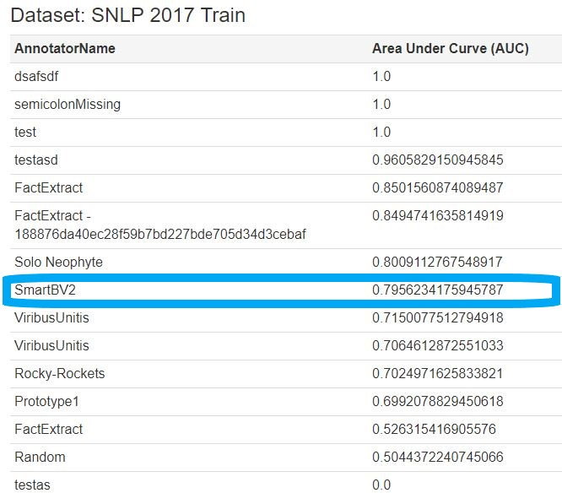
Evaluation Results

Slide 9
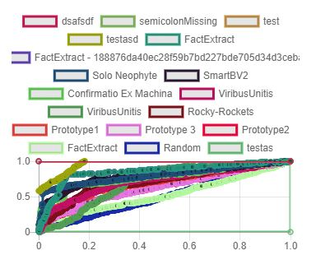
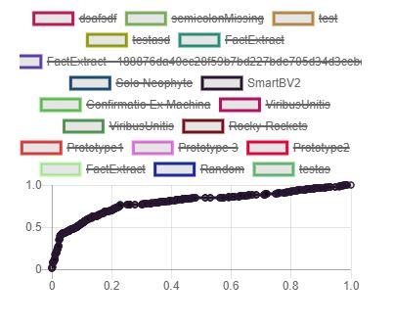
Train Data: ROC

Slide 10
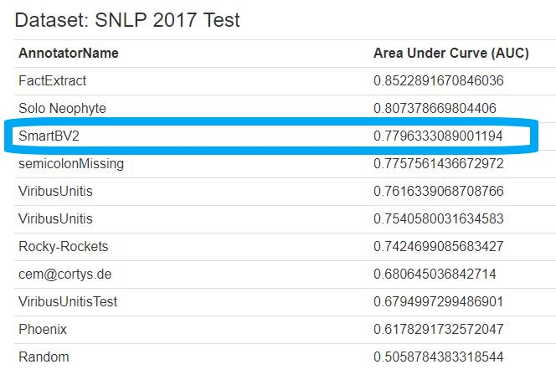

Slide 11
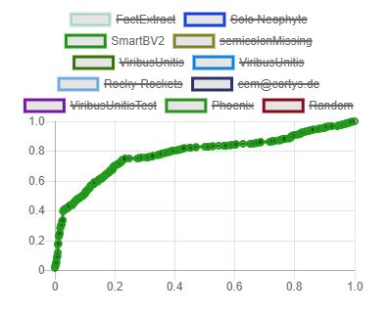
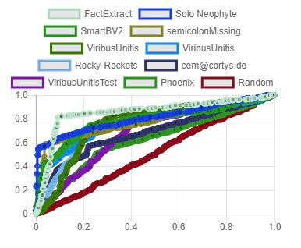
Test Data: ROC

Slide 12
Task Distribution
Tasks | Done by
Updating Wiki | Varma
Reading and Writing into file | Vineet
Parsing of data into FOX | Varma
Reading Json format and obtain entity | Varma
Search by entity in DBpedia | Varma
Tokenization of sentence | Vineet
Cleaning of stop words | Varma & Vineet
Comparison of DBpedia and token | Vineet
Calculation of confidence | Vineet

Slide 13
Thank you.

