Slide 1
Web Standards
About web standards & methods used in most of the sites.

Slide 2
The GET Method
Note that the query string (name/value pairs) is sent in the URL of a GET request:
/test/demo_form.asp?name1=value1&name2=value2
Some other notes on GET requests:
GET requests can be cached
GET requests remain in the browser history
GET requests can be bookmarked
GET requests should never be used when dealing with sensitive data
GET requests have length restrictions
GET requests should be used only to retrieve data
http://www.w3schools.com/tags/ref_httpmethods.asp
Notes:
http://www.w3schools.com/tags/ref_httpmethods.asp

Slide 3
The POST Method
Note that the query string (name/value pairs) is sent in the HTTP message body of a POST request:
POST /test/demo_form.asp HTTP/1.1 Host: w3schools.com name1=value1&name2=value2
Some other notes on POST requests:
POST requests are never cached
POST requests do not remain in the browser history
POST requests cannot be bookmarked
POST requests have no restrictions on data length
Notes:
http://www.w3schools.com/tags/ref_httpmethods.asp

Slide 4
Web Form Validation
https://www.smashingmagazine.com/2009/07/web-form-validation-best-practices-and-tutorials/
WHAT TO VALIDATE
REQUIRED INFORMATION
Information without which operation cannot be completed successfully
Avoid unwanted or optional information fields
CORRECT FORMAT
email address, URL, dates, phone numbers
CONFIRMATION FIELDS:
Get confirmation by getting data again like for Passwords/ emails

Slide 5
Web Form Validation
SERVER-SIDE VALIDATION
Information is being sent to the server & validated using one of server-side languages.
If the validation fails, the response is then sent back to the client, page that contains the web form is refreshed and a feedback is shown.
Work even if JavaScript is turned off in the browser
Ajax calls to the server can validate as you type and provide immediate feedback. eg: validating rules such as username availability

Slide 6
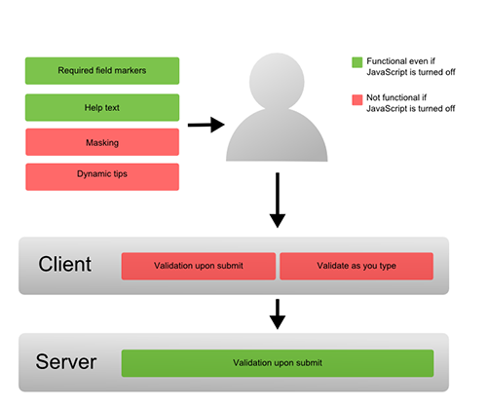
Differences between client-side and server-side validation

Slide 7
Web Form Validation
CLIENT-SIDE VALIDATION
Server-side validation is enough to have a successful and secure form validation. but
Client-side validation provides better user experience.
With client-side validation, form never gets submitted if validation fails.
Main drawback
It relies on JavaScript- If users turn JavaScript off, they can easily bypass the validation
Combining both side validation we get:
fast response,
more secure validation and
better user experience.

Slide 8
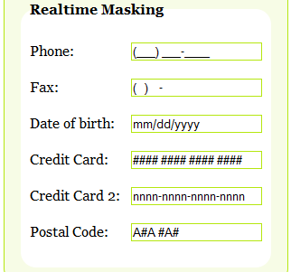
Realtime Masking
REAL-TIME VALIDATION (OR INSTANT VALIDATION)
real-time-validation alerts users while they are filling in the form.
MASKING AND REFORMATTING USER’S INPUT
Apart from validating user’s input and assisting users, web applications can also take part in providing correct data by formatting user’s input. This can be done by masking input fields in order to force users to enter information in an appropriate format.
iMask
TypeCast
jQuery Masked input plugin
Typecast

Slide 9
Performance Testing
Performance testing should be done to ensure that heavy load will not break the web application.
This includes – Load Testing and Stress testing.
In web load testing, testing should be done to ensure that, system can sustain in peak load times, site can handle simultaneous user requests, large input data from users, simultaneous connection to db, heavy load on specific pages etc.
Web stress testing should be done to break the system by giving stress and to ensure that it is capable of recovering from crashes.

Slide 10
Responsive Web Design
It’s a set of techniques and ideas
usage of what’s known as a fluid grid
Fluid grids go a few steps beyond the traditional liquid layout. Instead of designing a layout based on rigid pixels or arbitrary percentage values, a fluid grid is more carefully designed in terms of proportions. This way, when a layout is squeezed onto a tiny mobile device or stretched across a huge screen, all of the elements in the layout will resize their widths in relation to one another.

Slide 11
UNIT TEST JS

