Slide 1

ANTENNA THEORY AND SIMULATION (YAGI)
SSP MINI PROJECT
BY-VINEET GALA
(COMM SUBSYSTEM)

Slide 2
Aim Of The Project
To simulate the Yagi antenna (ground station) for 145 Hz frequency and analyze results.
Study factors which antenna parameters depend on.

Slide 3
Approach
Read about antenna parameters and theory associated.
Referred a couple of tutorials on HFSS.
Got used to HFSS by making simple antenna models and proceed step by step.
Structured and planned simulations for different configurations of antenna.

Slide 4
About Antennas
How antennas work?
Antenna parameters-
Gain
Radiation Pattern
Directivity
S11

Slide 5
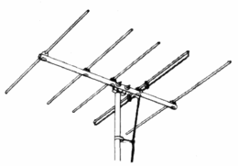
More About Antennas
Dipole antenna
Yagi antenna
Why use a Yagi antenna?

Slide 6
Achieving The First Milestone
By the end of week 1, I made a simple dipole antenna powered by source via a coaxial cable.
I learnt how to simulate and how to view and analyse results of the simulation such as S11 for different antenna lengths (optimetrics), gain etc.

Slide 7
Achieving The Second Milestone
By the end of second week, I made a simple Yagi antenna model and started simulations
What difference does a reflector and 1, 2, 3 directors make?
Antenna | Maximum Gain (dB)
Dipole | 2.3805
Yagi (1 reflector, 1 director) | 7.1425
Yagi (1 reflector, 2 directors) | 7.6902
Yagi (1 reflector, 3 directors) | 8.0146

Slide 8
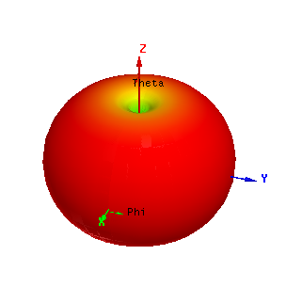
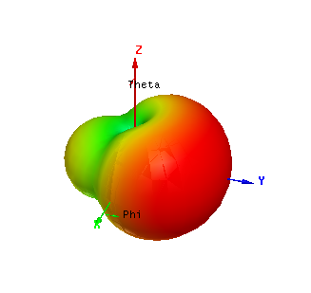
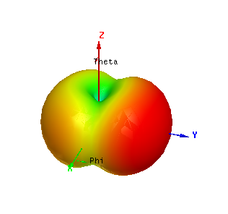
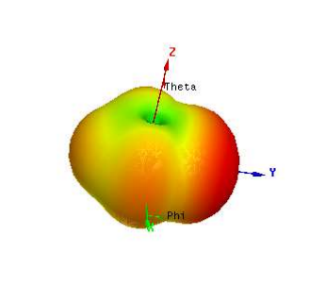
Radiation
Patterns
Dipole
Yagi – 1 ref, 1 dir
Yagi – 1 ref, 2 dir
Yagi – 1 ref, 3 dir

Slide 9
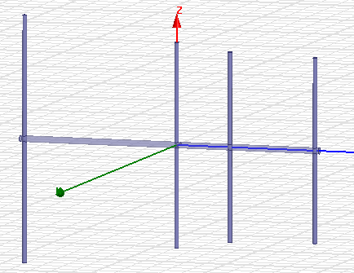
Achieving The Final Milestone
Added the boom to the setup but faced problems (for later).
Simulated the antenna for different distances of reflector, directors from feed pole.

Slide 10
Analysis
Reflector Distance (mm) | Maximum Gain (dB)
735 | 7.6799
740 | 7.6902
745 | 7.6485
750 | 7.6324
Dir 1 Distance (mm) | Dir 2 Distance (mm) | Maximum Gain (dB)
270 | 680 | 7.6687
250 | 680 | 7.6794
270 | 660 | 7.5824
250 | 660 | 7.5997
258.75 | 672.75 | 7.6120

Slide 11
Problems
Unavailability of HFSS license initially.
Unable to simulate the Aluminium Boom.
Long time taken for simulating models with optimetrics – which failed because I could not see the results for the concerned variable.
Garbage reports popping up due to some small mistakes.

Slide 12
Takeaway Lessons
Most of what I know about wireless communication.
Tracked satellites and received information.
Other subsystems’ work.
Managing time, sleep and academics.
Working in a team and being answerable for my work – being consistent.

Slide 13
Feedback
The Mini Project and Recruitment Process:
Busiest and most productive 3 weeks so far.
A very good idea to introduce a newcomer to the ways of the team.
Mentor: Atharv Savarkar
Go-to Person for any problems related to my Mini Project at anytime.
Understanding and helpful.

Slide 14
THANK YOU!

Slide 15
APPENDIX

Slide 18
https://github.com/vineetgala/SSP_Mini_Project

