Slide 1
Cache-oblivious Iterated Predecessor Queries via Range Coalescing
6.851 – Advanced Data Structures
Final Project
Vineet Gopal & Will Hasenplaugh

Slide 2
L₁
L₂
...
L_{k}
value

Slide 3
iterated predecessor query:
q
L₁
L₂
...
L_{k}
value

Slide 4
q
L₁
L₂
...
L_{k}
value

Slide 5
range coalescing:
L₁
L₂
...
L_{k}
value

Slide 6
O(k) elements
L₁
L₂
...
L_{k}
value

Slide 7
splitters
L₁
L₂
...
L_{k}
value

Slide 8
L₁
L₂
...
L_{k}
value

Slide 9
L₁
L₂
...
L_{k}
value

Slide 10
L₁
L₂
...
bin: k list subsequences
L_{k}
value

Slide 11
Query
QUERY(H, q)
⟨D,s⟩ = vEB(H.S,q)
j=1
for i=1 to D.size
if D_{i} ≤ q
Z_{j}= D_{i}
if D_{i+1} < s
j++
return Z

Slide 12
Query
QUERY(H, q)
⟨D,s⟩ = vEB(H.S,q)
j=1
for i=1 to D.size
if D_{i} ≤ q
Z_{j}= D_{i}
if D_{i+1} < s
j++
return Z
s
value
contents of D

Slide 13
Query
QUERY(H, q)
⟨D,s⟩ = vEB(H.S,q)
j=1
for i=1 to D.size
if D_{i} ≤ q
Z_{j}= D_{i}
if D_{i+1} < s
j++
return Z
s
value
i:
1
2
3
4
...
|D|
contents of D

Slide 14
Query
QUERY(H, q)
⟨D,s⟩ = vEB(H.S,q)
j=1
for i=1 to D.size
if D_{i} ≤ q
Z_{j}= D_{i}
if D_{i+1} < s
j++
return Z
O(k) elements
q
contents of D

Slide 15
Query
QUERY(H, q)
⟨D,s⟩ = vEB(H.S,q)
j=1
for i=1 to D.size
if D_{i} ≤ q
Z_{j}= D_{i}
if D_{i+1} < s
j++
return Z
monotonically increasing
subsequences
j:
1
2
3
...
k

Slide 16
Query
QUERY(H, q)
⟨D,s⟩ = vEB(H.S,q)
j=1
for i=1 to D.size
if D_{i} ≤ q
Z_{j}= D_{i}
if D_{i+1} < s
j++
return Z
initial elements
strictly less than s
j:
1
2
3
...
k

Slide 17
Query
QUERY(H, q)
⟨D,s⟩ = vEB(H.S,q)
j=1
for i=1 to D.size
if D_{i} ≤ q
Z_{j}= D_{i}
if D_{i+1} < s
j++
return Z
O(k/B) memory transfers

Slide 18
Bin Construction
ConstructBin(S, L, k, n)
t=1
for i=1 to n
j=1
while j < k
D[t] = *L[j]
t++
if *(L[j]+1) < S[i+1]
L[j]++
else
j++
return D
n
k

Slide 19
Bin Construction
ConstructBin(S, L, k, n)
t=1
for i=1 to n
j=1
while j < k
D[t] = *L[j]
t++
if *(L[j]+1) < S[i+1]
L[j]++
else
j++
return D
n
k
n bins and at least k different cache blocks per bin incurs
O(kn) memory transfers...

Slide 20
Bin Construction
ConstructBin(S, L, k, n)
t=1
for i=1 to n
j=1
while j < k
D[t] = *L[j]
t++
if *(L[j]+1) < S[i+1]
L[j]++
else
j++
return D
n
k
Z-ordering!

Slide 21
Bin Construction
ConstructBin(S, L, k, n)
t=1
for i=1 to n
j=1
while j < k
D[t] = *L[j]
t++
if *(L[j]+1) < S[i+1]
L[j]++
else
j++
return D
n
k
2^{r}
2^{r}
Consider the largest r for which O(2^{r}) cache blocks fit in cache

Slide 22
L₉
L₁₀
...
L₁₆
lists
bins
full block
non-full block
D₂₅
D₂₆
...
D₃₂

Slide 23
Z-order analysis
a2^{r} = M for some constant a > 0
nk/2^{2r} = a²nk/M² total cache flushes, each of M blocks
Total memory transfers:
a²nk/M = O(nk/B) when M=Ω(B)

Slide 24
Finding splitters
We have a randomized algorithm for finding splitters using O(nk/B) memory transfers. It is mostly just a bunch of Chernoff Bounds and not that interesting algorithmically (essentially just a variation of sample sort).

Slide 25
Implementation
Binary Search
vEB Layout Binary Search
Fractional Cascading
Range Coalescing
Quadratic Storage

Slide 26
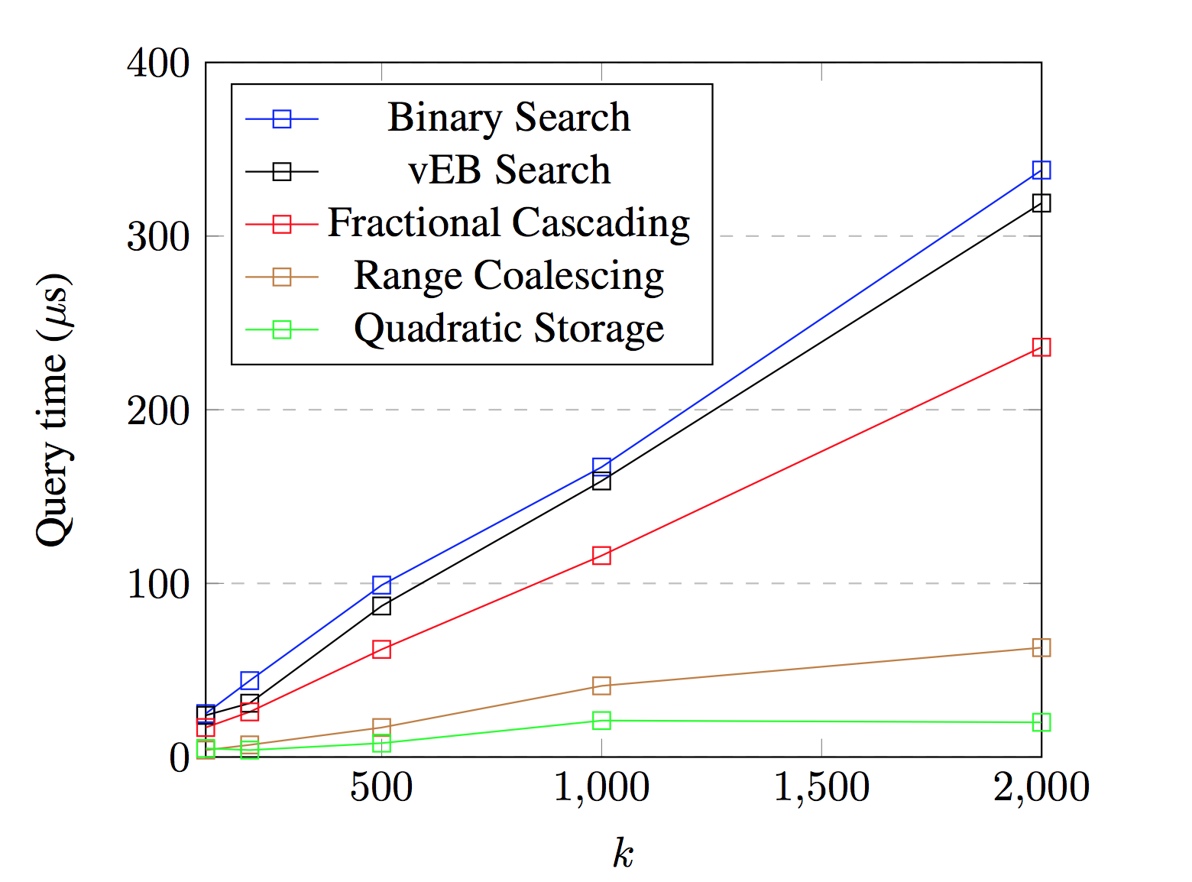
Query times vs k (fixed n=1000)

Slide 27
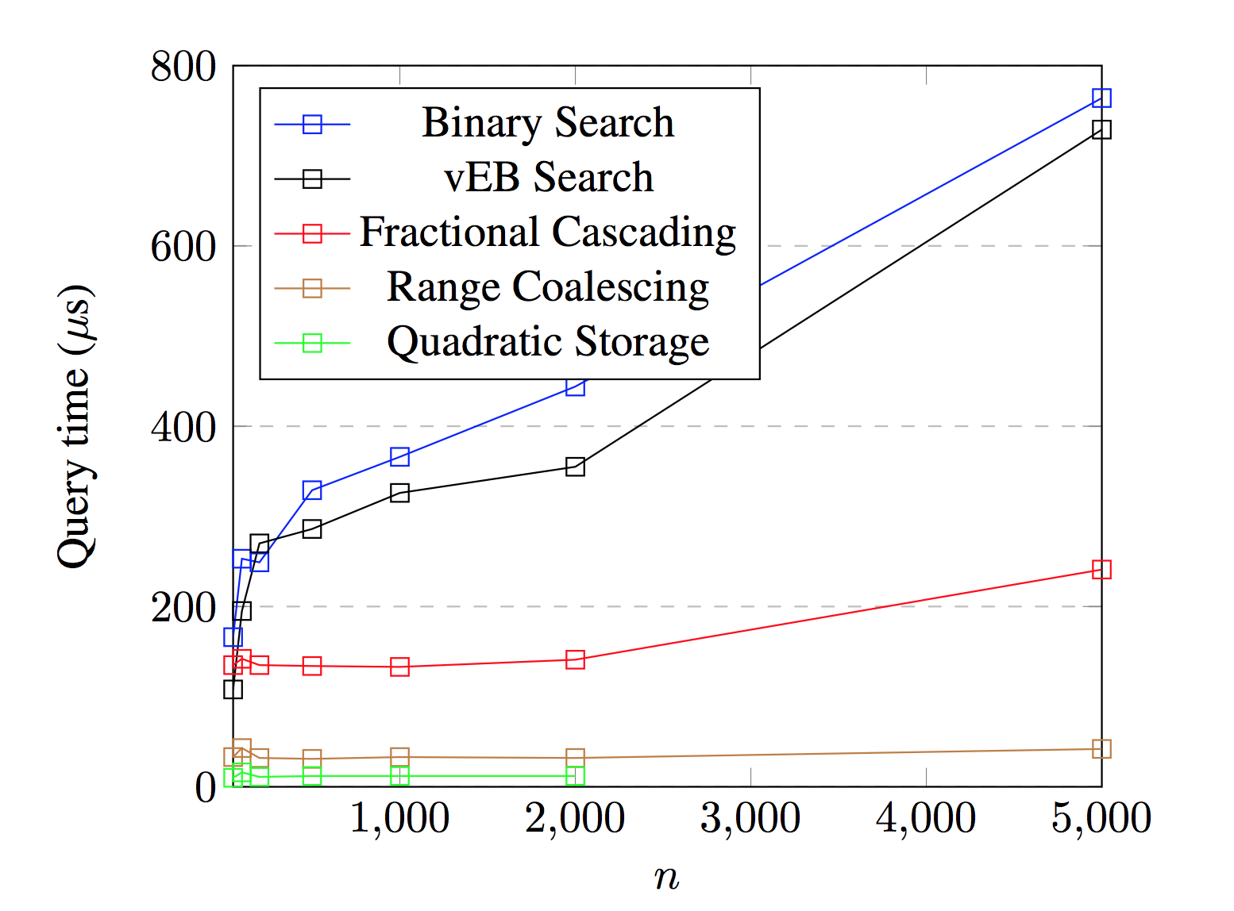
Query times vs n (fixed k=1000)

