Slide 1
Okta Application Onboarding Process
03/17/2021

Slide 2

Objectives
Define process for rapid application onboarding.
Provide repeatable “Patterns” and “Accelerators” for faster testing and implementation.
Application Onboarding Questionnaires

Slide 3

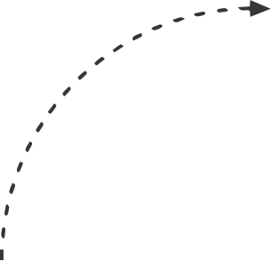
Onboarding Approach
The Application Onboarding Factory is comprised of accelerators, standards and processes that applications will follow during application onboarding process to Okta.
Management is advocating for all applications owner to migrate into Okta for SSO capabilities.
A designated source in SharePoint to retrieve information on application onboarding expectations.
Joint team effort is required between BA, Operation and Application teams to ensure a successful delivery.
Process
Accelerators
Integration Pattern

Slide 4
Current Application Onboarding Process
Current onboarding process consist of manually onboarding an application in the preview environment. Once UAT has concluded, the operation team will follow the same application onboarding steps performed in preview environment to migrate the application into production.
The image below shows a high-level flow of the current end-to-end application onboarding process:

Slide 5
Application Onboarding Process Maturity Level 1
Onboarding an application into Okta is typically performed in 6 phases (Preparation (Shared steps with Saviynt), Data Gathering/Intake form, Patterns Identification, Onboarding apps to preview tenant, User Acceptance Testing (UAT) and Production Deployment).
The image below shows a high-level flow of the end-to-end application onboarding process.
Preparation
Intake
Patterns
Onboarding
UAT
Production
Application Onboarding Survey
Onboarding
Kick-Off
Review Data
Promote App to Preview Tenant
Notify App Team to start UAT
Promote App to Production Okta
Scope Applications
Complete Questionnaire
Identify Patterns
Application changes
Conduct UAT
Application side changes in Production
Identify
App Owner / SMEs
Submit the Request
Based on integration Pattern, bucket apps in queue
Sanity testing
Address UAT Defects
Obtain App Team’s Commitment
UAT Sign off
Steps shared with Saviynt Onboarding Process
Distribute Onboarding Docs
Legend
PMO Team
Application Team
BA/Operation Team | Note: Once Saviynt will be ready then Intake Process and all tasks done through Script will move to Saviynt.
Tasks done via Scripts
Schedule Kick-Off

Slide 6
Comparison between Onboarding Processes
Below are the new features that will help accelerate application onboarding process within Okta.
Tasks | Current Process | New Process
Scoping of application for onboarding | No | Yes
Onboarding Process | Manual | Automated through Script
Bulk Onboarding | No | Yes
Automated testing | No | Yes
Onboarding document and test cases for each integration type | No | Yes
Onboarding Questionnaires | Yes | Yes (Additional questions added to determine integration pattern)

Slide 7
Integration Patterns
Below are the Cigna Preferred Integration Patterns for onboarding the applications in Okta
Integration Type | Application Type | Priority | Complexity | Onboarding Process
Okta pre-integrated applications | Application already present In OIN Catalog (e.g. Salesforce, Google Apps, Workday, etc.), | High | Low | Automated
SAML | Application support Service Provider (SP) Initiated or Identity Provider (IdP) Initiated Authentication with SAML 2.0 POST profile. | High | Medium | Automated
OIDC | Application require OIDC (authentication), OAuth (authorization) or both and support OIDC. | High | Medium | Automated
OAuth | Service application with no user (System to System) API Protection | Low | High | Manual
OKTA OIDC for Mobile apps | Mobile application developed on Android 5.0 (Lolipop) and above Native iOS application. | Low | High | Manual

Slide 8
Integration Patterns
Integration Pattern which will require discussion and approval before using it to onboard the applications in Okta
Radius
Secure web Authentication (SWA)
Reverse Proxies (Header based Authentication)
Web Services Federation (WS-Federation)
Kerberos/IWA (Not an Okta Supported Pattern)

Slide 9
Decision tree
Decision tree to select the integration option that best fits with Application for Onboarding

Slide 10
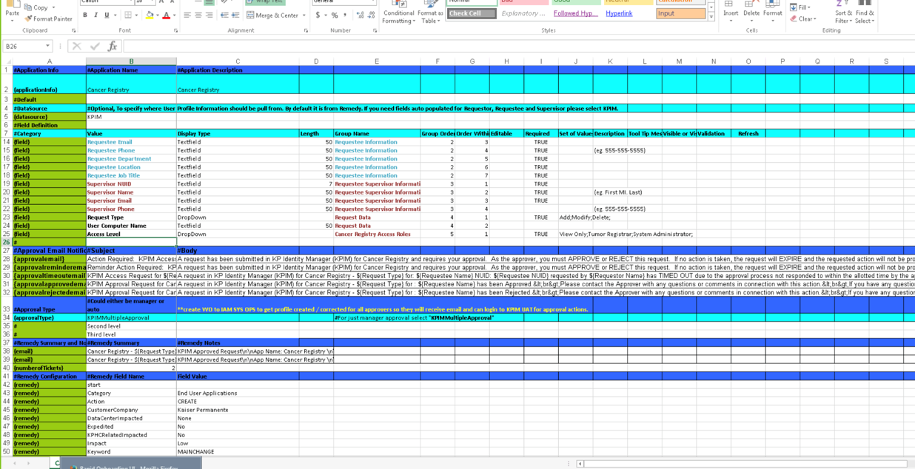
Accelerators Maturity Level 1
How Application Onboarding Script helps
Excel Template
Application Onboarding Script
From each application configuration taking hours it get down to mere minutes
A single file can be used to onboard multiple (possible 100s) of applications at the same time
Provide file based application onboarding. A team member without intimate knowledge of Okta product can be trained to fill up the XLS document
Manual errors completely eliminated on application onboarding
To move between environments use source controlled version of XLS
Supported Functionalities
Onboard the applications in bulk
Automated testing after onboarding
Create Okta Groups
MFA Factor enrollment
Decommissioning of application.
✓
Product APIs

Slide 11
Accelerators Maturity Level 2
MFA Enrollment Tool
How Application Onboarding Script helps
Excel Template
Application Onboarding Script
From each application configuration taking hours it get down to mere minutes
A single file can be used to onboard multiple (possible 100s) of applications at the same time
Provide file based application onboarding. A team member without intimate knowledge of Okta product can be trained to fill up the XLS document
Manual errors completely eliminated on application onboarding
To move between environments use source controlled version of XLS
Supported Functionalities
Onboard the applications in bulk
Automated testing after onboarding
Create Okta Groups
MFA Factor enrollment
Decommissioning of application.
✓
Product APIs

Slide 12
Onboarding Process Through Saviynt

Slide 13
Application Onboarding Form (Questionnaire)
Application Data
Is the application hosted on the premises or in the Cloud?
Is the application a custom build or COTS (Commercial Off The Shelf)?
Application type (Web, Thick Client, Mainframe, Hybrid?, Native/Mobile, Other)
Users who access application? (Permanent, Contractor, Service Provider, Customer)
Identity store/directory used by application? (Okta AD, ADFS, SAP, OID, Local, Azure AD, Other)
Will Okta being acting as the IDP or the SP?
Available Environments (Dev, Test, Preprod, Prod) with URL's
What type of End-user authentication is currently used? (SAML, AD Password, Local User ID, Password, IWA, OAuth2, Other)
Does the Application support industry standard authentication & authorization protocols? (SAML, OAuth, OIDC, etc.)
Are there any technical interfaces, APIs etc. which can be used to access application data? If so, please provide this information. (used for securing endpoints for synchronizing user data or application endpoints for reporting, external application integrations, etc.)
If the application type is not able to be integrated and there are no technical interfaces, can an extract be provided in a structured comma-delimited CSV file?
Does the application have a mobile application? If so, what mobile OS's are supported by the mobile application?
Does the mobile application support SAML authentication?

Slide 14
Application Onboarding Form (Questionnaire)
General Application Information
Application Name
Application Inventory ID #
Application Description
Application Owner and Contact Details
General Identity Store Information
Identity Store Name
Is the Identity Store on-premises or in the Cloud?
What type of Identity Store? (ADFS, SAP, OID, Local, Azure AD, SaaS HR, Other)
Directory version? (AD 2016, etc.)
What attribute is currently used to uniquely identify each account? E.g. Global ID, Email address
Is there an attribute that is used to correlate application accounts to Identity Store?
What different type of accounts exist within the identity store? E.g. system accounts, disabled users, third party accounts and how are they identified?
Application Connectivity
IP Address / FQDN
Port Details
Service Account credentials for connecting to the application
Details of any special considerations (drivers, firewall, WAN, cloud, etc.)
What are the number of production users?
Peak Logins Per Day?
Peak Concurrent Usage?
What type of load balancing is used to route to you application web servers? (i.e. Location / Topology, Round Robin, Failover)

Slide 15
Application Onboarding Process for Preview Tenant Maturity Stage 1

Slide 16
Migration of Application from Preview to Production Tenant Maturity Stage 1

Slide 17
Application Onboarding Form (Questionnaire)
Application Users
Is the user uniquely identified in the application?
Is there an attribute that is used to correlate application accounts to Identity Store?
Is Birthright access supported for this application?
Is the Entitlement repository stored internally or externally?
How is user access determined? (Group membership, Individual, Other?)
Role Based Access: What roles / AD group memberships are required to access this application? This is not used for fine grained access within an application.
What attributes / criteria determine application access rights for users? E.g. Access given based on specific job titles / functional area?
What different type of accounts exist within the application? E.g. system accounts, disabled users, third party accounts and how are they identified?
Is this application directly linked or embedded (cross dependencies) with another application?
Is there an existing SSO that is being replaced? (ADFS, Azure AD, Okta, OIM?, Other)
Is there current MFA that is being replaced? (Type: OTP, Biometric, Token (VIP), Other)
Is there step-up authentication used within the application?
Are there any special use cases that MFA is used?
Adaptive or Risk Based Authentication used?
What is the total number of concurrent users for this application?

Slide 18
Application Onboarding Form (Questionnaire)
Application Group Assignment
Does Okta Application Groups exist in AD or need to be created?
Should an existing AD Group be used for this application?
AD Group Name
Should an Okta Mastered group be used for this application?
Are Group rules required for user assignment to Okta Group?
User Attribute for Okta Group Assignment?
Group Membership for Okta Group Assignment?
Group Assignment Name?
Identity Store Administration
How does a user get provisioned in the identity store currently?
Current provisioning system? (OIM, Azure AD, Okta, SailPoint, Ping, Other)
Provisioning method? (Agent, API, SAML, JIT, Manual, Other)
Who performs the account administration and user provisioning for this application? E.g. AskIT / application team
Is there a Ticketing system in place, currently? (e.g. ServiceNow)
What happens when a user is deprovisioned? (Deleted, disabled? HR?)
How is Password management handled? (Azure AD, OIM, Local Application, Other)

