Slide 1
Azure Talkbook
Version DRAFT
May 07, 2020

Slide 2

Overview
I
Introduction
II
KPMG with Microsoft
III
Capability framework and reference architecture
IV
Securing with Azure
V
Our perspective
VI
Case studies

Slide 3
Cloud context and focus has changed
Introduction
Cloud is fundamentally changing all aspects of the digital business ecosystem. The role and requirements of security are changing as organizations learn from their cloud journey.
Today’s technology
New World
Single Platform
Lift and shift; use security we already have
Lower risk data and nominal volumes
Multi Cloud
Build and secure natively
Mission critical and highly regulated data; massive volumes
Security as technology problem
Cloud or app teams can handle security
Security as a standards, governance and technology problem
Cloud security requires cross-team involvement
Deploy cloud first, security as afterthought
Largely still perimeter and network based
Security by design across platform and applications
Data, identity, and API-focused security
Largely waterfall with aspirations of continuous
Limited automation (still somewhat manual)
Continuous integration and deployment is non-negotiable
Automate everything
Cloud is a foundational digital enabler of business outcomes with the agility to evolve with the business:
Idea to production at speed & scale
Everything as a service
Built-in Security
Cloud

Slide 4

Differentiated approach
KPMG with Microsoft
Harnessing Digital Automation to accelerate enterprise intelligence, enhance customer centricity, and deliver operational efficiencies, all in the secure Microsoft Azure cloud
Joint
Innovation
Financial Services
Cloud Transformation
KPMG Solutions and Use Cases
in Market
Power of Alliance
Healthcare & Lifesciences
Business Applications
Asset Management
Powered Sales
Powered Finance
KPMG Trusted Cloud
Citizen Engagement
Intelligent Case Management
Intelligent Underwriting
Sales Intelligence Engine
Outmaneuver Competition
Innovate Right Products and Services
Federal Government
Data & AI
Clients
Business
and Industry
Solutions
Disruption
Pace of Change
State & Local Government
Workplace
of the Future
Adopting New Business Models
Attract and Retain Customers
Retail & Consumer
Cyber Security
Industrial Markets
Blockchain
Global Scale
Continuous Innovation
Client
Centricity

Slide 5
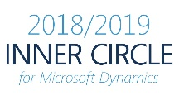
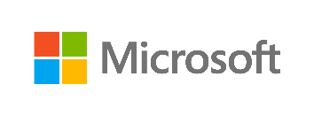
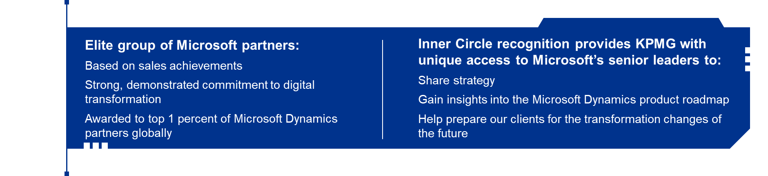
Alliance is award winning
KPMG with Microsoft
Business Applications
Artificial Intelligence
2018 Innovation Partner of the Year - Consulting & SI Cloud
2018 Partner of the Year Finalist - Health Award
Gold Application Development
Gold Data Analytics
Gold Customer Relationship Management
Gold Enterprise Resource Planning
Gold Collaboration and Content
Silver Data Platform
Silver Learning
HfS Top 10 Microsoft AI services 2019 report assessed and rated MSFT AI services and capabilities and
Microsoft Partner
named
#1
for Microsoft services delivery
For Microsoft Artificial Intelligence
#1
in AI strategy
Highlighted KPMG was a critical partner for Microsoft’s AI strategy

Slide 6

KPMG has 1350+ practitioners delivering Microsoft services across 152 countries
KPMG with Microsoft
KPMG Global Footprint
Global KPMG Cyber Practice Team Members
1,350+
207,000+ professionals
In the United States
10,500+ partners
2,200+ partners
$9.5Bn in revenue
700+ offices
D365 Delivery Centers
India
Malta
>$29Bn in revenue
50 States
35,000+ professionals
153 Countries operational
100 offices
KPMG’s Services include:
Strategic planning
Roadmap development/business case creation
Full solution delivery through implementation and post-production support
Diagnostics (current state assessment; proprietary maturity model)
Solution design and architecture
To be updated
US KPMG Cyber Practice Team Members
175+

Slide 7






















Cloud security capability mapping: Azure
Capability framework
KPMG’s Cloud Security Capability framework provides a tool-agnostic and leading-practice model to help organizations assess, design, build, deploy, test, operate & monitor secure workloads across multi-cloud environments.
Azure Services
Security Compliance
Control Automation
Reporting
Cloud Security Governance
Engineering
Data
Code Repository & Integrity
Secure SDKs
Encryption & Obfuscation
Secrets & Key Management
Threat Modeling
Secure Code Review
Data Lifecycle Management
Data Discovery
Secure Cloud Development
Secure Cloud Platform
Application
Testing
Certificate Lifecycle
Web Application Firewall
SAST & DAST Analysis
Penetration Testing
Web Application Scanning
API Security
Secure Cloud Operations
Host
Deployment
Anti-malware Protection
Container Security
Automated Resource Provisioning
Asset Inventory
Virtual Machine Integrity
Virtual Machine Access
Automated Build & Releases
Network
DDOS Mitigation
Network Traffic Management
Perimeter Security
VPN
Logging & Auditing
Monitoring
Vulnerability Management
Change & Configuration Management
Logging
Auditing
Monitoring & Alerting
Threat Intelligence
Automated Patch Management
Vulnerability Remediation
Policy Orchestration
Change & Configuration Rule Orchestration
UEBA
Access Management
SSO & Federation
Authorization
MFA & Adaptive Access
Directory Services
Privileged Access Management
Availability & Scalability
Failover & Redundancy
Backups & Recovery
Auto Scaling

Slide 8














Cloud security capability mapping: Azure
Capability framework
KPMG’s Cloud Security Capability framework provides a tool-agnostic and leading-practice model to help organizations assess, design, build, deploy, test, operate & monitor secure workloads across multi-cloud environments.
Azure Services
Security Compliance
Control Automation
Reporting
Azure
Repos
Azure
Policy
Cloud Security Governance
Engineering
Data
Azure
KeyVault
Azure
Blueprints
Code Repository & Integrity
Secure SDKs
Encryption & Obfuscation
Secrets & Key Management
Application Firewall
Reports
Threat Modeling
Secure Code Review
Data Lifecycle Management
Data Discovery
Secure Cloud Development
Secure Cloud Platform
Application
Azure AD
Azure VPN
Testing
Certificate Lifecycle
Web Application Firewall
SAST & DAST Analysis
Penetration Testing
Web Application Scanning
API Security
Azure Artifacts
Azure Monitoring
Secure Cloud Operations
Host
Deployment
Anti-malware Protection
Container Security
Azure
Resource
Manager
Conditional Access
Automated Resource Provisioning
Asset Inventory
Virtual Machine Integrity
Virtual Machine Access
Azure Pipeline
Cloud App Security
Automated Build & Releases
Network
DDOS Mitigation
Network Traffic Management
Database Encryption
Azure Automation
Perimeter Security
VPN
Data
Discovery
Backups
Logging & Auditing
Monitoring
Vulnerability Management
Change & Configuration Management
Logging
Auditing
Monitoring & Alerting
Threat Intelligence
Automated Patch Management
Vulnerability Remediation
Policy Orchestration
Change & Configuration Rule Orchestration
Traffic Manager
VM Scale Set
UEBA
Microsoft Defender ATP
Availability Sets
Access Management
SSO & Federation
Authorization
MFA & Adaptive Access
Directory Services
Privileged Access Management
Bastion
Activity Log
Availability & Scalability
Failover & Redundancy
Backups & Recovery
Auto Scaling

Slide 9












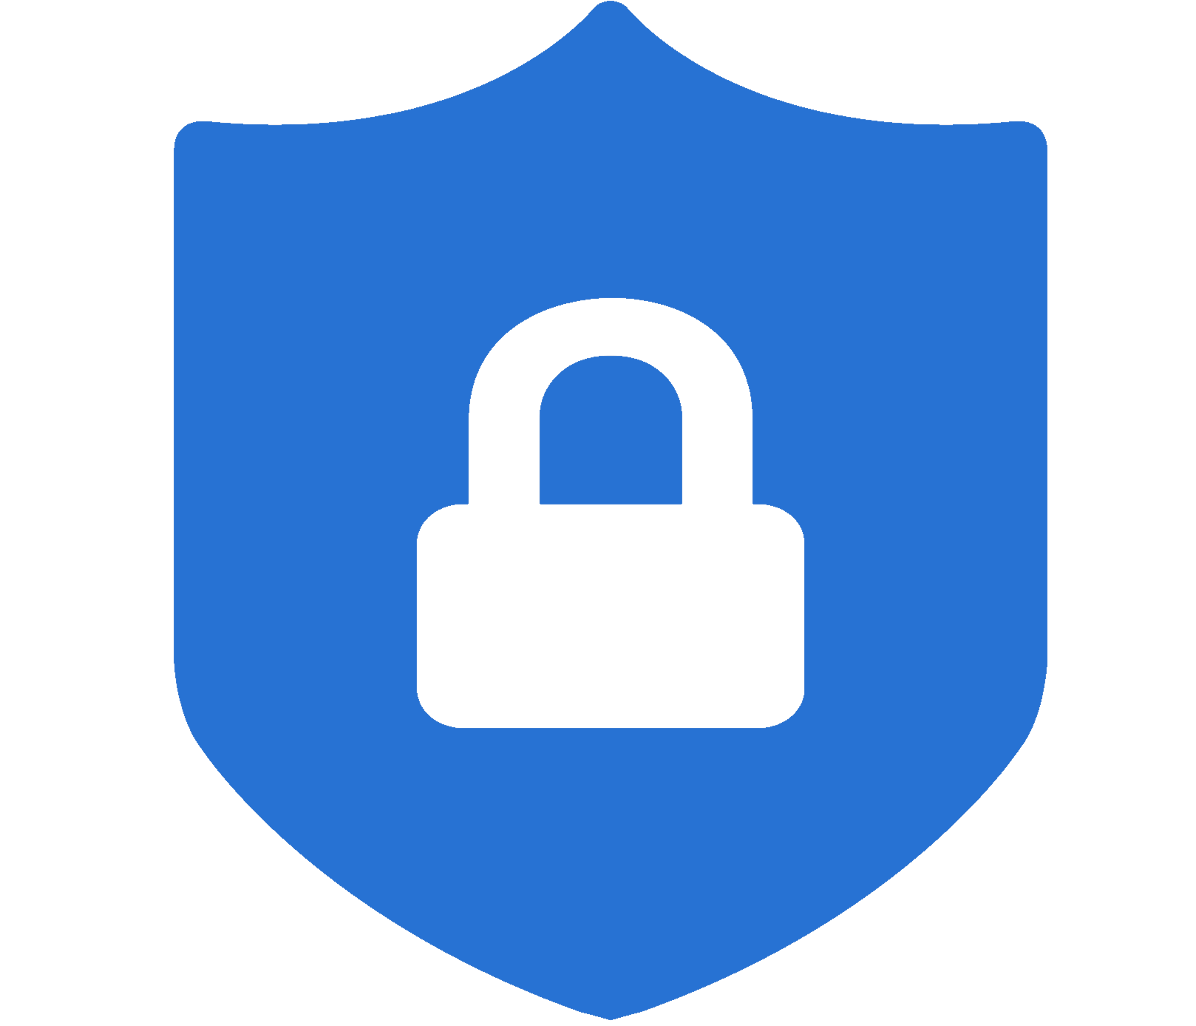


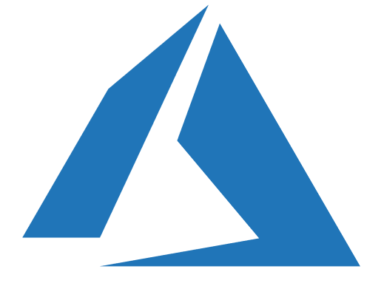





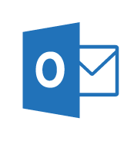

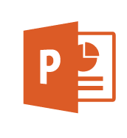
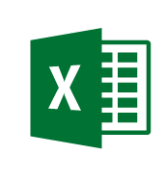



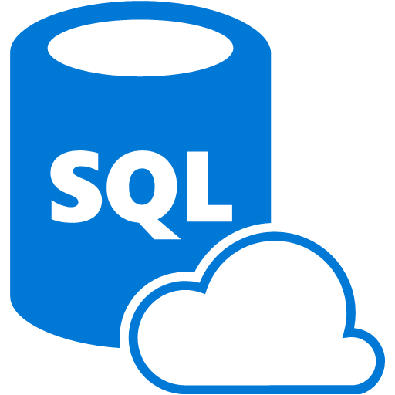
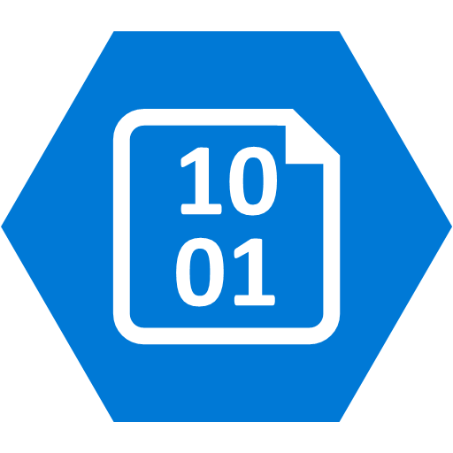


Security Operations Center (SOC)
Cybersecurity Reference Architecture
May 2018 – https://aka.ms/MCRA | Video Recording | Strategies
Software as a Service
Vulnerability Management
Cybersecurity Operations Service (COS)
Office 365
Incident Response and Recovery Services
Secure Score
MSSP
Azure
Security Center
Windows Defender
Office 365
Security & Compliance
Azure
Customer Lockbox
SIEM + Analytics
This is interactive!
Present Slide
Hover for Description
Click for more information
Roadmaps and Guidance
Securing Privileged Access
Office 365 Security
Rapid Cyberattacks (Wannacrypt/Petya)
Cloud App
Security
Advanced Threat Protection (ATP)
Dynamics 365
Identity & Access
Graph Security API (Public Preview)
Information Protection
Azure Active Directory
Alert & Log Integration
Conditional Access – Identity Perimeter Management
Clients
Hybrid Cloud Infrastructure
Cloud App Security
Azure AD Identity Protection
Leaked cred protection
Behavioral Analytics
Unmanaged &
Mobile Devices
On Premises Datacenter(s)
3rd party IaaS
Microsoft Azure
Azure Information Protection (AIP)
Discover
Classify
Protect
Monitor
Azure Security Center – Cross Platform Visibility, Protection, and Threat Detection
Configuration Hygiene
Just in Time VM Access
Azure AD PIM
NGFW
Security Appliances
Adaptive App Control
Multi-Factor Authentication
Intune MDM/MAM
Classification Labels
Extranet
Edge DLP
Azure Policy
Hold Your Own Key (HYOK)
Azure AD B2B
Managed Clients
SSL Proxy
AIP Scanner
IPS
Azure Key Vault
Azure AD B2C
Express Route
Azure WAF
Hello for Business
System Center Configuration Manager
Windows Server 2016 Security
Window 10 + Just Enough Admin, Hyper-V Containers, Nano server, and more…
Azure Antimalware
Office 365
Data Loss Protection
Data Governance
eDiscovery
MIM PAM
Windows Defender ATP
Network Security Groups
Azure ATP
Shielded VMs
VMs
Intranet Servers
Backup & Site Recovery
Azure Stack
Azure SQL
Threat Detection
Active Directory
Secure Score
Threat Analytics
Privileged Access Workstations (PAWs)
Disk & Storage Encryption
SQL Encryption & Data Masking
ESAE Admin Forest
IoT and Operational Technology
Included with Azure (VMs/etc.)
Premium Security Feature
Confidential Computing
Azure SQL Info Protection (Preview)
Windows 10 Enterprise Security
Network protection
Credential protection
Exploit protection
Reputation analysis
Full Disk Encryption
Attack surface reduction
App control
Isolation
Antivirus
Behavior monitoring
DDoS attack Mitigation+Monitor
Windows 10 IoT
Azure Sphere
IoT Security Maturity Model
Endpoint DLP
Azure IoT Security
IoT Security Architecture
Compliance Manager
S Mode
Security Development Lifecycle (SDL)
Trust Center
Intelligent Security Graph
Notes:
STATIC SLIDE VERSION (No Animations)
The Microsoft Cybersecurity Reference Architecture (https://aka.ms/MCRA) describes Microsoft’s cybersecurity capabilities and how they integrate with existing security architectures and capabilities. We recently updated this diagram and wanted to share a little bit about the changes and the document itself to help you better utilize it.
How to use it
We have seen this document used for several purposes by our customers and internal teams (beyond a geeky wall decoration to shock and impress your cubicle neighbors :-)
Starting template for a security architecture – The most common use case we see is that organizations use the document to help define a target state for cybersecurity capabilities. Organizations find this architecture useful because it covers capabilities across the modern enterprise estate that now spans on-premise, mobile devices, many clouds, and IoT/Operational Technology.
Comparison reference for security capabilities – We know of several organizations that have marked up a printed copy with what capabilities they already own from various Microsoft license suites (many customers don't know they own quite a bit of this technology), which ones they already have in place (from Microsoft or partner/3rd party), and which ones are new and could fill a need.
Learn about Microsoft capabilities – In presentation mode, each capability has a "ScreenTip" with a short description of each capability + a link to documentation on that capability to learn more.
Learn about Microsoft's integration investments – The architecture includes visuals of key integration points with partner capabilities (e.g., SIEM/Log integration, Security Appliances in Azure, DLP integration, and more) and within our own product capabilities among (e.g., Advanced Threat Protection, Conditional Access, and more).
Learn about Cybersecurity – We have also heard reports of folks new to cybersecurity using this as a learning tool as they prepare for their first career or a career change.
As you can see, Microsoft has been investing heavily in security for many years to secure our products and services as well as provide the capabilities our customers need to secure their assets. In many ways, this diagram reflects Microsoft massive ongoing investment into cyber security research and development, currently over $1 billion annually (not including acquisitions).
What has changed and why
We made quite a few changes in v2 and wanted to share a few highlights on what's changed as well as the underlying philosophy of how this document was built.
New visual style – The most obvious change for those familiar with the first version is the simplified visual style. While some may miss the "visual assault on the senses" effect from the bold colors in v1, we think this format works better for most people.
Interactivity instructions – Many people did not notice that each capability on the architecture has a quick description and link to more information, so we added instructions to call that out (and updated the descriptions themselves).
Complementary Content – Microsoft has invested in creating cybersecurity reference strategies (success criteria, recommended approaches, how our technology maps to them) as well as prescriptive guidance for addressing top customer challenges like Petya/WannaCrypt, Securing Privileged Access, and Securing Office 365. This content is now easier to find with links at the top of the document.
Added Section headers for each grouping of technology areas to make it easier to navigate, understand, and discuss as a focus area.
Added Foundational Elements – We added descriptions of some core foundational capabilities that are deeply integrated into how we secure our cloud services and build our cybersecurity capabilities that have been added to the bottom. These include
Trust Center – This is where describe how we secure our cloud and includes links to various compliance documents such as 3rd party auditor reports.
Compliance Manager is a powerful (new) capability to help you report on your compliance status for Azure, Office 365, and Dynamics 365 for General Data Protection Regulation (GDPR), NIST 800-53 and 800-171, ISO 27001 and 27018, and others.
Intelligent Security Graph is Microsoft threat intelligence system that we use to protect our cloud, our IT environment, and our customers. The graph is composed of trillions of signals, advanced analytics, and teams of experts hunting for malicious activities and is integrated into our threat detection and response capabilities.
Security Development Lifecycle (SDL) is foundational to how we develop software at Microsoft and has been published to help you secure your applications. Because of our early and deep commitment to secure development, we were able to quickly conform to ISO 27034 after it was released.
Moved Devices/Clients together – As device form factors and operating systems continue to expand and evolve, we are seeing security organizations view devices through the lens of trustworthiness/integrity vs. any other attribute.
We also re-organized the Windows 10 and Windows Defender ATP capabilities around outcomes vs. feature names for clarity.
We also reorganized windows security icons and text to reflect that Windows Defender ATP describes all the platform capabilities working together to prevent, detect, and (automatically) respond and recover to attacks. We also added icons to show the cross-platform support for Endpoint Detection and Response (EDR) capabilities that now extend across Windows 10, Windows 7/8.1, Windows Server, Mac OS, Linux, iOS, and Android platforms.
We also faded the intranet border around these devices because of the ongoing success of phishing, watering hole, and other techniques that have weakened the network boundary.
Updated SOC section – We moved several capabilities from their previous locations around the architecture into the Security Operations Center (SOC) as this is where they are primarily used. This move enabled us to show a clearer vision of a modern SOC that can monitor and protect the hybrid of everything estate. We also added the Graph Security API (in public preview) as this API is designed to help you integrate existing SOC components and Microsoft capabilities.
Simplified server/datacenter view – We simplified the datacenter section to recover the space being taken up by duplicate server icons. We retained the visual of extranets and intranets spanning on-premises datacenters and multiple cloud provider(s). Organizations see Infrastructure as a Service (IaaS) cloud providers as another datacenter for the intranet generation of applications, though they find Azure is much easier to manage and secure than physical datacenters. We also added Azure Stack capability that allows customers to securely operate Azure services in their datacenter.
New IoT/OT section – IoT is on the rise on many enterprises due to digital transformation initiatives. While the attacks and defenses for this area are still evolving quickly, Microsoft continues to invest deeply to provide security for existing and new deployments of Internet of Things (IoT) and Operational Technology (OT). Microsoft has announced $5 billion of investment over the next four years for IoT and has also recently announced an end to end certification for a secure IoT platform from MCU to the cloud called Azure Sphere.
Updated Azure Security Center – Azure Security Center grew to protect Windows and Linux operating system across Azure, on-premises datacenters, and other IaaS providers. Security Center has also added powerful new features like Just in Time access to VMs and applied machine learning to creating application whitelisting rules and North-South Network Security Group (NSG) network rules.
Added Azure capabilities including Azure Policy, Confidential Computing, and the new DDoS protection options.
Added Azure AD B2B and B2C – Many Security departments have found these capabilities useful in reducing risk by moving partner and customer accounts out of enterprise identity systems to leverage existing enterprise and consumer identity providers.
Added information protection capabilities for Office 365 as well as SQL Information Protection (preview).
Updated integration points – Microsoft invests heavily to integrate our capabilities together as well as to ensure use our technology with your existing security capabilities. This is a quick summary of some key integration points depicted in the reference architecture:
Conditional Access connecting info protection and threat protection with identity to ensure that authentications are coming from a secure/compliant device before accessing sensitive data.
Advanced Threat Protection integration across our SOC capabilities to streamline detection and response processes across Devices, Office 365, Azure, SaaS applications, and on Premises Active Directory.
Azure Information Protection discovering and protecting data on SaaS applications via Cloud App Security.
Data Loss Protection (DLP) integration with Cloud App Security to leverage existing DLP engines and with Azure Information Protection to consume labels on sensitive data.
Alert and Log Integration across Microsoft capabilities to help integrate with existing Security Information and Event Management (SIEM) solution investments.
Feedback
We are always trying to improve everything we do at Microsoft and we need your feedback to do it! You can contact the primary author (Mark Simos) directly on LinkedIn (https://aka.ms/markslist) with any feedback on how to improve it or how you use it, how it helps you, or any other thoughts you have.

Slide 10











Security reference architecture
Reference architecture
Governance
Azure Advisor
Azure Policy
Azure BluePrints
Managed
SaaS
Office 365
Box
Salesforce
Azure
Microsoft Defender ATP
Edge
Compute
Storage
KeyVault
Data from client
Application Gateway
Virtual Machines
Database
Advance Threat Protection
Unmanaged
Azure AD
On premise
Express Route
Azure Information Protection
Applications
Servers
App Proxy
Alerts
Activity
Logs
State
Access
Keys
Certificate
Microsoft Cloud App Security
State
Azure Firewall
Security Operations
Security Services
Azure Security Center
Alerts
Sentinel
Identity and Access Management
Credential Management

Slide 11
Azure security & management
Securing with Azure
Identity and Access Management
Universal platform to manage and secure identities.
Azure Active Directory
Microsoft Endpoint Manager
Threat Protection
Stop attacks with integrated and automated security.
Microsoft Defender
Advanced Threat Protection
Azure Sentinel (SIEM)
Azure DDoS Protection
Information Protection
Discover, classify, and protect sensitive data wherever it lives or travels.
Microsoft Information Protection
Microsoft Cloud App Security
Cloud Security Management
Safeguard cross-cloud resources.
Azure Security Center
Azure Security Center for IoT
Microsoft Cloud App Security
Graph API
Enhanced security through simplified and intelligent security management with Microsoft.
Visibility
Understand the security state and risk across resources.
Control
Define consistent security policies and enable controls.
Guidance
Elevated security through built-in intelligence and recommendations.

Slide 12
Identity and access management
Securing with Azure
Effectiveness of castle-and-moat architecture
Patchwork of IAM solutions
Managing identity across large number of SaaS applications
Changing threat landscape
Challenges
Azure AD provides MFA and conditional access to enable zero trust architecture.
Business process aligned with Azure AD can provide well integrated solutions.
Out of box support for the increasing number of SaaS applications in Azure AD.
Strong threat intelligence combined with continuous feature rollout.
Capabilities

Slide 13
Threat protection
Securing with Azure
Large capital expense for infrastructure and operations
Increasing operational complexity
Skill shortage and staff burnout
Growing attack complexity
Challenges
Eliminate infrastructure setup and maintenance costs and focus on security.
Continuous monitoring and automation allows support for large hybrid infrastructures.
Sentinel’s machine learning and AI detects threats; automation reduces user intervention.
Strong threat intelligence with improving machine learning capabilities.
Capabilities

Slide 14
Securing with Azure
Information protection
Manual classification
Protection across on-premise and SaaS products
Incorrect or stale classification
Cost of maintaining information protection
Challenges
Automatically classify and label information using machine learning and AI.
Native integration with Microsoft and third-party products.
Policies and controls for continuous evaluation ensure errors are identified and changes applied.
Pay as you go structure helps companies to reduce costs and focus on security.
Capabilities

Slide 15
Cloud security management
Securing with Azure
Proliferation of cloud services
Security baseline drift
Resource and skills shortage
New technologies like IoT
Challenges
Native integration with services along with comprehensive view across platform and beyond.
Continuous assessments against the specified policy and recommendations.
Continuously updated recommendations built on industry best practices and compliance; machine learning.
Support for new technology natively in the security platform.
Capabilities

Slide 16
Securing with Azure: Considerations
Our perspective
Growing Azure security beyond Office 365 can be a challenge due to limited visibility of management, siloed cloud teams across different cloud providers, and limited product knowledge within an organization’s security teams.
Plan for feature and third-party product licensing
Feature and capability management
False sense of availability
Not all data services are secured equally
Azure security cost model can provide significant cost benefits if managed continuously and aggressively.
Even though Microsoft rolls out new features and changes which are secure by default, additional controls are needed to track changes in highly regulated industries.
Systems that are designed for 99.99% availability should not depend on services with 99.9% availability unless adequate controls are in place.
Continuously evaluate available data services against organization policies for encryption, data discovery, identity and access management.

Slide 17





Zero trust architecture with Azure
Our perspective
Good support for user (Azure AD) and device identity (Defender ATP, Intune) and securing network in cloud (NSG); Strong threat intelligence capability (conditional access) along with monitoring and logging (sentinel, monitor); Limited capability to on-board other sources of information (e.g., access requests, provisioning policies) to conditional access model
Key Input
Components of Zero Trust platform
Key Input
Microsoft Defender ATP
Diagnostics and mitigation
Software as Service
Data Access Policy
Microsoft Intune
Managed
Azure AD
Compliance System
Application
User ID
Data
PKI
Sentinel
User Data
Device Data
Conditional Access
Threat Intelligence
User ID
Identity Management
Unmanaged
Network Segmentation
Network Security Group
Activity Logs
Application
SIEM System
KeyVault
Policy
Notes:
- Azure AD with Microsoft Defender ATP and Intune platform (managed devices) provides significant set of capabilities required to build a zero-trust platform.
- Network capabilities in cloud and Client Application proxy for on premise applications (in combination with using existing on-premise next generation firewalls and Software defined perimeters-SDP) to build micro-segmented network.
- Microsoft’s strong threat intelligence capability in combination with Azure AD conditional access allows enterprises to support unmanaged devices accessing the infrastructure.
There is limited capability to add other sources of information (e.g., access requests, provisioning policies) to conditional access model and significant development is needed to provide support for application entitlement and data protection.
Azure provides individual monitoring and logging capabilities across the entire tool and product set that can be consolidated on the sentinel platform with very limited out of box support for zero trust infrastructure.

Slide 18








Secure DevOps with Azure
Our perspective
Strong service provider for security of devops platform (Azure AD, Azure KeyVault, monitor, sentinel) and operational security (Secure DevOps Kit for Azure); Depends on third-party tools and products for security during the development phase (SAST, DAST, license management) and operations (vulnerability scanning)
DEV
Ops
Continuous integration
Continuous deployment
KeyVault
Open
source
libraries
Secure
coding
standards
Security
training
Code Update
Versioning
Open source
analysis
License
management
Bug Fix
Management
Incident
management
Operations
Failure
management
Automated PEN testing
Vulnerability
scanning
Azure AD
Tester
Secure DevOps Kit for Azure
Web
Access
Firewall
DEV
Policy
Environment
QA
Continuous Monitoring
Sentinel
User stories
Developer
Local
repository
Source code
repository
Build tools
Repository
Deployment
PROD
Security
monitoring
Artifacts
Security
Requirements
Threat
modelling
Malware
analysis
Static code
analysis
Peer
review
Security
& unit
testing
Application &
infrastructure
configuration management
Application
versioning
Application &
infrastructure
configuration
scanning
Application,
Infrastructure & container
security
Automated
threats
Bug bounty &
hack days
Pipeline
Repos
Access & authentication
Key and credential mgmt
Policies and process
Data security
Asset management
Logging and analytics
Boards
Security
* Note: vendors are representative only
Notes:
Azure provides a comprehensive DevOps platform with significant support of security on operations side.
Microsoft continues to rely on third-party/vendors products to provide security during the development phase. Azure AD provides the identity and access platform used to secure access to entire devops platform.
Most of the development and testing specific security tools like malware analysis, opensource analysis, license management, static code analysis (SAST), security and unit testing (DAST) must be implemented using third-party solutions.
Azure Artifact provides limited security controls around build and deployment.
Secure Devops Kit for Azure provides some basic security baselining capabilities across the operational platform.
Third-party products for vulnerability scaning, pen testing along with additional tools like application insights, monitor and sentinel providing the capabilities that can be used to build robust security operation.

Slide 19








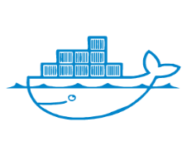





Container security with Azure
Our perspective
Authenticate and authorize
Strong platform security for authentication and authorization (Azure AD), credential management (KeyVault), image signing (Azure Registry) and runtime monitoring (monitor and sentinel); Depends on third-party tools for static code scan, image vulnerability scan) container scanning and network policies.
Continuous integration
Continuous delivery
Azure AD
Code
Build
Test
Static code scan
Image vulnerability scan
Image trust and signing
Ship
Deploy
Run
Credential Management
Runtime monitoring
Network policies
Retire
Container Registry
Kubernetes
KeyVault
Sentinel
Container repository
Repos
Pipeline
DevTest Lab
Artifacts
* Note: vendors are representative only

Slide 20
Client proof points
Case studies
KPMG has worked extensively to help clients meet their cloud goals across industries. The below are examples of some of the Azure work KPMG has been engaged to complete.
Azure Target Operating Model & Architecture
For a major global technology provider built:
Target model and architecture incorporating Azure PAAS and IAAS services
FedRAMP compliant Microsoft Azure environment which can be scaled to host future SaaS solutions
Azure Cloud Data Migration
For a major global beverage maker developed:
Overall strategy with detailed plan to migrate applications leveraging AD Azure and federation services
CA IAM and AD on-premises footprint reduction and directed migration to MS AD Azure-based security services
Azure Security Compliance
For a large professional services firm created:
Azure cloud security architecture and controls strategy
A PCI, HIPAA and NIST 800.53 compliant pre-production environment for sensitive health care data analytics
Azure Cloud PaaS Platform Build/Data Migration
For a large federal government agency built:
Streamlined modern Azure based LRS using open source technologies and hosted on a Microsoft Azure private Cloud
Data migration from multiple legacy applications
Azure Cloud Native App & Infrastructure Development
For a non-profit educational firm developed:
Strategy for migration
Moved applications to Azure environment and established a DevOps process using cloud native tools.

Slide 21
Some or all of the services described herein may not be permissible for KPMG audit clients and their affiliates or related entities.
kpmg.com/socialmedia
The information contained herein is of a general nature and is not intended to address the circumstances of any particular individual or entity. Although we endeavor to provide accurate and timely information, there can be no guarantee that such information is accurate as of the date it is received or that it will continue to be accurate in the future. No one should act upon such information without appropriate professional advice after a thorough examination of the particular situation.
© 2020 KPMG LLP, a Delaware limited liability partnership and the U.S. member firm of the KPMG network of independent member firms affiliated with KPMG International Cooperative (“KPMG International”), a Swiss entity. All rights reserved. NDP083680-1A
The KPMG name and logo are registered trademarks or trademarks of KPMG International.

