Slide 1
Security and cloud

Slide 2
Cloud context and focus has changed
Security and cloud
Cloud is fundamentally changing all aspects of the digital business ecosystem. The role and requirements of security are changing as organizations learn from their cloud journey.
Today’s technology
New World
Single Platform
Lift and shift; use security we already have
Lower risk data and nominal volumes
Multi Cloud
Build and secure natively
Mission critical and highly regulated data; massive volumes
Security as technology problem
Cloud or app teams can handle security
Security as a standards, governance and technology problem
Cloud security requires cross-team involvement
Deploy cloud first, security as afterthought
Largely still perimeter and network based
Security by design across platform and applications
Data, identity, and API-focused security
Largely waterfall with aspirations of continuous
Limited automation (still somewhat manual)
Continuous integration and deployment is non-negotiable
Automate everything
Cloud is a foundational digital enabler of business outcomes with the agility to evolve with the business:
Idea to production at speed & scale
Everything as a service
Cloud
— Built-in Security

Slide 3
Azure security

Slide 4

































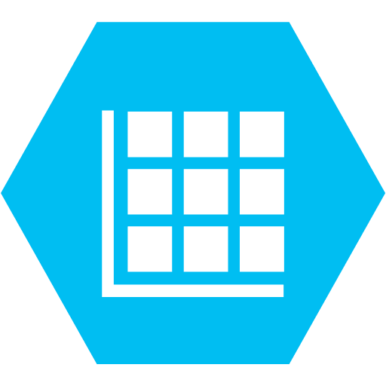











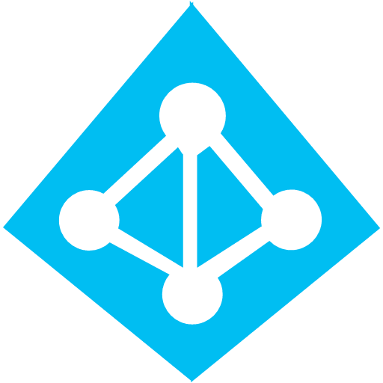











Azure security services [To be updated]
Azure security
Marketplace
Office 365
Dynamic 365
Security
Sharing and Collaboration
Word
Excel
Powerpoint
Outlook
OneDrive
Customer Relationship Management
Finance
Human Resources
Business Central
Business Apps
Analytics
Container Orchestration
Mobile
IOT
Blockchain
Machine Learning
DevOPS
Business Intelligence
Databases
Data Factories
Kubernates Services
App Services
IoT Hub
Cognitive Services
Cognitive Services
API Management Services
DevOps Tools
Power Business Intelligence
Container Registry
Power Platform
Stack Edge
Batch AI
Application Insights
Networking
Core Services
Infrastructure
Hybrid architecture
Storage
Networking
Storage
Compute
Database
Regions
Availability Zones
Data Integration
Integrated IAM
Management tools
Technical and business support
Migration
Resource Groups
Portal
Resource Manager
Professional Services
Support
Account Management
Schema Conversion
Database Migration
Application Migration
Monitoring
Compliance and security
Monitor
Metrics
Alert
Azure Active Directory
Identity Protection
Privileged Identity Management
Sentinel
Monitoring
Multi Factor Authentication
Conditional Access
Governance
Azure Advisor
User Privacy
Cost Management
Azure Solutions
Azure Policy
User Privacy
Azure Arc
Management Groups

Slide 5

Key Challenges to securing using Azure
Azure security
Most of the Azure clients start with Office 365 deployment but then struggle with greater adoptions of Azure security services within the organization due to limited visibility of management, siloed cloud teams across different cloud providers, limited product knowledge within organization’s security teams
Beyond Office 365 information protection capabilities
Develop governance model and review existing capabilities to improve information protection posture
Azure as DevOps platform of choice
Improve developer’s experience with IAM platform; integrate with existing process and technologies
Limited success of Azure as a identity and access platform
Prioritize applications for on-boarding and ensure support from management for migration
Azure is not traditional platform security
Use technology and cost rationalization to evaluate security capabilities
Challenge
Resolution

Slide 6
KPMG’s Cloud Security Capability Framework
Azure Security
KPMG’s Cloud Security Capability framework provides a tool-agnostic and leading-practice model to help organizations assess, design, build, deploy, test, operate & monitor secure workloads across multi-cloud environments.
Cloud Security Governance
Security Compliance
Control Automation
Reporting
Engineering
Data
Code Repository & Integrity
Secure SDKs
Encryption & Obfuscation
Secrets & Key Management
Threat Modeling
Secure Code Review
Data Lifecycle Management
Data Discovery
Secure Cloud Development
Secure Cloud Platform
Application
Testing
Certificate Lifecycle
Web Application Firewall
SAST & DAST Analysis
Penetration Testing
Web Application Scanning
API Security
Host
Deployment
Secure Cloud Operations
Anti-malware Protection
Container Security
Automated Resource Provisioning
Asset Inventory
Virtual Machine Integrity
Virtual Machine Access
Automated Build & Releases
Network
DDOS Mitigation
Network Traffic Management
Perimeter Security
VPN
Logging & Auditing
Monitoring
Vulnerability Management
Change & Configuration Management
Logging
Auditing
Monitoring & Alerting
Threat Intelligence
Automated Patch Management
Vulnerability Remediation
Policy Orchestration
Change & Configuration Rule Orchestration
UEBA
Access Management
SSO & Federation
Authorization
MFA & Adaptive Access
Directory Services
Privileged Access Management
Availability & Scalability
Failover & Redundancy
Backups & Recovery
Auto Scaling

Slide 7
KPMG’s Cloud Security Capability Framework
Azure Security
KPMG’s Cloud Security Capability framework provides a tool-agnostic and leading-practice model to help organizations assess, design, build, deploy, test, operate & monitor secure workloads across multi-cloud environments.
Cloud Security Governance
Security Compliance
Control Automation
Reporting
Engineering
Data
Code Repository & Integrity
Secure SDKs
Encryption & Obfuscation
Secrets & Key Management
Threat Modeling
Secure Code Review
Data Lifecycle Management
Data Discovery
Secure Cloud Development
Secure Cloud Platform
Application
Testing
Certificate Lifecycle
Web Application Firewall
SAST & DAST Analysis
Penetration Testing
Web Application Scanning
API Security
Host
Deployment
Secure Cloud Operations
Anti-malware Protection
Container Security
Automated Resource Provisioning
Asset Inventory
Virtual Machine Integrity
Virtual Machine Access
Automated Build & Releases
Network
DDOS Mitigation
Network Traffic Management
Perimeter Security
VPN
Logging & Auditing
Monitoring
Vulnerability Management
Change & Configuration Management
Logging
Auditing
Monitoring & Alerting
Threat Intelligence
Automated Patch Management
Vulnerability Remediation
Policy Orchestration
Change & Configuration Rule Orchestration
UEBA
Access Management
SSO & Federation
Authorization
MFA & Adaptive Access
Directory Services
Privileged Access Management
Availability & Scalability
Failover & Redundancy
Backups & Recovery
Auto Scaling

Slide 8
Azure security service capability mapping [To be updated]
Azure security
Azure provides a plethora of products that directly or indirectly map to KPMG’s Security Capability framework. In addition to the product identified, multiple alternate solutions are also available through the Azure Marketplace to provide specific features and capabilities needed.
Cloud Security Governance
Azure Advisor
Azure Security
Azure Trust Portal
Engineering
Data
Application Insights
Secure SDKs
Azure Disk Encryption
Key Vault
Microsoft Threat Modeling Tool
Azure Code
Azure Storage Analytics
Advanced Data Security
Secure Cloud Development
Secure Cloud Platform
Application
Testing
App Diagnostic Tool
Web Application Firewall
Microsoft SAST & DAST Analysis
Azure Penetration Testing
Tinfoil Security Scanning
Azure API Management
Host
Deployment
Secure Cloud Operations
Microsoft Antimalware
Azure Container Security
Azure Advisor
Asset Inventory
Azure Resource Manager Template
Just in Time VM Access
Azure Automate
Network
Azure DDOS Protection
Azure Traffic Manager
Azure Virtual Network
Azure DNS
Logging & Auditing
Monitoring
Vulnerability Management
Change & Configuration Management
Log Analytics Workspace
Azure Activity Logs
Azure Monitor
Security Center
Tinfoil Vulnerability Scanning
Vulnerability Remediation
Azure Policy
Change Tracking
Sentinel
Identity & Access Management
Identity Governance
Privileged Identity Management
Conditional Access & MFA
Azure Active Directory
Single Sign-On
Availability & Scalability
Azure Load Balancer
Azure Backup
Azure Auto Scale

Slide 9
Reference Architecture

Slide 10






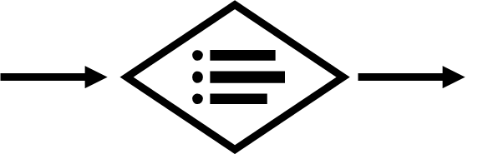






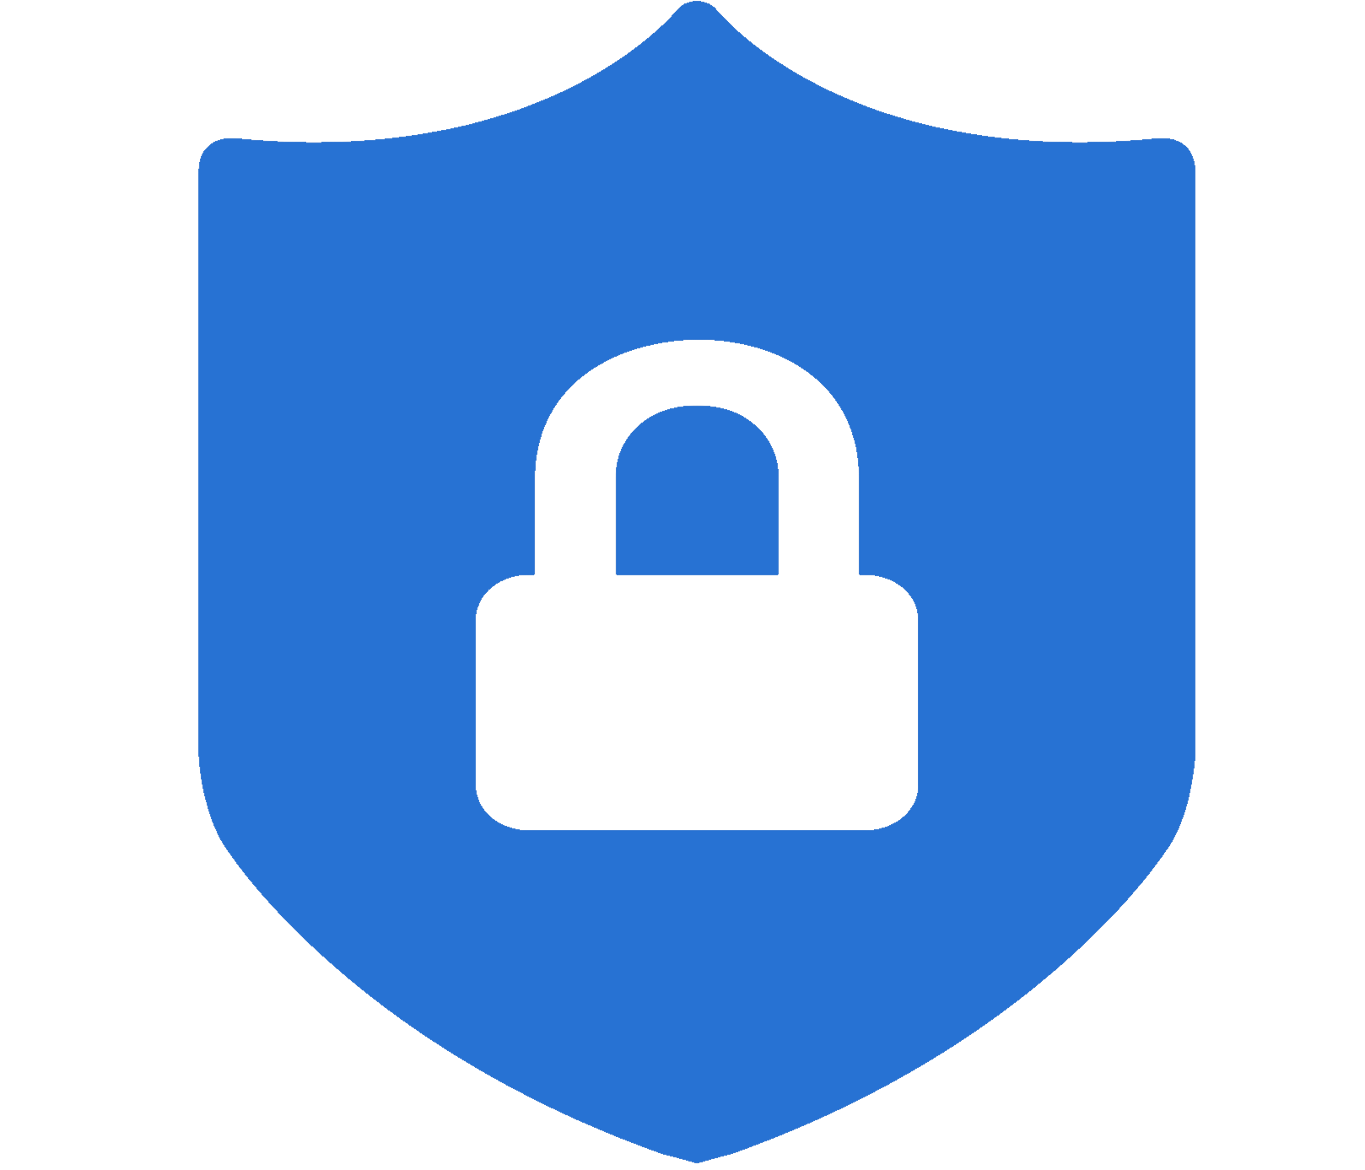


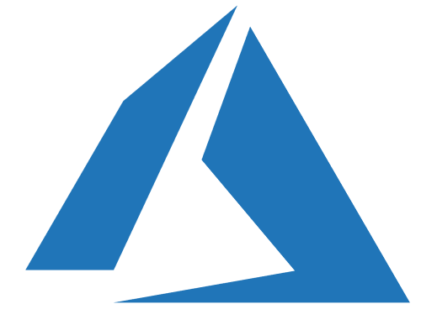





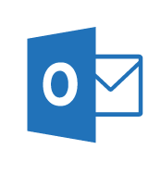

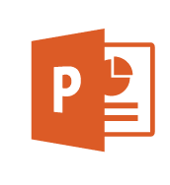
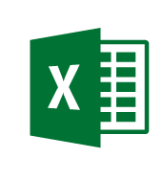



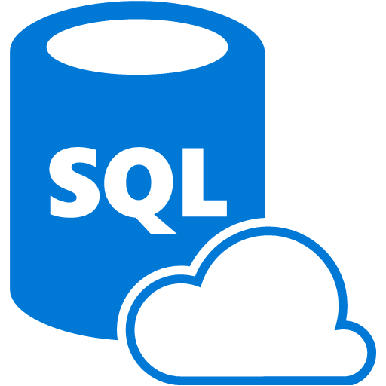
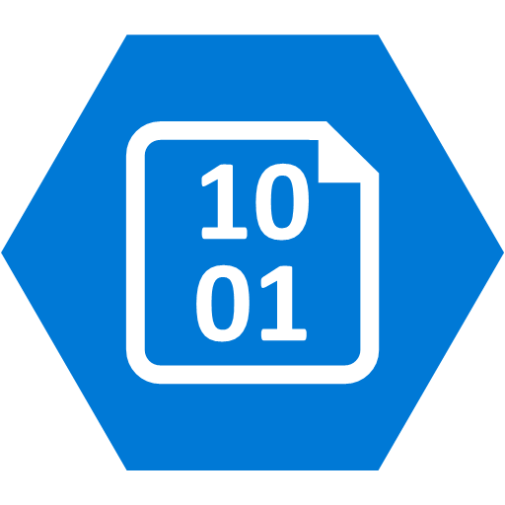



Security Operations Center (SOC)
Cybersecurity Reference Architecture
May 2018 – https://aka.ms/MCRA | Video Recording | Strategies
Software as a Service
Vulnerability Management
Cybersecurity Operations Service (COS)
Office 365
Incident Response and Recovery Services
Secure Score
MSSP
Azure
Security Center
Windows Defender
Office 365
Security & Compliance
Azure
Customer Lockbox
SIEM + Analytics
This is interactive!
Present Slide
Hover for Description
Click for more information
Roadmaps and Guidance
Securing Privileged Access
Office 365 Security
Rapid Cyberattacks (Wannacrypt/Petya)
Cloud App
Security
Advanced Threat Protection (ATP)
Dynamics 365
Identity & Access
Graph Security API (Public Preview)
Information Protection
Azure Active Directory
Alert & Log Integration
Conditional Access – Identity Perimeter Management
Clients
Hybrid Cloud Infrastructure
Cloud App Security
Azure AD Identity Protection
Leaked cred protection
Behavioral Analytics
Unmanaged &
Mobile Devices
On Premises Datacenter(s)
3rd party IaaS
Microsoft Azure
Azure Information Protection (AIP)
Discover
Classify
Protect
Monitor
Azure Security Center – Cross Platform Visibility, Protection, and Threat Detection
Configuration Hygiene
Just in Time VM Access
Azure AD PIM
NGFW
Security Appliances
Adaptive App Control
Multi-Factor Authentication
Intune MDM/MAM
Classification Labels
Managed Clients
Extranet
Edge DLP
Azure Policy
Hold Your Own Key (HYOK)
Azure AD B2B
SSL Proxy
Azure Key Vault
AIP Scanner
Azure AD B2C
IPS
Hello for Business
Express Route
Azure WAF
System Center Configuration Manager
Windows Server 2016 Security
Window 10 + Just Enough Admin, Hyper-V Containers, Nano server, and more…
Azure Antimalware
Office 365
Data Loss Protection
Data Governance
eDiscovery
MIM PAM
Windows Defender ATP
Network Security Groups
Azure ATP
Shielded VMs
VMs
Intranet Servers
Backup & Site Recovery
Azure Stack
Azure SQL
Threat Detection
Active Directory
Secure Score
Threat Analytics
Privileged Access Workstations (PAWs)
Disk & Storage Encryption
SQL Encryption & Data Masking
ESAE Admin Forest
Windows 10 Enterprise Security
IoT and Operational Technology
Included with Azure (VMs/etc.)
Premium Security Feature
Confidential Computing
Azure SQL Info Protection (Preview)
Network protection
Credential protection
Exploit protection
Reputation analysis
Full Disk Encryption
Attack surface reduction
App control
Isolation
Antivirus
Behavior monitoring
DDoS attack Mitigation+Monitor
Windows 10 IoT
Azure Sphere
IoT Security Maturity Model
Endpoint DLP
Azure IoT Security
IoT Security Architecture
Compliance Manager
S Mode
Security Development Lifecycle (SDL)
Trust Center
Intelligent Security Graph
Notes:
STATIC SLIDE VERSION (No Animations)
The Microsoft Cybersecurity Reference Architecture (https://aka.ms/MCRA) describes Microsoft’s cybersecurity capabilities and how they integrate with existing security architectures and capabilities. We recently updated this diagram and wanted to share a little bit about the changes and the document itself to help you better utilize it.
How to use it
We have seen this document used for several purposes by our customers and internal teams (beyond a geeky wall decoration to shock and impress your cubicle neighbors :-)
Starting template for a security architecture - The most common use case we see is that organizations use the document to help define a target state for cybersecurity capabilities. Organizations find this architecture useful because it covers capabilities across the modern enterprise estate that now spans on-premise, mobile devices, many clouds, and IoT / Operational Technology.
Comparison reference for security capabilities - We know of several organizations that have marked up a printed copy with what capabilities they already own from various Microsoft license suites (many customers don't know they own quite a bit of this technology), which ones they already have in place (from Microsoft or partner/3rd party), and which ones are new and could fill a need.
Learn about Microsoft capabilities - In presentation mode, each capability has a "ScreenTip" with a short description of each capability + a link to documentation on that capability to learn more.
Learn about Microsoft's integration investments - The architecture includes visuals of key integration points with partner capabilities (e.g. SIEM/Log integration, Security Appliances in Azure, DLP integration, and more) and within our own product capabilities among (e.g. Advanced Threat Protection, Conditional Access, and more).
Learn about Cybersecurity - We have also heard reports of folks new to cybersecurity using this as a learning tool as they prepare for their first career or a career change.
As you can see, Microsoft has been investing heavily in security for many years to secure our products and services as well as provide the capabilities our customers need to secure their assets. In many ways, this diagram reflects Microsoft massive ongoing investment into cyber security research and development, currently over $1 billion annually (not including acquisitions).
What has changed and why
We made quite a few changes in v2 and wanted to share a few highlights on what's changed as well as the underlying philosophy of how this document was built.
New visual style - The most obvious change for those familiar with the first version is the simplified visual style. While some may miss the "visual assault on the senses" effect from the bold colors in v1, we think this format works better for most people.
Interactivity instructions - Many people did not notice that each capability on the architecture has a quick description and link to more information, so we added instructions to call that out (and updated the descriptions themselves).
Complementary Content - Microsoft has invested in creating cybersecurity reference strategies (success criteria, recommended approaches, how our technology maps to them) as well as prescriptive guidance for addressing top customer challenges like Petya/WannaCrypt, Securing Privileged Access, and Securing Office 365. This content is now easier to find with links at the top of the document.
Added Section headers for each grouping of technology areas to make it easier to navigate, understand, and discuss as a focus area.
Added Foundational Elements - We added descriptions of some core foundational capabilities that are deeply integrated into how we secure our cloud services and build our cybersecurity capabilities that have been added to the bottom. These include
Trust Center - This is where describe how we secure our cloud and includes links to various compliance documents such as 3rd party auditor reports.
Compliance Manager is a powerful (new) capability to help you report on your compliance status for Azure, Office 365, and Dynamics 365 for General Data Protection Regulation (GDPR), NIST 800-53 and 800-171, ISO 27001 and 27018, and others.
Intelligent Security Graph is Microsoft threat intelligence system that we use to protect our cloud, our IT environment, and our customers. The graph is composed of trillions of signals, advanced analytics, and teams of experts hunting for malicious activities and is integrated into our threat detection and response capabilities.
Security Development Lifecycle (SDL) is foundational to how we develop software at Microsoft and has been published to help you secure your applications. Because of our early and deep commitment to secure development, we were able to quickly conform to ISO 27034 after it was released.
Moved Devices/Clients together - As device form factors and operating systems continue to expand and evolve, we are seeing security organizations view devices through the lens of trustworthiness/integrity vs. any other attribute.
We also re-organized the Windows 10 and Windows Defender ATP capabilities around outcomes vs. feature names for clarity.
We also reorganized windows security icons and text to reflect that Windows Defender ATP describes all the platform capabilities working together to prevent, detect, and (automatically) respond and recover to attacks. We also added icons to show the cross-platform support for Endpoint Detection and Response (EDR) capabilities that now extend across Windows 10, Windows 7/8.1, Windows Server, Mac OS, Linux, iOS, and Android platforms.
We also faded the intranet border around these devices because of the ongoing success of phishing, watering hole, and other techniques that have weakened the network boundary.
Updated SOC section - We moved several capabilities from their previous locations around the architecture into the Security Operations Center (SOC) as this is where they are primarily used. This move enabled us to show a clearer vision of a modern SOC that can monitor and protect the hybrid of everything estate. We also added the Graph Security API (in public preview) as this API is designed to help you integrate existing SOC components and Microsoft capabilities.
Simplified server/datacenter view - We simplified the datacenter section to recover the space being taken up by duplicate server icons. We retained the visual of extranets and intranets spanning on-premises datacenters and multiple cloud provider(s). Organizations see Infrastructure as a Service (IaaS) cloud providers as another datacenter for the intranet generation of applications, though they find Azure is much easier to manage and secure than physical datacenters. We also added Azure Stack capability that allows customers to securely operate Azure services in their datacenter.
New IoT/OT section - IoT is on the rise on many enterprises due to digital transformation initiatives. While the attacks and defenses for this area are still evolving quickly, Microsoft continues to invest deeply to provide security for existing and new deployments of Internet of Things (IoT) and Operational Technology (OT). Microsoft has announced $5 billion of investment over the next four years for IoT and has also recently announced an end to end certification for a secure IoT platform from MCU to the cloud called Azure Sphere.
Updated Azure Security Center - Azure Security Center grew to protect Windows and Linux operating system across Azure, on-premises datacenters, and other IaaS providers. Security Center has also added powerful new features like Just in Time access to VMs and applied machine learning to creating application whitelisting rules and North-South Network Security Group (NSG) network rules.
Added Azure capabilities including Azure Policy, Confidential Computing, and the new DDoS protection options.
Added Azure AD B2B and B2C - Many Security departments have found these capabilities useful in reducing risk by moving partner and customer accounts out of enterprise identity systems to leverage existing enterprise and consumer identity providers.
Added information protection capabilities for Office 365 as well as SQL Information Protection (preview).
Updated integration points - Microsoft invests heavily to integrate our capabilities together as well as to ensure use our technology with your existing security capabilities. This is a quick summary of some key integration points depicted in the reference architecture:
Conditional Access connecting info protection and threat protection with identity to ensure that authentications are coming from a secure/compliant device before accessing sensitive data.
Advanced Threat Protection integration across our SOC capabilities to streamline detection and response processes across Devices, Office 365, Azure, SaaS applications, and on Premises Active Directory.
Azure Information Protection discovering and protecting data on SaaS applications via Cloud App Security.
Data Loss Protection (DLP) integration with Cloud App Security to leverage existing DLP engines and with Azure Information Protection to consume labels on sensitive data.
Alert and Log Integration across Microsoft capabilities to help integrate with existing Security Information and Event Management (SIEM) solution investments.
Feedback
We are always trying to improve everything we do at Microsoft and we need your feedback to do it! You can contact the primary author (Mark Simos) directly on LinkedIn (https://aka.ms/markslist) with any feedback on how to improve it or how you use it, how it helps you, or any other thoughts you have.

Slide 11



































































Azure Security Reference Architecture
Azure Cloud Services
AAD Connect
On-Premises
Integrated Threat Intelligence
On-Premises AD Forest
Azure
Policy
Azure VMs Data & Storage IoT App Services Containers Compute Resources
Azure AD
Analyst
Config checks Updates
Endpoint Protection
Just in Time Access
Adaptive Application Controls
Azure Policy Checks
Identity & Access Management
Conditional Access Policy/MFA
Identity Protection
CISO
ASC Default Policy Template
Threat Feeds
Auditor
Information Protection
Azure Security Center
Behavioral Analytics - Anomaly Detection
REST API / PS
Security Analysis
Analyst
ATP Alerts
ATP
Dashboards
Centralized review of
security posture
ATP Alerts
Windows Servers
Platform Alerts
Microsoft
Monitoring Agent
Windows 3rd Party
Defender EPP
Azure Security Center Logs
& Notable Events
Azure Security Center Logs
& Notable Events
Azure Network Security Groups
Next Generation Firewall
Config checks, Updates, ATP Alerts, FIM, Crush-dump Analysis, Endpoint Protection
Azure Monitor
Log Analytics Workspace
Logs / Metrics
Telemetry / Health Monitoring
Linux Servers
Microsoft Monitoring Agent
Config checks, Updates, Audit Alerts,
Endpoint Protection
Azure Security Center Logs
Azure Security Center
Notable Events
Storage ATP
SQL ATP
Azure Sentinel
Playbooks
Logic Apps
Security Operation Center
Alerts / Reports / Tickets
(SOC)
Automation &
Orchestration
Microsoft Intelligent
Security Graph
ASC Alerts
On-Premises SIEM
Azure Events Hub
ASC Alerts

Slide 12
Our perspective

Slide 13
Threat Protection
Azure Security & Management
Identity and Access Management
Universal platform to manage and secure identities.
Azure Active Directory Microsoft Endpoint Manager
Information
Protection
Discover, classify, and protect sensitive data - wherever it lives or travels.
Microsoft Information
Protection
Cloud Security Management
Safeguard cross- cloud resources.
Stop attacks with integrated and automated security.
Microsoft Defender Advanced Threat Protection
Azure Sentinel (SIEM) Azure DDoS Protection
Azure Security Center Azure Security Center for IoT Microsoft Cloud App Security
Enhanced security through simplified and intelligent security management with Microsoft
Visibility
Undertake the security state and risk across resources
Control
Define consistent security policies and enable controls
Guidance
Elevated security through built-in intelligence and recommendations

Slide 14
Identity and Access Management Challenges
Our perspective
Challenge
Effectiveness of Castle-and-moat architecture
Patchwork of IAM solutions
Support migration to SaaS
Changing Threat Landscape
Resolution
Azure AD provides MFA, conditional access to enable zero trust architecture
Technology rationalization with business process changes
Native support for wide range of SaaS products
Strong threat intelligence combined with continuous feature rollout
© 2019 KPMG International Cooperative (“KPMG International”), a Swiss entity. Member firms of the KPMG network of independent firms are affiliated with KPMG International. KPMG International provides no client services. No member firm has any
authority to obligate or bind KPMG International or any other member firm third parties, nor does KPMG International have any such authority to obligate or bind any member firm. All rights reserved.

Slide 15
Our perspective
Threat Protection
Challenges
Large capital expense for infrastructure and operations
Increasing Operational complexity
Skill Shortage and Staff Burnout
Growing Attack Complexity
Proposal
Eliminate infrastructure setup and maintenance costs and focus on Security
See and stop threats quick, with SIEM reinvented for the next decade.
Sentinel’s Machine Learning and AI detects threats and automates complex processes.
Strong threat intelligence with improving Machine learning capabilities
© 2019 KPMG International Cooperative (“KPMG International”), a Swiss entity. Member firms of the KPMG network of independent firms are affiliated with KPMG International. KPMG International provides no client services. No member firm has any
authority to obligate or bind KPMG International or any other member firm third parties, nor does KPMG International have any such authority to obligate or bind any member firm. All rights reserved.

Slide 16
Our perspective
Information Protection
Challenges
Manual Classification
Multiple access-channel of information
Incorrect or stale classification
Approach
Automatically classify and label information using machine learning and AI.
Native integration with Microsoft and third-party products.
Policies and controls for continuous evaluation ensure errors are identified and changes applied
© 2019 KPMG International Cooperative (“KPMG International”), a Swiss entity. Member firms of the KPMG network of independent firms are affiliated with KPMG International. KPMG International provides no client services. No member firm has any
authority to obligate or bind KPMG International or any other member firm third parties, nor does KPMG International have any such authority to obligate or bind any member firm. All rights reserved.

Slide 17
Cloud Security Challenges
Our perspective
Challenge
Proliferation of cloud services
Security baseline drift
Resource and skills shortage
New technologies like IoT
Resolution
Native integration with services along with comprehensive view across platform and beyond
Continuous assessments against the specified policy and recommendations
Continuously updated recommendations built on industry best practices and compliance; Machine learning
Support for new technology natively in the security platform
© 2019 KPMG International Cooperative (“KPMG International”), a Swiss entity. Member firms of the KPMG network of independent firms are affiliated with KPMG International. KPMG International provides no client services. No member firm has any
authority to obligate or bind KPMG International or any other member firm third parties, nor does KPMG International have any such authority to obligate or bind any member firm. All rights reserved.

Slide 18






Zero trust architecture with Azure
Our perspective
Good support for user (Azure AD) and device identity (Defender ATP, Intune) and securing network in cloud (NSG); Strong threat intelligence capability (conditional access) along with monitoring and logging (sentinel, monitor); Limited capability to on-board other sources of information (e.g. access requests, provisioning policies) to conditional access model
Key Input
Components of Zero Trust platform
Key Input
Diagnostics and mitigation
Managed
Data Access Policy
Software as Service
Compliance System
PKI
User Data
Application
User ID
Data
Device Data
Threat Intelligence
User ID
Network Segmentation
Identity Management
Unmanaged
Application
Activity Logs
SIEM System
Microsoft Defender ATP
Microsoft Intune
Azure AD
Sentinel
Conditional Access
Network Security Group
KeyVault
Policy
* Note: vendors are representative only
Notes:
- Azure AD with Microsoft Defender ATP and Intune platform (managed devices) provides significant set of capabilities required to build a zero-trust platform.
- Network capabilities in cloud and Client Application proxy for on premise applications (in combination with using existing on-premise next generation firewalls and Software defined perimeters-SDP) to build micro-segmented network.
- Microsoft’s strong threat intelligence capability in combination with Azure AD conditional access allows enterprises to support unmanaged devices accessing the infrastructure.
There is limited capability to add other sources of information (e.g. access requests, provisioning policies) to conditional access model and significant development is needed to provide support for application entitlement and data protection.
Azure provides individual monitoring and logging capabilities across the entire tool and product set that can be consolidated on the sentinel platform with very limited out of box support for zero trust infrastructure.

Slide 19





Secure DevOps with Azure
Our perspective
Strong service provider for security of devops platform (Azure AD, Azure KeyVault, monitor, sentinel) and operational security (Secure DevOps Kit for Azure); Depends on third-party tools and products for security during the development phase (SAST, SAST, license management) and operations (vulnerability scanning)
DEV
Ops
KeyVault
Continuous integration
Continuous deployment
Azure AD
Open
source
libraries
Secure
coding
standards
Security
training
Code Update
Versioning
Open source
analysis
License
management
Bug Fix
Management
Incident
management
Operations
Failure
management
Automated PEN testing
Vulnerability
scanning
Secure DevOps Kit for
Azure
Tester
Policy
Web
Access
Firewall
DEV
Sentinel
Environment
QA
Continuous Monitoring
Artifacts
User stories
Developer
Local
repository
Source code
repository
Build tools
Repository
Deployment
PROD
Security
monitoring
Pipeline
Repos
Security
Requirements
Threat
modelling
Malware
analysis
Static code
analysis
Peer
review
Security
& unit
testing
Application &
infrastructure
configuration management
Application
versioning
Application &
infrastructure
configuration
scanning
Application,
Infrastructure & container
security
Automated
threats
Bug bounty &
hack days
Boards
Access & authentication
Key and credential mgmt
Policies and process
Data security
Asset management
Logging and analytics
Security
* Note: vendors are representative only
Notes:
Azure provides a comprehensive DevOps platform with significant support of security on operations side.
Microsoft continues to rely on third-party/vendors products to provide security during the development phase. Azure AD provides the identity and access platform used to secure access to entire devops platform.
Most of the development and testing specific security tools like malware analysis, opensource analysis, license management, static code analysis (SAST), security and unit testing (DAST) must be implemented using third-party solutions.
Azure Artifact provides limited security controls around build and deployment.
Secure Devops Kit for Azure provides some basic security baselining capabilities across the operational platform.
Third-party products for vulnerability scaning, pen testing along with additional tools like application insights, monitor and sentinel providing the capabilities that can be used to build robust security operation.

Slide 20




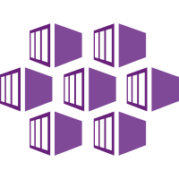


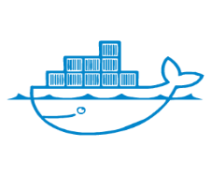
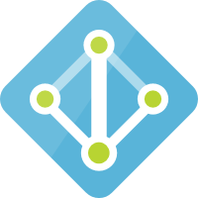





Container Security with Azure
Our perspective
Authenticate and authorize
Strong platform security for authentication and authorization (Azure AD), credential management (KeyVault), image signing (Azure Registry) and runtime monitoring (monitor and sentinel); Depends on third-party tools for static code scan, image vulnerability scan) container scanning and network policies.
Continuous integration
Continuous delivery
Code
Build
Test
Static code scan
Image vulnera- bility scan
Image trust and signing
Ship
Deploy
Run
Creden- tial Manage-
ment
Runtime monitor- ing
Network policies
Retire
Container repository
Azure AD
Container Registry
Kubernetes
KeyVault
Sentinel
Repos
Pipeline
DevTest Lab
Artifacts
* Note: vendors are representative only

Slide 21
Case studies

Slide 22
Client Proof Points
Case studies
KPMG has worked extensively to help clients meet their cloud goals across industries. The below are examples of some of the Azure work KPMG has been engaged to complete.
For a major global technology provider built:
Target model and architecture incorporating Azure PAAS and IAAS services
FedRAMP compliant Microsoft Azure environment which can be scaled to host future SaaS solutions
For a major global beverage maker developed:
Overall strategy with detailed plan to migrate applications leveraging AD Azure and federation services
CA IAM and AD on-premises footprint reduction and directed migration to MS AD Azure-based security services
For a large professional services firm created:
Azure cloud security architecture and controls strategy
A PCI, HIPAA and NIST 800.53 compliant pre-production environment for sensitive health care data analytics
Azure Target Operating Model & Architecture
Azure Cloud Data Migration
Azure Security Compliance
For a large federal government agency built:
Streamlined modern Azure based LRS using open source technologies and hosted on a Microsoft Azure private Cloud
Data migration from multiple legacy applications
For a non-profit educational firm developed:
Strategy for migration
Moved applications to Azure environment and established a DevOps process using cloud native tools.
Azure Cloud PaaS Platform Build/Data Migration
Azure Cloud Native App & Infrastructure Development
© 2019 KPMG International Cooperative (“KPMG International”), a Swiss entity. Member firms of the KPMG network of independent firms are affiliated with KPMG International. KPMG International provides no client services. No member firm has any authority to obligate or bind KPMG International or any other member firm third parties, nor does KPMG International have any such authority to obligate or bind any member firm. All rights reserved.

