Slide 1

COVID-19 Time Series Forecasting
Submitted To:
Dr. Neha Goel
Assistant Professor
Submitted By:
Vineet Gupta
14517702018
BCA 5-C

Slide 2
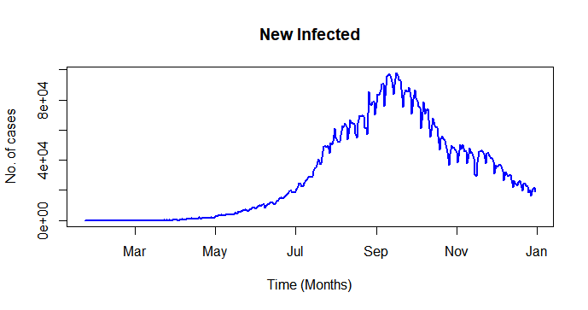
Introduction
Time Series is a series of observations recorded at different times. Example: Daily Newly Infected Cases
Basic time series models include:
White Noise (WN)
Random Walk (RW)
Autoregression (AR)
Moving Average (MA)
Last two models are important because these are integrated to form an ARIMA model (AR Integrated MA)
Actual source: covid19.who.int
Third party: https://raw.githubusercontent.com/datasets/covid-19/master/data/time-series-19-covidcombined.csv

Slide 3
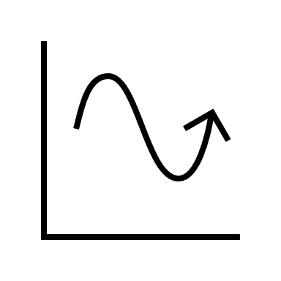

Objective
Retrieving data from a website, preprocessing it and exporting it to directory for future reference.
Plotting the processed data, its modelling and estimation of parameters of the model.
Making predictions for the future values and plotting them along with confidence intervals at 80% and 95% confidence levels.
Comparing the predictions made by both models.

Slide 4

Platform Overview
R Programming: R is a language and
environment for statistical computing and graphics.
Why R?
R provides a wide variety of statistical (linear and nonlinear modelling, classical statistical tests, time-series analysis, classification, clustering, etc.) and graphical techniques, and is highly extensible.
R has huge built-in libraries and open-source libraries, which the user can install by just running a command in the console.
RStudio is an IDE that provides a set of integrated tools designed to help us be more productive with R and Python. It includes a console, syntax-highlighting editor that supports direct code execution, and a variety of robust tools for plotting, viewing history, debugging and managing your workspace.

Slide 5
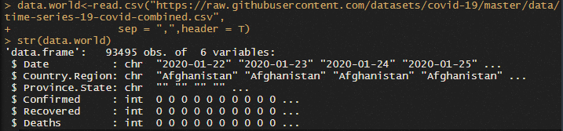

1. Data Retrieval and Pre-processing
Raw data looks like this:
Processed data looks like this:

Slide 6
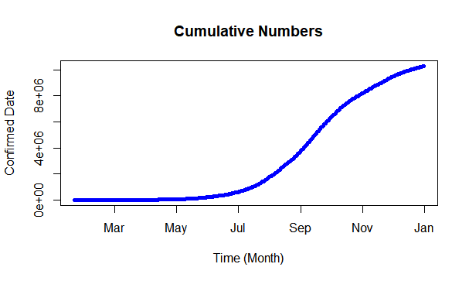

2.1 Plotting data

Slide 7
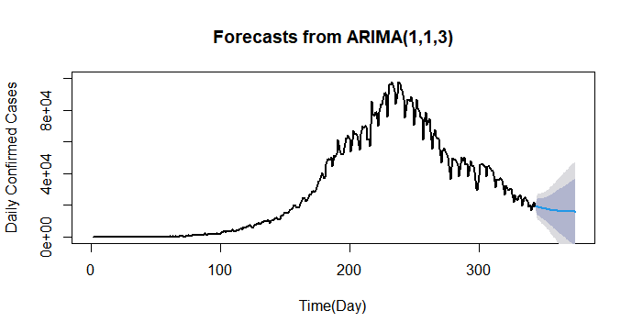
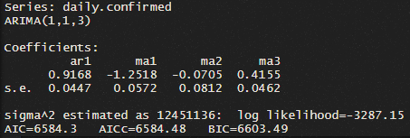
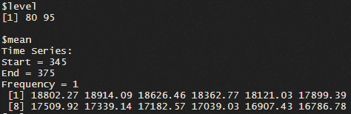
2.2 Modelling and estimation of data
1. ARIMA (Autoregressive Integrated Moving Average):
This model uses both the main time series models: AR and MA
The auto.arima() function optimizes the AIC values for a minimum number of parameters.

Slide 8
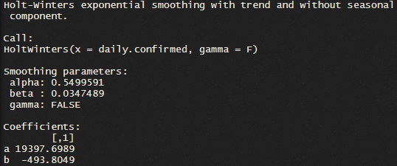
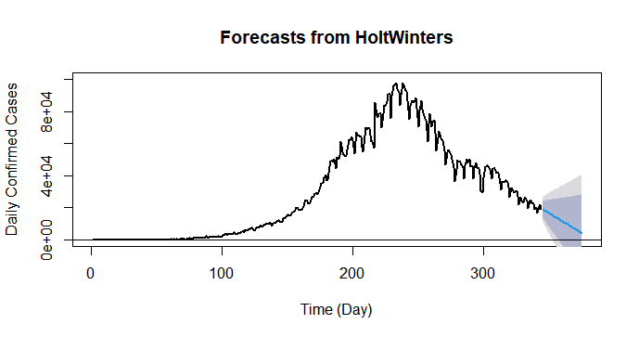
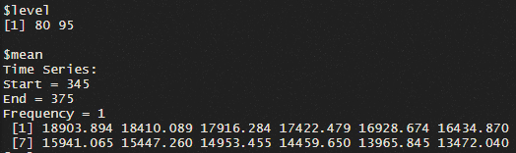
2.2 Modelling and estimation of data
2. Holt-Winters
This used an exponential smoothing technique to model the data and same for parameter estimation.
In this case, double exponential smoothing fits best so two parameters are estimated.

Slide 9
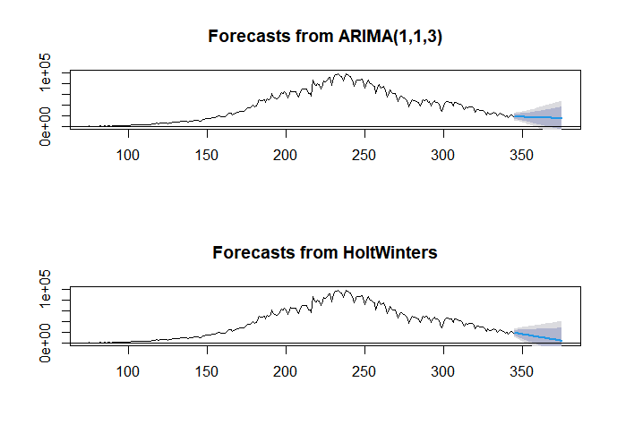
3. Comparing the two models
ARIMA(1,1,3) vs HoltWinters(alpha,beta)
The two models show similar prediction that the trend of future values will be declining.
However, the ARIMA model suggested the future values that show almost an exponential decline.
On the other hand, Holt-Winters model suggested the same show what is close to a linear model.
These future predictions are purely based on past data and does not consider external factors, though it can be useful for important decision making.

Slide 10
Conclusion
• A case study on the spread of the novel Coronavirus (Covid-19), in which we observe the trends of daily newly infected cases through time-series.
• Daily cases were modelled through Autoregressive Integrated Moving Average modelling and Holt-Winters exponential smoothing for further forecasting.
• The predicted numbers are displayed along with their confidence interval at 80% and 95% confidence level.

