Slide 1
IITBay- Buy, Sell & Lost-Found
Course: CS699 – Software Lab
Instructor: Prof. Om Damani
Chittari Vineeth Babu (25M0808)
Harshith Matta (25M0834)
Jamala Mohana Sai Naik (25M0815)

Slide 2
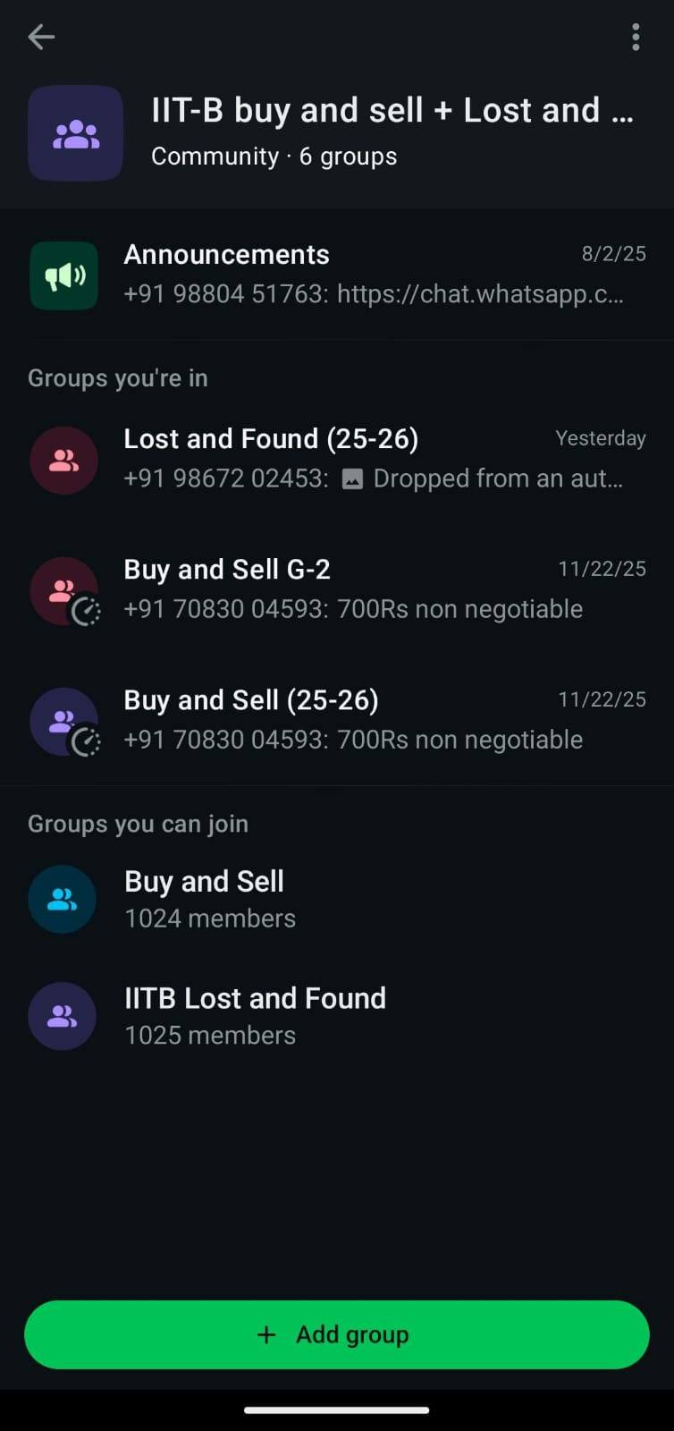
Problem Statement :
At IIT Bombay, students depend heavily on multiple WhatsApp groups for Buy & Sell and Lost & Found activities.
Each WhatsApp group has a ~1000-member limit, leading to 4–5 separate groups that students must monitor.
Posts made in one group are not visible in the others, causing important information to be missed.
Lost-and-found announcements are scattered across different groups, making it difficult and time-consuming for students to track items.
There is a strong need for a unified web platform where all Buy & Sell and Lost & Found posts are consolidated.

Slide 3
Scope:
User Authentication: Login, logout, and role-based access control (Student/Admin).
Buy & Sell Module: Add, edit, delete items, mark as sold, and browse available listings.
Lost & Found Module: Add, edit, delete items, and mark lost items as resolved.
Payment Integration: Secure online payments using Razorpay. Real-Time
Chat System: Enables communication between buyers and sellers.
Notifications: In-app real-time notifications and automated Gmail alerts for important updates.
Image Management: Upload and display images for all listed items.
User Dashboard: “Your Products” section to track user activity and item status.
Database Storage: Lightweight and efficient storage using SQLite. UI/UX: Simple and modern interface built with Flask + HTML/CSS.

Slide 4
Limitations:
Not yet cloud-deployed (local only)
No moderation or verification of posts

Slide 5
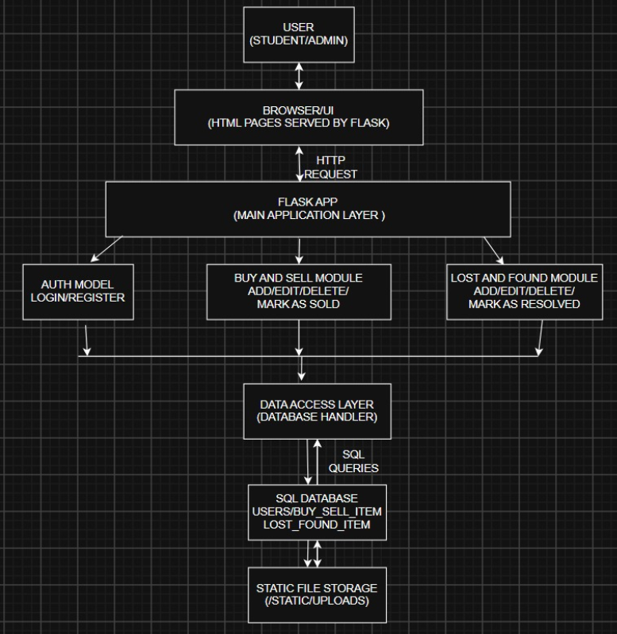
Architecture Diagram:

Slide 6
Technologies Used:
Frontend:
HTML5, CSS3
JavaScript (UI interactions)
Jinja2 templating
Backend:
Python Flask
Session-based authentication
Database:
SQLite3
SQL CRUD operations
Storage:
Static file storage (static/uploads )

Slide 7
Module Overview:
Lost & Found:
Add Lost/Found item
Edit/Delete
Mark as Resolved
View Active / Resolved items
Authentication Module:
Register/ Login/ Logout
Admin verification using passkey
Buy & Sell:
Add item
Edit/Delete
Mark item as Sold
View Active / Resolved items
Dashboard(“Your Products”):
All Buy/Sell + Lost/Found items posted by logged-in user
Image Upload Module
Validates file type
Stores in static/uploads

Slide 8
Project Contribution Details:
Chittari Vineeth Babu
Flask Backend
DB schema
All core routes
Jamala Mohan Sai Naik
Frontend Styling
CSS
UI layout
Harshith Matta
Backend integration
Buy/sell template work
Lost/Find template work

Slide 9
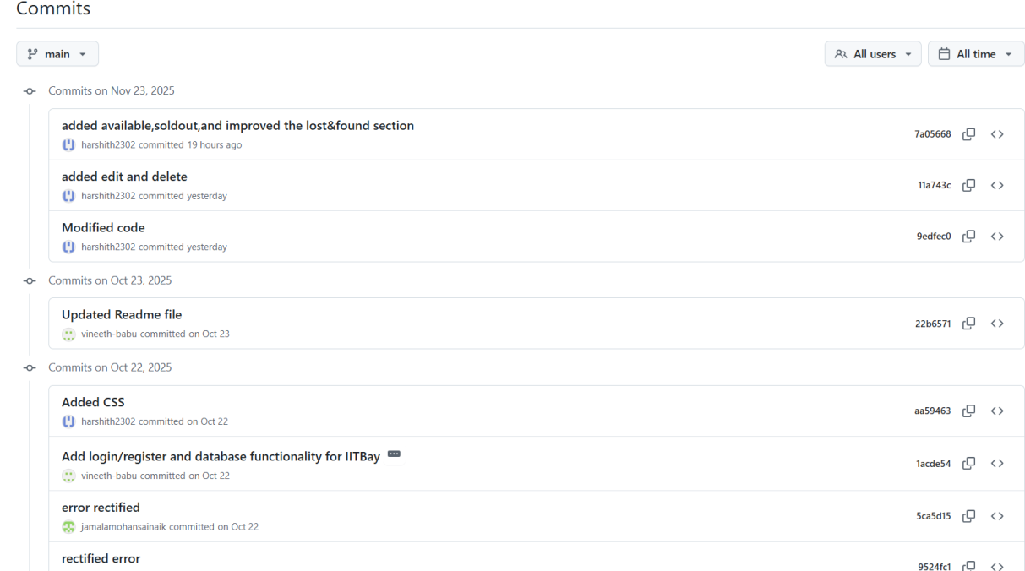
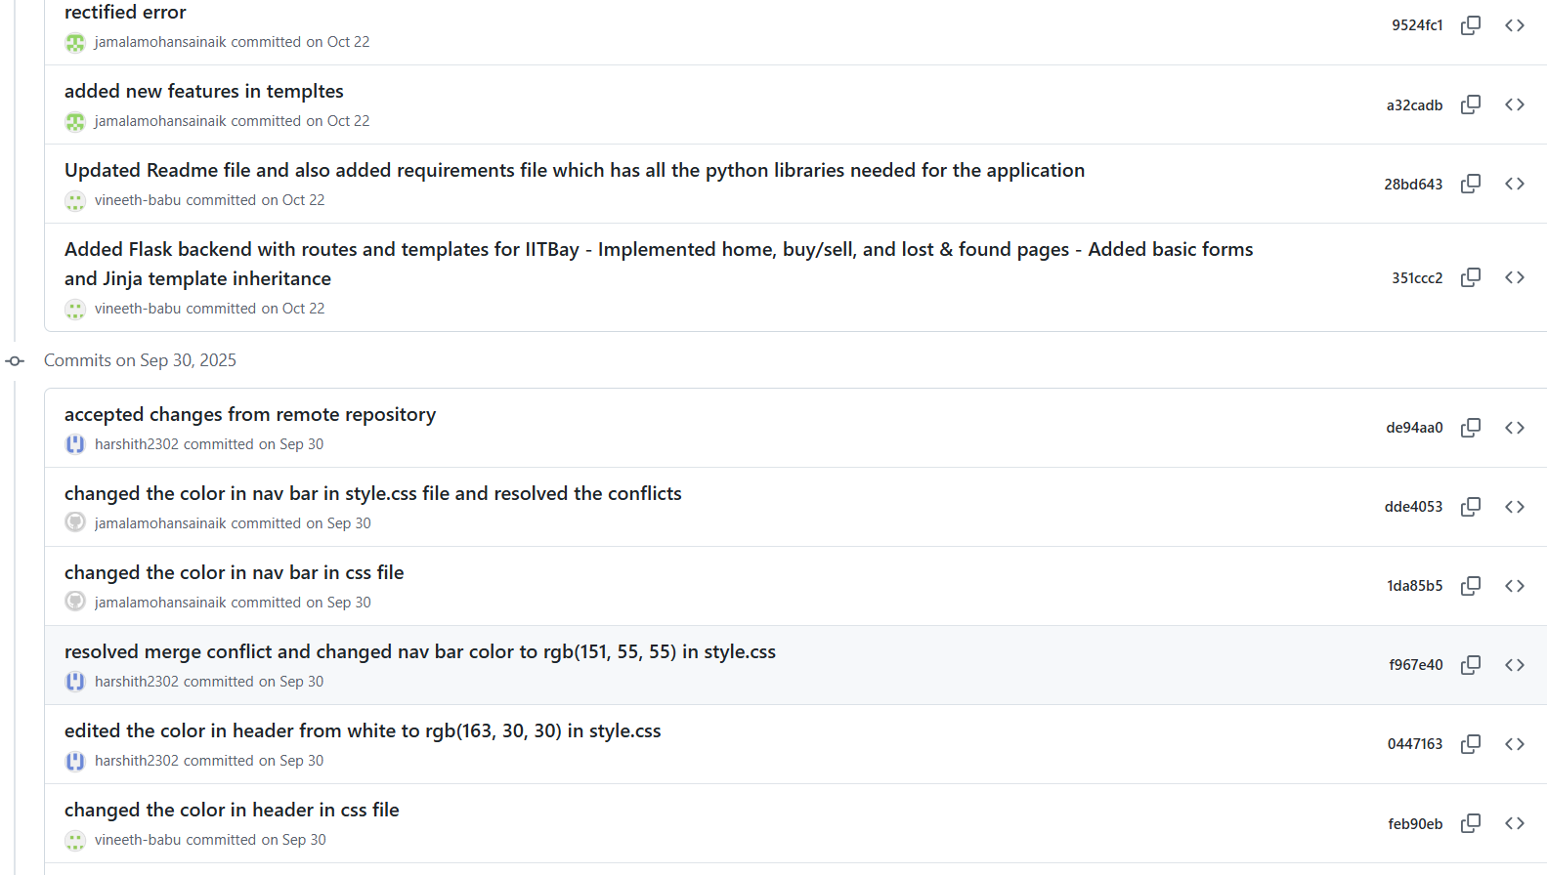
Git Hub Commits:

Slide 10
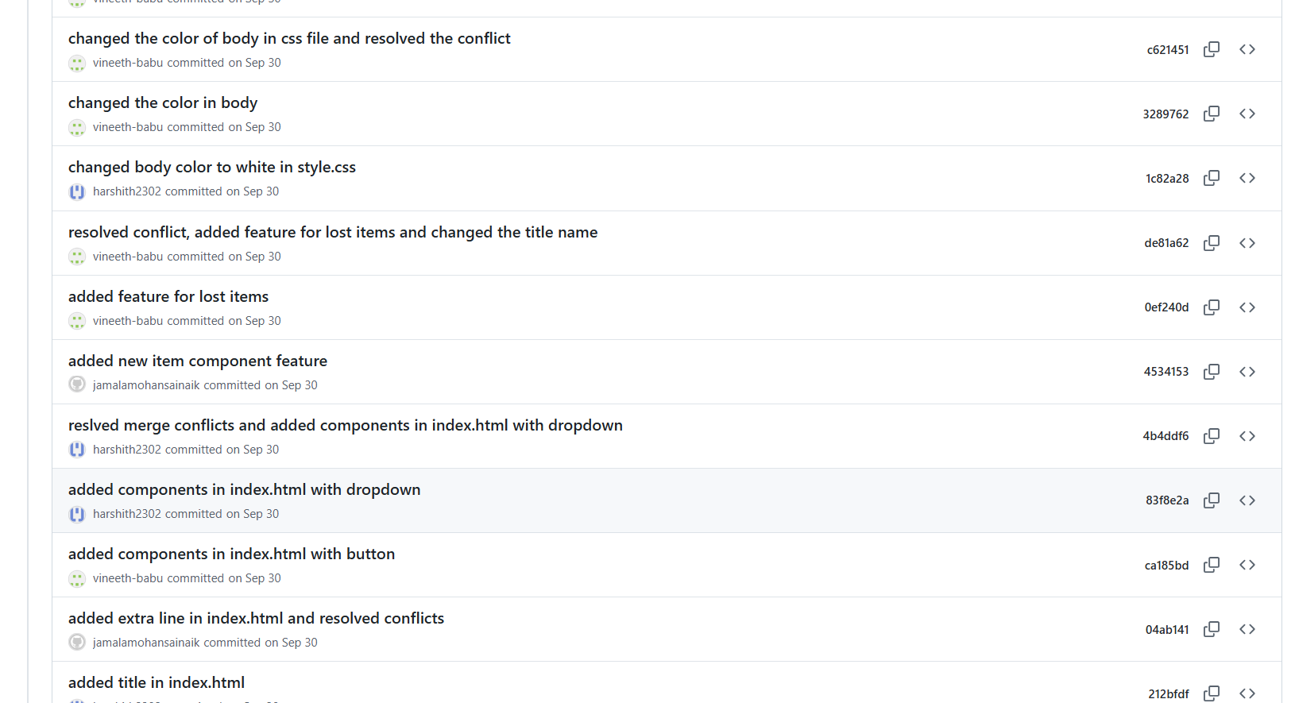
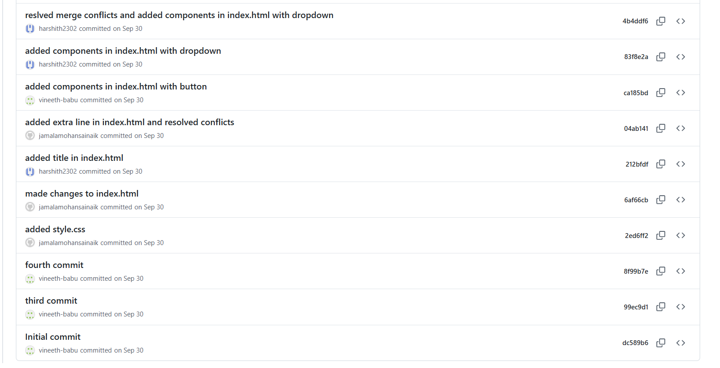

Slide 11
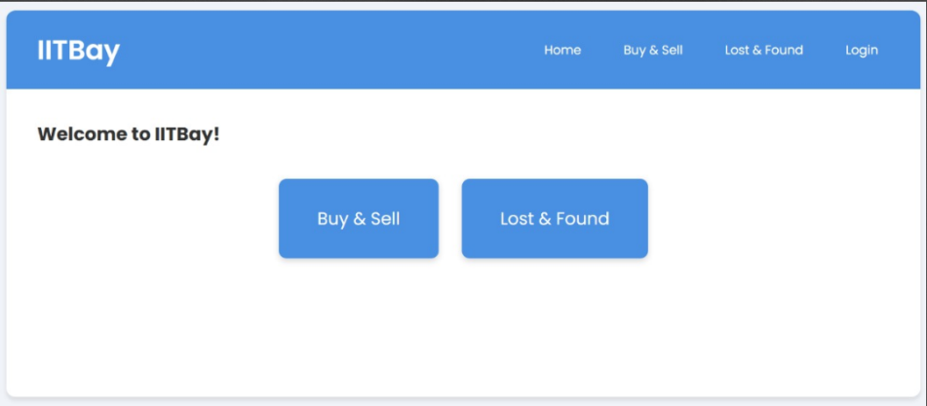
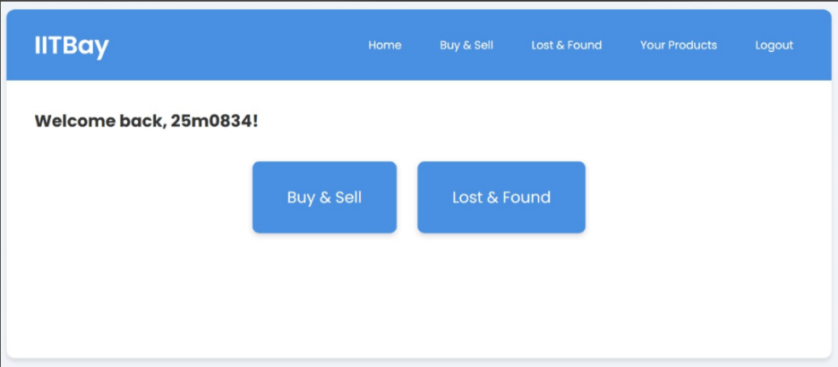
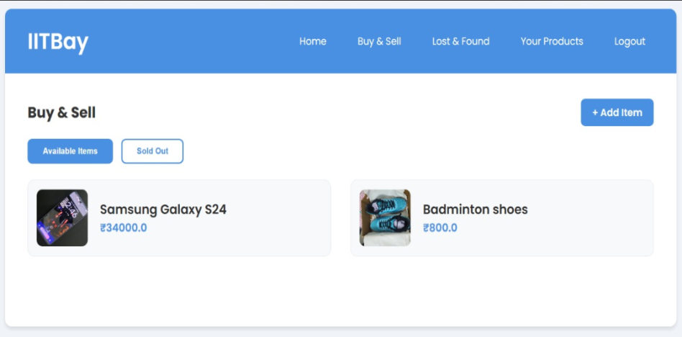
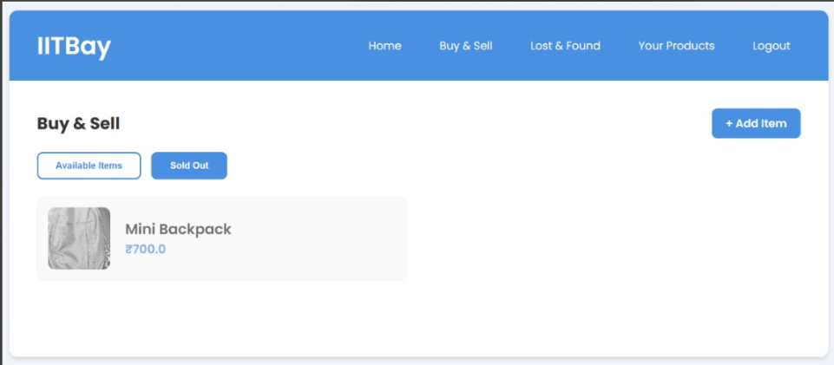
Screenshots:
Index page
Home page of userc
Buy and Sell Available items
Buy and Sell Soldout items

Slide 12
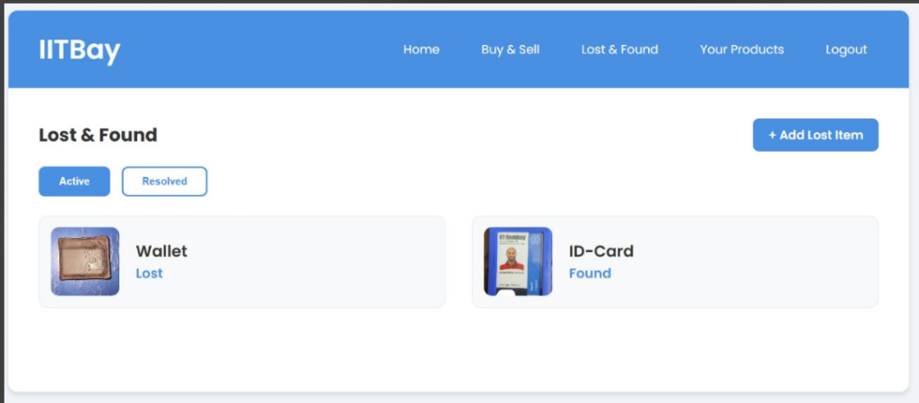
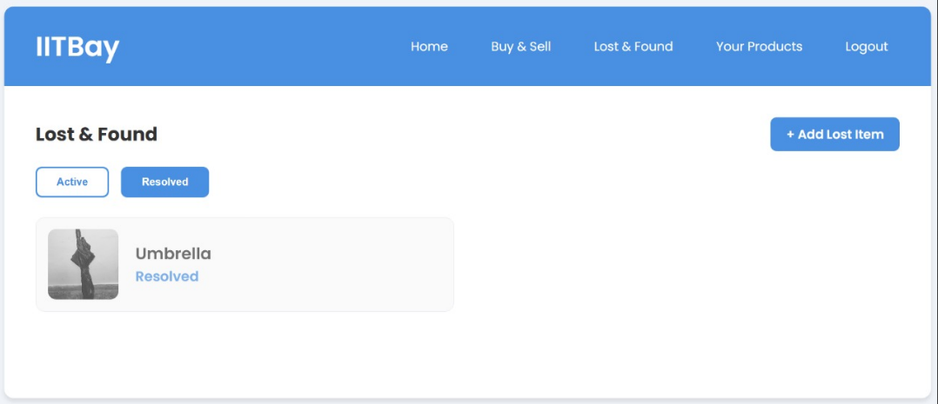
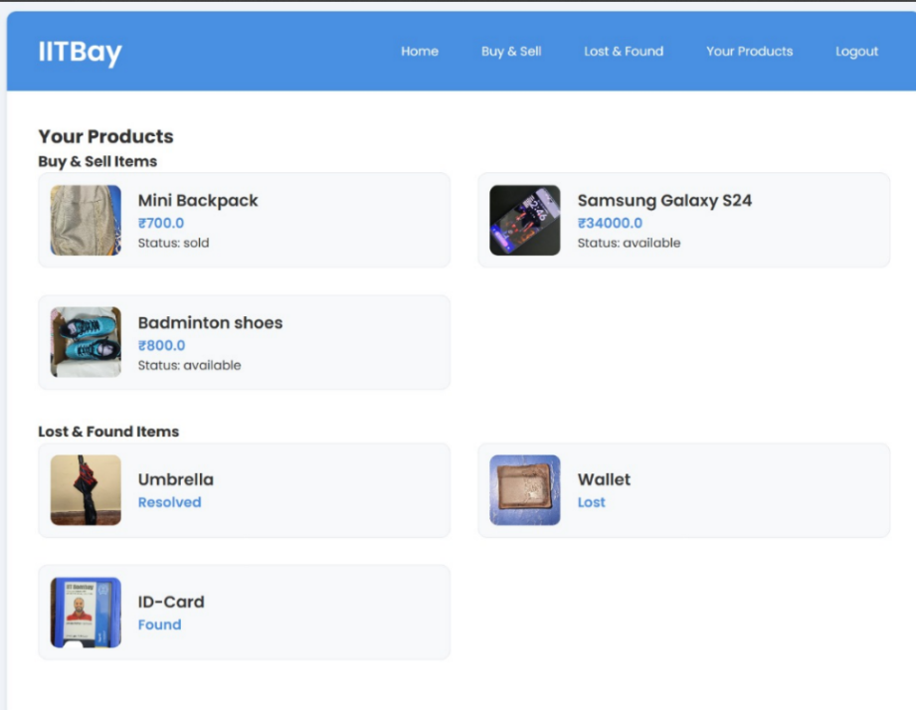
Lost and Found Active items
Lost and Found
Resolved items
Your Product list of a user

Slide 13
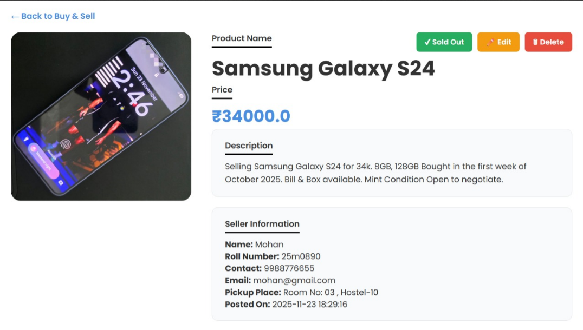
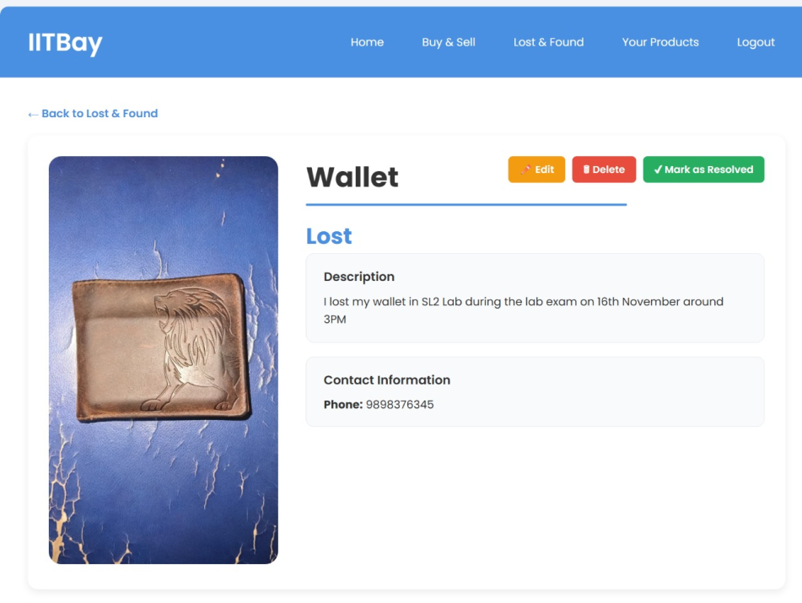
Details of a product item
Details of Lost and Found item

Slide 14
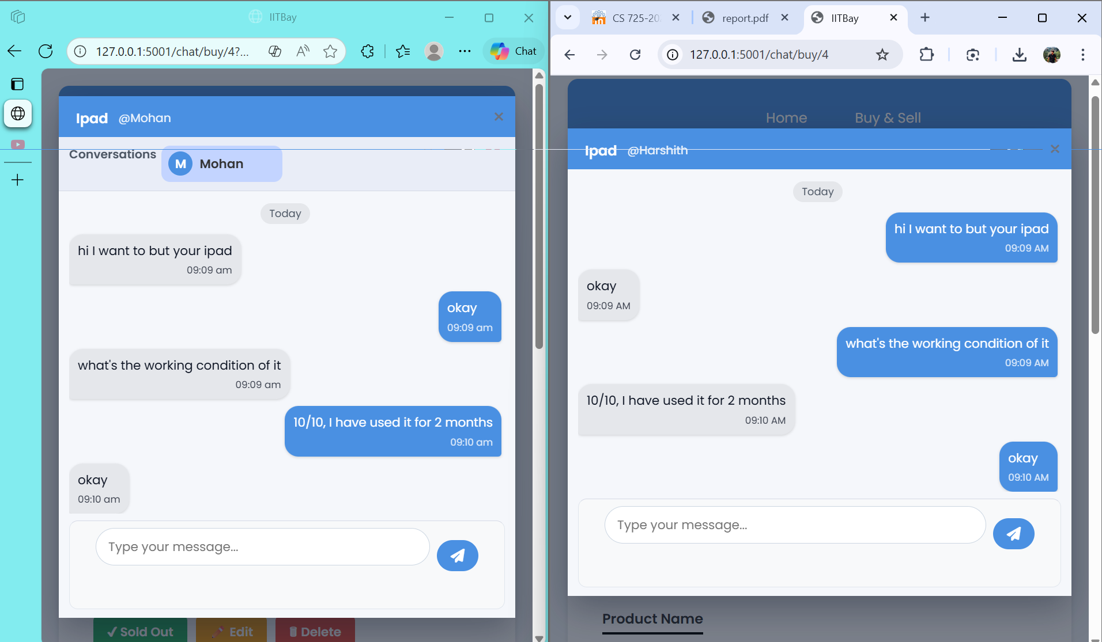
Added Chat system:

Slide 15
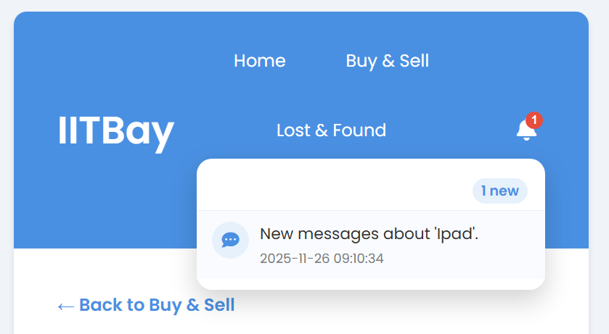
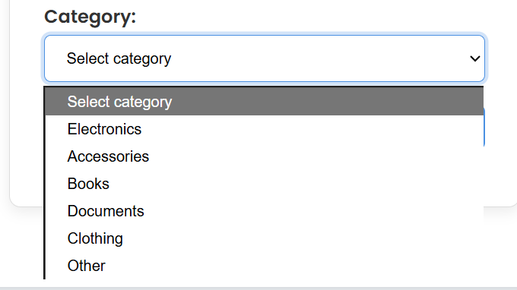
Added Notification System:
Added Categories in the lost and found section :

Slide 16
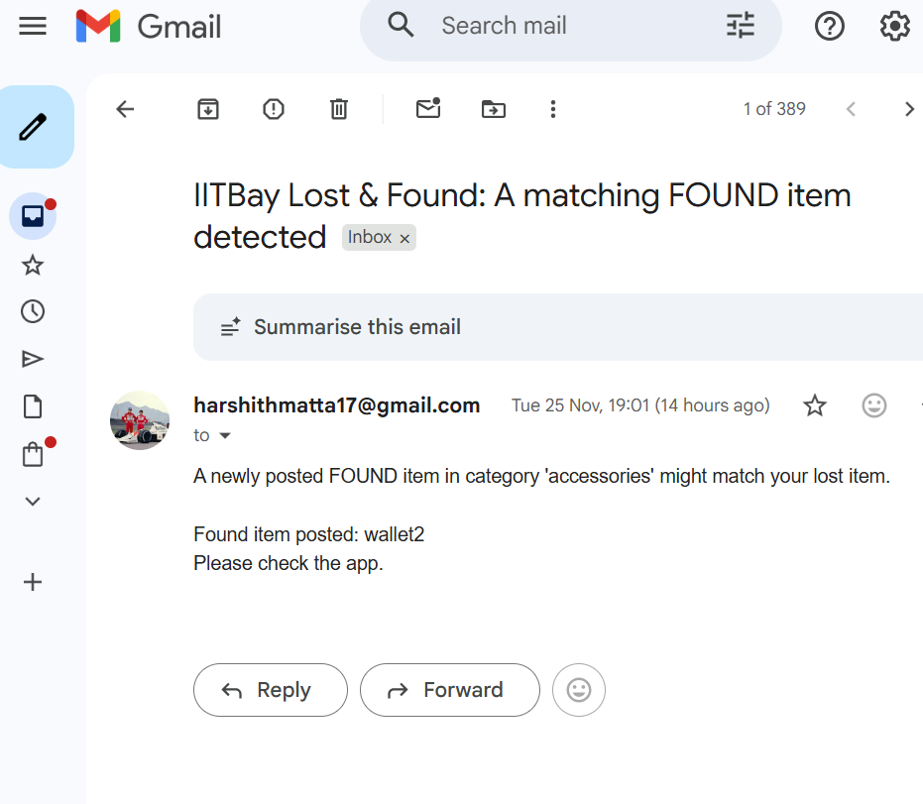
Added Gmail Notification System:
Whenever a new item is posted under a specific category, the system will automatically send a Gmail notification to the user who has reported losing that item.

Slide 17
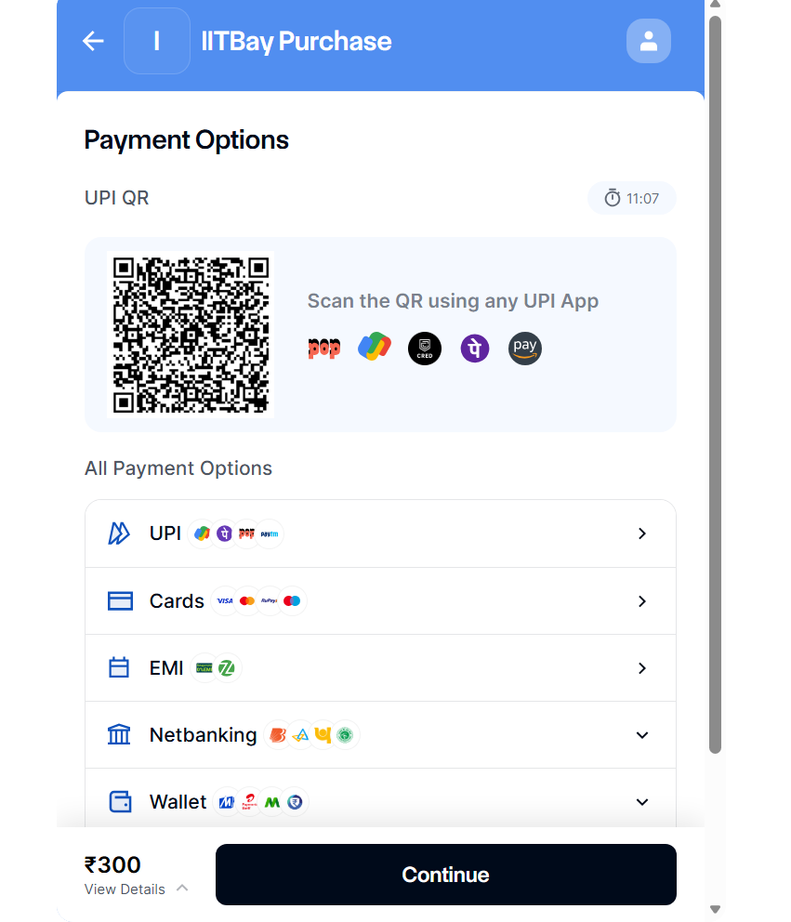
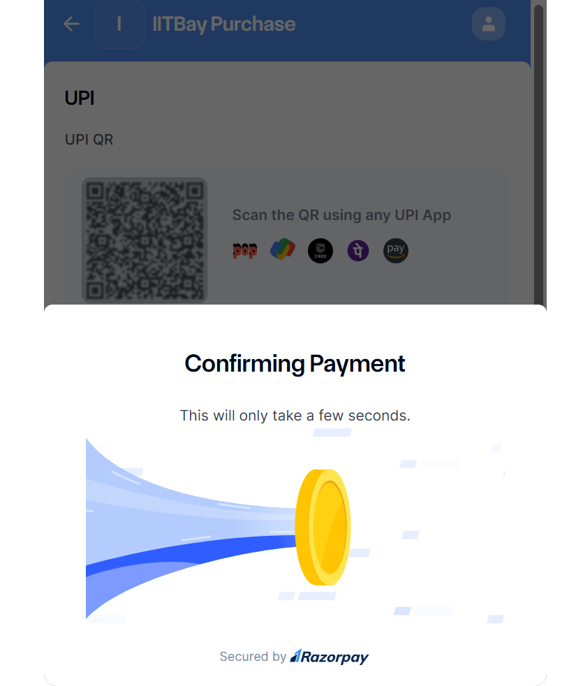
Added Chat system:

Slide 18
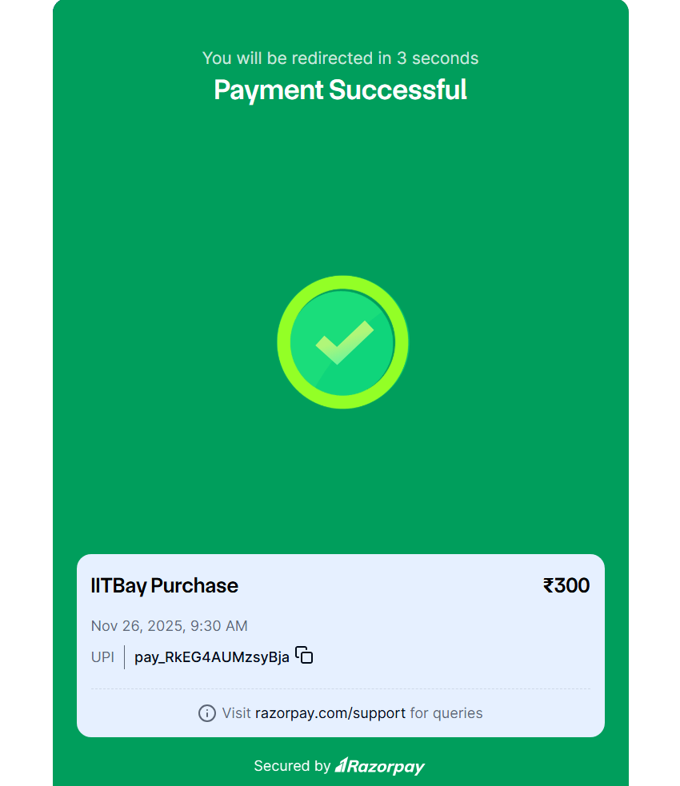

Slide 19
Challenges :
Razorpay does not trigger any backend callback on payment failure or cancellation, and since webhooks cannot be tested on localhost, implementing a reliable payment-failed route was not possible.
Anti-scraping ProtectionsGoogle Shopping, Amazon, Flipkart block automated scraping aggressively.Many requests returned blocked pages, empty data, or 429 (Too Many Requests).
Implemented polling in the chat module to support real-time conversations.
Integrated polling-based app notifications for instant user updates.
Added automated Gmail notifications to alert users about relevant events.

