Slide 1
Breast Cancer Classification
Vineeth Kumar , Renukuntla
Spring 21, Rowan University

Slide 2
INTRODUCTION
Breast cancer is growing problem among women, knowing the stage of it is a must and treated accordingly. Here, by using the Classification algorithms, we can classify the tumor as Benign or Malignant. In 2018, there were an estimated 3,676,262 women living with female breast cancer in the United States.

Slide 3
PROBLEM STATEMENT
Here, by using the Classification algorithms, we can classify the tumor as Benign or Malignant.
It’s a binary classification

Slide 4
DATASET CHARACTERISTICS
Here we got the data from UCI repository , it has got 32 attributes with 569 records
Ten real-valued features are computed for each cell nucleus: a) radius (mean of distances from center to points on the perimeter) b) texture (standard deviation of gray-scale values) c) perimeter d) area e) smoothness (local variation in radius lengths) f) compactness (perimeter^2 / area - 1.0) g) concavity (severity of concave portions of the contour) h) concave points (number of concave portions of the contour) i) symmetry j) fractal dimension ("coastline approximation" - 1)

Slide 5
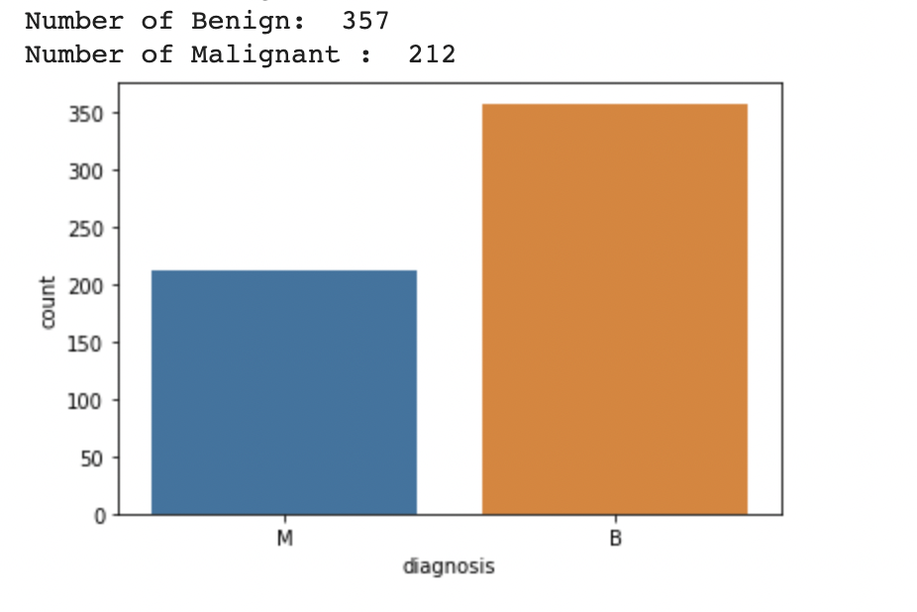
Target Variable

Slide 6
Environment and tools
Google Colab
Numpy
Pandas
Scikit-learn
Matplotlib
Seaborn

Slide 7
Correlation Heatmap

Slide 8
GOALS
01
VENUS
02
MERCURY
03
MARS
Venus has a beautiful name, but it’s terribly hot
Mercury is the closest planet to the Sun
Despite being red, Mars is actually a cold place

Slide 9
RESEARCH AND PUBLICATIONS
01
02
Venus has a beautiful name and is the second planet from the Sun. It’s terribly hot, even hotter than Mercury
Mercury is the closest planet to the Sun and the smallest one in our Solar System—it’s only a bit larger than our Moon
by VENUS
by MERCURY

