Slide 1

Amazon web services
AWS account creation

Slide 2
AWS Account Creation Steps
Email verification
Contact information
Billing information
Identity confirmation
Support plan selection

Slide 3
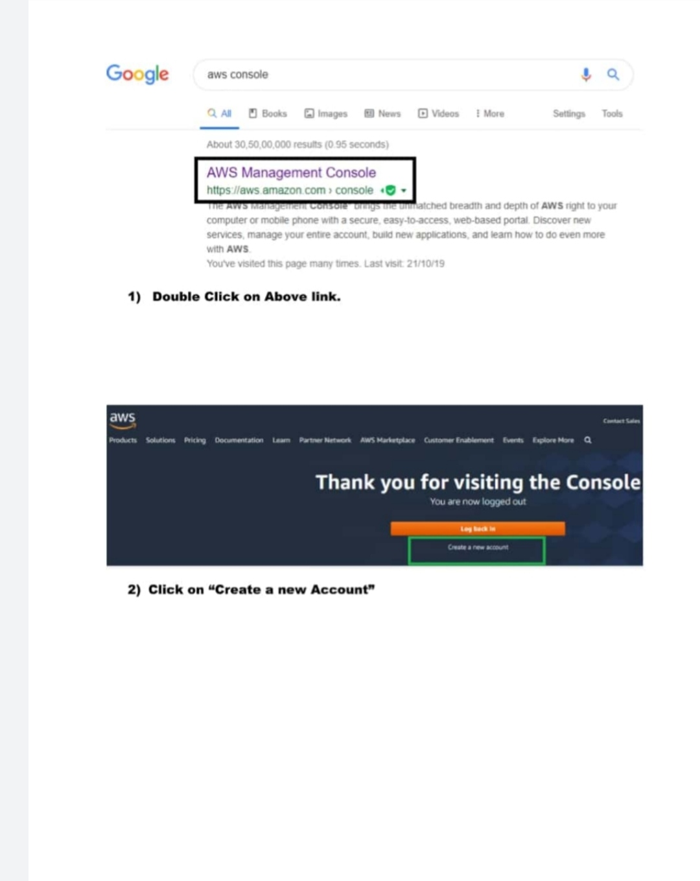

Slide 4
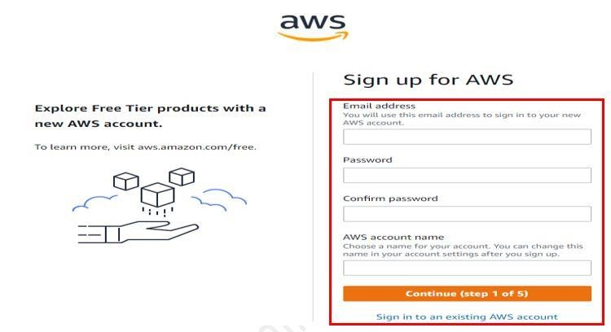

Slide 5
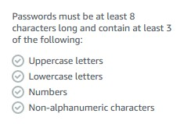
AWS Account Name must be unique

Slide 6
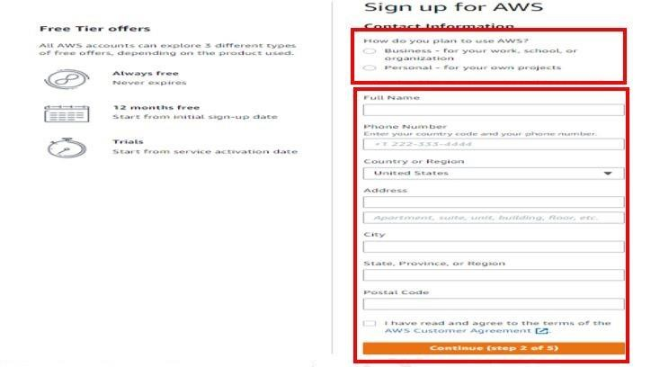

Slide 7
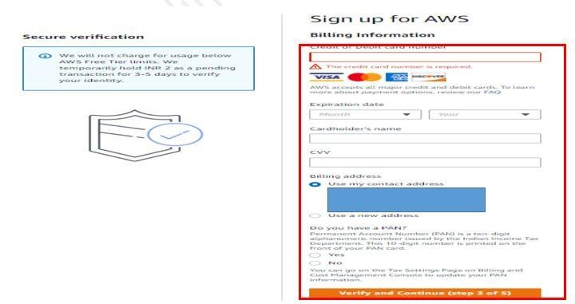

Slide 8
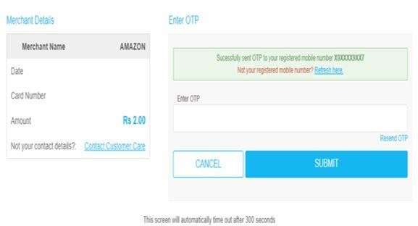

Slide 9
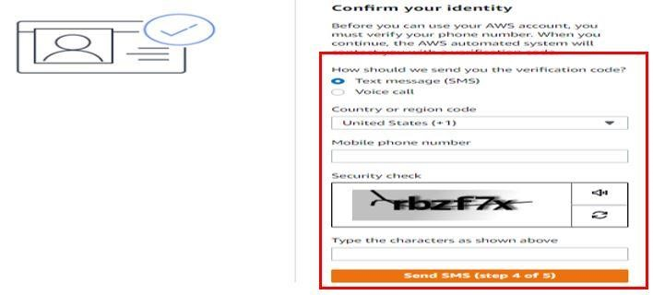

Slide 10
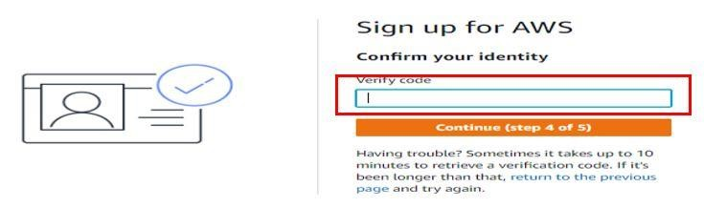

Slide 11
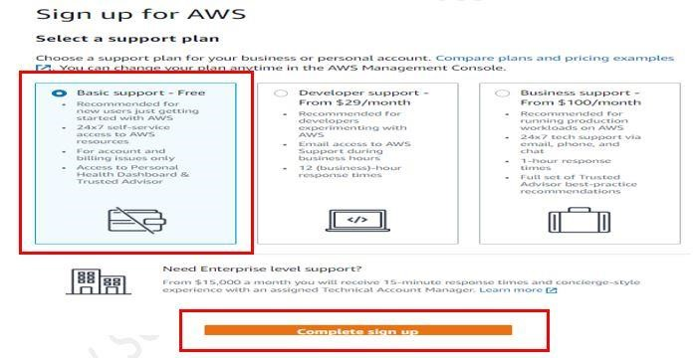

Slide 12
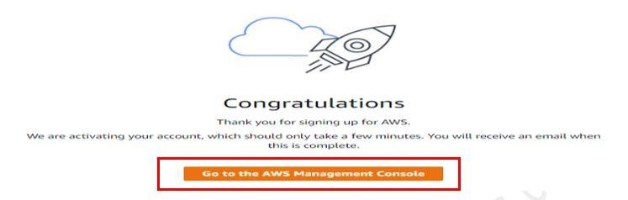

Slide 13
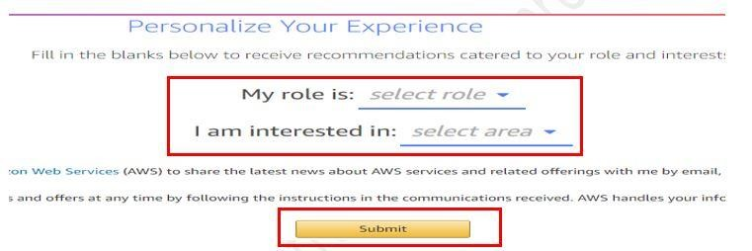

Slide 14
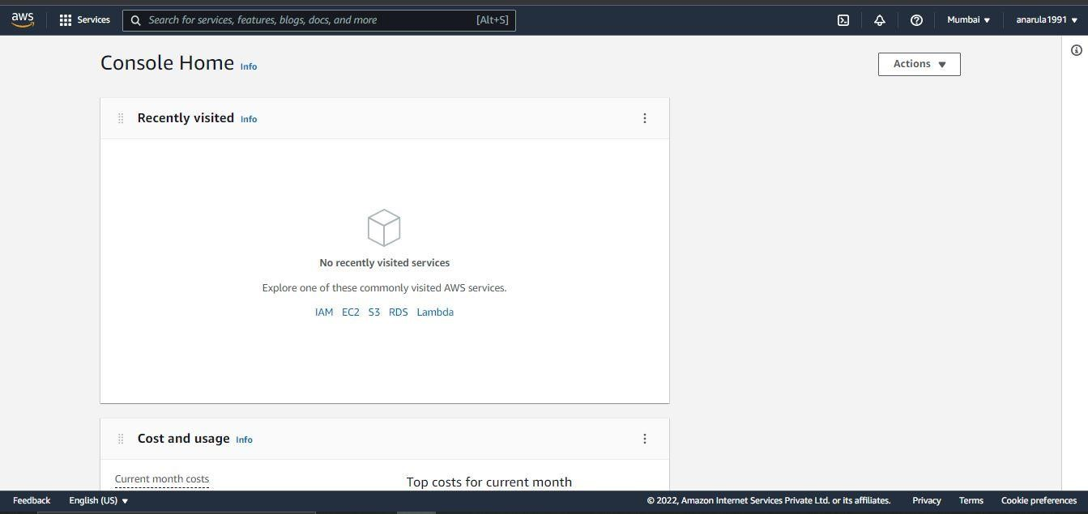

Slide 15
EC2 - Linux
Select EC2 Service
Click on Launch Instances
Choose Amazon Machine Image (AMI) (Amazon Linux)
Choose an Instance Type (t2.micro)
Configure Instance Details
Add Storage
Add Tags

Slide 16
EC2 - Linux
Configure Security Group
Note: For Windows Instance RDP Port Needs to be open & for Linux Instance SSH Port
Review Instance Launch
Create Key Pair
Download Putty & Puttygen

Slide 17
EC2 - Linux
Open Website: https://www.chiark.greenend.org.uk/~sgtatham/pu tty/latest.html
Generate PPK File Using Puttygen
Select the EC2 Machine & Click on connect
Go to SSH Client

Slide 18
EC2 - Linux
Note down the host name
Open putty
Enter the Host name
Attach PPK File with Putty
Click on open
Click on Accept

Slide 19
Linux (EC2 Instance Connect)
Select the EC2 Machine & Click on connect
Go to EC2 Instance Connect
Note down the Public IPV4 Address
Open Putty Enter IP Address
Attach PPK File File
Click on open
Enter User name (ec2-user)

Slide 20
Terminate/ Stop the Instance
Select the Instance
Click on Stop/ Terminate
Instance State
Stop/Terminate instance

Slide 21


