Slide 1

Emotion Classification
An Architectural View

Slide 2
Introduction
Architecture of a pipeline involving various steps like data collection, processing and classifying emotions in the text.
Framework to support various types of data sources to inject the data to the pipeline.
Utilizing NRC Lexicon to classify the emotions of the text.
A lightweight web application to have a clear understanding of the emotions involved in the text.

Slide 3






Tools
Development and
Web Interface
Streaming and
Processing
Storage, Search and
Visualization

Slide 4
Pipeline – High level View
Pre-Processing
And
Feature Engineering
Training/Evaluation
Deployment
Scoring
Historical storage
Online Streams
NRC - LEXICON

Slide 5

Historical Data
CSV
Loader
ES
Elasticsearch
Raw offline index
JSON
Spark service
offline_classifer.py
XML
NRC - Lexicon
ES
Elasticsearch
Emotions index
Historical
Data

Slide 6


Streaming Data
ES
Elasticsearch
Raw online index
Loader
online_loader.py
TwitteR
STREaming
Service
Kafka Broker
ES
streaming_service.py
Elasticsearch
Emotions index
Spark Classifier
online_classifer.py

Slide 7
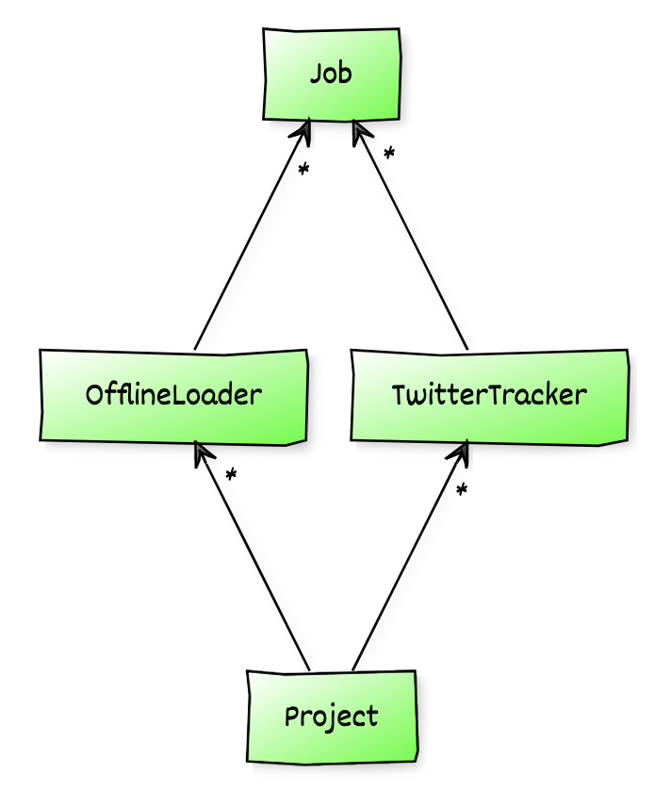
Handline New Projects
Configure Data Sources with corresponding job handlers
Create a new project with available data sources

Slide 8
Future Scope
Support for machine learning pipeline – Training/Evaluation, Deployment and Scoring modules.
Dockerized setup to make it more feasible to deploy in any cloud vendors like GCP or AWS.
Support for more file formats or online streams to extend to multiple types of projects.

Slide 9

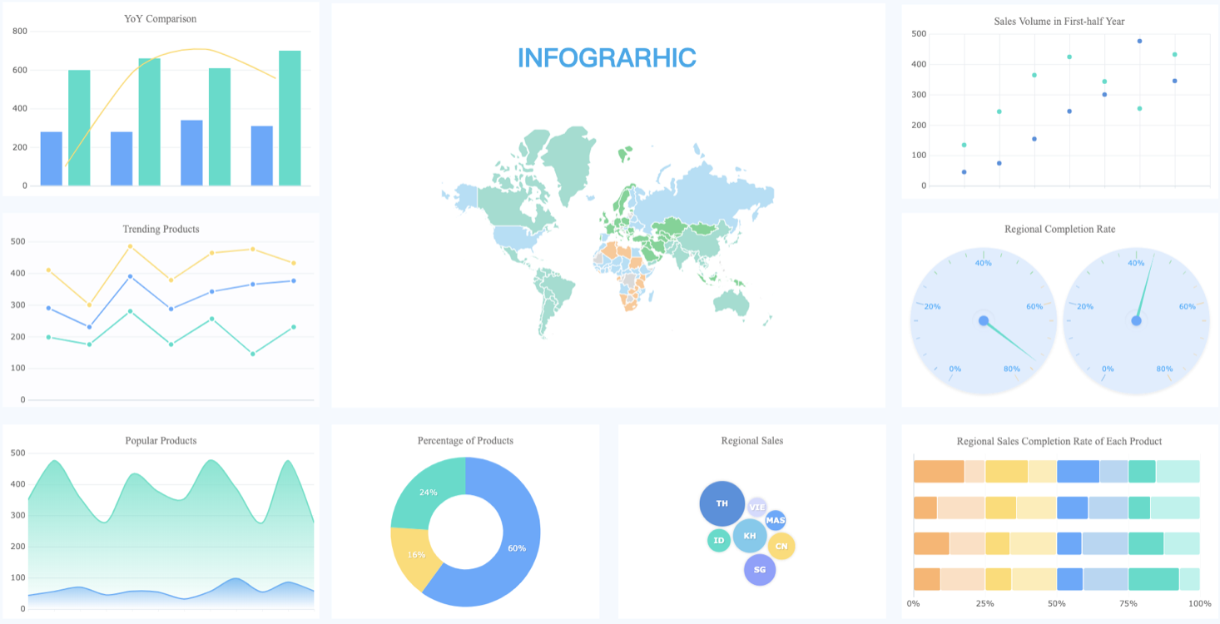

COVID19 - ANALYTICS PIPELINE
Structured
Data
Twitter posts
NRC Lexicon
Multi-variate timeseries analysis
STORAGE
Kafka Broker
Structured data
VISUALIZATION
Static twitter
storage

