Slide 1
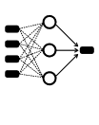
Numerical data
Web scraping
Word2Vec or GloVe
Returns
Raw text
Word embeddings
TF-IDF + PCA
Neural network

Slide 2
CNNs
LSTMs
Fully connected
Return prediction
Features
Pooling

