Slide 1
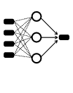
Numerical data
Web scraping
Return movement
predictions
Raw text
Word2Vec
Word embeddings
Filtering via k-means
Neural network

Slide 2
Recurrent dropout
CNNs
Fully connected
LSTMs
Fully connected
Softmax
Return classification
Features
Pooling
Dropout
Dropout

