Slide 1








Charging
Driving
$$E_{k+1}^{c}=E_{k}^{c}+P_{charge,k}T_{s}$$
$$E_{k+1}^{c}=E_{k}^{c}−P_{drive,k}^{c}T_{s}$$
$$d_{k+1}^{c}=d_{k}^{c}$$
$$d_{k+1}^{c}=d_{k}^{c}+δ_{drive,k}^{c}T_{s}$$
$$E_{k+1}^{c}=E_{k}^{c}$$
$$d_{k+1}^{c}=d_{k}^{c}$$
Waiting

Slide 2

















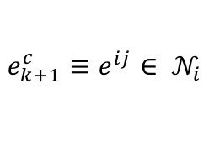







Charging
Driving
Node
$$γ_{k+1}^{c}=1$$
$${\sim γ}_{k+1}^{c}$$
$$ε_{k+1}^{c}=0$$
$$E_{k+1}^{c}=E_{k}^{c}+P_{charge,k}^{c}T_{s}$$
$$E_{k+1}^{c}=E_{k}^{c}−P_{drive,k}^{c}T_{s}$$
$$y_{k}^{c}=0/1$$
$$d_{k+1}^{c}=d_{k}^{c}$$
$$d_{k+1}^{c}=d_{k}^{c}+δ_{drive,k}^{c}T_{s}$$
$$γ_{k}^{c}∧y_{k}^{c}$$
$${\sim γ}_{k+1}^{c}$$
$ε_{k}^{c}≥e_{k}^{c}$
$$γ_{k+1}^{c}=0$$
$ε_{k+1}^{c}≥e_{k}^{c}$
$$e_{k+1}^{c}≡e^{ij}∈ 𝒩_{i}$$
$$γ_{k+1}^{c}≡1$$
$$γ_{k+1}^{c}∧y_{k+1}^{c}$$
$$γ_{k+1}^{c}∧{\sim y}_{k+1}^{c}$$
$$ε_{k+1}^{c}=ε_{k}^{c}+δ_{drive,k}^{c}T_{s}$$
$$E_{k+1}^{c}=E_{k}^{c}$$
$$γ_{k}^{c}=0$$
$$d_{k+1}^{c}=d_{k}^{c}$$
$e_{k+1}^{c}=e_{k}^{c}$
$$y_{k}^{c}=0$$
$ε_{k}^{c}<e_{k}^{c}$
$$γ_{k}^{c}∧{\sim y}_{k}^{c}$$
Edge
Waiting

Slide 3






Charging
Driving
Node
$$γ_{k+1}^{c}=1$$
$${\sim γ}_{k+1}^{c}$$
$$y_{k}^{c}=0/1$$
$$E_{k+1}^{c}=E_{k}^{c}+P_{charge,k}^{c}T_{s}$$
$$E_{k+1}^{c}=E_{k}^{c}−P_{drive,k}^{c}T_{s}$$
$$γ_{k}^{c}=1$$
$$d_{k+1}^{c}=d_{k}^{c}$$
$$d_{k+1}^{c}=d_{k}^{c}+δ_{drive,k}^{c}T_{s}$$
$$γ_{k}^{c}∧y_{k}^{c}$$
$${\sim γ}_{k+1}^{c}$$
$$ε_{k}^{c}=0$$
$ε_{k+1}^{c}≥e_{k}^{c}$
$$γ_{k+1}^{c}=0$$
$$γ_{k+1}^{c}≡1$$
$$ε_{k+1}^{c}≡0$$
$$e_{k+1}^{c}≡e^{ij}∈ 𝒩_{i}$$
$$γ_{k+1}^{c}∧y_{k+1}^{c}$$
$$γ_{k+1}^{c}∧{\sim y}_{k+1}^{c}$$
$$ε_{k+1}^{c}=ε_{k}^{c}+δ_{drive,k}^{c}T_{s}$$
$$E_{k+1}^{c}=E_{k}^{c}$$
$$γ_{k}^{c}=0$$
$$d_{k+1}^{c}=d_{k}^{c}$$
$e_{k+1}^{c}=e_{k}^{c}$
$$y_{k}^{c}=0$$
${0<ε}_{k}^{c}<e_{k}^{c}$
$$γ_{k}^{c}∧{\sim y}_{k}^{c}$$
Edge
Waiting

Slide 4
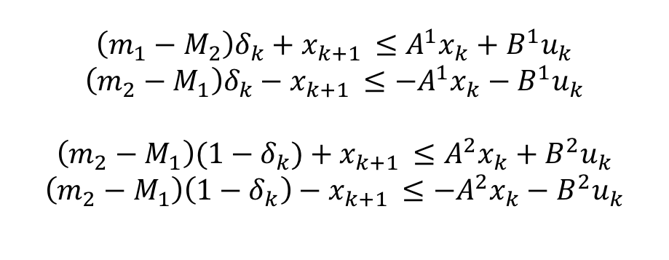
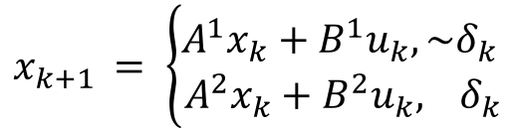
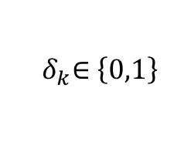


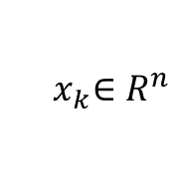
Piecewise linear (or affine) dynamics:
Big-M Formulation:
$$x_{k+1 }= \left\{\begin{aligned}A^{1}x_{k}+B^{1}u_{k},{\sim δ}_{k } \\ A^{2}x_{k}+B^{2}u_{k}, { δ}_{k}\end{aligned}\right.$$
$$\left(m_{1}−M_{2}\right)δ_{k}+x_{k+1 }≤A^{1}x_{k}+B^{1}u_{k}$$
$$\left(m_{2}−M_{1}\right)δ_{k}−x_{k+1 }≤−A^{1}x_{k}−B^{1}u_{k}$$
$$\left(m_{2}−M_{1}\right)(1−δ_{k})+x_{k+1 }≤A^{2}x_{k}+B^{2}u_{k}$$
$$\left(m_{2}−M_{1}\right)\left(1−δ_{k}\right)−x_{k+1 }≤−A^{2}x_{k}−B^{2}u_{k}$$
$${ δ}_{k}∈\left\{0,1\right\}$$
$$Dom\left(q_{1}\right)=\left[m_{1},M_{1}\right]$$
$$Dom\left(q_{1}\right)=\left[m_{2},M_{2}\right]$$
$${ x}_{k}∈R^{n}$$

