Slide 1
Solving the Quantum multi-body problem using ANNs
-VINEET ASHOK KOTARIYA
EE,IIT-Bombay

Slide 2
Agenda
Background
Objective
Concept
Proofs/Derivations
Results

Slide 3
Background
Quantum many-body systems consist of a large number of entities interacting together.
The complexity of a large number of atomic systems involved increases exponentially with the number of systems and makes analytical calculations impractical
Recently there has been a push to use machine learning approaches to solve some multi-body problems
Which can possibly help us to find efficient representation of quantum states and their behaviour
Carleo and Troyer [1] have used Restricted Boltzmann machine to represent the quantum states in some models to provide state of the art results

Slide 4
Concept
1

Slide 5
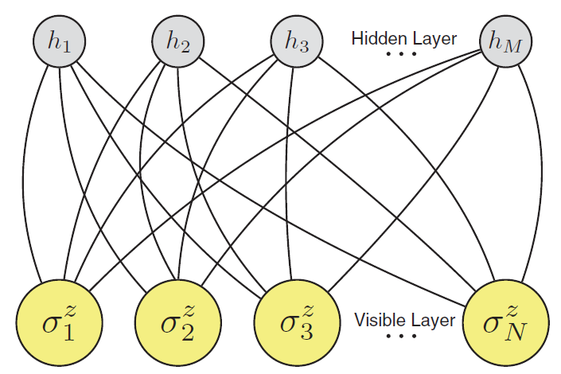
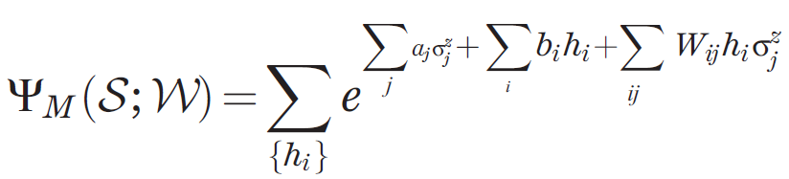
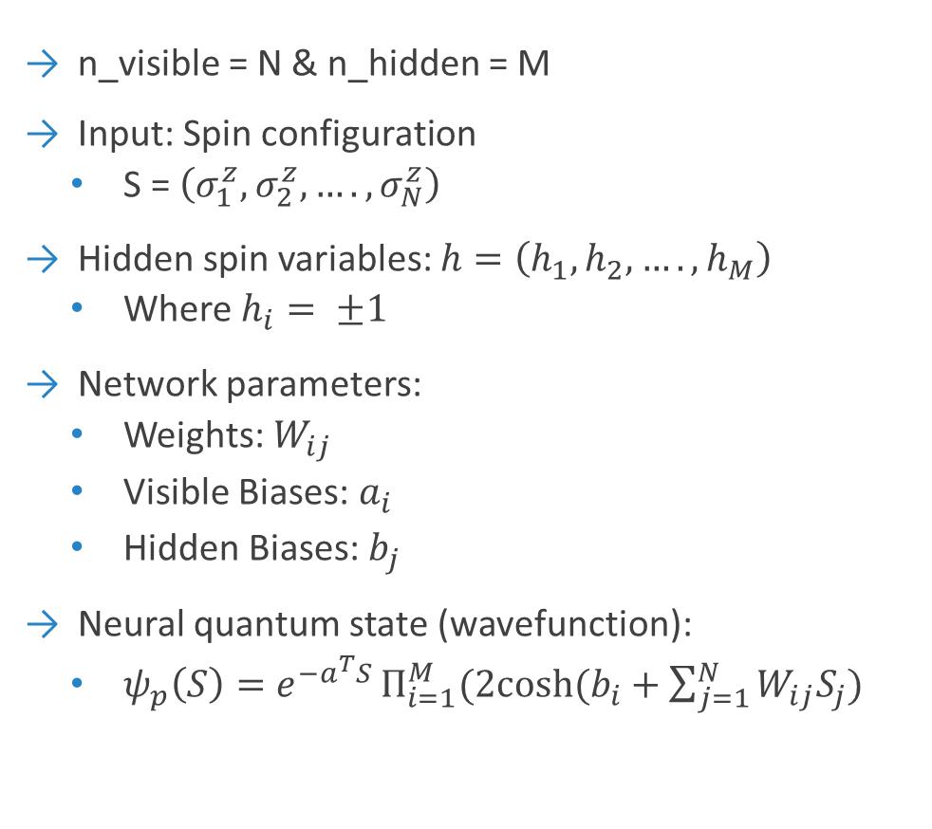
Architecture: Restricted Boltzmann Machine (RBM)
n_visible = N & n_hidden = M
Input: Spin configuration
S = $\left(σ_{1}^{z},σ_{2}^{z},….,σ_{N}^{z}\right)$
Hidden spin variables: $h=\left(h_{1}, h_{2}, …., h_{M}\right)$
Where $h_{i}= ±1$
Network parameters:
Weights: $W_{ij}$
Visible Biases: $a_{i}$
Hidden Biases: $b_{j}$
Neural quantum state (wavefunction):
$ψ_{p}\left(S\right)=e^{−a^{T}S }Π_{i=1}^{M}(2cosh⁡(b_{i}+\sum_{j=1}^{N}{W_{ij}S_{j}})$
Restricted Boltzmann Machine

Slide 6
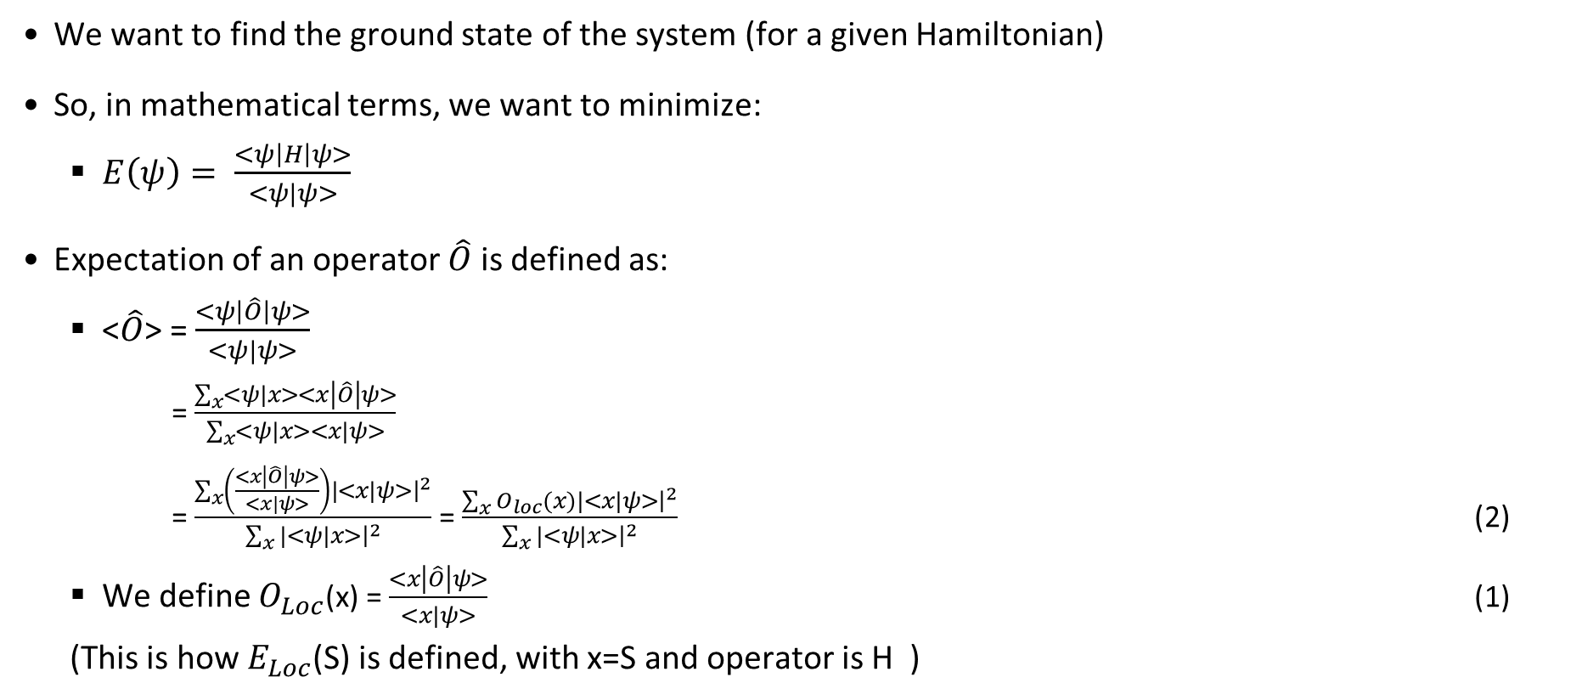
Objective
We want to find the ground state of the system (for a given Hamiltonian)
So, in mathematical terms, we want to minimize:
$E\left(ψ\right)= \frac{<ψ\left|H\right|ψ>}{<ψ|ψ>}$
Expectation of an operator $\hat{O}$ is defined as:
<$\hat{O}$> = $\frac{<ψ\left|\hat{O}\right|ψ>}{<ψ|ψ>}$
= $\frac{\sum_{x}{<ψ|x>}<x\left|\hat{O}\right|ψ>}{\sum_{x}{<ψ|x>}<x|ψ>}$
= $\frac{\sum_{x}{\left(\frac{<x\left|\hat{O}\right|ψ>}{<x|ψ>}\right)}|<x|ψ>{\left.​\right|}^{2}}{\sum_{x}{|<ψ|x>}{\left.​\right|}^{2}}$ = $\frac{\sum_{x}{O_{loc}(x)}|<x|ψ>{\left.​\right|}^{2}}{\sum_{x}{|<ψ|x>}{\left.​\right|}^{2}}$ (2)
We define $O_{Loc}$(x) = $\frac{<x\left|\hat{O}\right|ψ>}{<x|ψ>}$ (1)
(This is how $E_{Loc}$(S) is defined, with x=S and operator is H )

Slide 7
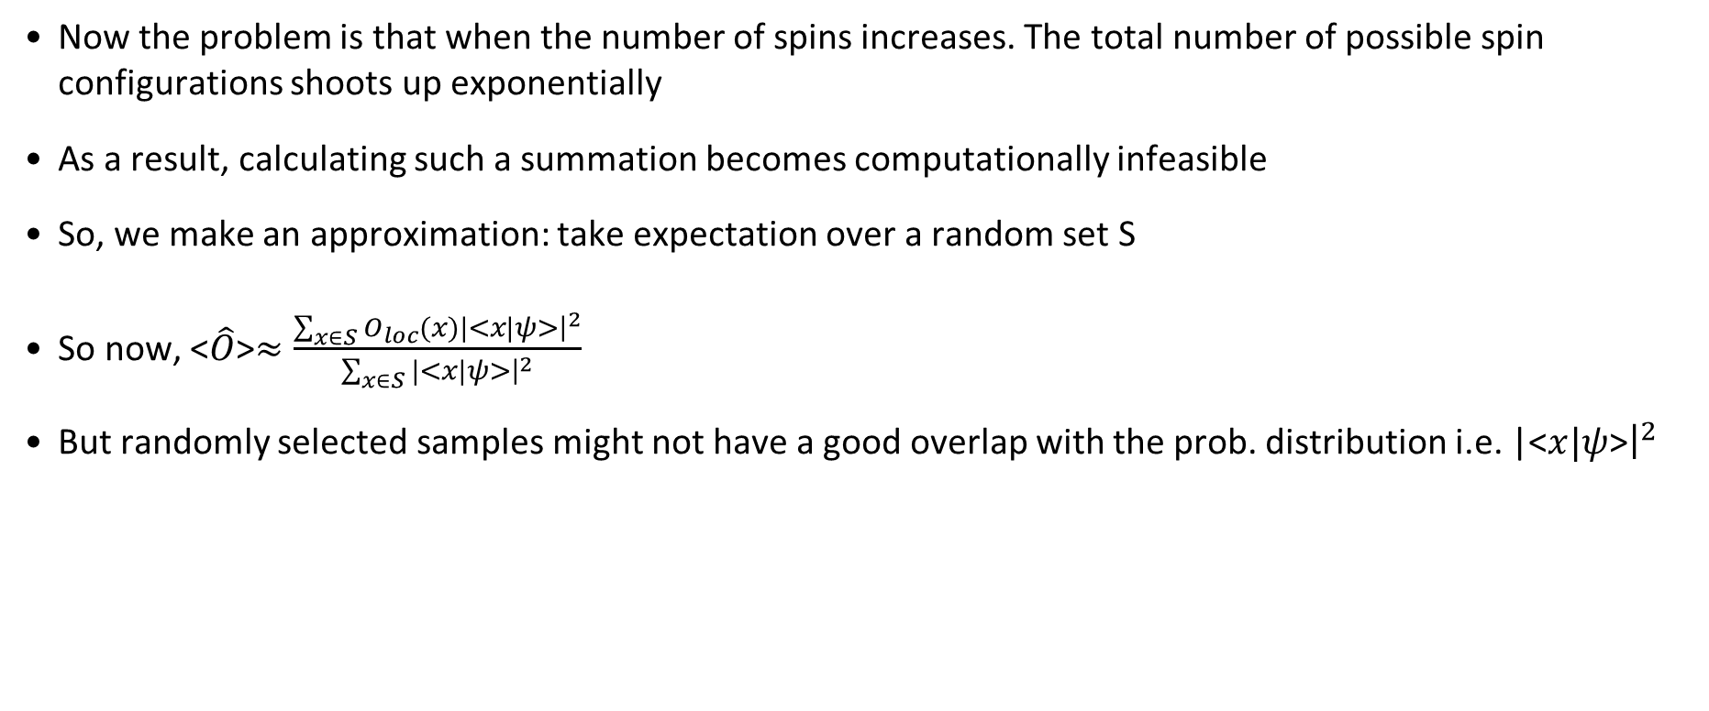
Approach
Now the problem is that when the number of spins increases. The total number of possible spin configurations shoots up exponentially
As a result, calculating such a summation becomes computationally infeasible
So, we make an approximation: take expectation over a random set S
So now, <$\hat{O}$>$≈\frac{\sum_{x∈S}{O_{loc}(x)}|<x|ψ>{\left.​\right|}^{2}}{\sum_{x∈S}{|<x|ψ>}{\left.​\right|}^{2}}$
But randomly selected samples might not have a good overlap with the prob. distribution i.e. |<$x|ψ$>${\left.​\right|}^{2}$

Slide 8
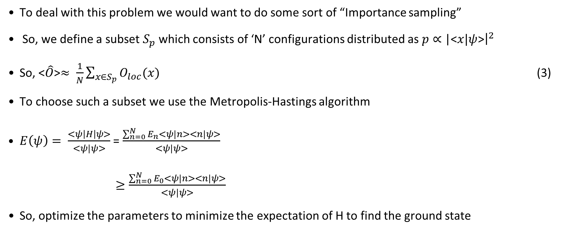
Approach
To deal with this problem we would want to do some sort of “Importance sampling”
So, we define a subset $S_{p}$ which consists of ‘N’ configurations distributed as $p∝$|<$x|ψ$>${\left.​\right|}^{2}$
So, <$\hat{O}$>$≈ \frac{1}{N}\sum_{x∈S_{p}}{O_{loc}(x)}$ (3)
To choose such a subset we use the Metropolis-Hastings algorithm
$E\left(ψ\right)= \frac{<ψ\left|H\right|ψ>}{<ψ|ψ>}$ = $\frac{\sum_{n=0}^{N}{E_{n}}<ψ|n><n|ψ>}{<ψ|ψ>}$
$≥\frac{\sum_{n=0}^{N}{E_{0}}<ψ|n><n|ψ>}{<ψ|ψ>}$
So, optimize the parameters to minimize the expectation of H to find the ground state
Notes:
Not Sp is a multi-subset i.e. the same configuration can possibly repeat multiple times

Slide 9
Metropolis Hastings Algorithm
2

Slide 10
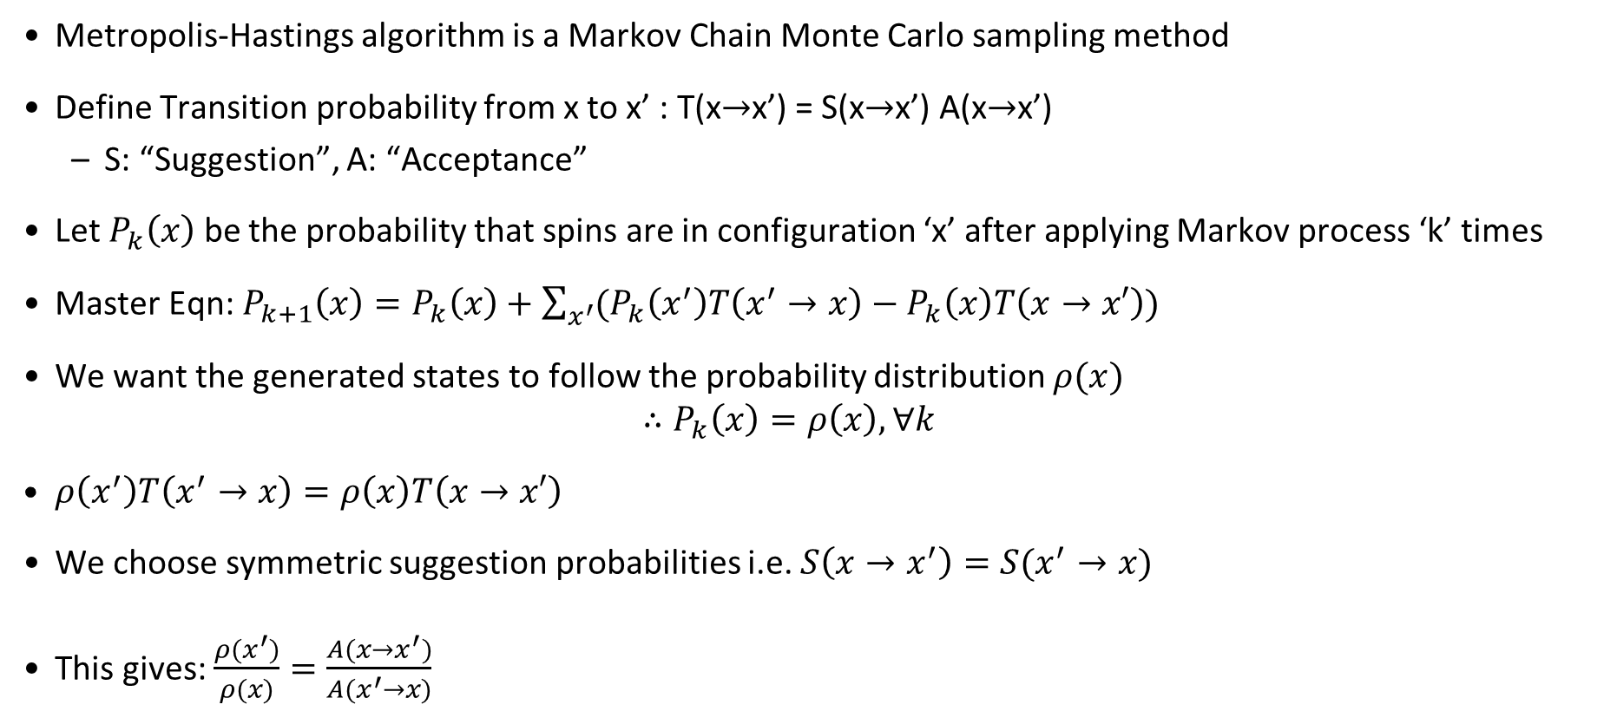
Metropolis Hastings’ Algorithm
Metropolis-Hastings algorithm is a Markov Chain Monte Carlo sampling method
Define Transition probability from x to x’ : T(x$→$x’) = S(x$→$x’) A(x$→$x’)
S: “Suggestion”, A: “Acceptance”
Let $P_{k}\left(x\right)$ be the probability that spins are in configuration ‘x’ after applying Markov process ‘k’ times
Master Eqn: $P_{k+1}\left(x\right)=P_{k}\left(x\right)+\sum_{x^{′}}{(P_{k}\left(x^{′}\right)T\left(x^{′}→x\right)−P_{k}\left(x\right)T\left(x→x′\right))}$
We want the generated states to follow the probability distribution $ρ(x)$
$$∴P_{k}\left(x\right)=ρ\left(x\right), ∀k$$
$ρ\left(x^{′}\right)T\left(x^{′}→x\right)=ρ\left(x\right)T\left(x→x′\right)$
We choose symmetric suggestion probabilities i.e. $S\left(x→x^{′}\right)=S(x^{′}→x)$
This gives: $\frac{ρ(x^{′})}{ρ(x)}=\frac{A({x→x}^{′})}{A(x^{′}→x)}$
Notes:
Not Sp is a multi-subset i.e. the same configuration can possibly repeat multiple times

Slide 11
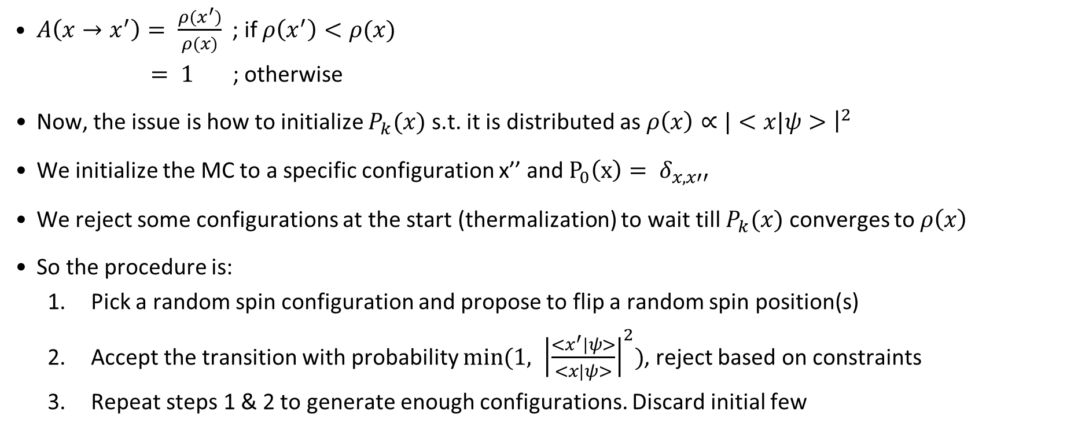
Metropolis Hastings’ Algorithm
$A\left(x→x^{′}\right)= \frac{ρ(x^{′})}{ρ(x)}$; if $ρ\left(x^{′}\right)<ρ(x)$
$= 1$ ; otherwise
Now, the issue is how to initialize $P_{k}(x)$ s.t. it is distributed as $ρ\left(x\right)∝|<x|ψ>{\left.​\right|}^{2}$
We initialize the MC to a specific configuration x’’ and $P_{0}\left(x\right)= δ_{x,x′′}$
We reject some configurations at the start (thermalization) to wait till $P_{k}(x)$ converges to $ρ\left(x\right)$
So the procedure is:
Pick a random spin configuration and propose to flip a random spin position(s)
Accept the transition with probability $min⁡(1, {\left|\frac{<x^{′}|ψ>}{<x|ψ>}\right|}^{2})$, reject based on constraints
Repeat steps 1 & 2 to generate enough configurations. Discard initial few
Notes:
At this point we would only like to mention that the detailed balance
together with the ergodicity is a sufficient condition for the Markov process’ property
to have a unique limiting distribution to which it will converge independently from the
initialization. A proof of this theorem can be found in [Häg02, chapter 5]. A practical
consequence of this is that one should always discard a certain number of configurations
at the beginning of the Markov chain because in general the probability Pk(x) first had
to converge to its limiting distribution (x). This process is called the equilibration of
the system.

Slide 12
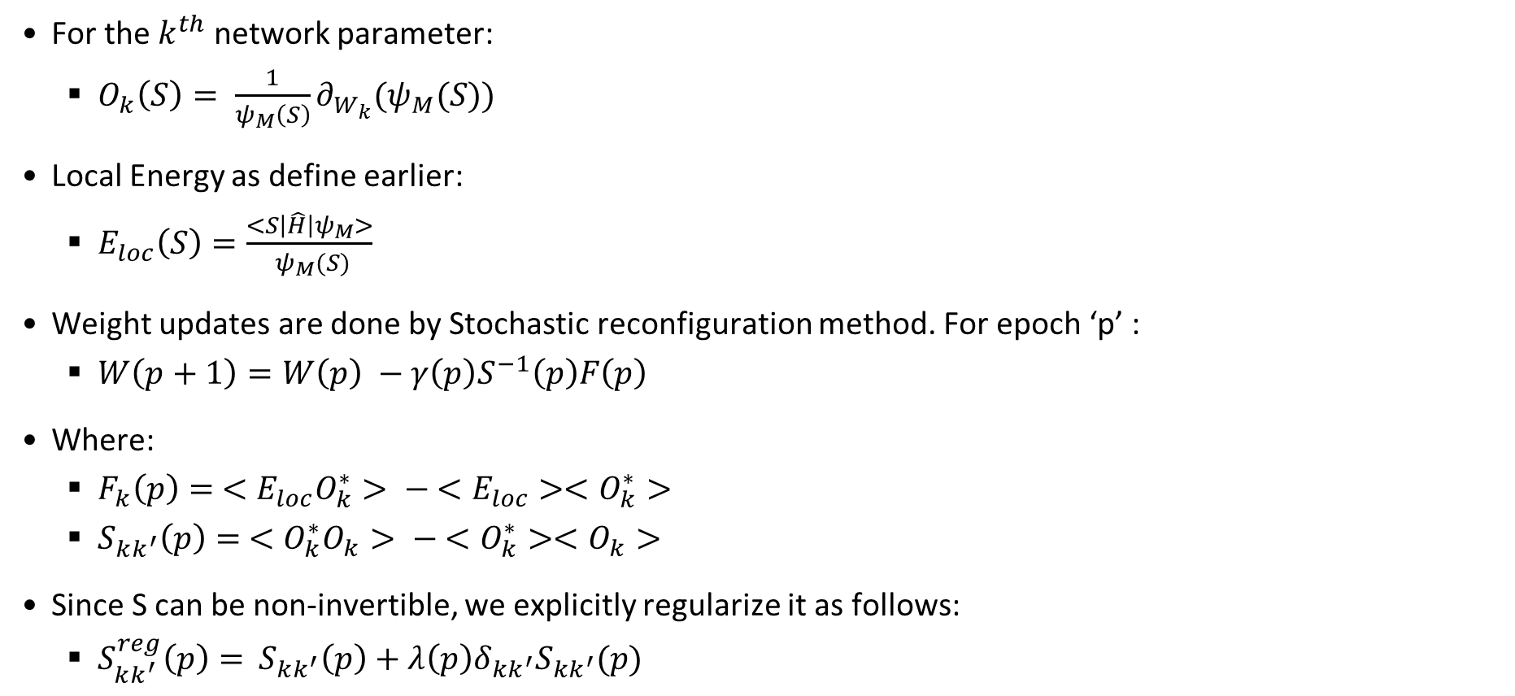
Learning Algorithm
For the $k^{th}$ network parameter:
$O_{k}\left(S\right)= \frac{1}{ψ_{M}\left(S\right)}∂_{W_{k}}{(ψ}_{M}(S))$
Local Energy as define earlier:
$E_{loc}\left(S\right)=\frac{<S\left|\hat{H}\right|ψ_{M}>}{ ψ_{M}(S)}$
Weight updates are done by Stochastic reconfiguration method. For epoch ‘p’ :
$W\left(p+1\right)=W\left(p\right) −γ\left(p\right)S^{−1}\left(p\right)F\left(p\right)$
Where:
$F_{k}\left(p\right)= <E_{loc}O_{k}^{∗}> − <E_{loc}><O_{k}^{∗}>$
$S_{kk^{′}}\left(p\right)= <O_{k}^{∗}O_{k}> − <O_{k}^{∗}><O_{k}>$
Since S can be non-invertible, we explicitly regularize it as follows:
$S_{kk^{′}}^{reg}\left(p\right)=$ $S_{kk^{′}}\left(p\right)+λ\left(p\right)δ_{kk^{′}}S_{kk^{′}}(p)$
Notes:
The learning rule is independent of the architecture. Rules are based on the SR method
SR can be interpreted as an effective imaginary-time evolution in the variational subspace.
𝜆(𝑝)=max(𝜆_0𝑏^𝑝,𝜆min) and typically take 𝜆0=100, 𝑏=0.9 and 𝜆min=10−4

Slide 13
Stochastic Reconfiguration
3

Slide 14
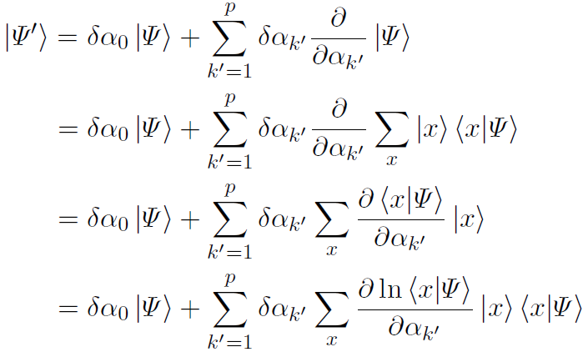

Stochastic Reconfiguration Derivation
Let $|ψ⟩$ be the trial wavefunction that depends on the parameters ${(α}_{1},α_{2},…., α_{p})$
We make the approximation/assumption (ansatz) of setting the new state $|ψ^{′}⟩$ to the Taylor expansion of $|ψ⟩$ in the variational parameters:
Notes:
Step 2 is like projecting onto |x>

Slide 15
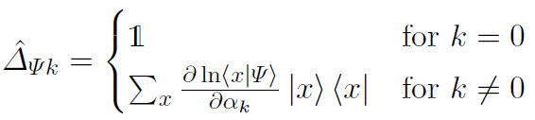
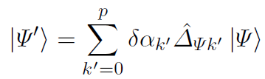
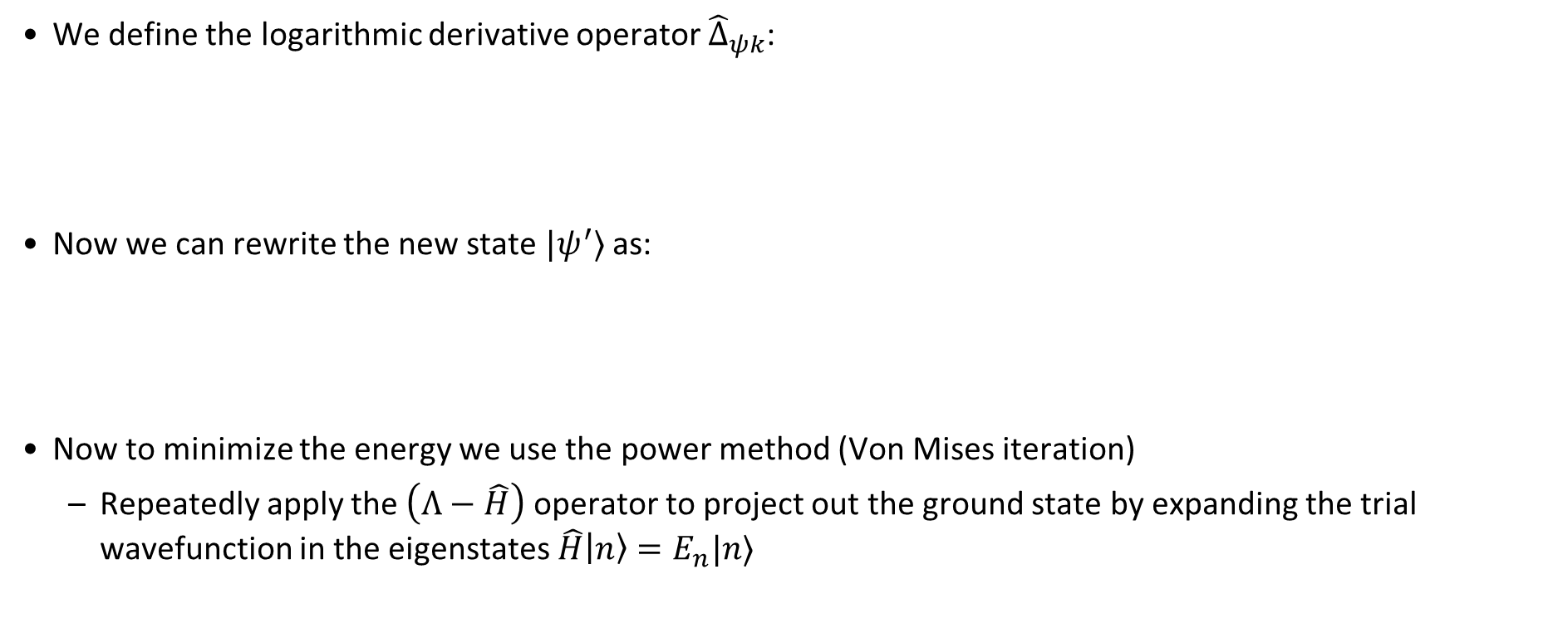
Stochastic Reconfiguration Derivation
We define the logarithmic derivative operator ${\hat{Δ}}_{ψk}$:
Now we can rewrite the new state $|ψ^{′}⟩$ as:
Now to minimize the energy we use the power method (Von Mises iteration)
Repeatedly apply the $\left(Λ−\hat{H}\right)$ operator to project out the ground state by expanding the trial wavefunction in the eigenstates $\hat{H}\left|n\right\rangle =E_{n}|n⟩$

Slide 16

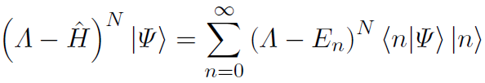


Stochastic Reconfiguration Derivation
We can rewrite $|ψ⟩$ as:
Now, applying the operator N times:
Now we know that $\left(Λ−E_{o}\right)≥\left(Λ −E_{i}\right) ∀i >0$, so the ground state projects out as $N→∞$
So, now we set the new state $|ψ^{′}⟩$ as:

Slide 17
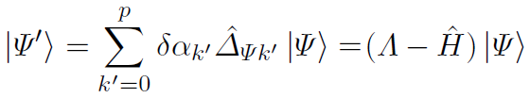
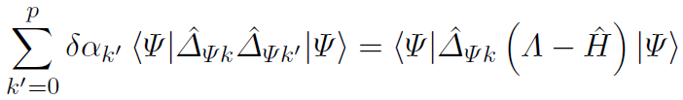
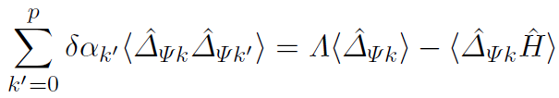

Stochastic Reconfiguration Derivation
Now project $\left|ψ^{′}\right\rangle$ onto ${\hat{Δ}}_{ψk}\left|ψ\right\rangle :$
Divide both sides by $\left\langle ψ | ψ\right\rangle :$
Notes:
In divide step we are basically converting it to an operator algebra equation

Slide 18
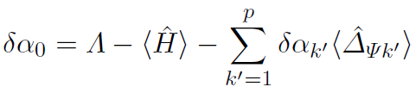
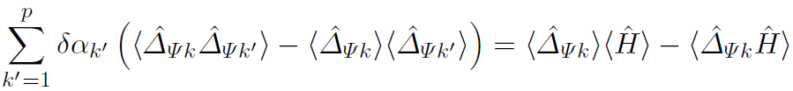
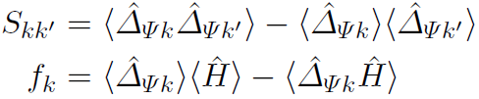

Stochastic Reconfiguration Derivation
Now to solve the equation substitute k=0 (since we know that ${\hat{Δ}}_{ψ0}=1$ ):
Now substitute $δ_{α_{0}}$ and rewrite the eqn:
This gives us our SR terms:

Slide 19
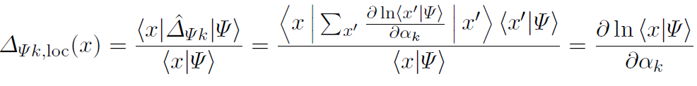


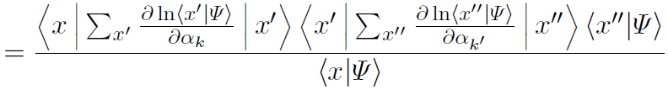

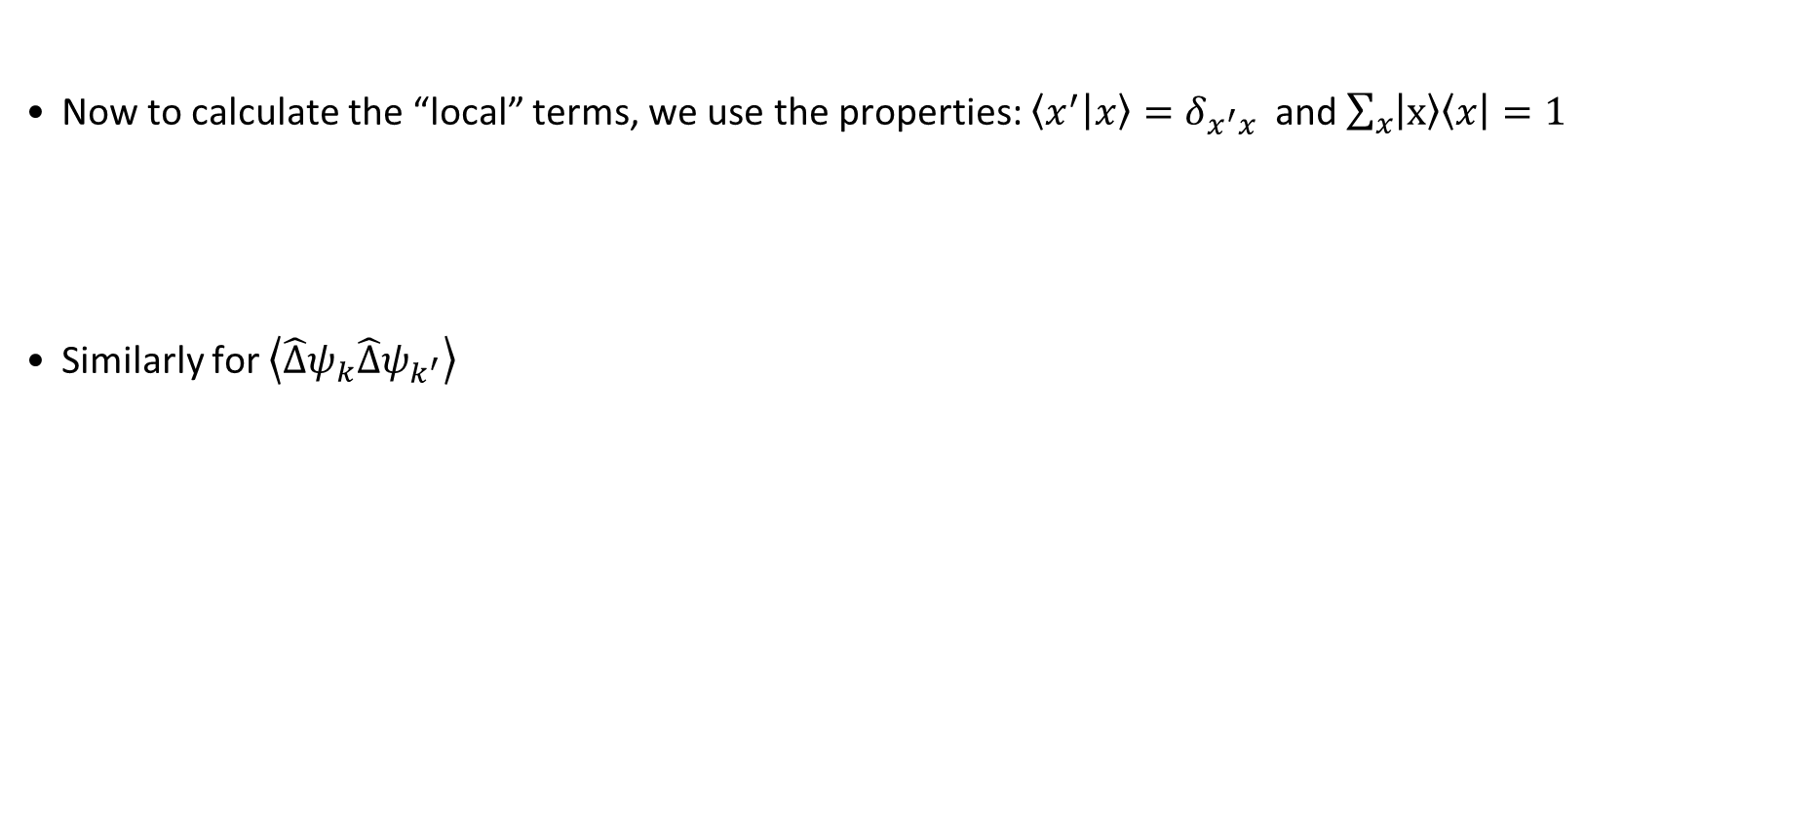
Stochastic Reconfiguration Derivation
Now to calculate the “local” terms, we use the properties: $\left\langle x^{′} | x\right\rangle =δ_{x^{′}x}$ and $\sum_{x}{\left|x\right\rangle \left\langle x\right|=1}$
Similarly for $\left\langle \hat{Δ}ψ_{k}\hat{Δ}ψ_{k^{′}}\right\rangle$

Slide 20
Results
4

Slide 21
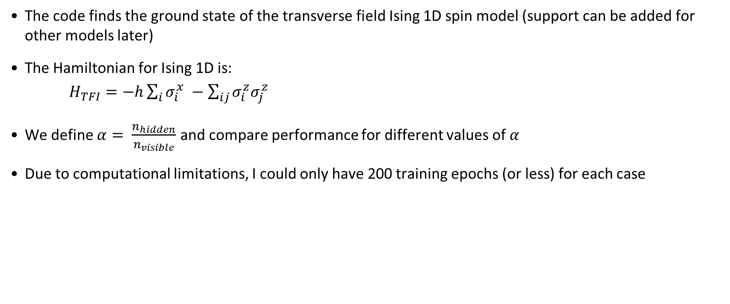
Setup
The code finds the ground state of the transverse field Ising 1D spin model (support can be added for other models later)
The Hamiltonian for Ising 1D is:
$H_{TFI}=−h\sum_{i}{σ_{i}^{x} −\sum_{ij}{σ_{i}^{z}σ_{j}^{z}}}$
We define $α= \frac{n_{hidden}}{n_{visible}}$ and compare performance for different values of $α$
Due to computational limitations, I could only have 200 training epochs (or less) for each case
Notes:
Running for only 200 epochs might be the reason behind the small difference in values
Code runs for 2D antiferromagnetic Heisenberg too, but takes too long to run on COLAB

Slide 22
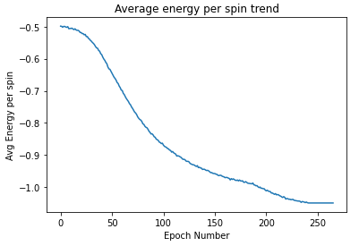
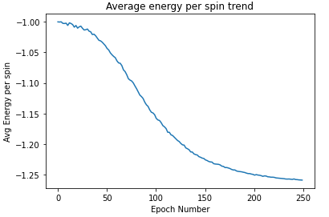
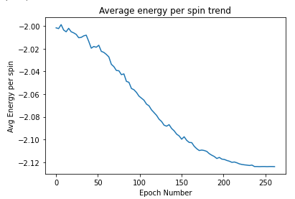
Energy Comparison
h | Average energy per spin |  | Difference(%)
 | Carleo-Troyer | My code
0.5 | -1.063 | -1.049 | 1.3
1 | -1.272 | -1.259 | 1.06
2 | -2.127 | -2.124 | 0.27

Slide 23
References
Giuseppe Carleo and Matthias Troyer. Solving the quantum many-body problem with artificial neural networks. Science, 355(6325):602–606, 2017. ISSN 0036-8075. doi: 10.1126/science.aag2302.
Rüger R 2013 Implementation of the variational Monte Carlo method for the Hubbard model Master's Thesis Goethe University Frankfurt

Slide 24
Thank You

Slide 25
“ There is no real ending.
It’s just the place where
You stop the story.”
-Frank Herbert
Notes:
Can also use Vivadi font

