Slide 1
Web Services

Slide 2
Introduction
A web service makes software application resources available over networks using standard technologies. Because web services are based on standard interfaces, they can communicate even if they are running on different operating systems and are written in different languages
Web services are excellent approach for building distributed applications that must incorporate diverse systems over a network

Slide 3
Standard Technologies
Web services are able to expose their resources in this generally accessible way because they adhere to recognized standards.
Publicly describes its own functionality through a WSDL file
Communicates with other applications via XML messages, often formatted with SOAP
Employs a standard network protocol such as HTTP

Slide 4
Components of Web Services
The basic web services platform is XML + HTTP. All the standard web services work using the following components.
XML-RPC
SOAP (Simple Object Access Protocol)
UDDI (Universal Description, Discovery and Integration)
WSDL (Web Services Description Language)

Slide 5
How Does a Web Service Work?
A web service enables communication among various applications by using open standards such as HTML, XML, WSDL, and SOAP. A web service takes the help of -
XML to tag the data
SOAP to transfer a message
WSDL to describe the availability of service

Slide 6
WSDL Files
The Web Service Description Language (WSDL) is a standard XML format for describing web services.
A WSDL file describes a particular web service so that other software applications can interface with it

Slide 7
XML and SOAP
Extensible Markup Language (XML) messages provide a common language by which different applications can talk to one another over a network.
A client sends an XML message containing a request to the web service, and the web service responds with an XML message containing the results of the operation.
Simple Object Access Protocol (SOAP) specifies a standard format for applications to call each other's methods and pass data to one another. The types of messages supported by a particular web service are delineated in the service's WSDL file.

Slide 8
Network Protocol
Web services receive requests and send responses using widely used protocols such as HyperText Transfer Protocol (HTTP) and Java Message Service (JMS).
A web service may support more than one protocol.
The protocols that a web service supports are published in the WSDL file.

Slide 9
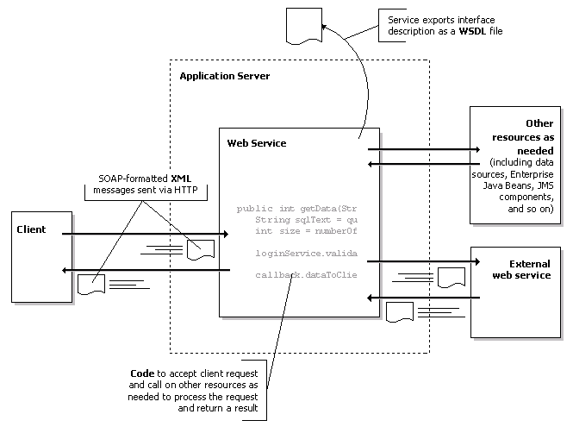
Architecture

Slide 10
Asynchronous Web Services
Callbacks
Asynchronous Request-Response

