Slide 1
Java Architecture

Slide 2
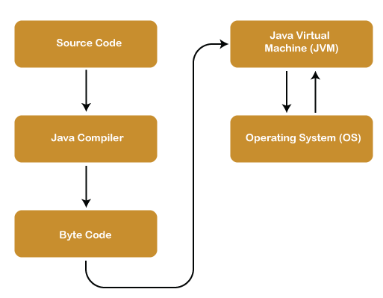

Slide 3
Components of Java Architecture
Java Virtual Machine
Java Runtime Environment
Java Development Kit

Slide 4
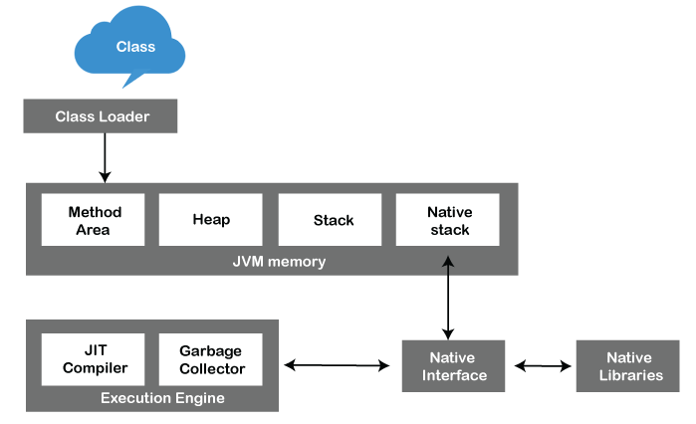
JVM Architecture

Slide 5
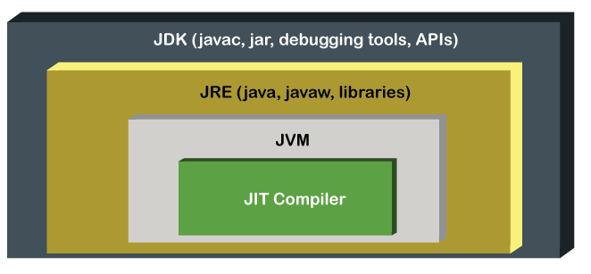
What is JIT

Slide 6
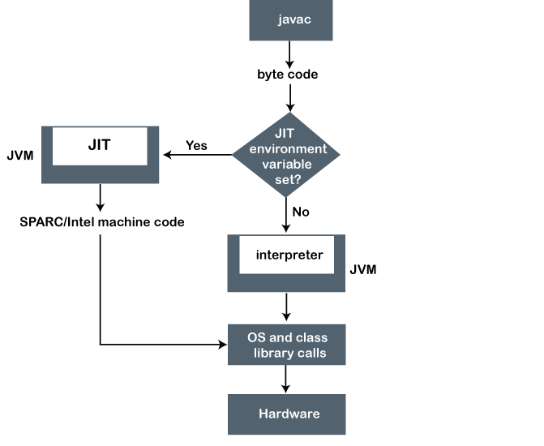
JIT compilation process

