Slide 1
JAXB (Java Architecture for XML Binding)

Slide 2
Introduction
Java Architecture for XML Binding (JAXB) provides a fast and convenient way to bind XML schemas and Java representations, making it easy for Java developers to incorporate XML data and processing functions in Java applications.
As part of this process, JAXB provides methods for unmarshalling (reading) XML instance documents into Java content trees, and then marshalling (writing) Java content trees back into XML instance documents.
JAXB also provides a way to generate XML schema from Java objects.

Slide 3
JAXB 2.0
Support for all W3C XML Schema features. (JAXB 1.0 did not specify bindings for some of the W3C XML Schema features.)
Support for binding Java-to-XML, with the addition of the javax.xml.bind.annotation package to control this binding. (JAXB 1.0 specified the mapping of XML Schema-to-Java, but not Java-to-XML Schema.)
A significant reduction in the number of generated schema-derived classes.
Additional validation capabilities through the JAXP 1.3 validation APIs.
Smaller runtime libraries.

Slide 4
JAXB on Java 6, 7, 8, Java 9, 10, 11, and beyond
Jakarta XML Binding (JAXB; formerly Java Architecture for XML Binding).
The rise of XML-based web services, the JAXB became part of Java 6.
The rise of JSON-based web services or REST web structure makes developers migrate from XML to JSON and REST.
The JAXB still part of Java 7 and Java 8.
Java 9 deprecated the Java EE modules, including the JAXB javax.xml.*, and mark it deprecated for removal, which means the JAXB still part of Java 9 and the future Java release will remove them.
JAXB javax.xml.* are still deprecated and part of Java 10.
The JAXB still part of Java 9 and Java 10 but disabled or not included in the default module path; However, we still can explicitly enable it via --add-modules (Not recommended). The recommended solution is to add a separate JAXB API and JAXB implementation.

Slide 5
JAXB on Java 6, 7, 8, Java 9, 10, 11.... cont’d
The rise of microservices, developers want a small and lightweight Java runtime.
Java 11 removed the JAXB javax.xml.* completely. Now, we need to add a separate JAXB API and JAXB implementation to use the JAXB features.
Oracle submitted the Java EE to Eclipse Foundation, and the Java EE rebrand to Jakarta EE because of the trademark "Java". The JAXB javax.xml.* also repackage to jakarta.xml.* since version 3.0.

Slide 6
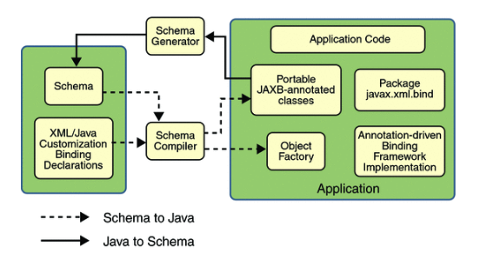
JAXB Architecture

Slide 7
JAXB Implementation
Schema compiler: Binds a source schema to a set of schema-derived program elements. The binding is described by an XML-based binding language.
Schema generator: Maps a set of existing program elements to a derived schema. The mapping is described by program annotations.
Binding runtime framework: Provides unmarshalling (reading) and marshalling (writing) operations for accessing, manipulating, and validating XML content using either schema-derived or existing program elements.

Slide 8
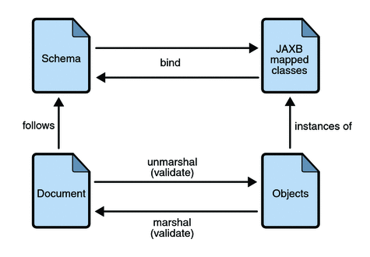
JAXB Binding Process

Slide 9
JAXB Data Binding Process ... cont’d
Generate classes: An XML schema is used as input to the JAXB binding compiler to generate JAXB classes based on that schema.
Compile classes: All of the generated classes, source files, and application code must be compiled.
Unmarshal: XML documents written according to the constraints in the source schema are unmarshalled by the JAXB binding framework. Note that JAXB also supports unmarshalling XML data from sources other than files and documents, such as DOM nodes, string buffers, SAX sources, and so forth.
Generate content tree: The unmarshalling process generates a content tree of data objects instantiated from the generated JAXB classes; this content tree represents the structure and content of the source XML documents.

Slide 10
JAXB Data Binding Process ... cont’d
Validate (optional): The unmarshalling process involves validation of the source XML documents before generating the content tree. Note that if you modify the content tree in Step 6, you can also use the JAXB Validate operation to validate the changes before marshalling the content back to an XML document.
Process content: The client application can modify the XML data represented by the Java content tree by using interfaces generated by the binding compiler.
Marshal: The processed content tree is marshalled out to one or more XML output documents. The content may be validated before marshalling.

Slide 11
Unmarshalling
Unmarshalling provides a client application the ability to convert XML data into JAXB-derived Java objects.

Slide 12
Marshalling
Marshalling provides a client application the ability to convert a JAXB-derived Java object tree into XML data.
By default, the Marshaller uses UTF-8 encoding when generating XML data.
Client applications are not required to validate the Java content tree before marshalling. There is also no requirement that the Java content tree be valid with respect to its original schema to marshal it into XML data.

Slide 13
Validation
Validation is the process of verifying that an XML document meets all the constraints expressed in the schema.
JAXB 1.0 provided validation at unmarshal time and also enabled on-demand validation on a JAXB content tree.
JAXB 2.0 only allows validation at unmarshal and marshal time.

Slide 14
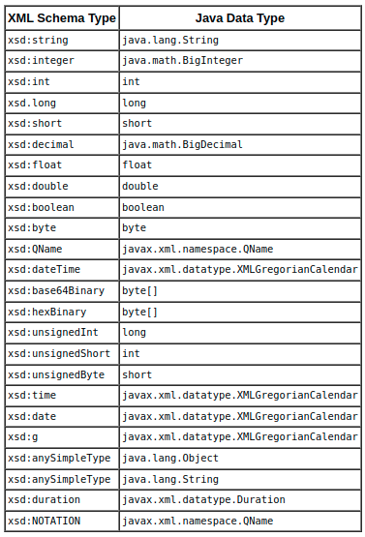
Binding XML Schemas
Schema-to-Java Bindings

Slide 15
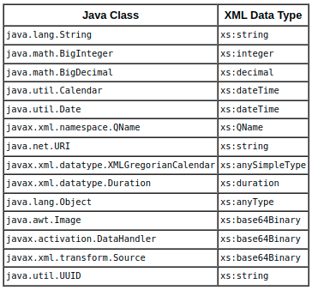
Binding XML Schemas ... cont’d
Java-to-Schema Mapping

Slide 16
Java 11 and JAXB RI dependencies
EclipseLink MOXy
Jakarta XML Binding

Slide 17
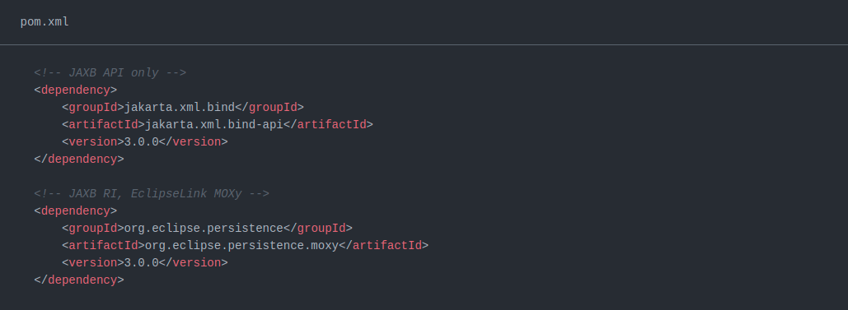
EclipseLink MOXy

Slide 18
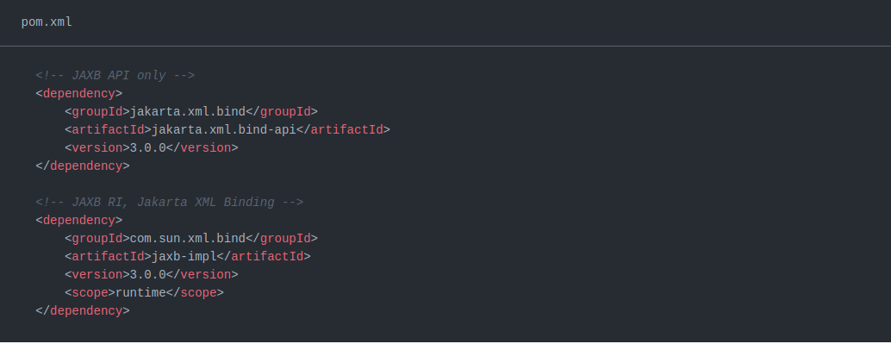
Jakarta Xml Binding (V 3.x.x)

Slide 19
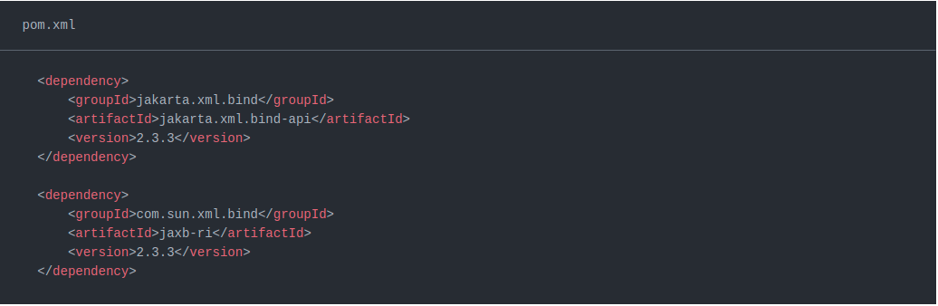
Jakarta Xml Binding (V 2.x.x)

Slide 20
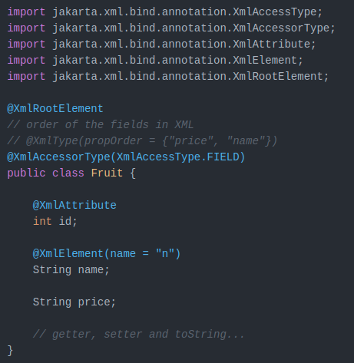
JAXB - Hello World

Slide 21
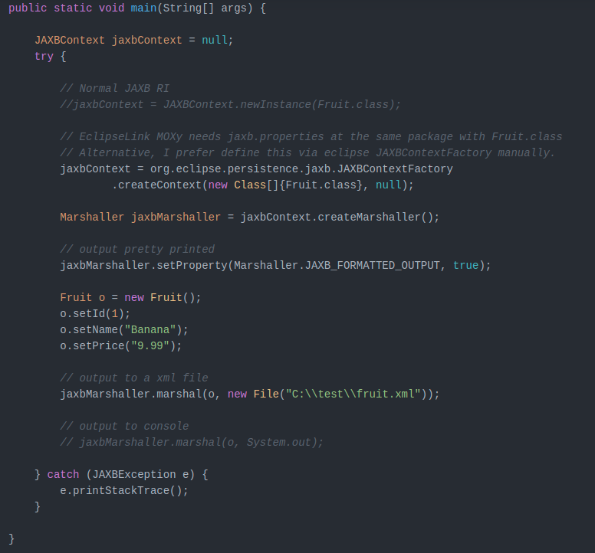
JAXB XML Marshalling

Slide 22
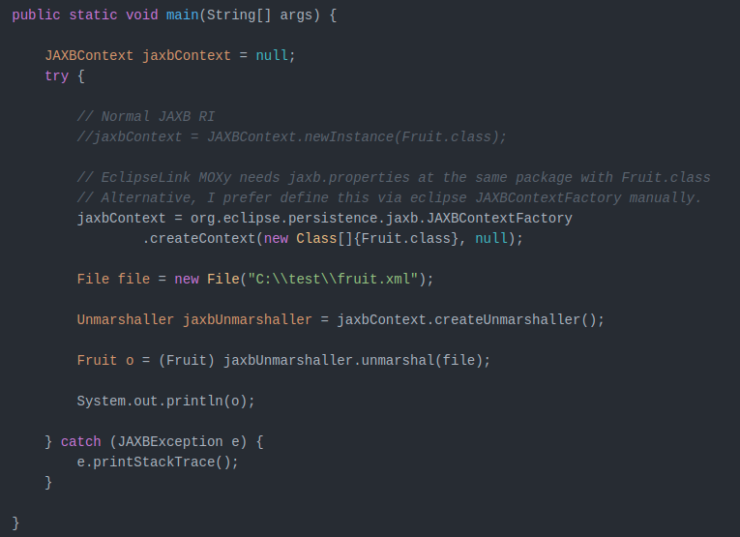
JAXB XML Unmarshalling

Slide 23
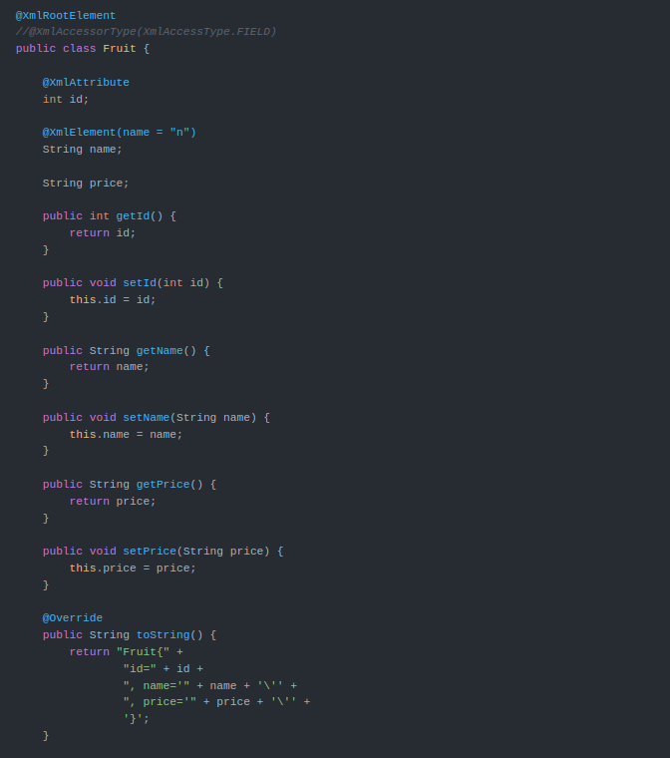
What is @XmlAccessorType

Slide 24
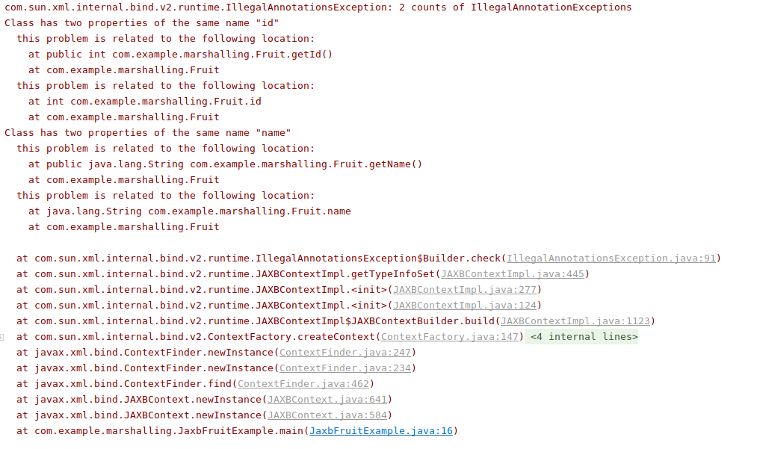
What is @XmlAccessorType ... cont’d

Slide 25
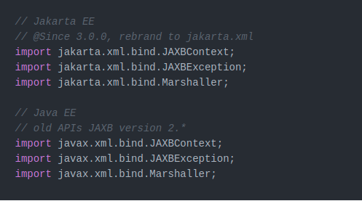
Difference between javax.xml.* and jakarta.xml.*
Eclipse foundation rebrand the Java EE javax.xml.* to Jakarta EE jakarta.xml.*

Slide 26
JAXB Tips

Slide 27


XML pretty print
By default, the JAXB output the XML in compact mode.
For JAXB to output the XML in pretty print or formatted mode, and we can set the property Marshaller.JAXB_FORMATTED_OUTPUT to true.

Slide 28
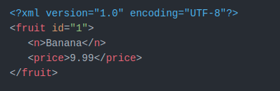
XML pretty print - Output

Slide 29
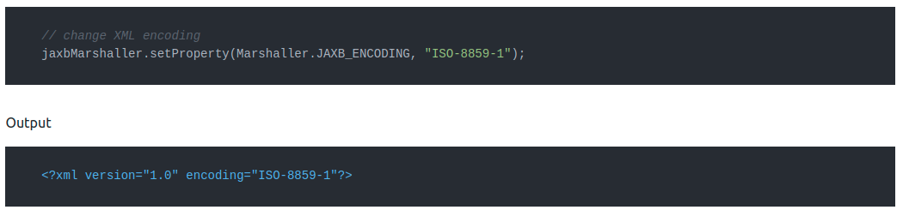
Change the XML encoding
JAXB default XML encoding to encoding="UTF8", and we can configure a specified XML encoding via the property Marshaller.JAXB_ENCODING.

Slide 30
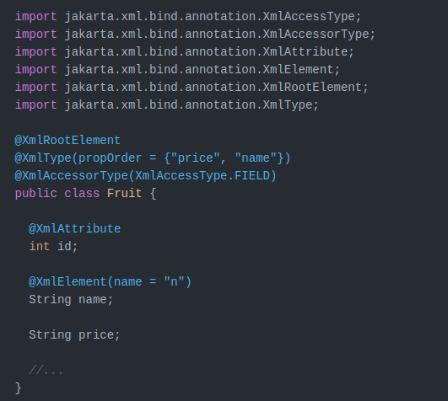
Change the order of the fields

Slide 31
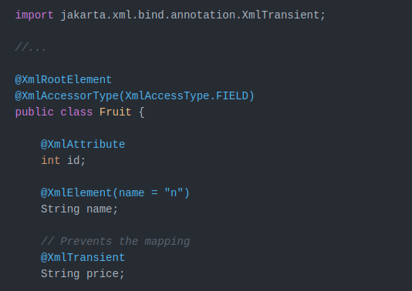
Hide a specified field for mapping

Slide 32
Q & A

