Slide 1
Introduction to REST API

Slide 2
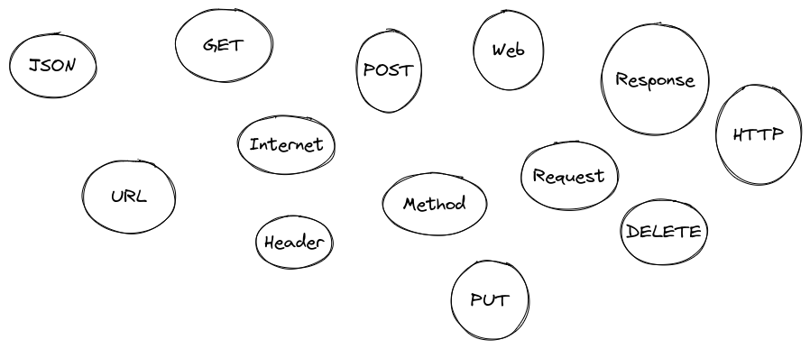
What is it?

Slide 3
What is it?
REST
Representational
State
Transfer

Slide 4
Representational, State, Transfer
It represent the state of database at a time.
REST is an architechural style which is based on web-standards and the HTTP protocol.
In a REST based architecture everthing is a Resource.
A resource is accessed via a common interface based on the HTTP standard.
Typically we have a REST server which provides access to the resources and a rest client which access and modifies the REST resources.

Slide 5
Representational, State, Transfer
Every resource should support the HTTP common operations.
Resources are identfied by global Ids (which are typically URIs or URLs).
REST allows that resources have different representations, e.g. text, XML, JSON etc.
Stateless in nature. Excellent for distributed system.
Stateless components can be freely redeployed if something fails, and they can scale to accomodate load changes.
This is because any request can be directed to any instance of a components.

Slide 6
HTTP Methods
The PUT, GET, POST and DELETE method are typically used in REST based architecture. The Following table gives an explanation of these opertation.
HTTP Method | CRUD Operation | Description
POST | INSERT/CREATE | Insert/create a new resource
PUT | UPDATE | Overrides existing resource
GET | SELECT | Fetches a resource
DELETE | DELTE | Delete a resource

Slide 7
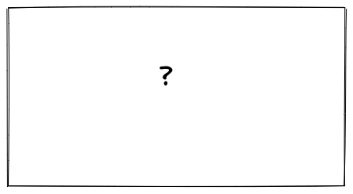
Architecture

Slide 8
HTTP Request
An HTTP request is made by a client, to a named host, which is located on a server. The aim of the request is to access a resource on the server.
A correctly composed HTTP request contains the following elements:
  A request line.
  A series of HTTP headers, or header fields.
  A message body, if needed.

Slide 9
Request line
The request line is the first line in the request message. It consists of at least three items:
  A method. The method is a one-word command that tells the server what it should do with the resource. For example, the server could be asked to send the resource to the client.
  The path component of the URL for the request. The path identifies the resource on the server.
  The HTTP version number, showing the HTTP specification to which the client has tried to make the message comply.
  GET /software/htp/cics/index.html HTTP/1.1

Slide 10
HTTP Headers
HTTP headers are written on a message to provide the recipient with information about the message, the sender, and the way in which the sender wants to communicate with the recipient.
Each HTTP header is made up of a name and a value.
    Host: www.test.com
    Accept: image/gif, image/jpeg, */*
    Accept-Language: fr, de
    Accept-Encoding: gzip
    User-Agent: Mozilla/4.0
    If-Modified-Since: Fri, 10 Dec 2004 11:22:13 GMT
    Content-Length: 35

Slide 11
Message body
The body content of any HTTP message can be referred to as a message body or entity body.
Technically, the entity body is the actual content of the message.
The message body contains the entity body, which can be in its original state, or can be encoded in some way for transport, such as by being broken into chunks (chunked transfer-coding).
The message body of a request may be referred to for convenience as a request body
bookId=123456&author=Tan

Slide 12
HTTP Response
An HTTP response is made by a server to a client.
The aim of the response is to provide the client with the resource it requested, or inform the client that the action it requested has been carried out; or else to inform the client that an error occurred in processing its request.
  An HTTP response contains:
  A status line.
  A series of HTTP headers, or header fields.
  A message body, which is usually needed.

Slide 13
Status line
The status line is the first line in the response message. It consists of three items:
  The HTTP version number, showing the HTTP specification to which the server has tried to make the message comply.
  A status code, which is a three-digit number indicating the result of the request.
  A reason phrase, also known as status text, which is human-readable text that summarizes the meaning of the status code.
  HTTP/1.1 200 OK

Slide 14
HTTP Headers
The HTTP headers for a server's response contain information that a client can use to find out more about the response, and about the server that sent it.
  Date: Thu, 09 Dec 2004 12:07:48 GMT
  Server: IBM_CICS_Transaction_Server/3.1.0(zOS)
  Content-type: image/jpg

Slide 15
Message body
The message body of a response may be referred to for convenience as a response body.
Message bodies are used for most responses. The exceptions are where a server is responding to a client request that used the HEAD method (which asks for the headers but not the body of the response), and where a server is using certain status codes.
<h1>My Home Page</h1>

Slide 16
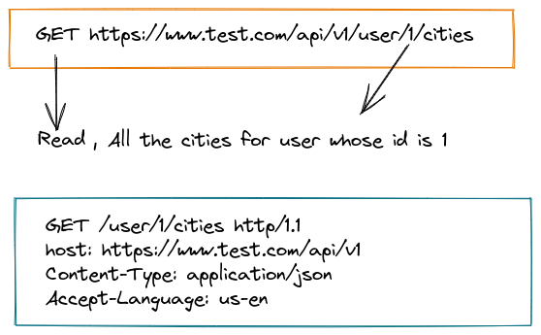
HTTP REST Request

Slide 17
HTTP Response Status Code
In the HTTP response that is sent to a client, the status code, which is a three-digit number, is accompanied by a reason phrase (also known as status text) that summarizes the meaning of the code. Along with the HTTP version of the response, these items are placed in the first line of the response, which is therefore known as the status line.
The status codes are classified by number range, with each class of codes having the same basic meaning.
    The range 100-199 is classed as Informational.
    200-299 is Successful.
    300-399 is Redirection.
    400-499 is Client error.
    500-599 is Server error.

Slide 18
Use Nouns but no verbs in path/URI
Purpose | Method | Incorrect | Correct
Retrieves a list of users | GET | /getAllCars | /users
Create a new user | POST | /createUser | /users
Delete a user | DELETE | /deleteUser | /users/10
Get balance of user | GET | /getUserBalance | /user/11/balance

Slide 19
Use plural nouns
Do not mix up singular and plural nouns.
Keep it simple and use only plural nouns for all resources.

Slide 20
GET method should not alter the state
Use PUT, POST and delete methods instead of the GET method to alter the state.

Slide 21
Use sub-resources for relation
If a resource is related to another resource use subresources
Get cars/1/drivers/ (Return a list of drivers for car 1)

Slide 22
Use HTTP headers for serialization
Both, client and server need to know which format is used for the communication.

