Slide 1
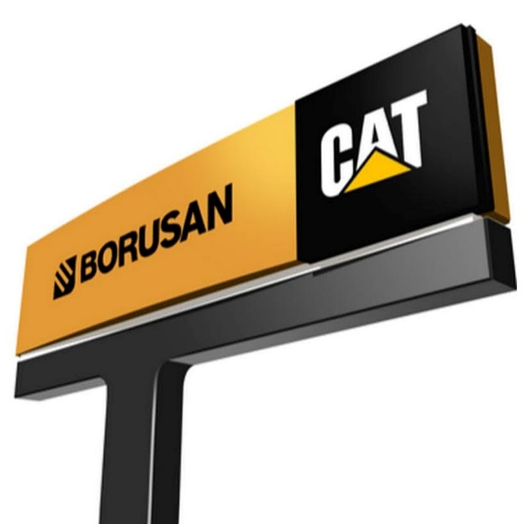
What Happened…

Slide 2
CVA Plus
CVA included only scheduled maintenance and oil sample
CVA plus: Bundling Muneccim into the company’s CVA (customer value agreements), customize them, and then sell the new and improved CVAs as a CVA Plus concept.
CVA+ included a wide range of contract offerings
At the lowest level it included preventative maintenance and labor as a bundle
The most comprehensive offering had a no downtime guarantee
Using CVA+, Borusan Cat practically minimized behavior change in required by their clients

Slide 3
The Cost-Benefit of Change
The Cost-Benefit of Adoption
High
Behavior Change Required
(Compatibility & Complexity)
(Perceived) Cost
Low
(Perceived) Benefit
Low
High
Improvement Offered

Slide 4
The Cost-Benefit of Change
The Cost-Benefit of Adoption
High
Strike Out
Long Haul
Behavior Change Required
(Compatibility & Complexity)
Low
Tinkering
Home Run
Low
High
Product Improvement Offered
(Relative Advantage)

Slide 5
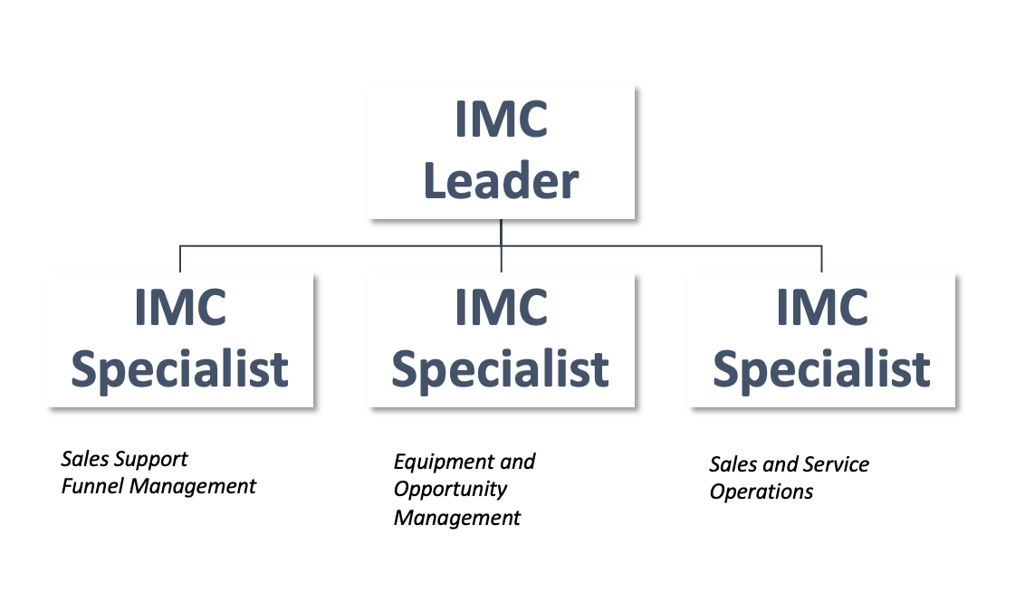
Interaction Management Center (IMC)
Initially, CVA plus sales were not at the desired level.
Durgun and Gunaydin designed a more focused sales approach for key accounts (IMC).
The IMC was initially composed of seven people each of whom was responsible to mimic a different component of Borusan Cat’s larger sales organization. Later they simplified the IMC organization.
Notes:
Initially, CVA Plus sales were not at the desired level, which prompted Durgun and Gunaydin to design a more focused sales approach for key accounts; they devised what they called an “interaction management center” (IMC). The IMC was composed of seven people, each of whom was responsible to mimic a different component of Borusan Cat’s larger sales organization. The flow worked like this: Using Muneccim’s insights, an “opportunity guru” evaluated Muneccim’s leads to help the sales reps with prioritization; a “sales guru” worked on scenarios to help the sales rep pitch the right package; another person carried out the billing, and yet another tried to upsell long-term service agreements. Two others reviewed the customer’s machinery portfolio and suggested products for cross-selling. All the while, the service team was already on the ground helping with replacements. To help convince the customer on the advantages of proactive maintenance, the IMC team also shared with them how much money they would save using this solution. A while after IMC team’s initial launch, Borusan Cat revised this team formation to create a more compact organization with focused job descriptions (shown in the slide).

Slide 6
B’ Daha Exchange Program
B’ Daha means “one more time”
Because the pre-emptively removed parts were still in relatively good condition, Borusan Cat could refurbish them for resale to other customers at considerable savings over the price of a new part
“CVA Plus, combined with the exchange program, creates a win-win proposition for us and the customers as well. It’s very difficult for the competition to imitate this kind of service without a predictive tool like Muneccim.”
Nazim Ergun
Notes:
With Muneccim, Borusan Cat was able to identify impending breakdowns before they occurred. It would then offer to “exchange” the faulty part in question with a new one so that work at the customer’s project site did not have to stop while repairs were being made. Because the pre-emptively removed parts were still in relatively good condition, Borusan Cat could refurbish them for resale to other customers at a considerable savings over the price of a new part. Seeing an opportunity here, Durgun championed the B’ Daha (one more time) program. She said, “We take out an engine before it breaks down and provide the customer with a new one. We then repair that engine and sell it to a different customer at a lower cost. It’s a win-win for all parties.” Over time, the program covered parts beyond just the engine (including various pumps and valves) and the exchange program offered short-term rentals (to keep worksites operational when parts were out for service). Borusan Cat had two component-rebuild centers in Turkey—one in Istanbul and another in Ankara—where the refurbishing would take place. The company also invested in a new center in Adana dedicated to refurbishing to grow B’Daha program. These specialized facilities allowed the company to respond faster to customer needs. “The most expensive core parts are engines. Customers prefer to buy replacement parts from the original manufacturer, and for repairs and overhauls, they want us to do that work. For less critical parts, however, they are more comfortable going to third-party service providers. When we launched B’ Daha, we first focused on engine exchanges so that we could start offering exchanges for other parts to not lose our customers to third party service providers.” Ergun added, “CVA Plus, combined with the exchange program, creates a win-win proposition for us and the customers as well. It’s very difficult for the competition to imitate this kind of service without a predictive tool like Muneccim.”
The company already had component-rebuild centers in Kazakhstan and Russia.

Slide 7
Financial Results
The construction sector in Turkey was exhibiting a negative growth of about 10% due to pandemic and other macro factors.
Borusan Cat saw its primary sales continue to decline to less than 3,000 units in 2021 from 7,074 in 2018.
The company nevertheless closed the year with revenues of over $750 million and record profitability.
With CVA Plus, the number of active agreements had reached to about 6,000.
The newly launched B’ Daha program had reached $1.1 million in sales in just six months and was returning decent margins.
Notes:
Financial results are BCAT folks’ estimates…

Slide 8
What Makes It Work…
What Makes for a Good Product?
What kind of value? Tangible/intangible?
How easy is it to communicate?
Customer
Value
Product Feature
Set
Differentiation
Value/returns
Competition
Company
Value
Collaborators
(Salesforce / Channel partners )
And it also considers the context
(e.g. higher price sensitivity due to macro market trends)

Slide 9
Some Takeaways…
Don’t start from the technology! Do your research, as trivial as it might be!
Sometimes (particularly in B2B cases) you might be able to estimate (at least) part of the value in dollars
Think about the value PERCIEVED by the customer
Define the customer correctly! Consider ALL the stakeholders.
To be successful, you need to manage the whole chain of value
Sometimes mapping “customer” journey can help understand stakeholders and their involvement much better.

