Slide 1

Homomorphic Encryption and Authentication for Healthcare Applications
Under the Guidance of
Dr. K S SHIVAPRAKASHA
Professor
Swapnil Sharma
4NM21EC161
Uditaparna Sarmah
4NM21EC173
Vikas Rai
4NM22EC421
Vineet M
4NM21EC183
Department of Electronics & Communication Engineering

Slide 2
Contents
Introduction
Literature Survey
Block Diagram / Flow Chart
Requirement Analysis
Work Progress
Gantt chart
References
Department of ECE
02

Slide 3
Introduction
What is Homomorphic Encryption?
Encryption method that allows computations to be performed on encrypted data without decryption.
The result of the computation is also encrypted, preserving data privacy throughout the process.
Two main types: fully homomorphic encryption (FHE) and partially homomorphic encryption (PHE).
Why Homomorphic Encryption and Authentication?
Data Privacy: Enables computations on encrypted data.
Security: Limits access to authorized users.
Efficiency: Allows secure, efficient data processing.
Department of ECE
03

Slide 4
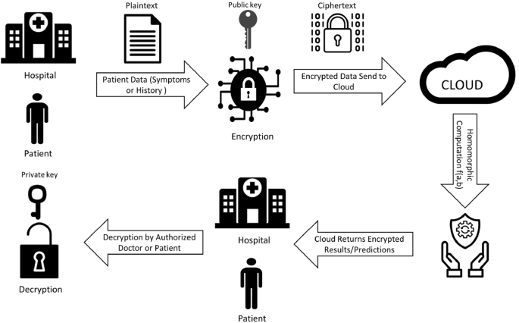
Introduction
Why Use Homomorphic Encryption in Healthcare?
Secure Data Sharing
Remote Data Analysis
Cloud-Based Healthcare
Department of ECE
Fig. 1
04

Slide 5


Literature Survey
Click Here
Department of ECE
05

Slide 6
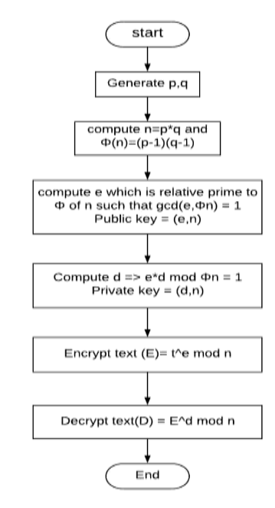
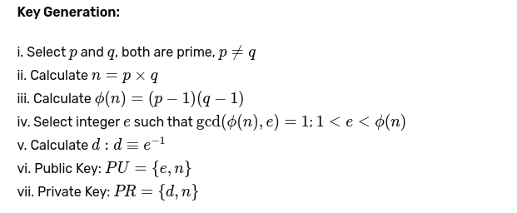
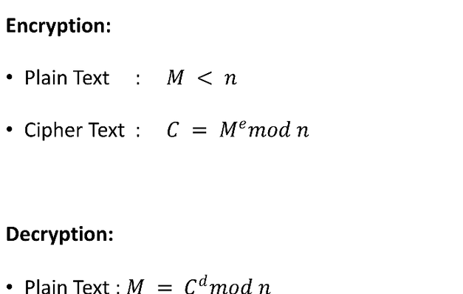
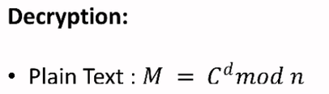
RSA Cryptosystem
Department of ECE
Fig. 2
06

Slide 7
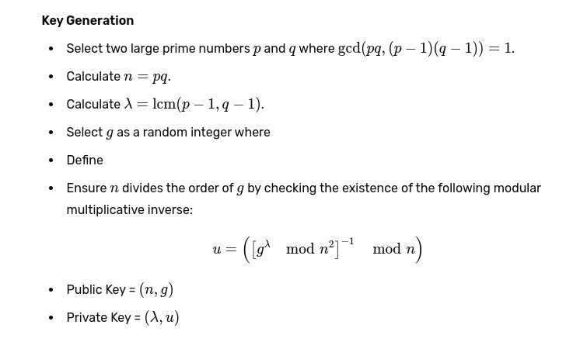
Paillier Cryptosystem
Department of ECE
07

Slide 8
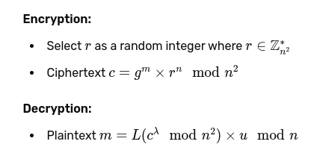
Paillier Cryptosystem
Department of ECE
08

Slide 9
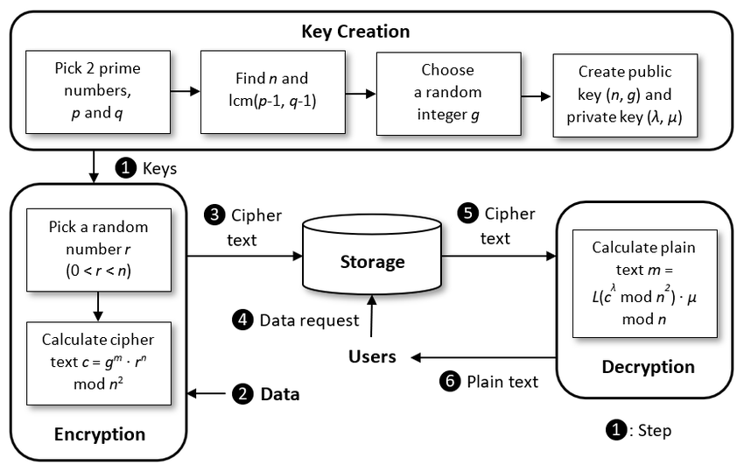
Paillier Cryptosystem
Department of ECE
Fig. 3
09

Slide 10
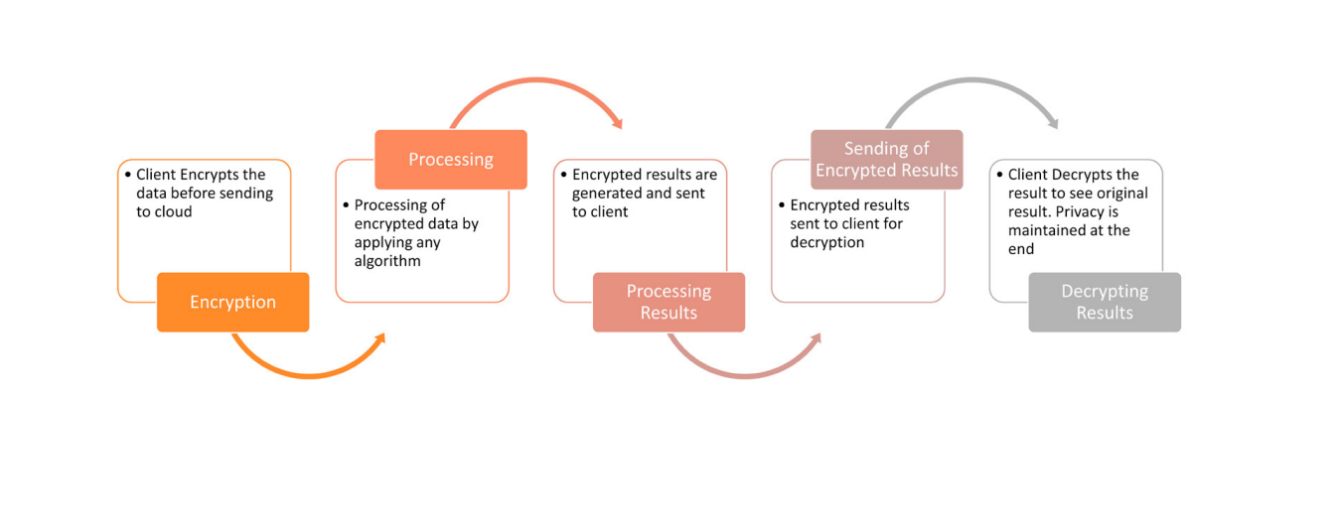
Block Diagram
Fig. 4. Process of Homomorphic encryption for providing security in cloud.
Department of ECE
10

Slide 11
Requirement Analysis
Software implementation:
Sl. No. | Requirement | Justification
01 | Python Programming | The latest version of python language i.e. Python 3.11 series is used in this system. This language is employed in developing the backend logic facilitating the collection and processing of encrypted feedback. It is also utilized for its versatility and ease of integration with homomorphic encryption libraries.
02 | Spyder | Spyder is a useful IDE for implementing Python-based algorithms like RSA and Paillier. It provides a user-friendly interface, real-time code analysis, debugging, and support for Python libraries, which helps in developing and testing cryptographic algorithms effectively. Spyder's features make it a good choice for handling complex cryptographic computations.
Department of ECE
11

Slide 12
Requirement Analysis
:
Software implementation:
Software implementation | Software implementation | Software implementation
03 | Anaconda | One of the top cloud computing platforms is Amazon Web Services (AWS), which provides a wide range of services on a pay- per-use basis. Without having to invest in physical infrastructure, consumers may access databases, machine learning, storage, processing capacity, and more with AWS. Because of its scalable, dependable, and secure services, businesses, governments, and startups all favour it.
04 | Tkinter | Tkinter is the standard GUI toolkit that comes bundled with python.
Department of ECE
12

Slide 13
Work Split
SI. No. | Phase | Description
01 | Literature Survey | A survey on basics of HE methods Types of homomorphic encryption Pailliers Cryptosystem and RSA Cryptosystem
02 | System Architecture and Design | Defining the overall structure, components, and interactions within the student feedback system. Outlining the data flow, user interfaces, and backend data processing.
03 | Homomorphic Encryption Implementation | Implementing Pascal Pailliers and RSA algorithms for preserving privacy of student feedback system. using PySEAL library to generate encryption and decryption keys Using Spyder platform
04 | Documentation | Code documentation for developers. Documenting user guides for end-users. System documentation outlining the architecture and deployment processes.
Department of ECE
13

Slide 14
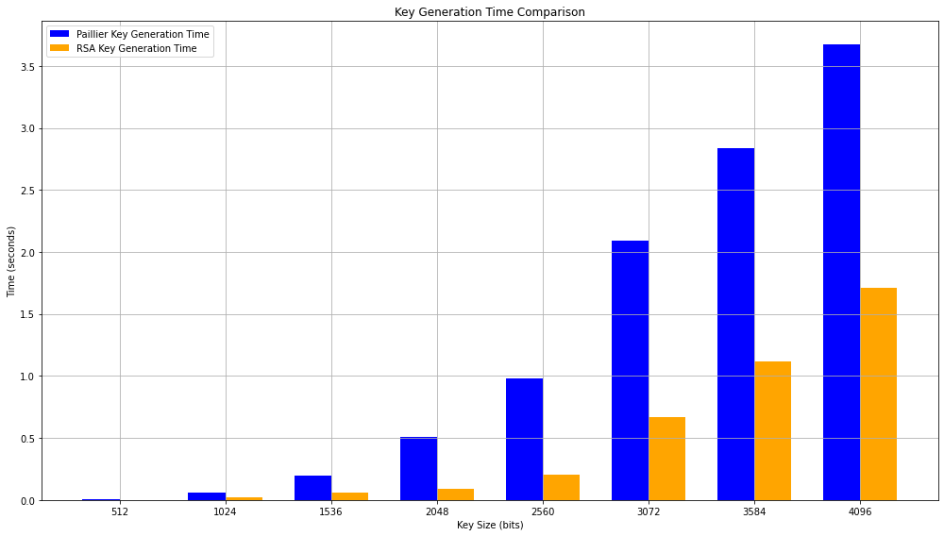
Result and Analysis
Fig. 5 Key Generation time analysis for RSA and Paillier algorithm
14

Slide 15
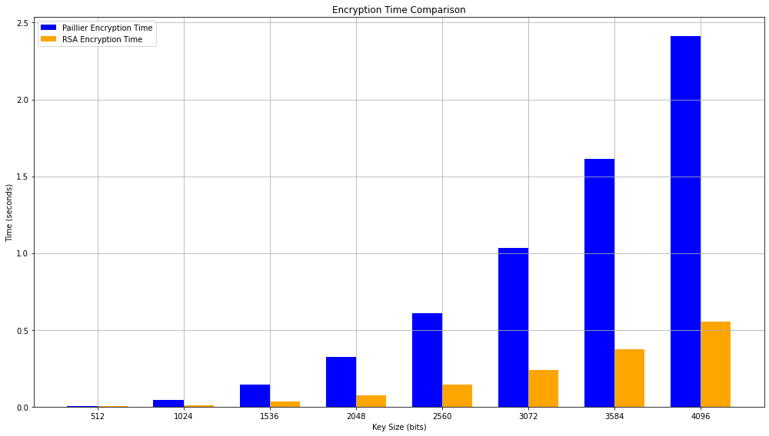
Result and Analysis
Fig. 6 Encryption time analysis for RSA and Paillier algorithm
1503

Slide 16
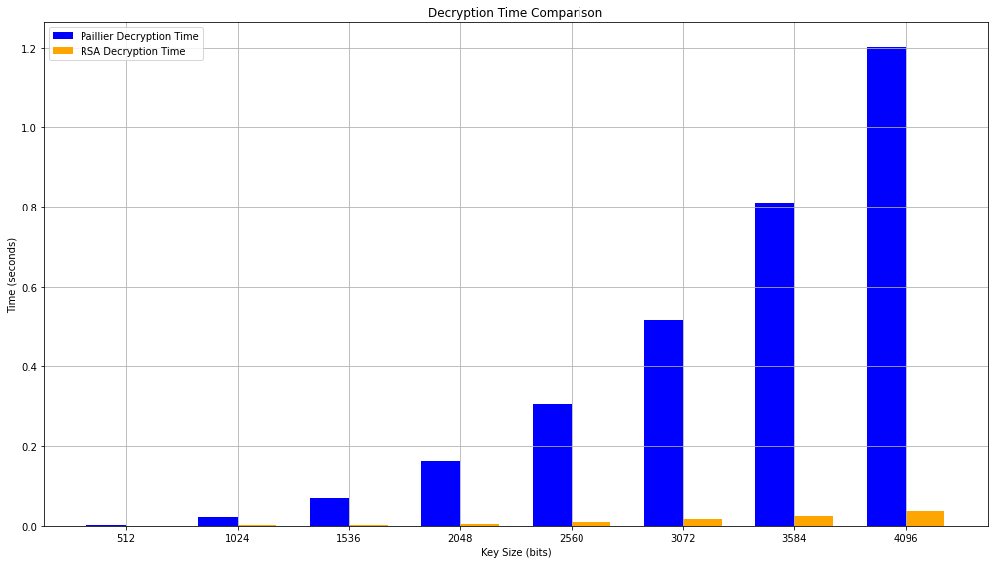
Result and Analysis
Fig. 7 Decryption time analysis for RSA and Paillier algorithm
16

Slide 17
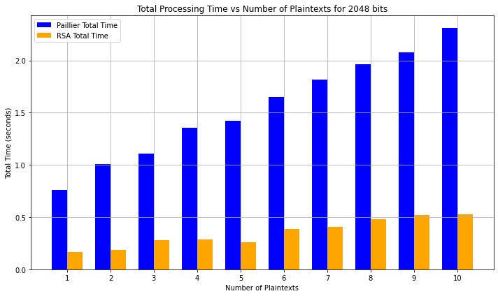
Result and Analysis
Fig. 8 Time analysis for RSA and Paillier algorithm with multiple messages
Department of ECE
17

Slide 18
Gantt Chart
Click Here
18

Slide 19
References
[1]. Milanov, Evgeny. "The RSA algorithm." RSA laboratories (2009): 1-11.
[2]. Mahajan, Prerna, and Abhishek Sachdeva. "A study of encryption algorithms AES,
DES and RSA for security." Global journal of computer science and technology 13, no. 15 (2013): 15-22.
[3]. Ma, Changshe, Jian Weng, Yingjiu Li, and Robert Deng. "Efficient discrete logarithm based multi-signature scheme in the plain public key model." Designs, Codes and Cryptography 54 (2010): 121-133.
[4]. Hellman, Martin E. "An overview of public key cryptography." IEEE Communications Magazine 40, no. 5 (2002): 42-49.
[5]. Munjal, Kundan, and Rekha Bhatia. "A systematic review of homomorphic encryption and its contributions in healthcare industry." Complex & Intelligent Systems 9, no. 4 (2023): 3759-3786
[6]. Transforms, InformationYPreserving. "Complex Adaptive Systems, Publication 3 Cihan H. Dagli, Editor in Chief Conference Organized by Missouri University of Science and Technology 2013Y Baltimore, MD." Procedia Computer Science 20 (2013).
[7]. Zhang, Chuan, Liehuang Zhu, Chang Xu, and Rongxing Lu. "PPDP: An efficient and privacy-preserving disease prediction scheme in cloud-based e-Healthcare system." Future Generation Computer Systems 79 (2018): 16-25.
[8]. Sendhil, R., and A. Amuthan. "Contextual fully homomorphic encryption schemesbased privacy preserving framework for securing fog-assisted healthcare data exchanging applications." International Journal of Information Technology 13, no. 4 (2021): 1545-1553.
[9]. Das, Debasis. "Secure cloud computing algorithm using homomorphic encryption and multi-party computation." In 2018 International Conference on Information Networking (ICOIN), pp. 391-396. IEEE, 2018.
[10]. Das, Debasis. "Secure cloud computing algorithm using homomorphic encryption and multi-party computation." In 2018 International Conference on Information Networking (ICOIN), pp. 391-396. IEEE, 2018.
[11]. Scheibner, James, Marcello Ienca, and Effy Vayena. "Health data privacy through homomorphic encryption and distributed ledger computing: an ethical-legal qualitative expert assessment study." BMC Medical Ethics 23, no. 1 (2022): 121.
Department of ECE
19

Slide 20
References
[12]. Aiswarya, R., R. Divya, D. Sangeetha, and V. Vaidehi. "Harnessing healthcare data security in cloud." In 2013 International Conference on Recent Trends in Information Technology (ICRTIT), pp. 482-488. IEEE, 2013.
[13]. Bensitel, Yasmina, and Rahal Romadi. "Secure data storage in the cloud with homomorphic encryption." In 2016 2nd International Conference on Cloud Computing Technologies and Applications (CloudTech), pp. 1-6. IEEE, 2016.
[14]. Ding, Wenxiu, Zheng Yan, and Robert H. Deng. "Encrypted data processing with homomorphic re-encryption." Information Sciences 409 (2017): 35-55.
[15]. Song, Chen, and Xinghua Shi. "ReActHE: A homomorphic encryption friendly deep neural network for privacy-preserving biomedical prediction." Smart Health 32 (2024): 100469.
[16]. Zhou, Yousheng, Liyuan Song, Yuanni Liu, Pandi Vijayakumar, Brij B. Gupta, Wadee Alhalabi, and Hind Alsharif. "A privacy-preserving logistic regression-based diagnosis scheme for digital healthcare." Future Generation Computer Systems 144 (2023): 63-73.
[17]. Nayak, Nachiketha, Prajwal G. Anchan, H. N. Ramachandra, and K. S. Shivaprakasha. "Secure Communication for Healthcare Using Homomorphic Encryption: A Comparative Study." In 2023 2nd International Conference on Futuristic Technologies (INCOFT), pp. 1-4. IEEE, 2023.
[18]. Hao, Meng, Hongwei Li, Guowen Xu, Zhe Liu, and Zongqi Chen. "Privacy-aware and resource-saving collaborative learning for healthcare in cloud computing." In ICC 2020-2020 IEEE International Conference on Communications (ICC), pp. 1-6. IEEE, 2020.
[19]. Kim, Miran, and Kristin Lauter. "Private genome analysis through homomorphic encryption." In BMC medical informatics and decision making, vol. 15, pp. 1-12. BioMed Central, 2015.
[20]. Alloghani, Mohamed, Mohammed M. Alani, Dhiya Al-Jumeily, Thar Baker, Jamila Mustafina, Abir Hussain, and Ahmed J. Aljaaf. "A systematic review on the status and progress of homomorphic encryption technologies." Journal of Information Security and Applications 48 (2019): 10236
Department of ECE
20

Slide 21
Thank You
Department of ECE
21

