Slide 1
HTML
HyperText Markup
Language

Slide 2
Agenda
• Main HMTL elements
• Block-level HTML elements
• Text-level HTML element
• Creating hypertext links
• Adding images to documents
• Building tables
• Creating and publishing a Web page

Slide 3
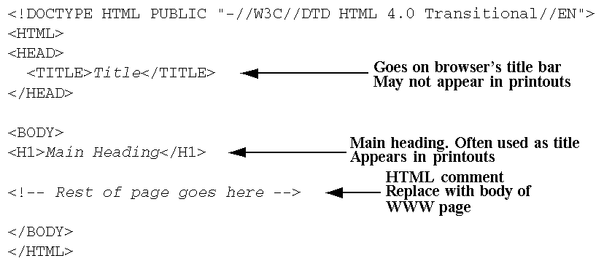
Notes:
A set of services, APIs and protocols. Multi Tiered web applications.
A Standardized way of doing things. Decreases the need for programming a lot of features which are already available as re-usable components.

Slide 4
Main HTML Elements
1.DOCTYPE
2.HTML
3.HEAD
– TITLE element required
– META
– SCRIPT
– STYLE
– LINK

Slide 5
4.BODY Element
– <BODY BGCOLOR="YELLOW">
– BACKGROUND
– BGCOLOR
– OnLoad, OnFocus, OnBlur
5.Elements inside BODY element
– Remaining HTML elements

Slide 6
Block-Level Elements
• Headings
– H1 ... H6
– ALIGN
• Basic Text Sections
– P
– ALIGN
Notes:
A set of services, APIs and protocols. Multi Tiered web applications.
A Standardized way of doing things. Decreases the need for programming a lot of features which are already available as re-usable components.

Slide 7
• Lists
–OL
–LI
–UL
–LI
• Tables and Forms (Postponed)
• Misc.
–HR
–DIV

Slide 8
<!DOCTYPE HTML PUBLIC "-//W3C//DTD HTML 4.0 Transitional//EN">
<HTML>
<HEAD>
<TITLE>Document Headings</TITLE>
</HEAD>
<BODY>
Samples of the six heading types:
<H1>Level-1 (H1)</H1>
<H2 >Level-2 (H2)</H2>
<H3>Level-3 (H3)</H3>
<H4 ALIGN="RIGHT">Level-4 (H4)</H4>
<H5>Level-5 (H5)</H5>
<H6>Level-6 (H6)</H6>
</BODY>
</HTML>
Notes:
A set of services, APIs and protocols. Multi Tiered web applications.
A Standardized way of doing things. Decreases the need for programming a lot of features which are already available as re-usable components.

Slide 9
P – The Basic Paragraph
• Attributes: ALIGN
– LEFT (default), RIGHT, CENTER. Same as headings.
– Whitespace ignored (use <BR> for line break)
• Consecutive <P>’s do not yield multiple blank lines
– End Tag is Optional:
<BODY>
<P>
Paragraph 1
</P>
<P>
Paragraph 2
</P>
</BODY>
Notes:
A set of services, APIs and protocols. Multi Tiered web applications.
A Standardized way of doing things. Decreases the need for programming a lot of features which are already available as re-usable components.

Slide 10
OL: Ordered (Numbered) Lists
OL Element
<OL>
<LI>List Item One
<LI>List Item Two
<LI>List Item Three
</OL>
A sample list:
<uL>
<LI>List Item One
<LI>List Item Two
<LI>List Item Three
</uL>

Slide 11
Nested Ordered Lists
<UL TYPE="DISC">
<LI>The UL tag
<UL TYPE="CIRCLE">
<LI>TYPE
<UL TYPE="SQUARE">
<LI>DISC<\LI>
<LI>CIRCLE<\LI>
<LI>SQUARE<\LI>
</UL><\LI>
<LI>COMPACT
</UL>
<LI>The LI tag<\LI>
<UL TYPE="CIRCLE">
<LI>TYPE
<UL TYPE="SQUARE">
<LI>DISC<\LI>
<LI>CIRCLE<\LI>
<LI>SQUARE<\LI>
</UL><\LI>
<LI>VALUE<\LI>
</UL><\LI>
</UL><\LI>
</ul>

Slide 12
Text-Level Elements
Physical Character Styles
– FONT
• COLOR
• FACE
• Size
• Logical Character Styles
– EM, STRONG

Slide 13
Text-Level Elements
Hypertext Links
–A
• HREF
• NAME
• TARGET...
- IMG
SRC (required), ALT, ALIGN, WIDTH, HEIGHT, BORDER,
• Misc. Text-Level Elements
BR (Explicit line break)

Slide 14
Hypertext Links
Links can contain images and other text-
level elements (i.e., <A HREF...> ... </A>)
• Link to Absolute URL
– Use a complete URL beginning with http://
Java is discussed in
<A HREF="http://host/path/chapter2.html">
Chapter 2</A>.
• Link to Relative URL
– Use a filename or relative path to filename
• Interpreted wrt location of current file
Java is discussed in
<A HREF="chapter2.html">Chapter 2</A>.

Slide 15
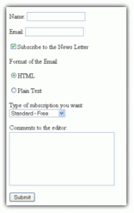
Form
Form
<form id='sampleform' method='post' action='' >
<p>
Name: <input type='text' name='Name' />
</p>
<p>
Email: <input type='text' name='Email' />
</p>
<p>
<input type=v"checkbox" name="subscribe" checked />Subscribe to the News Letter
</p>
<p>
Format of the Email:

Slide 16
<p>
<input type="radio" name="format" value="html" checked='checked' />HTML
</p>
<p>
<input type="radio" name="format" value="text" />Plain Text
</p>
</p>
<p>
Type of subscription you want:
<p>
<select name="type">
<option value="standard">Standard - Free</option>
<option value="prof">Professional - Paid</option>
</select>
</p>
</p>
<p>
Comments to the editor:<br/>
<textarea name="comments" rows="7" cols="30"></textarea>
</p>
<p>
<input type='submit' name='Submit' value='Submit' />
</p>
</form>

Slide 17
Exrecise
1
Item Name | price
laptop | 22,000
Monitor | 10,200
Printer | 7,100

Slide 18
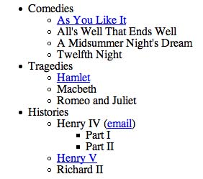
Exrecise
2

Slide 19
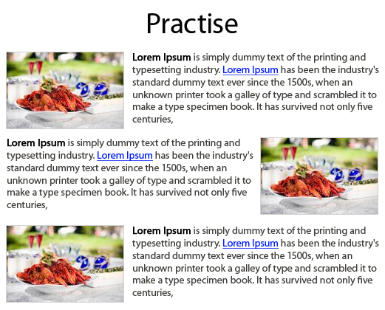
Exrecise
3

Slide 20
Exercise
4

