Slide 1
CSS
cascading style sheet

Slide 2
Three type of css
1. Inline Style
2. Embedded Style
3. External Style Sheet
Notes:
A set of services, APIs and protocols. Multi Tiered web applications.
A Standardized way of doing things. Decreases the need for programming a lot of features which are already available as re-usable components.

Slide 3
Inline Style
<p style="color: #ff0000;">Some red text</p>
Notes:
A set of services, APIs and protocols. Multi Tiered web applications.
A Standardized way of doing things. Decreases the need for programming a lot of features which are already available as re-usable components.

Slide 4
Embedded Style
<head>
<title><title>
<style type="text/css">
.alternate{background:#ff0000;}
#alternate{background:#ff0000;}
</style>
</head>
<body>

Slide 5
External Style Sheet
<head>
<title><title>
<link rel="stylesheet" type="text/css"href="style.css" />
</head>
<body>
or
<head>
<title><title>
<style type="text/css"> @import url(Path To stylesheet.css)
</style>
</head>
<body>

Slide 6
selector
selector { property: value }
body {background: #eeeeee;font-family: "Trebuchet MS", Verdana, Arial, serif;}
h1 {font-family: Georgia, sans-serif;}
p {font-family: Tahoma, serif;}
h1, h2 {color: #009900;font-family: Georgia, sans-serif;}
Notes:
A set of services, APIs and protocols. Multi Tiered web applications.
A Standardized way of doing things. Decreases the need for programming a lot of features which are already available as re-usable components.

Slide 7
Id and Class
<div id="container">
Everything within my document is inside this division.
</div>
<div class="container">
Everything within my document is inside this division.
</div>

Slide 8
Display
display: value;
Block
None
Visibility : Value
Visible
Hidden

Slide 9
Div and Span
<div>Site contents go here</div>
<div>content</div>
<span class="italic">This text is italic</span>
Notes:
A set of services, APIs and protocols. Multi Tiered web applications.
A Standardized way of doing things. Decreases the need for programming a lot of features which are already available as re-usable components.

Slide 10
Padding and Margin
padding-top:10px;
margin-top:10px;
margin-bottom:10px;
margin-left:10px;
margin-right:10px;
Notes:
A set of services, APIs and protocols. Multi Tiered web applications.
A Standardized way of doing things. Decreases the need for programming a lot of features which are already available as re-usable components.

Slide 11
Color
color: value;
#container{
Width: 70px;
Height:200px;
padding: 30px;
border: 1px solid #666;
color: #ffffff;}
Notes:
A set of services, APIs and protocols. Multi Tiered web applications.
A Standardized way of doing things. Decreases the need for programming a lot of features which are already available as re-usable components.

Slide 12
Text Align
text-align:value;
left
right
center
justify
Notes:
A set of services, APIs and protocols. Multi Tiered web applications.
A Standardized way of doing things. Decreases the need for programming a lot of features which are already available as re-usable components.

Slide 13
Text Decoration
none
underline
Notes:
A set of services, APIs and protocols. Multi Tiered web applications.
A Standardized way of doing things. Decreases the need for programming a lot of features which are already available as re-usable components.

Slide 14
Font -Family, Font Size
font-family: Verdana, sans-serif;
font-size: 15px;
Notes:
A set of services, APIs and protocols. Multi Tiered web applications.
A Standardized way of doing things. Decreases the need for programming a lot of features which are already available as re-usable components.

Slide 15
Font Weight
font-weight: Value
font-weight: bold;
font-weight: normal;

Slide 16
Link
<a href="" title="">some link text</a>
a:visited {color: #999999;}
a:hover {color: #333333;}
a:focus {color: #333333;}
a:active {color: #009900;}

Slide 17
Background and border
background: #ffffff url(path_to_image)
border: 1px solid #333333;
border-top: 1px solid #333333;

Slide 18
Clear and float
Clear:both
<div id=”mainBox”>
<div>simple text</div>
<div>simple text</div>
<div>simple text</div>
</div>
Float:left;
Float:right

Slide 19
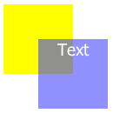
Position and z-index
<div>
<div >z-index :100</div>
<div>z-index :101</div>
</div>

Slide 20
Exrecise
1
Item Name | price
laptop | 22,000
Monitor | 10,200
Printer | 7,100

Slide 21
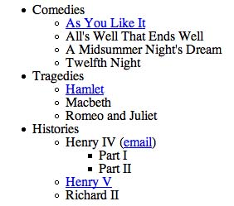
Exrecise
2

Slide 22
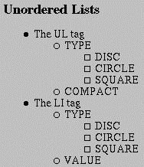
Exrecise
3

Slide 23
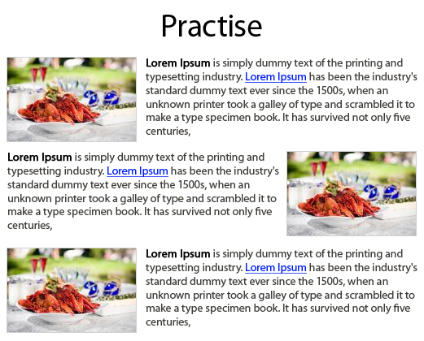
Exercise
4

