Slide 1
Introduction to GORM

Slide 2
GORM Basics
Reading Objects
Listing and Sorting
Saving, Updating and Deleting

Slide 3
GORM Basics: Reading Objects
Def album = Album.get(1)
Def album = Album.getAll(1,2,3)
Def album = Album.read(1) //read-only

Slide 4
GORM Basics: List, Sort, Count
list() method : Takes in Parameters like max, offset, sort, order
def albumList = Album.list(max:10, sort:'dateCreated', order:'desc')
def totalAlbums = Album.count()
def album = Album.listOrderByDateCreated()

Slide 5
GORM Basics: Save, Update
album.save()
When save method is called, Hibernate knows whether to call SAVE or UPDATE
Transitive persistence : class Album { ....
static mapping = {
songs cascade:'save-update'
}
}

Slide 6
GORM Basics: Managing Relationships
def album = Album.get(1)
album.addToSongs(new Song(title: 'eg1'))
This method supports chaining
You can add more objects to the relationship in the same statement

Slide 7
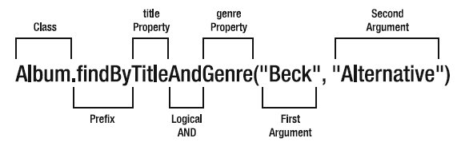
GORM: Dynamic Finders
We can use property names to perform queries

Slide 8
Dynamic Finders
Album.findByDateCreatedBetween(today-10,today)
Album.findByTitleEquals('Aha Shake Heartbreak')
Album.findByDateCreatedGreaterThan(lastMonth)
Album.findByDateCreatedGreaterThanOrEqual(lastMonth)
Album.findByTitleInList(['Aha Shake Heartbreak','Odelay'])
Album.findByGenreIsNull()
Album.findByGenreIsNotNull()
Album.findByDateCreatedLessThan(lastMonth)
Album.findByDateCreatedLessThanOrEqual(lastMonth)
Album.findByTitleLike('Shake')
Album.findByTitleNotEqual('Odelay")

Slide 9
GORM: Dynamic Finders
Available Dynamic Finder Expressions
Between, Equals, GreaterThan, GreaterThanOrEqual, InList, IsNull, IsNotNull, LessThan, LessThanOrEqual, Like, NotEqual

Slide 10
Questions ?

